Slide 1
Nuclear Stability and Radioactive Decay
Thermodynamic Stability of the Nucleus
Detection and Uses of Radioactivity
Nuclear Transformations
The Kinetics of Radioactive Decay
Nuclear Fission and Nuclear Fusion
Effects of Radiation

Slide 2
Importance of Nuclear Chemistry
Nuclear chemistry provides the basis for many useful diagnostic and therapeutic methods in medicine, such as these positron emission tomography (PET) scans. The PET/computed tomography scan on the left shows muscle activity. The brain scans in the center show chemical differences in dopamine signaling in the brains of addicts and nonaddicts. The images on the right show an oncological application of PET scans to identify lymph node metastasis.

Slide 3
Review – Isotope Symbols
Atomic Number (Z) – number of protons
(Z - also implies nuclear charge)
Mass Number (A) – sum of protons and neutrons

Slide 4
Types of Radiation Particles
Although many species are encountered in nuclear reactions, this table summarizes the names, symbols, representations, and descriptions of the most common of these.

Slide 5
Behavior of Radioactive Particles in Electric Field
Alpha particles, which are attracted to the negative plate and deflected by a relatively small amount, must be positively charged and relatively massive. Beta particles, which are attracted to the positive plate and deflected a relatively large amount, must be negatively charged and relatively light. Gamma rays, which are unaffected by the electric field, must be uncharged.

Slide 6
Behavior of Radioactive Particles in Electric Field

Slide 7
Behavior of Radioactive Particles in Magnetic Field

Slide 8
Radioactive Decay
Unstable nuclei undergo decomposition (or decay) to form stable nuclei.
Examples:

Slide 9
Types of Radioactive Decay
Alpha (α) decay :
Beta (β) decay :

Slide 10
Types of Radioactive Decay
Gamma (γ) radiation:
Positron emission:

Slide 11
Annihilation
Collision of a positron with an electron results in their annihilation and 2 gamma radiations are produced.

Slide 12
Types of Radioactive Decay
Electron capture:
Inner-orbital electron

Slide 13
Summary of Radioactive Decay
This table summarizes the type, nuclear equation, representation, and any changes in the mass or atomic numbers for various types of decay.

Slide 14
Application of Nuclear Radiation
A PET scanner (a) uses radiation to provide an image of how part of a patient’s body functions. The scans it produces can be used to image a healthy brain (b) or can be used for diagnosing medical conditions such as Alzheimer’s disease (c). (credit a: modification of work by Jens Maus)

Slide 15
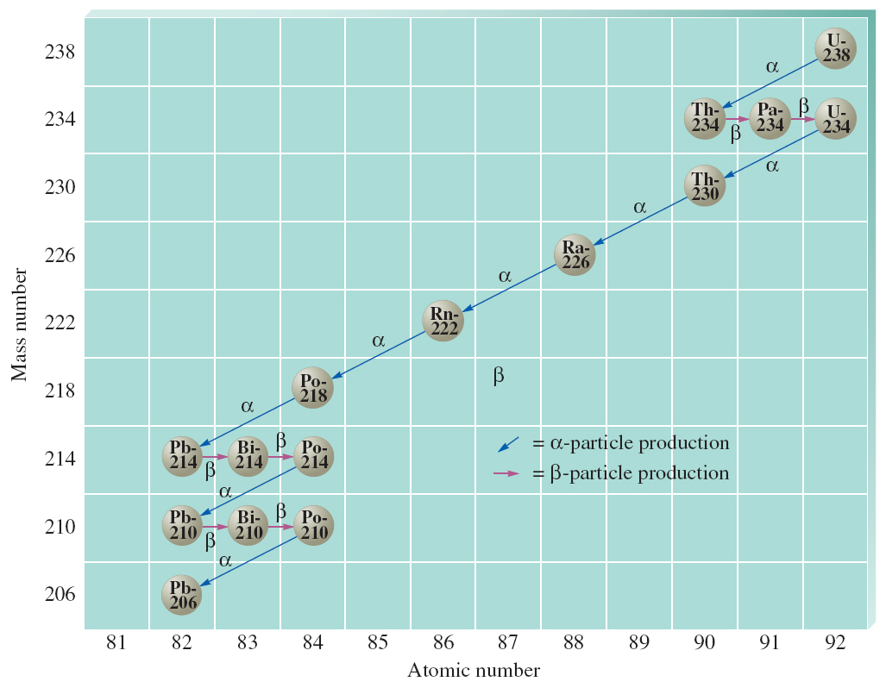
Decay Series (Series of Alpha and Beta Decays)

Slide 16
Criteria for Nuclear Stability
Light nuclides are stable when neutron/proton ratio ~ 1 (Z = A – Z);
For heavier nuclides, neutron/proton > 1 to be stable, increasing to ~ 1.52 in Bi;
Nuclides with 84 or more protons are unstable

Slide 17
Nuclear Stability
Certain combination of protons and neutrons seems to define nuclear stability.
There are more stable isotopes having even numbers of protons and neutrons than those with odd numbers.
The pairings of protons and neutrons have been suggested.

Slide 18
Condition for Nuclear Stability
Certain specific numbers of protons or neutrons produce especially stable nuclides.
2, 8, 20, 28, 50, 82, and 126

Slide 19
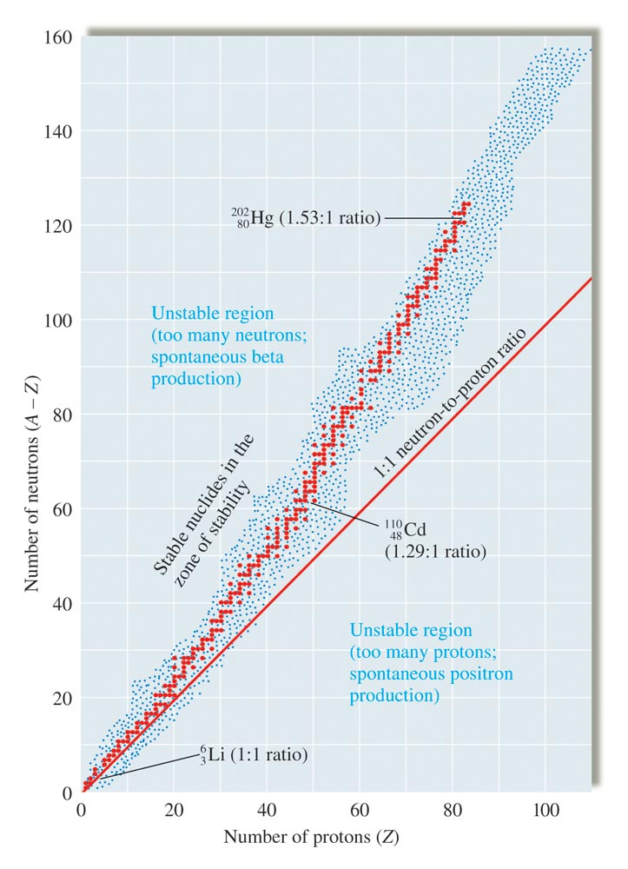
The Band of Stability

Slide 20
Concept Check
Which of the following produces a β particle?
electron capture
positron
alpha particle
beta particle
Notes:
The correct answer is d. Go through the rest of the equations to identify these types of equations as well.

Slide 21
Rate of Decay
Rate = kN
The rate of decay is proportional to the number of nuclides. This represents a first-order process.

Slide 22
Half-Life
Time required for the number of nuclides to reach half the original value.

Slide 23
Half-Life of Cobalt-60
For cobalt-60, which has a half-life of 5.27 years, 50% remains after 5.27 years (one half-life), 25% remains after 10.54 years (two half-lives), 12.5% remains after 15.81 years (three half-lives), and so on.

Slide 24
Half-Life of Nuclear Decay

Slide 25
Exercise-#1
A first order reaction is 35% complete at the end of 55 minutes. What is the value of k?
k = 7.8 x 10⁻³ min⁻¹
Notes:
k = 7.8 x 10⁻³ min⁻¹. If students use [A] = 35 in the integrated rate law (instead of 65), they will get k = 1.9 x 10⁻² min⁻¹.
Note: Use the red box animation to assist in explaining how to solve the problem.

Slide 26
Nuclear Transformation
The change of one element into another.

Slide 27
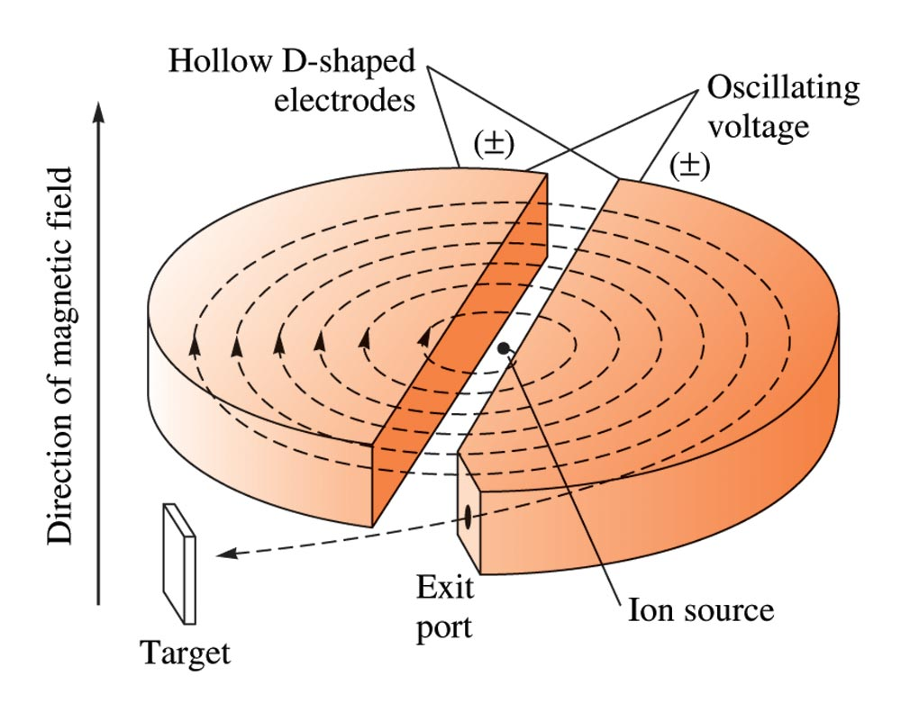
A Schematic Diagram of a Cyclotron

Slide 28
A Schematic Diagram of a Linear Accelerator

Slide 29
Measuring Radioactivity Levels
Geiger counter
Scintillation counter

Slide 30
Geiger Counter

Slide 31
Carbon–14 Dating
Used to date wood and cloth artifacts.
Based on carbon–14 to carbon–12 ratio.

Slide 32
Carbon-14 Isotope in Nature
Along with stable carbon-12, radioactive carbon-14 is taken in by plants and animals, and remains at a constant level within them while they are alive. After death, the C-14 decays and the C-14:C-12 ratio in the remains decreases. Comparing this ratio to the C-14:C-12 ratio in living organisms allows us to determine how long ago the organism lived (and died).

Slide 33
Carbon-14 Dating
Carbon-14 dating has shown that these pages from the Dead Sea Scrolls were written or copied on paper made from plants that died between 100 BC and AD 50.

Slide 34
Nuclear Binding Energy
The energy required to decompose the nucleus into its components.
Iron-56 is the most stable nucleus and has a binding energy of 8.97 MeV.

Slide 35
Energy and Mass
When a system gains or loses energy it also gains or loses a quantity of mass.
E = mc²
Δm = mass defect
ΔE = change in energy
A negative Δm yields negative ΔE, which implies a spontaneous process.

Slide 36
Mass Defect (Δm)
Calculating the mass defect for :
Since atomic masses include the masses of the electrons, we must account for the electron mass.
nucleus is “synthesized” from 2 protons and two neutrons.

Slide 37
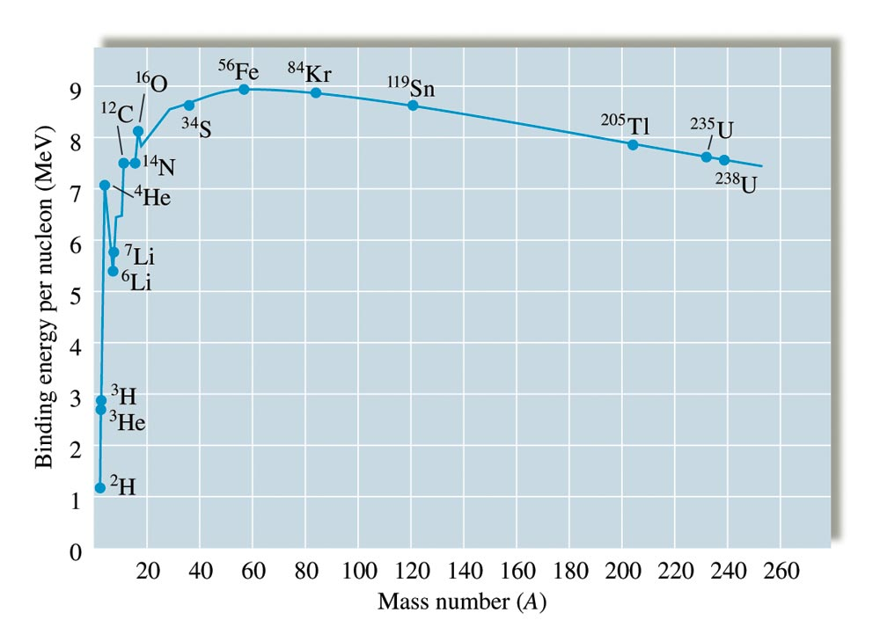
Binding Energy per Nucleon vs. Mass Number

Slide 38
Nuclear Fission and Fusion
Fusion – Combining two light nuclei to form a heavier, more stable nucleus.
Fission – Splitting a heavy nucleus into two nuclei with smaller mass numbers.

Slide 39
Nuclear Fission

Slide 40
Nuclear Fission

Slide 41
Nuclear Fission

Slide 42
Fission of Uranium-235
When a slow neutron hits a fissionable U-235 nucleus, it is absorbed and forms an unstable U-236 nucleus. The U-236 nucleus then rapidly breaks apart into two smaller nuclei (in this case, Ba-141 and Kr-92) along with several neutrons (usually two or three), and releases a very large amount of energy.

Slide 43
Fission Products of Uranium-235
Nuclear fission of U-235 produces a range of fission products.
The larger fission products of U-235 are typically one isotope with a mass number around 85–105, and another isotope with a mass number that is about 50% larger, that is, about 130–150.

Slide 44
Chain Reactions during Fission Process
The fission of a large nucleus, such as U-235, produces two or three neutrons, each of which is capable of causing fission of another nucleus by the reactions shown. If this process continues, a nuclear chain reaction occurs.

Slide 45
Sample Size in Chain Reactions
In a subcritical mass, the fissile material is too small and allows too many neutrons to escape the material, so a chain reaction does not occur.
In a critical mass, a large enough number of neutrons in the fissile material induce fission to create a chain reaction.

Slide 46
Fission Processes
A self-sustaining fission process is called a chain reaction.

Slide 47
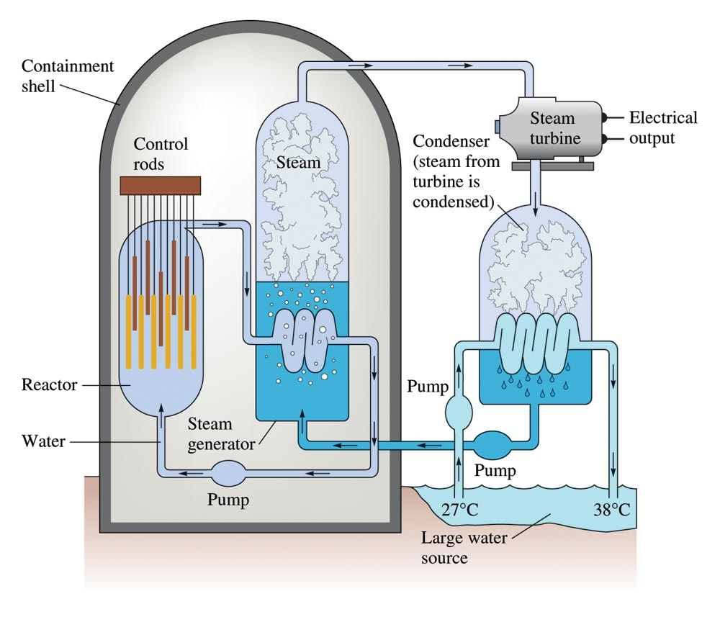
Schematic Diagram of a Nuclear Power Plant

Slide 48
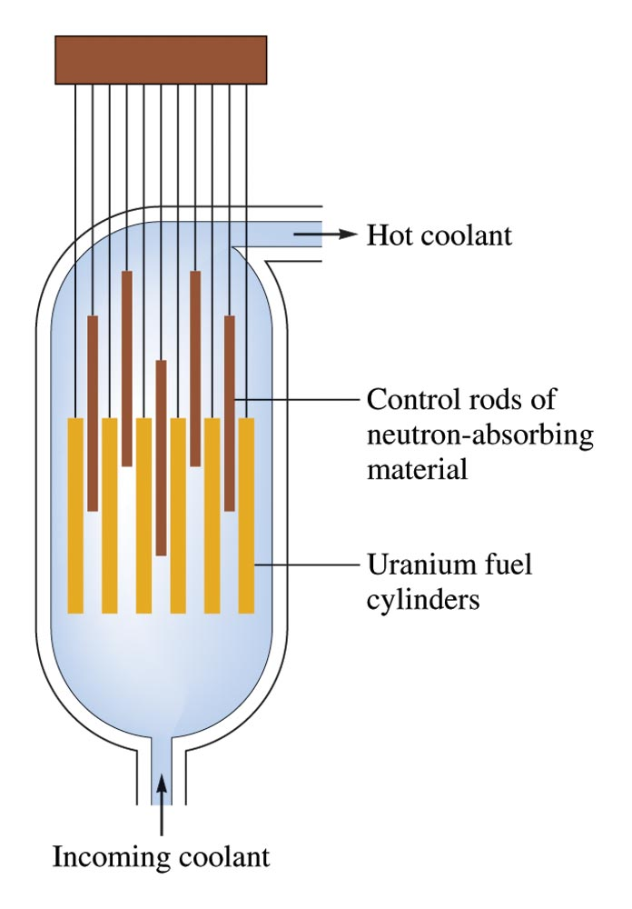
Schematic Diagram of a Reactor Core

Slide 49
Nuclear Reactor in California
(a) The Diablo Canyon Nuclear Power Plant near San Luis Obispo is the only nuclear power plant currently in operation in California. The domes are the containment structures for the nuclear reactors, and the brown building houses the turbine where electricity is generated. Ocean water is used for cooling. (b) The Diablo Canyon uses a pressurized water reactor, one of a few different fission reactor designs in use around the world, to produce electricity. Energy from the nuclear fission reactions in the core heats water in a closed, pressurized system. Heat from this system produces steam that drives a turbine, which in turn produces electricity. (credit a: modification of work by “Mike” Michael L. Baird; credit b: modification of work by the Nuclear Regulatory Commission)

Slide 50
Three Mile Island Nuclear Reactor
In this 2010 photo of Three Mile Island, the remaining structures from the damaged Unit 2 reactor are seen on the left, whereas the separate Unit 1 reactor, unaffected by the accident, continues generating power to this day (right).
President Jimmy Carter visited the Unit 2 control room a few days after the accident in 1979.

Slide 51
Fission Bomb (Little Boy and Fat Man)
The nuclear fission bomb that destroyed Hiroshima on August 6, 1945, consisted of two subcritical masses of U-235, where conventional explosives were used to fire one of the subcritical masses into the other, creating the critical mass for the nuclear explosion.
The plutonium bomb that destroyed Nagasaki on August 12, 1945, consisted of a hollow sphere of plutonium that was rapidly compressed by conventional explosives. This led to a concentration of plutonium in the center that was greater than the critical mass necessary for the nuclear explosion.

Slide 52
Nuclear Fusion

Slide 53
Nuclear Fusion

Slide 54
Nuclear Fusion

Slide 55
International Thermonuclear Experimental Reactor (ITER)
This model is of the International Thermonuclear Experimental Reactor (ITER) reactor. Currently under construction in the south of France with an expected completion date of 2027, the ITER will be the world’s Largest experimental Tokamak nuclear fusion reactor with a goal of achieving large-scale sustained energy production.
In 2012, the National Ignition Facility at Lawrence Livermore National Laboratory briefly produced over 500,000,000,000 watts (500 terawatts, or 500 TW) of peak power and delivered 1,850,000 joules (1.85 MJ) of energy, the largest laser energy ever produced and 1000 times the power usage of the entire United States in any given moment. Although lasting only a few billionths of a second, the 192 lasers attained the conditions needed for nuclear fusion ignition. This image shows the target prior to the laser shot. (credit a: modification of work by Stephan Mosel)

Slide 56
Uses of Radioisotopes
Radioisotope Dating – example: Carbon dating
Source of Energy – fission reactor
Medical Diagnoses (Tracers) and Therapy
Food Irradiation – (Cobalt-60 or Cesium-137)
Radioisotope Tracers
Isotope Dilution
Elemental Analyses

Slide 57
Radioisotope Tracers
Radioactive nuclides that are introduced into organisms in food or drugs and whose pathways can be traced by monitoring their radioactivity.

Slide 58
Radioisotope Tracers for Medical Diagnose
Characteristics of radioisotopes as tracers;
Have relatively short half-life - (from several hours to a few days);
Decay products are nonradioactive and nontoxic;
Produce low energy but penetrating gamma radiation that can be detected externally;
Have chemical properties that allow it to concentrate in diseased tissues or organs, creating a “hot spot”, or rejected by the diseased tissues and create a “dark spot”.

Slide 59
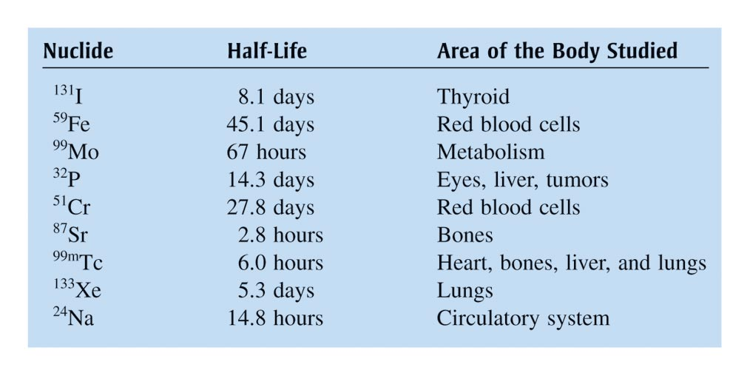
Radiotracers

Slide 60
Radioisotope Therapy
Mainly used for cancer treatment;
External radiation normally uses cobalt-60 - produces strong γ-rays that kills cancerous cells.
Some normal cells are also affected – patients often suffer side effect of radiation.

Slide 61
Radiotherapy
Internal radiation therapy is more selective – it depends on the organ or cancerous tissue to selectively absorb the radioactive isotope.
Iodine-131, a β-emitter (half-life ~ 8 days), administered internally to treat thyroid diseases;
Iodine selectively accumulates in thyroid.

Slide 62
Food Irradiation
Food irradiation commonly done using γ-rays from cobalt-60 or cesium-137.
Irradiation kills bacteria and fungi that cause food spoilage, thus improves the shelf-life.

Slide 63
Isotope Dilution
Technique used to determine whole blood volume in patients or animals.
A known volume of the animal’s blood is inoculated with chromium-51.
Treated blood is re-introduced into the animal and allowed to circulate.
After complete distribution, a blood sample is withdrawn and the radioactivity measured.
The whole blood volume is calculated as follows:
V_{blood} = (A_{i} x V_{i})/A_{blood}
A_{i} = initial activity; V_{i} = initial volume of blood sample;
A_{blood} = activity after circulation.

Slide 64
Elemental Analysis
This is done by neutron activation of the element;
For example:
⁷⁵₃₃As + ¹₀n → ⁷⁶₃₃As* → ⁷⁶₃₃As + γ
Each element produces a typical frequency of γ-rays

Slide 65
Use of Radioisotopes in Medicine
Administering thallium-201 to a patient and subsequently performing a stress test offer medical professionals an opportunity to visually analyze heart function and blood flow. (credit: modification of work by “Blue0ctane”/Wikimedia Commons)

Slide 66
Use of Radioisotopes in Medicine
(a) The first Tc-99m generator (circa 1958) is used to separate Tc-99 from Mo-99. The MoO₄ ²⁻ is retained by the matrix in the column, whereas the TcO₄− passes through and is collected. (b) Tc-99 was used in this scan of the neck of a patient with Grave’s disease. The scan shows the location of high concentrations of Tc-99. (credit a: modification of work by the Department of Energy; credit b: modification of work by “MBq”/Wikimedia Commons)

Slide 67
Application of Radiation in Medicine
The cartoon in (a) shows a cobalt-60 machine used in the treatment of cancer. The diagram in (b) shows how the gantry of the Co-60 machine swings through an arc, focusing radiation on the targeted region (tumor) and minimizing the amount of radiation that passes through nearby regions.

Slide 68
Radiation Energy from Cobalt-60 Decay
Co-60 undergoes a series of radioactive decays. The γ emissions are used for radiation therapy.

Slide 69
Uses of Radiation in Food Preservation
Common commercial uses of radiation include (a) X-ray examination of luggage at an airport and (b) preservation of food. (credit a: modification of work by the Department of the Navy; credit b: modification of work by the US Department of Agriculture)

Slide 70
Other Uses of Radioisotopes
Inside a smoke detector, Am-241 emits α particles that ionize the air, creating a small electric current. During a fire, smoke particles impede the flow of ions, reducing the current and triggering an alarm. (credit a: modification of work by “Muffet”/Wikimedia Commons)

Slide 71
Biological Effects of Radiation
Depend on the:
Energy of the radioactive particles;
Penetrating ability of the radiation;
Ionizing ability of the radiation;
Chemical properties of the radiation source;

Slide 72
Biological Effect of Radiation
Radiation can harm biological systems by damaging the DNA of cells. If this damage is not properly repaired, the cells may divide in an uncontrolled manner and cause cancer.

Slide 73
Penetrating Ability of Radiations

Slide 74
Different Penetration Ability of Radiation
The ability of different types of radiation to pass through material is shown. From least to most penetrating, they are alpha < beta < neutron < gamma.

Slide 75
Biological Effects of Radiation
Ionizing radiation can (a) directly damage a biomolecule by ionizing it or breaking its bonds, or (b) create an H₂O⁺ ion, which reacts with H₂O to form a hydroxyl radical, which in turn reacts with the biomolecule, causing damage indirectly.

Slide 76
Radiation Dose
Different units are used to measure the rate of emission from a radioactive source, the energy that is absorbed from the source, and the amount of damage the absorbed radiation does.

Slide 77
Units for Radiation Dose
Gray (Gy) = 1 J/kg of absorbed radiation energy;
Rads = 0.01 J/kg of absorbed radiation energy;
Sievert (Sv) = Gy x RBE
rem = rads x RBE
RBE = relative biological effectiveness;
The quality of radiation base on how much damaging effect it can cause to the biological system.

Slide 78
rem (roentgen equivalent for man)
The energy dose of the radiation and its effectiveness in causing biologic damage must be taken into account.
Number of rems = (number of rads) × RBE
rads = radiation absorbed dose
RBE = relative effectiveness of the radiation in causing biologic damage

Slide 79
Radiation from the Environment
Radon-222 seeps into houses and other buildings from rocks that contain uranium-238, a radon emitter. The radon enters through cracks in concrete foundations and basement floors, stone or porous cinderblock foundations, and openings for water and gas pipes.

Slide 80
Sources of Radiation Exposure
The total annual radiation exposure for a person in the US is about 620 mrem. The various sources and their relative amounts are shown in this bar graph. (source: U.S. Nuclear Regulatory Commission)

Slide 81
Effects of Short-Term Exposures to Radiation

