Slide 1
Organic and Biological Molecules
Alkanes: Saturated Hydrocarbons
Alkenes and Alkynes
Aromatic Hydrocarbons
Hydrocarbon Derivatives
Polymers
Natural Polymer
Biological Macromolecules

Slide 2
Organic Chemistry
Organic Chemistry
The study of carbon-containing compounds and their properties. The vast majority of organic compounds contain chains or rings of carbon atoms.

Slide 3
Hydrocarbons
Compounds composed of carbon and hydrogen.

Slide 4
Classification of Hydrocarbons
Saturated: C—C bonds are all single bonds.
alkanes [C_{n}H_{2n+2}]

Slide 5
Classification of Hydrocarbons
Unsaturated: contains carbon–carbon multiple bonds.
Alkenes [C_{n}H_{2n}] Alkynes [C_{n}H_{2n – 2}]

Slide 6
Nomenclature of Hydrocarbons
Naming Alkanes:
Choose the longest (unbroken) carbon chain as parent structure;
Identify side-chains and their locations on the parent chain;
Number the parent chain from the end that would give the smallest number combination for the locations of side-chain.
Name side-chains in alphabetical order and followed by parent chain.

Slide 7
Name this compound.
CH₃ CH₃
| |
CH₃–CH–CH₂–C–CH₃
|
CH₃
2,2,4-trimethylpentane

Slide 8
Isomerism in Alkanes
Structural isomerism – occurs when two molecules have the same atoms but different bonds.
Butane and all succeeding members of the alkanes exhibit structural isomerism.

Slide 9
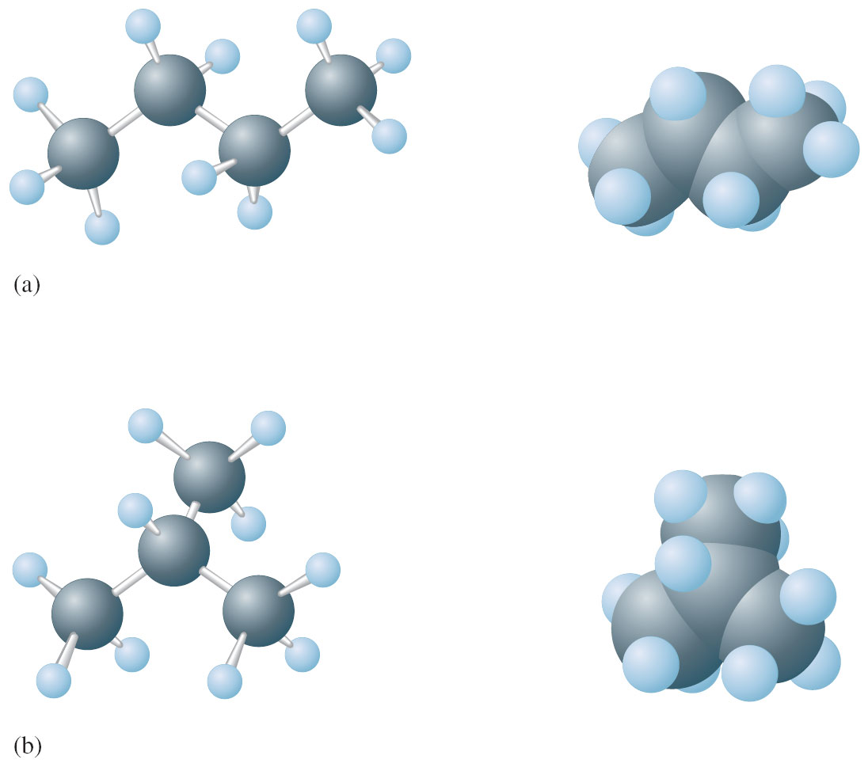
Butane

Slide 10
Rules for Naming Alkanes
For alkanes beyond butane, add –ane to the Greek root for the number of carbons.
CH₃–CH₂–CH₂–CH₂–CH₂–CH₃ = hexane
Alkyl substituents: drop the –ane and add –yl.
C₂H₆ is ethane
C₂H₅ is ethyl

Slide 11
Rules for Naming Alkanes
Positions of substituent groups are specified by numbering the longest chain sequentially. The numbering is such that substituents are at lowest possible number along chain.
CH₃
⎮
CH₃–CH₂–CH–CH₂–CH₂–CH₃
1 2 3 4 5 6
3-methylhexane

Slide 12
Rules for Naming Alkanes
Location and name are followed by root alkane name. Substituents are named in alphabetical order and use di–, tri–, etc.
CH₃ CH₃
⎮ ⎮
CH₃–CH₂–CH–CH–CH₂–CH₃
1 2 3 4 5 6
3,4-dimethylhexane

Slide 13
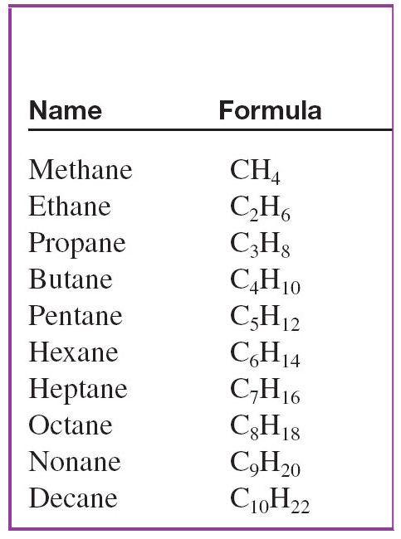
First Ten Normal Alkanes

Slide 14
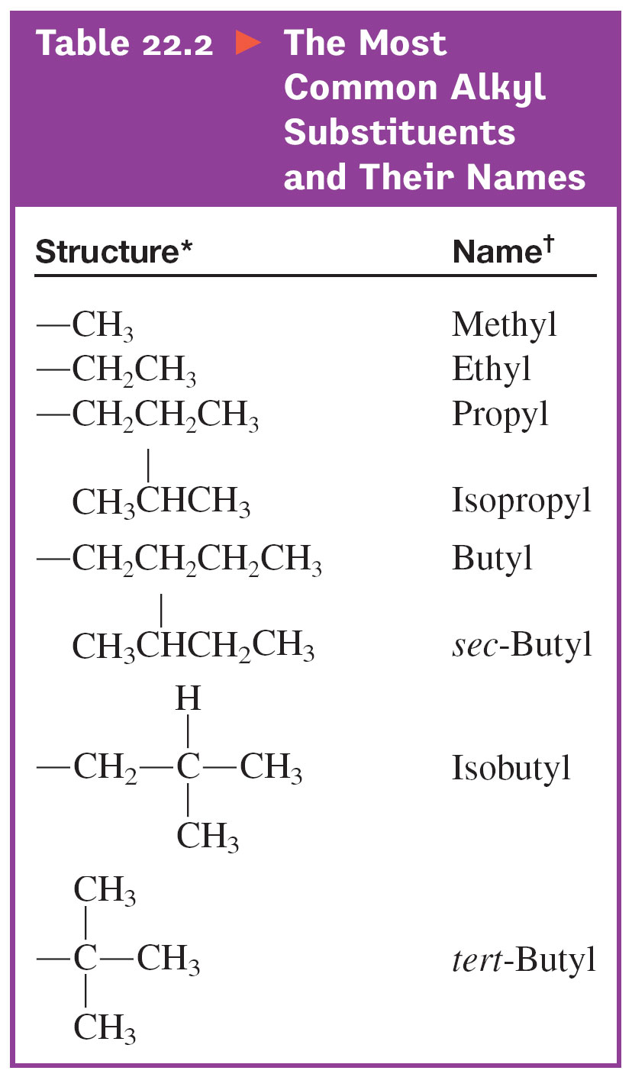
Most Common Alkyl Substituents and Their Names

Slide 15
Exercise-#1
Name each of the following:
(a)
(b)
Notes:
a) 2,2,4,5-tetramethylhexane
b) 3,6-diethyl-3-methyloctane

Slide 16
Combustion Reactions of Alkanes
At a high temperature, alkanes react vigorously and exothermically with oxygen. They are used as fuels.

Slide 17
Substitution Reactions of Alkanes
Primarily where halogen atoms replace hydrogen atoms.

Slide 18
Dehydrogenation Reactions of Alkanes
Hydrogen atoms are removed and the product is an unsaturated hydrocarbon.

Slide 19
Cyclic Alkanes
Carbon atoms can form rings containing only C—C single bonds.
General formula: C_{n}H_{2n}
C₃H₆, C₄H₈, C₆H₁₂

Slide 20
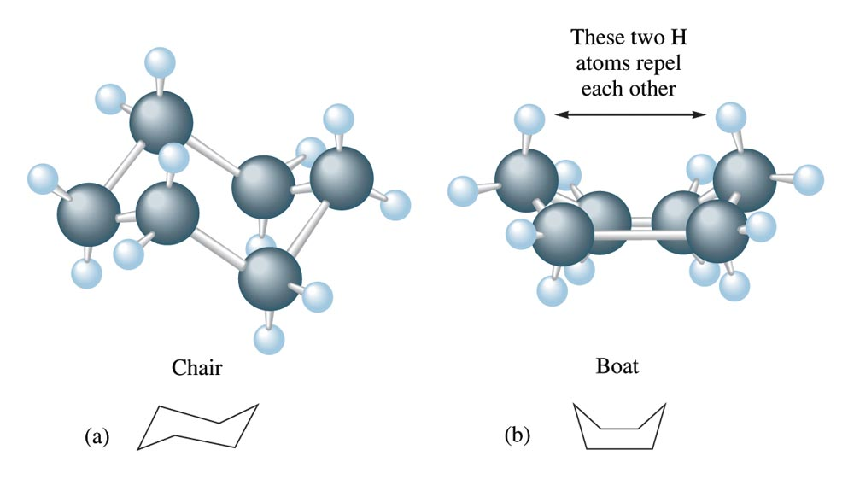
The Chair and Boat Forms of Cyclohexane

Slide 21
Hydrocarbons
Alkenes: hydrocarbons that contain a carbon–carbon double bond. [C_{n}H_{2n}]
CH₃CH═CH₂ propene
Alkynes: hydrocarbons containing a carbon–carbon triple bond.
CH₃CH₂C≡CCH₃ 2–pentyne

Slide 22
Rules for Naming Alkenes
Root hydrocarbon name ends in –ene.
C₂H₄ is ethene
2. With more than 3 carbons, double bond is indicated by the lowest–numbered carbon atom in the bond.
CH₂=CHCH₂CH₃
1 2 3 4
1–butene

Slide 23
Rules for Naming Alkynes
Same as for alkenes except use –yne as suffix.
CH₃CH₂C≡CCH₂CH₂CH₂CH₃
3–octyne

Slide 24
Exercise-#2
Name each of the following:
(a)
(b)
Notes:
a) 2,3,5-trimethyl-2-hexene
b) 6-ethyl-3-methyl-3-octene

Slide 25
Addition Reactions
Pi Bonds (which are weaker than the C—C bonds), are broken, and new bonds are formed to the atoms being added.

Slide 26
Halogenation Reactions
Addition of halogen atoms of alkenes and alkynes.

Slide 27
Addition Reactions
Addition of HX molecules to an Alkene and alkyne:
CH₃CH₂CH═CH₂ + HBr → CH₃CH₂CHBrCH₃
1-butene 2-bromobutane
CH₃CH₂C≡CH + 2HBr → CH₃CH₂CBr₂CH₃
1-butyne 2,2-dibromobutane

Slide 28
Aromatic Compounds
A special class of cyclic unsaturated hydrocarbons.
Simplest of these is benzene (C₆H₆).
The delocalization of the π−electrons makes the benzene ring behave differently from a typical unsaturated hydrocarbon.

Slide 29
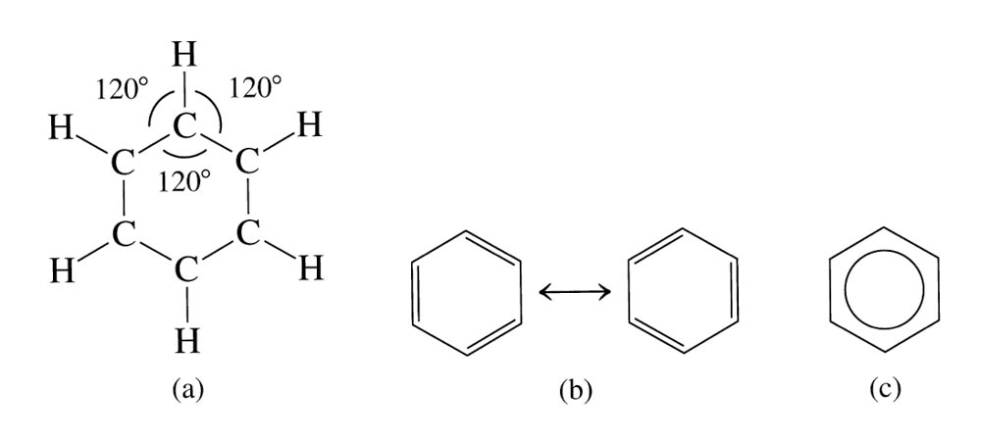
Benzene (Aromatic Hydrocarbon)

Slide 30
Substitution reactions of Aromatic Compounds
Unsaturated hydrocarbons generally undergo rapid addition reactions, but benzene does not.
Benzene undergoes substitution reactions in which hydrogen atoms are replaced by other atoms.
Cl
+ Cl₂
+ HCl
Benzene
Chlorobenzene

Slide 31
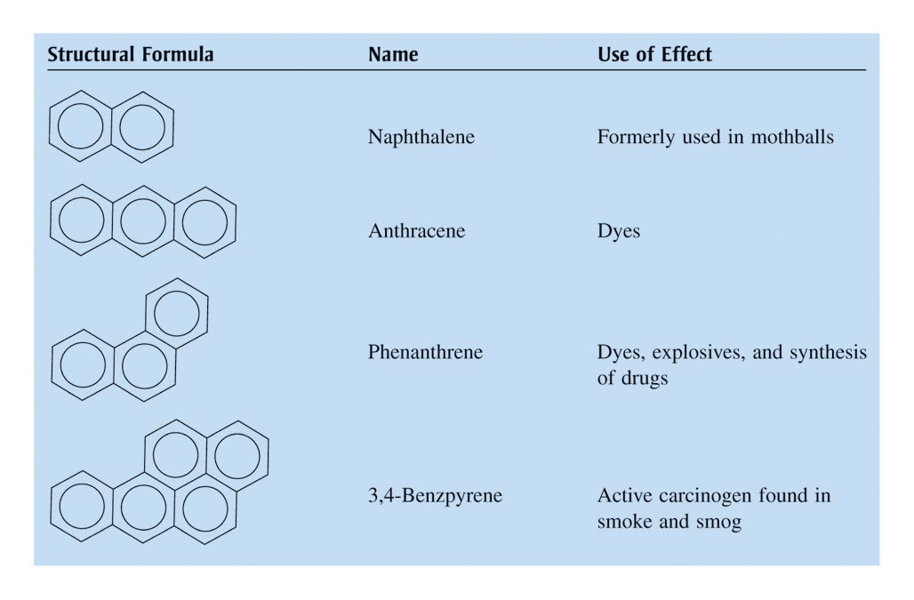
More Complex Aromatic Systems

Slide 32
Organic Compounds with Functional Groups
Molecules that are fundamentally hydrocarbons but have additional atoms or groups of atoms called functional groups.

Slide 33
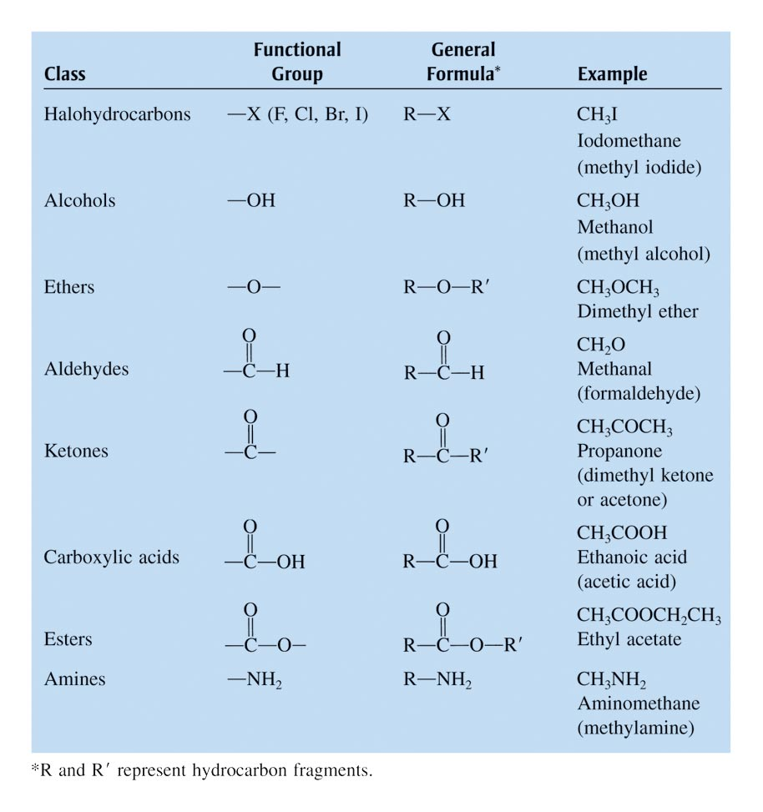
The Common Functional Groups

Slide 34
Alcohols
CH₃OH Methanol
CH₃CH₂OH Ethanol
CH₃CH₂CH₂OH 1-propanol
CH₃CH(OH)CH₃ 2-Propanol
CH₃CH₂CH₂CH₂OH 1-Butanol
CH₃CH₂CH(OH)CH₃ 2-Butanol
CH₃CH₂CH₂CH₂CH₂OH 1-Pentanol
CH₃CH₂CH₂CH(OH)CH₃ 2-Pentanol
CH₃CH₂CH(OH)CH₂CH₃ 3-Pentanol

Slide 35
Ether
CH₃OCH₃ Dimethyl ether
CH₃CH₂OCH₂CH₃ Diethyl ether
CH₃CH₂OCH₃ Ethylmethyl ether
CH₃OCH₂CH₂CH₃ Methylpropyl ether
(CH₃)₂CHOCH₃ Isopropylmethyl ether
CH₃OC(CH₃)₃ Methyltert-butyl ether (MTBE)
(MTBE – was used as additive in gasoline)

Slide 36
Aldehyde
HCHO Methanal
CH₃CHO Ethanal
CH₃CH₂CHO Propanal
CH₃CH₂CH₂CHO Butanal
CH₃CH₂CH₂CH₂CHO Pentanal
CH₃
│
CH₃CH₂CH−CHCHO
│
Cl
2-chloro-3-methylpentanal

Slide 37
Ketones
CH₃COCH₃ Propanone
CH₃CH₂COCH₃ Butanone
CH₃CH₂CH₂COCH₃ 2- Pentanone
CH₃CH₂COCH₂CH₃ 3-Pentanone
O
║
CH₃CH₂ CCHCH₃ 2-chloro-3-pentanone
│
Cl

Slide 38
Carboxylic Acids
HCHOOH Methanoic acid (Formic acid)
CH₃COOH Ethanoic acid (Acetic acid)
CH₃CH₂COOH Propanoic acid
CH₃CH₂CH₂COOH Butanoic acid
CH₃CH₂CH₂CH₂COOH Pentanoic acid

Slide 39
Derivatives of Carboxylic Acids
O
║
CH₃CH₂ CCOOH 2-ketobutanoic acid
OH
│
CH₃CH₂ CHCOOH 2-hydroxybutanoic acid
Cl
│
CH₃CH₂ CHCOOH 2-chlorobutanoic acid

Slide 40
Amines
CH₃NH₂ Methylamine (1º)
CH₃CH₂NH₂ Ethylamine (1º)
(CH₃CH₂)₂NH Diethylamine (2º)
(CH₃CH₂)₃N Triethylamine (3º)
(CH₃)₂NH Dimethylamine (2º)
CH₃CH₂NHCH₃ Ethylmethylamine (2º)
CH₃CH₂N(CH₃)₂ Dimethylethylamine (3º)
(1º = primary; 2º = secondary; 3º = tertiary)

Slide 41
Esters
CH₃COOCH₂CH₃ Ethylacetate
O
║
CH₃C-OCH₂CH₃ Ethylacetate
O
║
CH₃C-OCH₂CH₂CH₂CH₂CH₃ Pentylacetate

Slide 42
Amides
CH₃CONH₂ Ethanamide (Acetamide)
CH₃CH₂CONH₂ Propanamide
CH₃CONHCH₃ N-methylethanamide
(N-methylacetamide)
CH₃CON(CH₃)₂ N,N-dimethylethanamide
(N,N-dimethylacetamide)
O
║
CH₃C-NH₂ Ethanamide (Acetamide)

Slide 43
Organic Polymers
Large, usually chainlike molecules that are built from small molecules called monomers.
Monomer Polymer
Ethylene Polyethylene
Vinyl chloride Polyvinyl chloride
Tetrafluoroethylene Teflon®

Slide 44
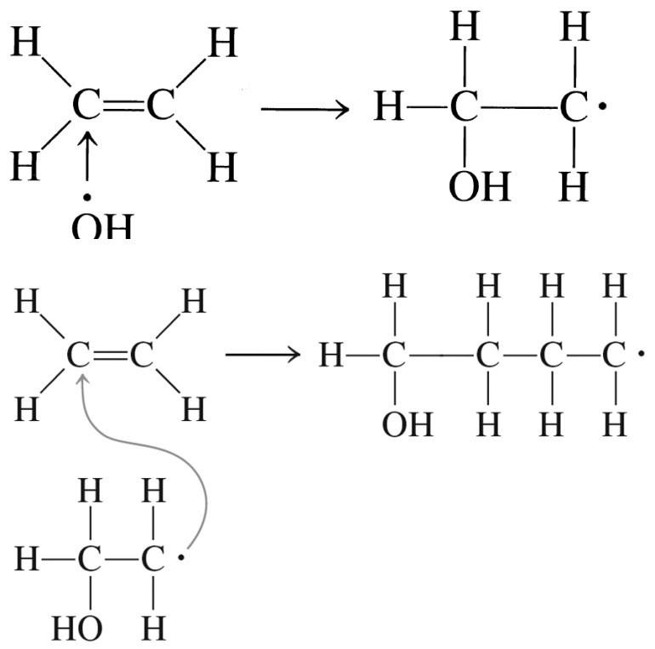
Types of Polymerization
Addition Polymerization
Monomers “add together” to form the polymer, with no other products. (Teflon®)

Slide 45
Types of Polymerization
Condensation Polymerization
A small molecule, such as water, is formed for each extension of the polymer chain. (Nylon)

Slide 46
Proteins
Natural polymers made up of α-amino acids with molar masses:
≈ 6000 to > 1,000,000 g/mol
Fibrous Proteins: provide structural integrity and strength to muscle, hair and cartilage.

Slide 47
Proteins
Globular Proteins:
Roughly spherical shape
Transport and store oxygen and nutrients
Act as catalysts
Fight invasion by foreign objects
Participate in the body’s regulatory system
Transport electrons in metabolism

Slide 48
α-Amino Acids
–NH₂ always attached to the α-carbon
(the carbon attached to -COOH)
C = α-carbon
R = side chains

Slide 49
Bonding in α-Amino Acids
+ H₂O
↑
A peptide linkage
There are 20 amino acids commonly found in proteins.

Slide 50
Levels of Structure in Proteins
Primary: Sequence of amino acids in the protein chain.
Secondary: The arrangement of the protein chain in the long molecule (hydrogen bonding determines this).
Tertiary: The overall shape of the protein (determined by hydrogen-bonding, dipole-dipole interactions, ionic bonds, covalent bonds and London forces).

Slide 51
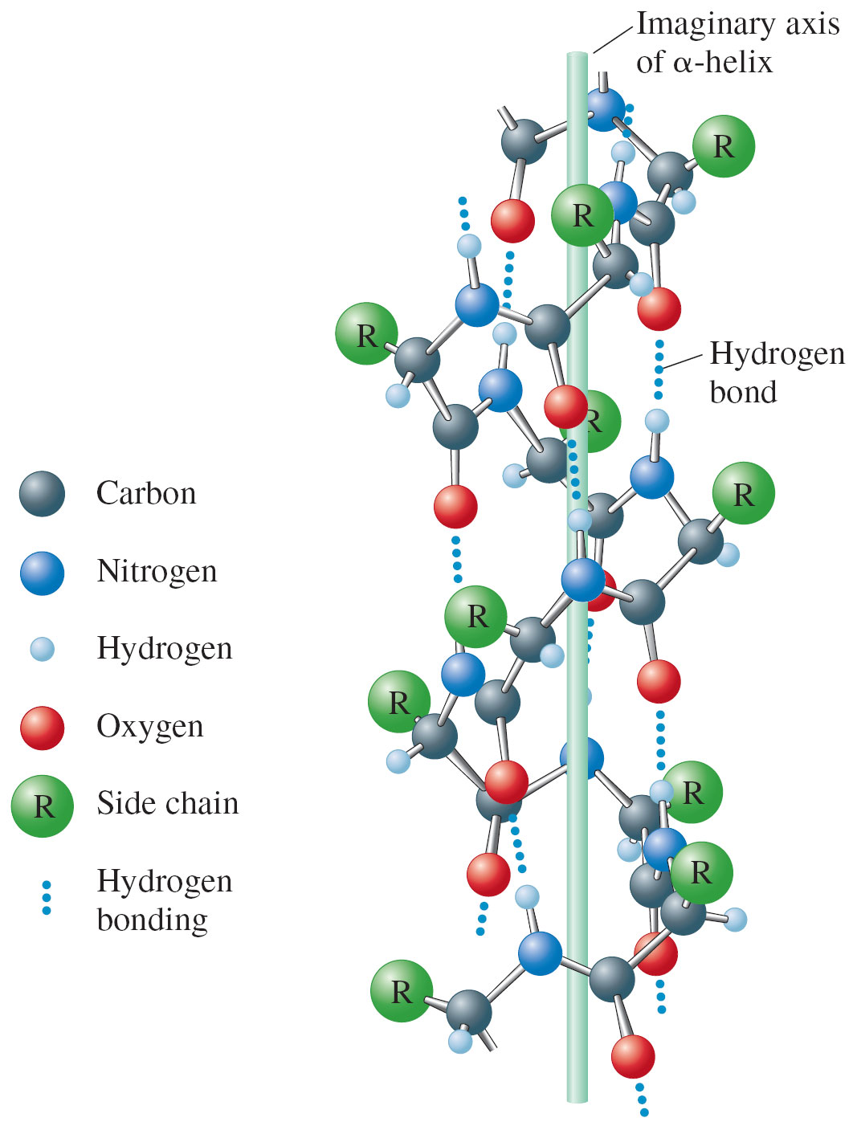
Hydrogen Bonding in α-Helical Arrangement of a Protein Chain

Slide 52
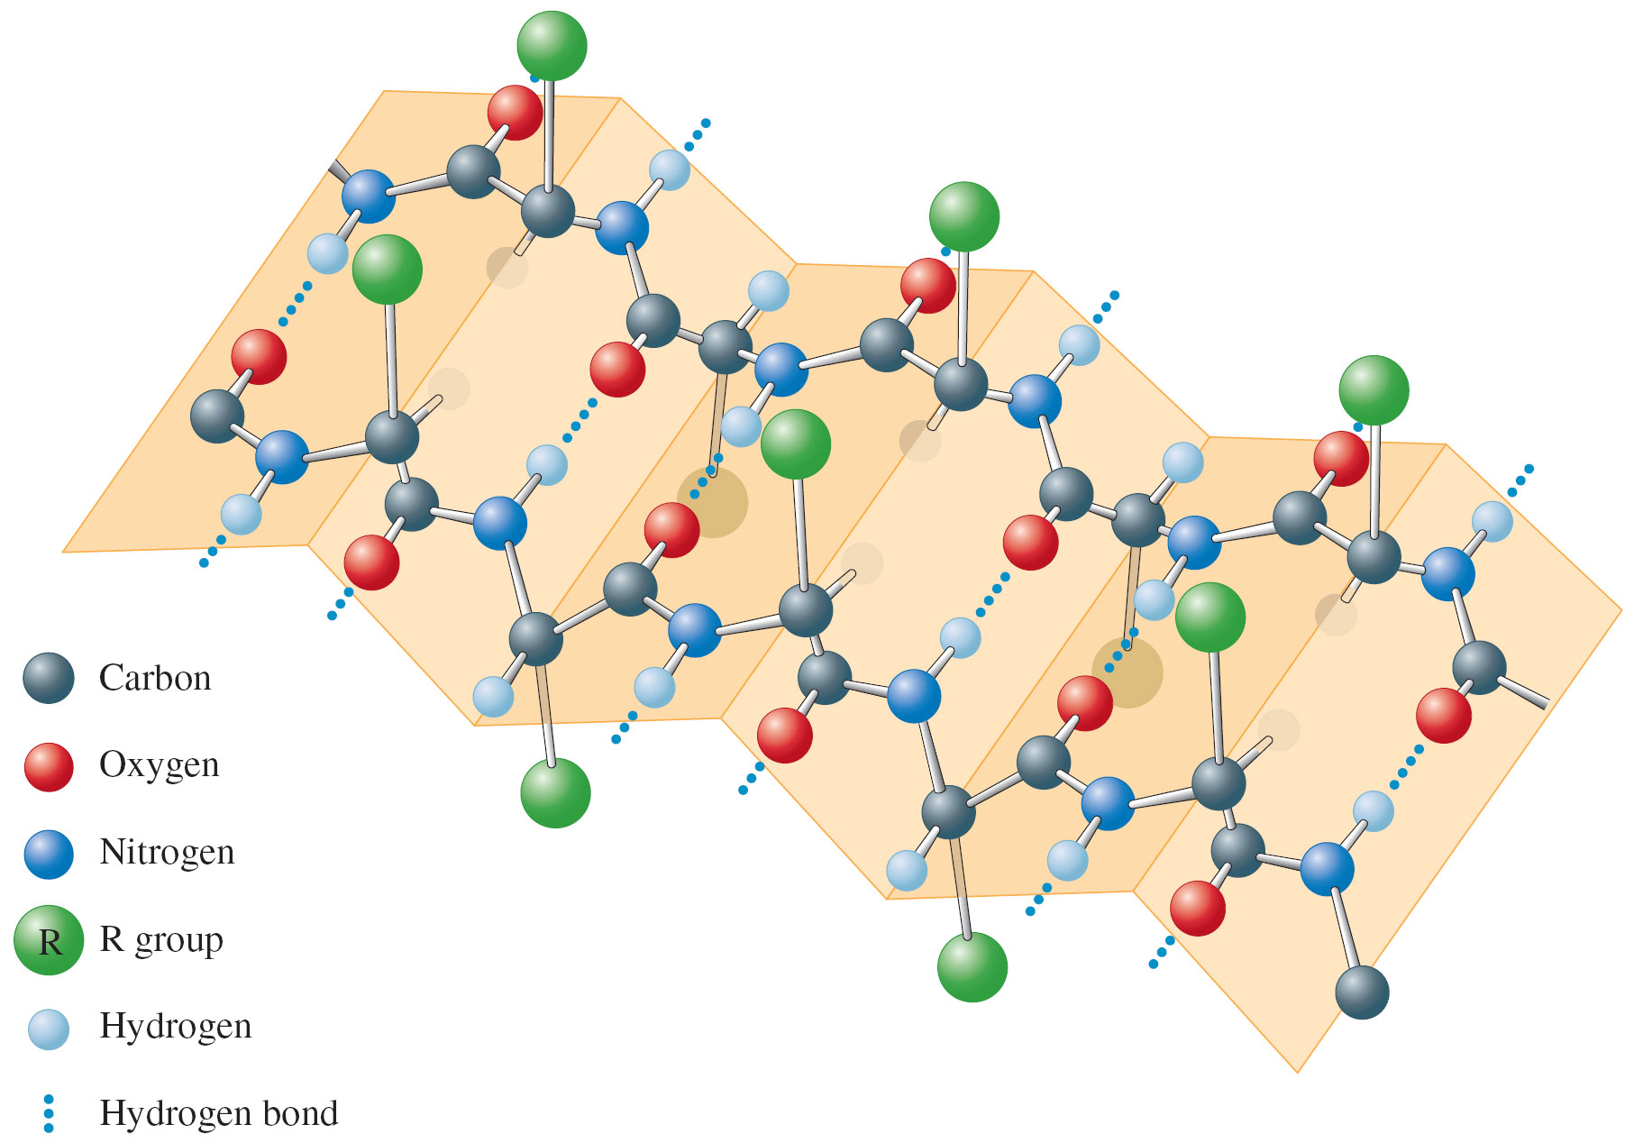
Pleated Sheet

Slide 53
Carbohydrates
Food source for most organisms and structural material for plants.
Empirical formula = CH₂O
Monosaccharides (simple sugars)
pentoses – ribose, arabinose
hexoses – fructose, glucose

Slide 54
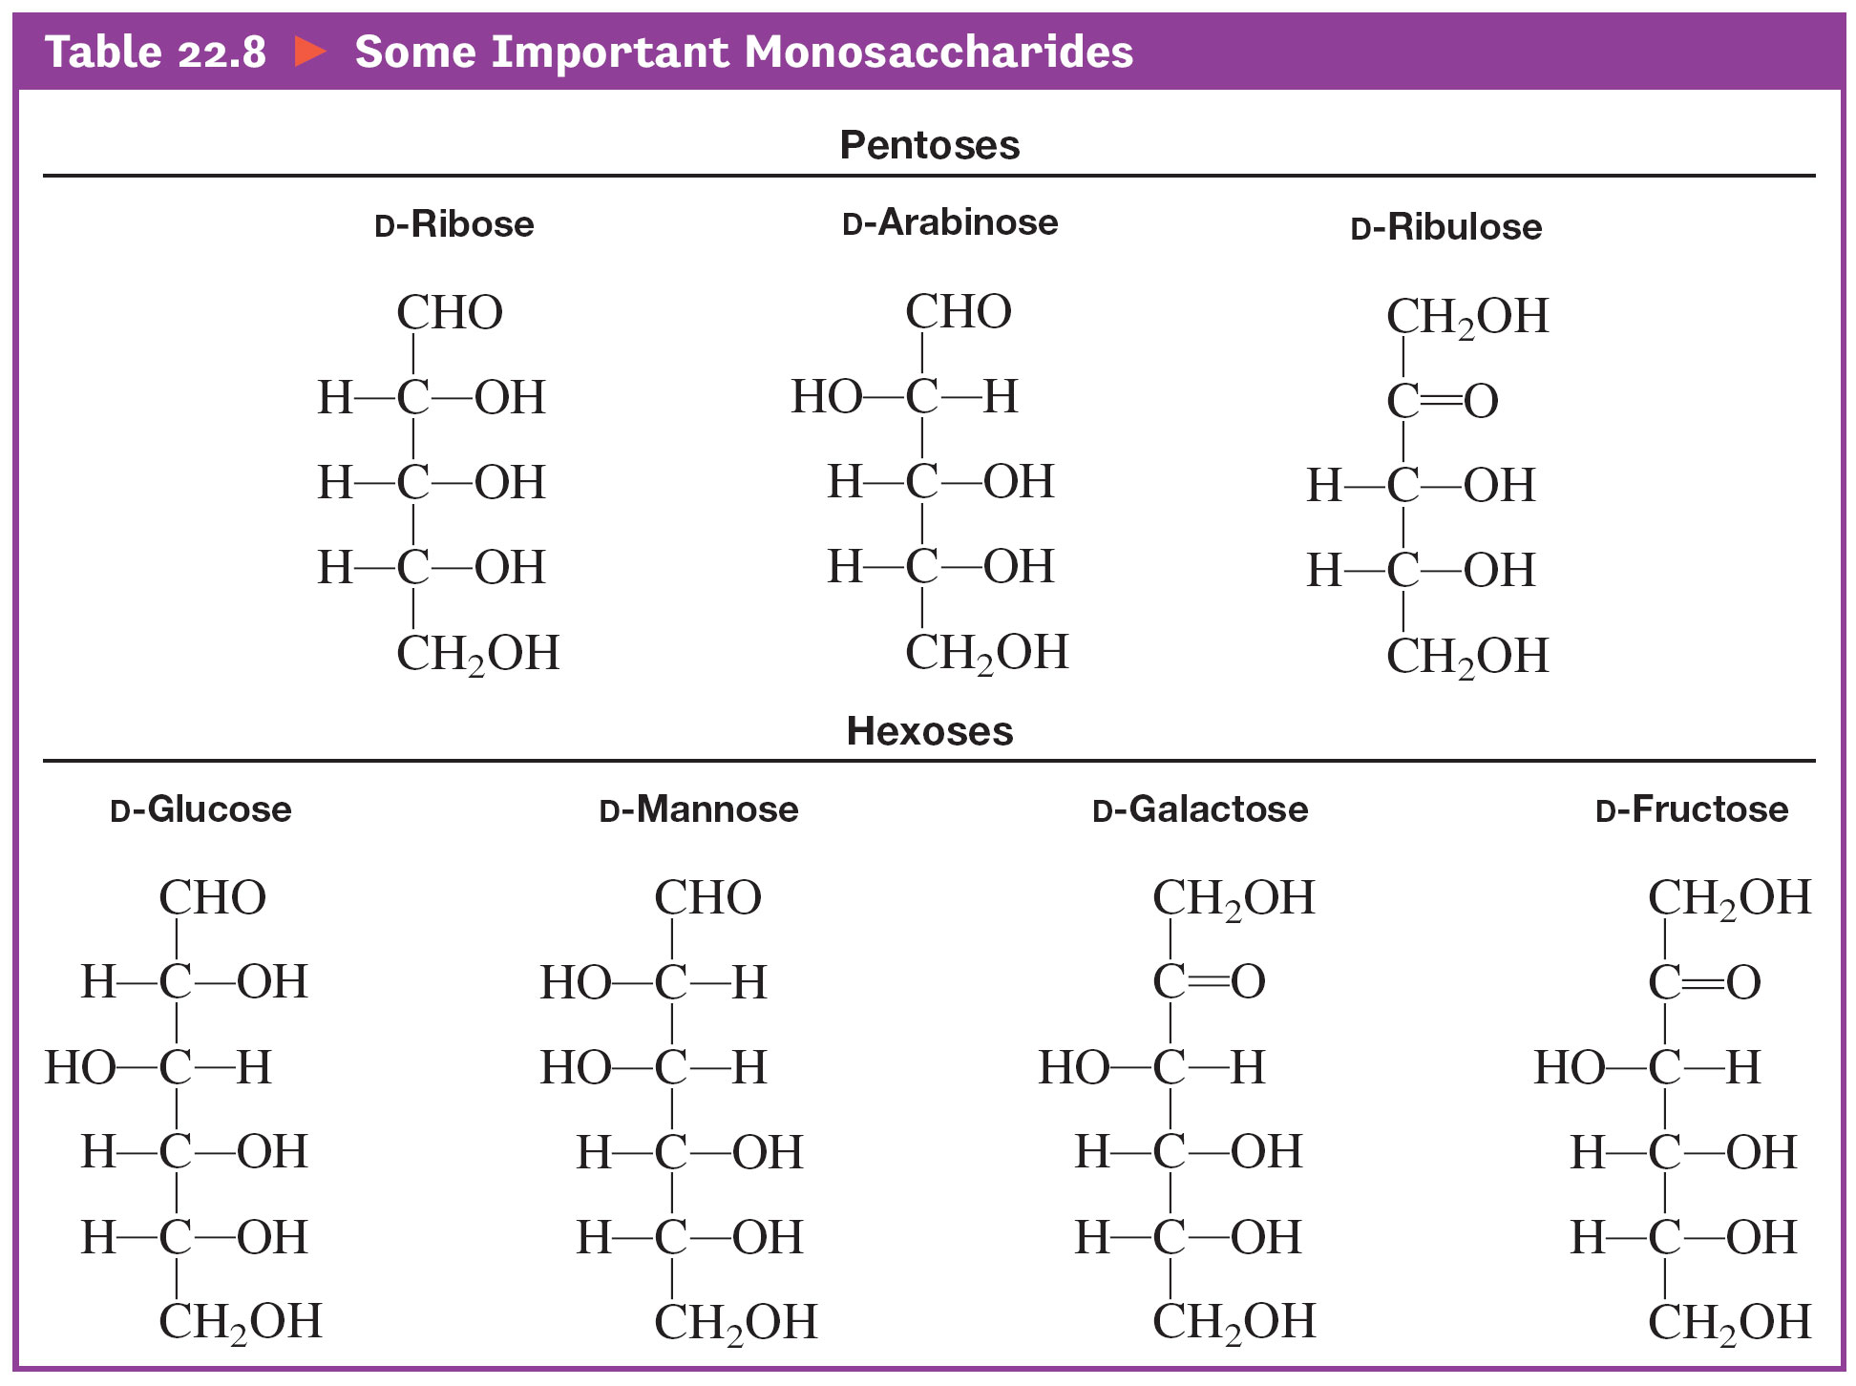
Some Important Monosaccharides

Slide 55
Carbohydrates
Disaccharides (formed from 2 monosaccharides joined by a glycoside linkage, a C—O—C bond between the rings):
sucrose (glucose + fructose)
Polysaccharides (many monosaccharide units):
starch, cellulose

Slide 56
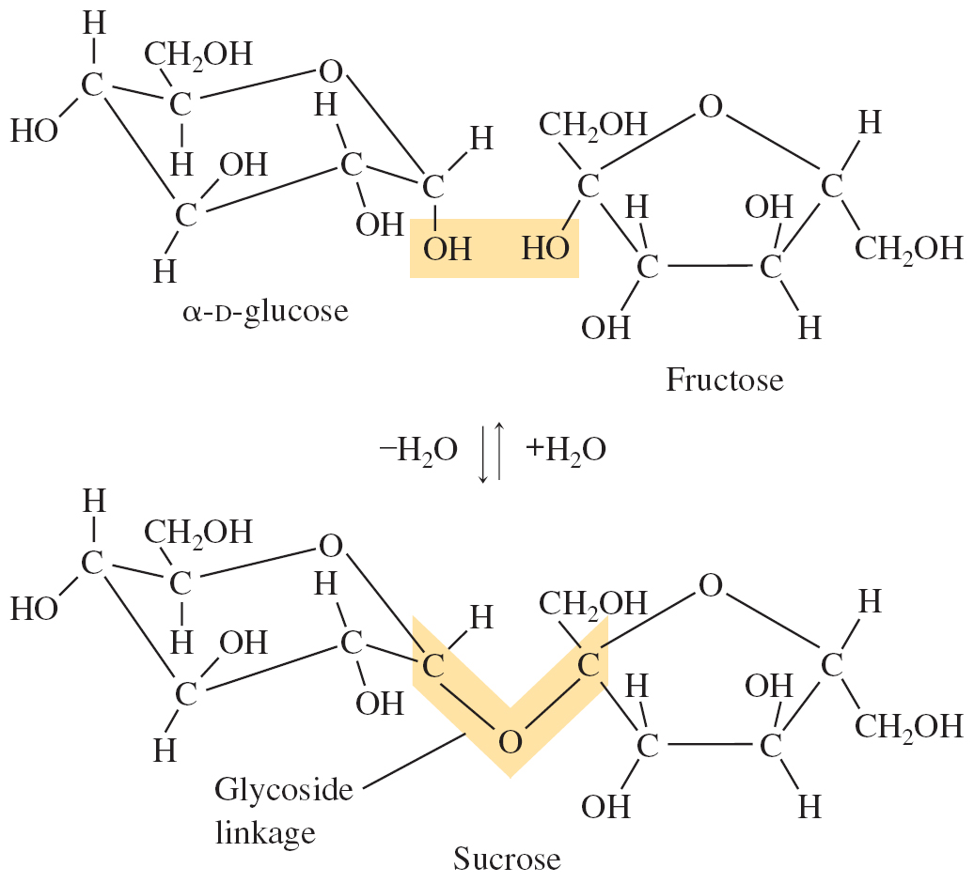
The Disaccharide Sucrose is formed from α-D-glucose and Fructose

Slide 57
Nucleic Acids
DNA (deoxyribonucleic acid): stores and transmits genetic information, responsible (with RNA) for protein synthesis.
(Molar masses = several billion)
RNA (ribonucleic acid): helps in protein synthesis.
(Molar masses from 20,000 to 40,000 g/mol)

Slide 58
Nucleotides
Monomers of the nucleic acids.
Three distinct parts:
A five–carbon sugar, deoxyribose in DNA and ribose in RNA.
A nitrogen–containing organic base.
A phosphoric acid molecule (H₃PO₄).

Slide 59
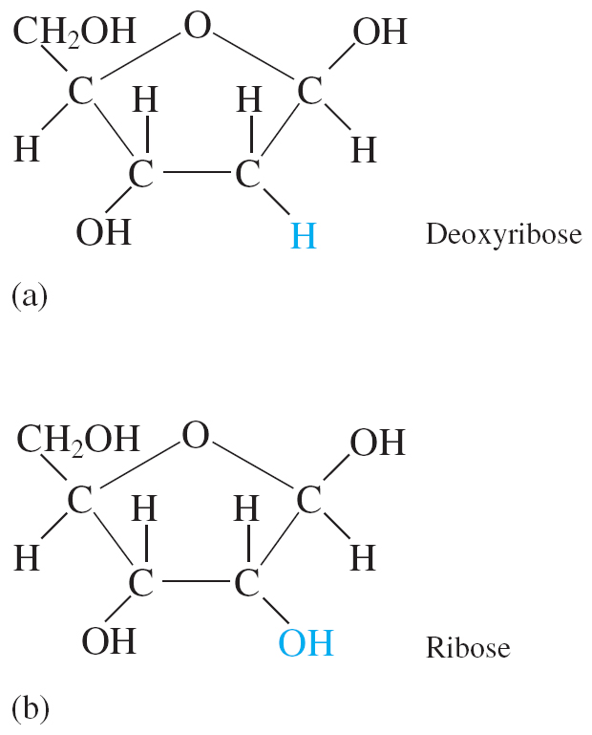
Deoxyribose (in DNA) and Ribose (in RNA)

Slide 60
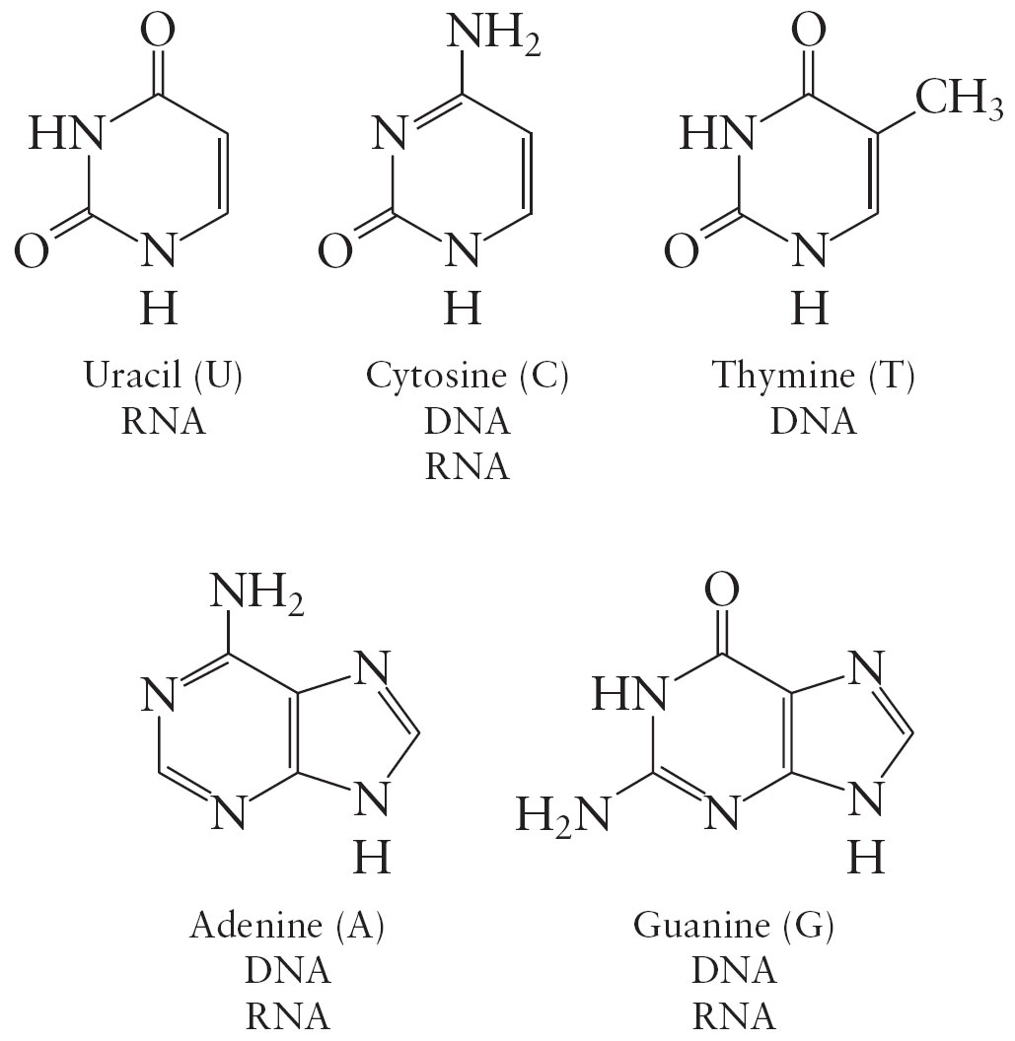
The Organic Bases Found in DNA and RNA

Slide 61
DNA
Key to DNA’s functioning is its double-helical structure with complementary bases on the two strands.
The bases form hydrogen bonds to each other.

Slide 62
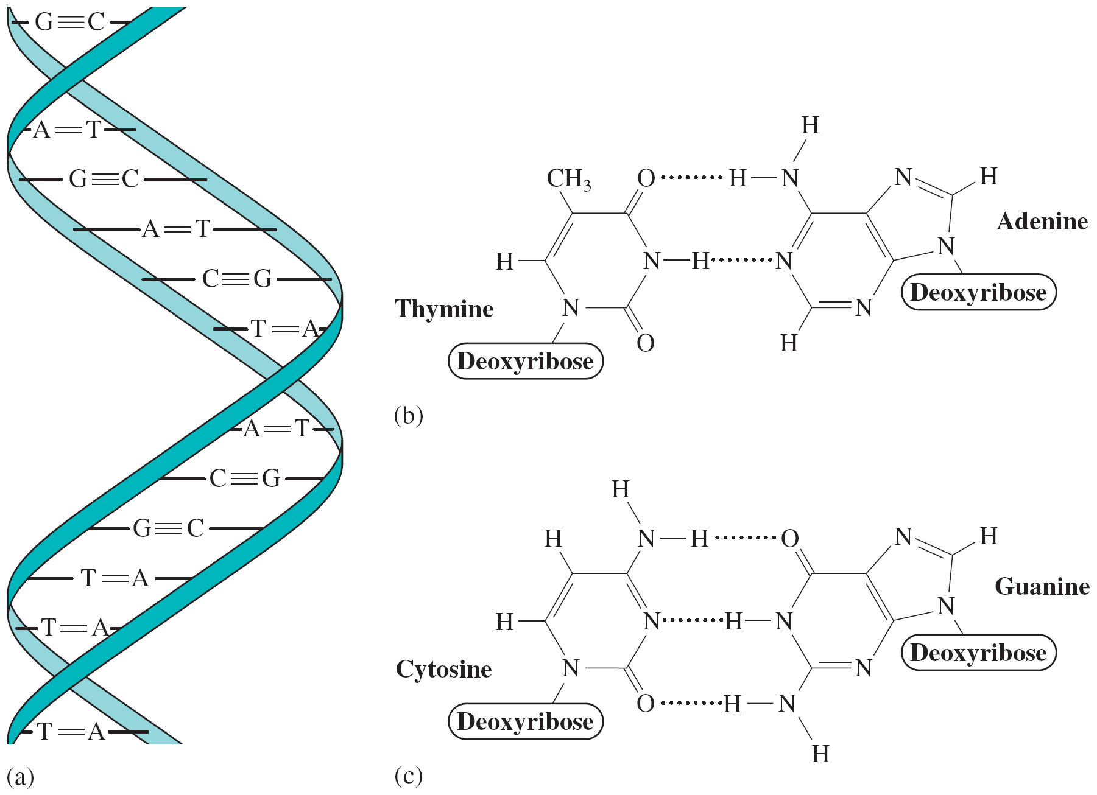
Hydrogen Bonding in DNA

