Slide 1
Transition Metals and Coordination Compounds
A Survey of The Transition Metals
The First-Row Transition Metals
Coordination Compounds
Structural Isomerism
Bonding in Complex Ions:
The Localized Electron Model
The Crystal Field Model
The Biologic Importance of Coordination Complexes
Metallurgy and Iron and Steel Production

Slide 2
Transition Metals and the Coordination Compounds
Transition metals often form vibrantly colored complexes. The minerals malachite (green), azurite (blue), and proustite (red) are some examples.
(credit left: modification of work by James St. John; credit middle: modification of work by Stephanie Clifford; credit right: modification of work by Terry Wallace)

Slide 3
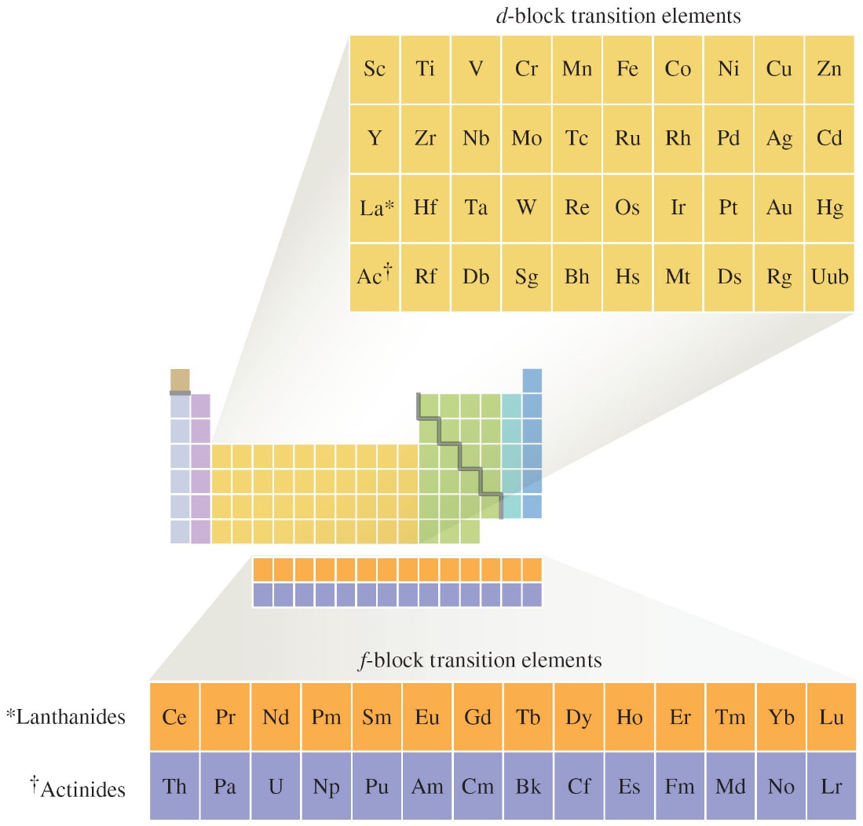
Transition Metals

Slide 4
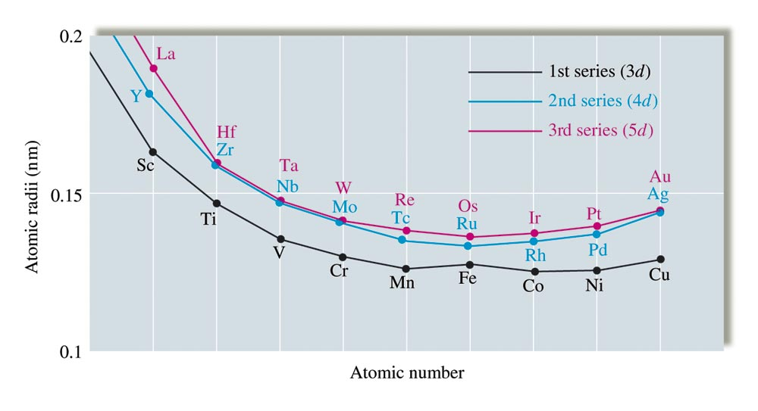
Atomic Radii of the 3d, 4d, and 5d Transition Series

Slide 5
Some Important Transition Metals
Titanium – excellent structural material: light weight, high tensile strength, and corrosion and heat resistance;
Vanadium – used mostly in alloys with other metals
Chromium – production of stainless steel
Manganese – forms hard steel (e.g. armored car plate)
Iron – most abundant and most important heavy metal
Cobalt – alloys with other metals (surgical instrument)
Nickel – stainless steel alloys, re-chargeable batteries
Copper – plumbing, electrical applications, and important alloys (e.g. bronze and brass)
Zinc – production of galvanized steel

Slide 6
Electron Configurations of Transition Metals
The valence shell of first row transition metals have the general electron configurations in the form of: [Ar] 4s²3d^{m}
Examples:
Sc: [Ar] 4s² 3d¹
Fe: [Ar] 4s² 3d⁶
Exceptions: Cr and Cu have the form: [Ar]4s¹3d^{m}
Cr: [Ar]4s¹3d⁵
Cu: [Ar]4s¹3d¹⁰

Slide 7
Electron Configurations of Transition Metal Cations
First-row transition metal ions do not have 4s electrons.
When an atom ionizes, its loses electrons from the outermost (valence) shell;
For first-row transition metals, the 4s electrons are ionized before 3d electrons.
Examples: Fe: [Ar] 4s²3d⁶
Fe²⁺: [Ar] 3d⁶
Fe³⁺: [Ar] 3d⁵

Slide 8
Ionic Compounds of Transition Metals
Many compounds of transition metals are paramagnetic – the transition metal ions have at least one unpaired electron in the valence shell;
Many compounds of transition metals are also colored – the compounds exhibit absorption in the visible region of the electromagnetic radiation spectrum

Slide 9
Typical Compounds of Chromium

Slide 10
Typical Compounds of Manganese

Slide 11
Typical Compounds of Iron

Slide 12
Typical Compounds of Cobalt

Slide 13
Typical Compounds of Nickel

Slide 14
Typical Compounds of Copper

Slide 15
Ionic Compounds of Transition Metals
Most transition metals exhibit more than one oxidation state.
Transition metal ions also form complex ions in aqueous solution;
Complex ions are ions composed of transition metal ions surrounded by ligands.

Slide 16
Complex Ions
Complex ions- ions composed of transition metal ions surrounded by ligands.
Ligands: anions or molecules containing at least one pair of nonbonding electrons (aka lone-pair);
Ligands are covalently bonded to the transition metal ions;
The number of covalent bonds the metal ion forms with ligands is called the coordination number (c.n.):
Coordination number = 4 and 6 are the most common;
c.n. = 2 and 8 also exist, but less common.

Slide 17
Coordination Numbers

Slide 18
Complex Ion of Co³⁺ and NH₃: Co(NH₃)₆³⁺
(NH₃ are ligand)

Slide 19
Coordination Compounds
These are compounds composed of complex ions and counterions;
Counterions are anions or cations needed to produce neutral compounds):
Examples:
[Co(NH₃)₅Cl]Cl₂
[Fe(en)₂(NO₂)₂]₂SO₄
NaCr(OH)₄

Slide 20
Ligands
Neutral molecules or anions covalently bonded to the metal ion in a complex ion.
Monodentate ligands – those form one bond to the metal ion;
Bidentate ligands – those form two bonds to the metal ion;
Polydentate ligands – those form more than two bonds to a metal ion

Slide 21
Monodentate Ligands
From neutral molecules and their names:
H₂O = aqua; NH₃ = ammine; CO = carbonyl;
From anions and their names:
F– = fluoro-; Cl– = chloro-; Br– = bromo-;
I– = iodo-; CN– = cyano-; OH– = hydroxo-;
NO₃– = nitrato; NO₂– = nitrito (if bonded to –O);
NO₂– = nitro (if bonded to –N);
CO₃^{2–} = carbonato;

Slide 22
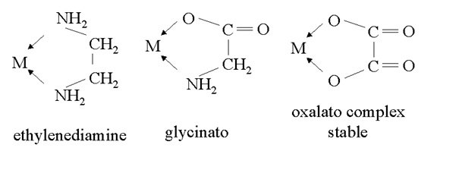
Bidentate Ligands
Ethylenediamine = H₂NCH₂CH₂NH₂
Oxalato = C₂O₄^{2–}
Bonding by bidentate ligands:

Slide 23
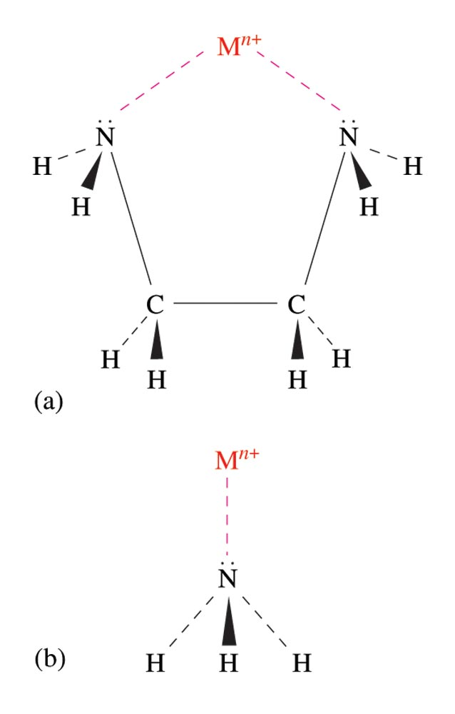
Mono- and Bi-dentate Bonding to Metal
The Bidentate Ligand Ethylenediamine and the Monodentate Ligand Ammonia

Slide 24
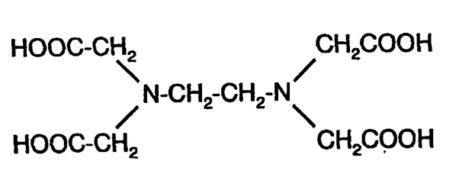
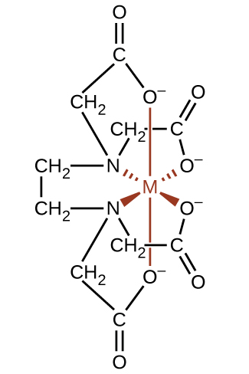
Polydentate Ligand and Its Bonding to Metal
EDTA = ethylenediamine tetraacetate

Slide 25
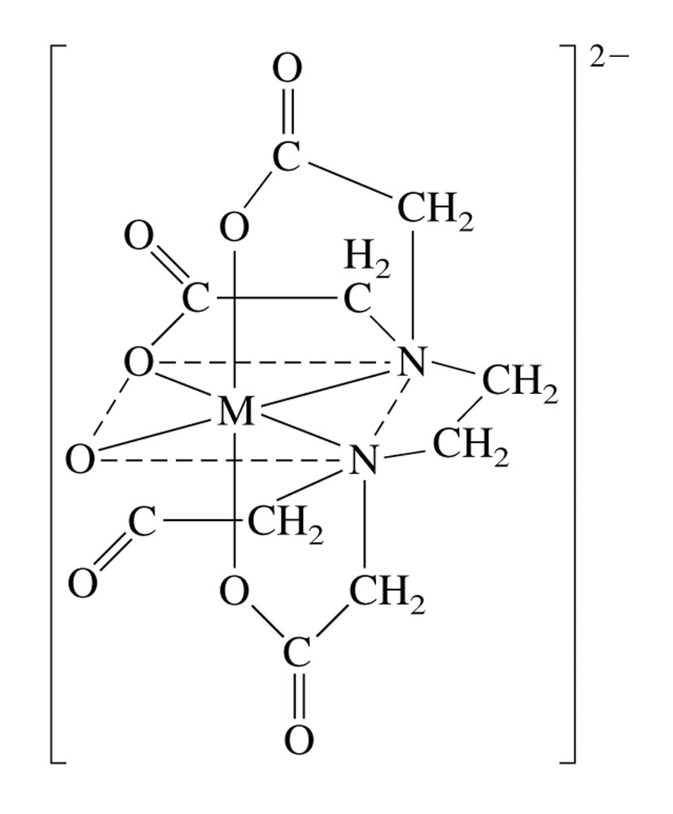
Complex ion of M²⁺ with EDTA

Slide 26
Naming Coordination Compounds
Cation is named before the anion.
For the complex ion, ligands are named before the metal ion.
For negatively charged ligands, an “o” is added to the root name of an anion (such as fluoro, bromo, chloro, etc.).
The prefixes mono-, di-, tri-, etc., are used to denote the number of simple ligands.
The oxidation state of the central metal ion is designated by a Roman numeral:
When more than one type of ligand is present, they are named alphabetically:
If the complex ion has a negative charge, the suffix “ate” is added to the name of the metal.

Slide 27
Naming Coordination Compounds
Example-1: consider the compound [Co(NH₃)₄Cl₂]Cl
The cation is a complex ion: [Co(NH₃)₄Cl₂]⁺ ;
Chloride ion, Cl– , is counter ion;
NH₃ and Cl– are ligands; (name: ammine and chloro, respectively)
Oxidation state on cobalt is +3; name: cobalt(III))
The name of compound is:
Tetraamminedichlorocobalt(III) chloride

Slide 28
Naming Coordination Compounds
Example-2: consider the compound K₃[Co(CN)₆]
The complex ion is anion: [Co(CN)₆]³⁻ ;
Potassium ion, K⁺ , is counter ion;
CN– ligand; (name: cyano)
Oxidation state on metal is +3; name: cobaltate(III)
The name of compound is:
Potassium hexacyanocobaltate(III)

Slide 29
Formula and Names for Selected Coordination Compounds
[Co(H₂O)₆]Cl₂: Hexaquacobalt(II) chloride
[Cr(NH₃)₄(H₂O)₂](NO₃)₃:
Tetraamminediaquachromium(III) nitrate
[Co(en)₂Cl₂]Cl:
Dichlorobis(ethylenediamine)cobalt(III) chloride

Slide 30
Formula and Names for Selected Coordination Compounds
K₄[Fe(CN)₆]: Potassium hexacyanoferrate(II)
Na₂[Zn(OH)₄]: Sodium tetrahydroxozincate(III)
Na[CuCl₂]: Sodium dichlorocuprate(I)
[Note: if the complex ion is an anion, the name of metal ion is modified by adding ending –ate and the Latin name of the metal (if exist) is used.]

Slide 31
Formula, Name and Structure of Compound of Ni²⁺, en and Cl–;
[Ni(en)₂Cl₂]
Dichlorobis(ethylenediamine)nickel(II)

Slide 32
Exercise-#1:
Name the following coordination compounds, and indicate the coordination number (cn) and oxidation state (os) of the transition metal in each compound.
[Cr(NH₃)₆](NO₃)₃
[Cu(NH₃)₄]SO₄
[Co(en)₂(NO₂)₂]Cl
[Co(NH₃)₆][Cr(CN)₆]
K[Cr(NH₃)₂Cl₄]
Na₃[CoCl₆]

Slide 33
Exercise-#2:
Write the formula for each of the following coordination compounds:
Hexaamminenickel(II) nitrate
Diamminedichloroplatinum(II)
Diaquabis(ethylenediamine)copper(II) sulfate
Potassium tetracyanoaurate(III)
Sodium hexafluorocobaltate(III)
Potassium dicyanoargentate(I)

Slide 34
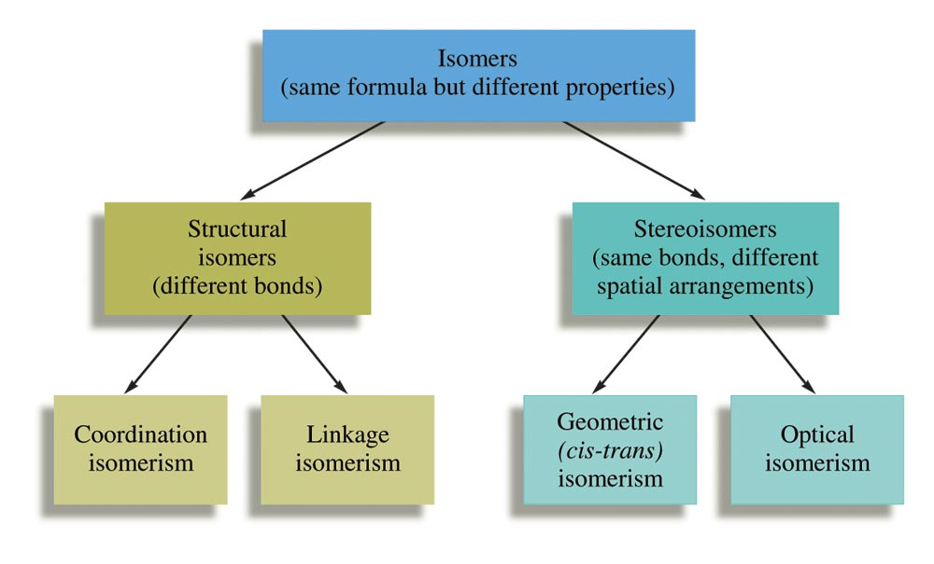
Isomerism in Coordination Compounds

Slide 35
Structural Isomerism
Coordination Isomers:
Composition of the complex ion varies.
[Cr(NH₃)₅SO₄]Br and [Cr(NH₃)₅Br]SO₄
Linkage Isomers:
Composition of the complex ion is the same, but the point of attachment of at least one of the ligands differs.

Slide 36
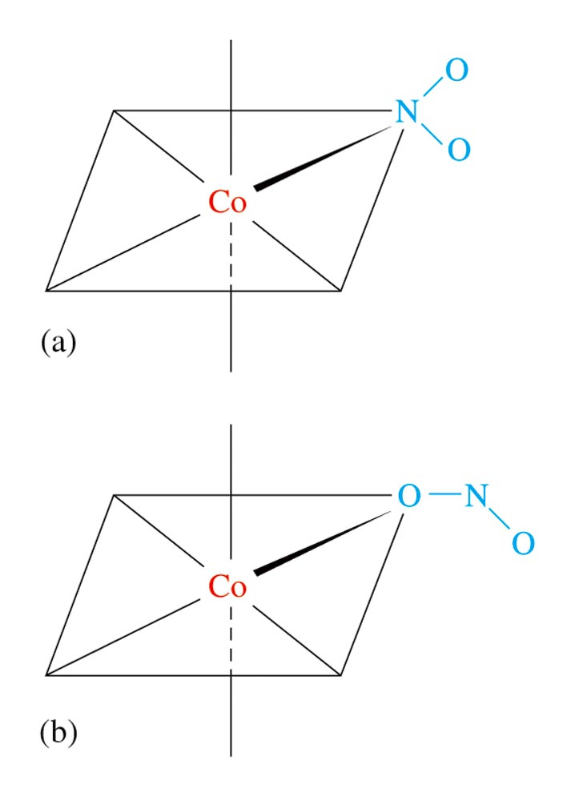
Linkage Isomerism of NO₂–
[Co(NH₃)₅(NO₂)]Cl₂
is orange
(a)
[Co(NH₃)₅(ONO)]Cl₂
is red
(b)

Slide 37
Stereoisomerism
Geometrical Isomerism (cis-trans):
Atoms or groups of atoms can assume different positions around a rigid structure.
Cis – same side (next to each other)
Trans – opposite sides (across from each other)

Slide 38
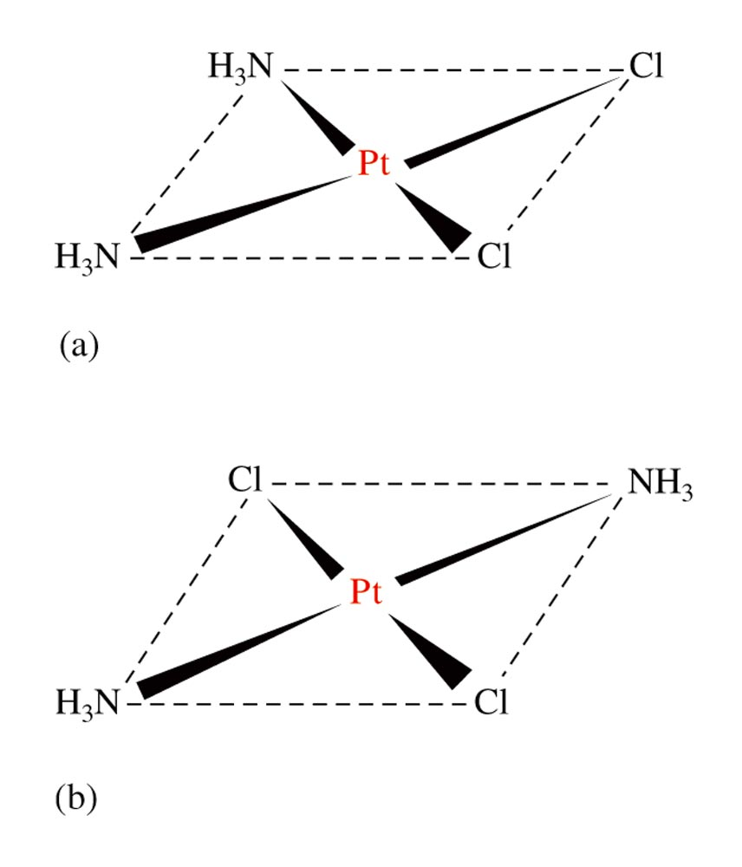
Geometrical Isomers for a Square Planar Compound
Geometrical (cis-trans) Isomerism for [Pt(NH₃)₂Cl₂] (a) cis isomer (b) trans isomer

Slide 39
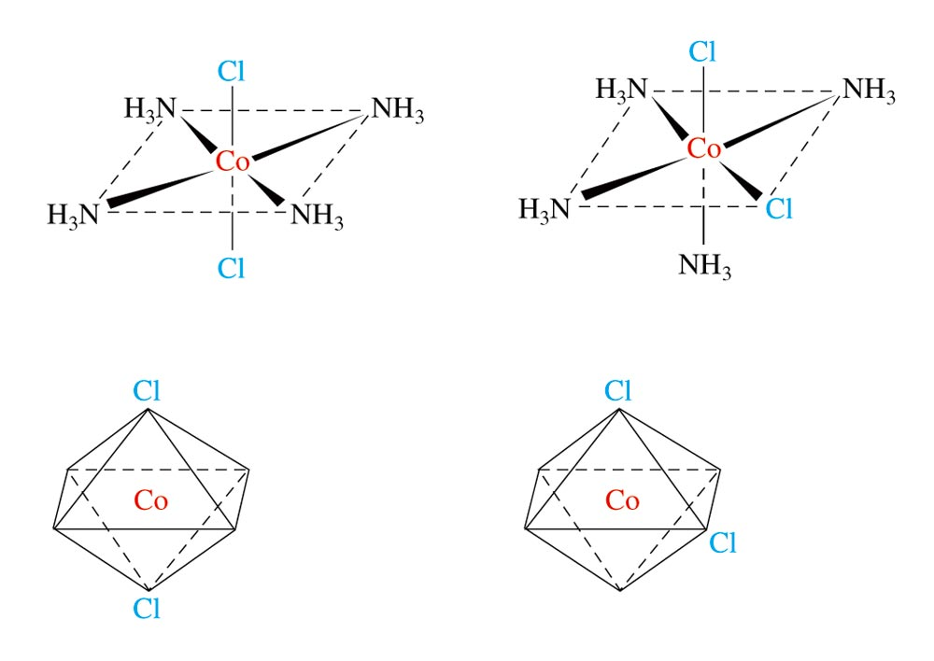
Geometrical (cis-trans) Isomerism for an Octahedral Complex Ion, [Co(NH₃)₄Cl₂]⁺

Slide 40
Stereoisomerism
Optical Isomerism:
Isomers have opposite effects on plane-polarized light.
If one isomer rotates plane-polarized light 10º clockwise, the other isomer will rotate it 10º counter-clockwise.

Slide 41
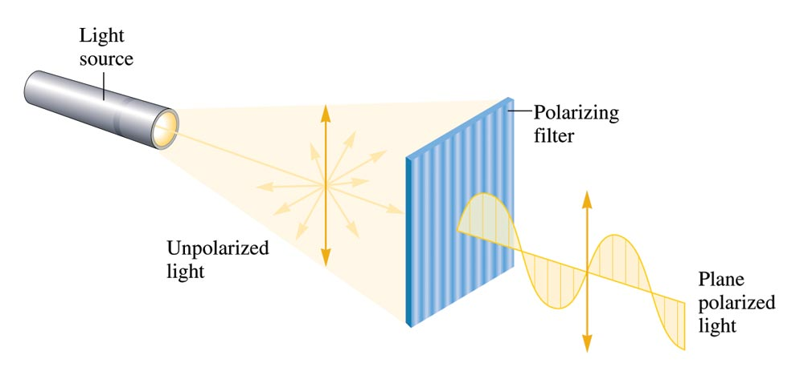
Unpolarized Light Consists of Waves Vibrating in Many Different Planes

Slide 42
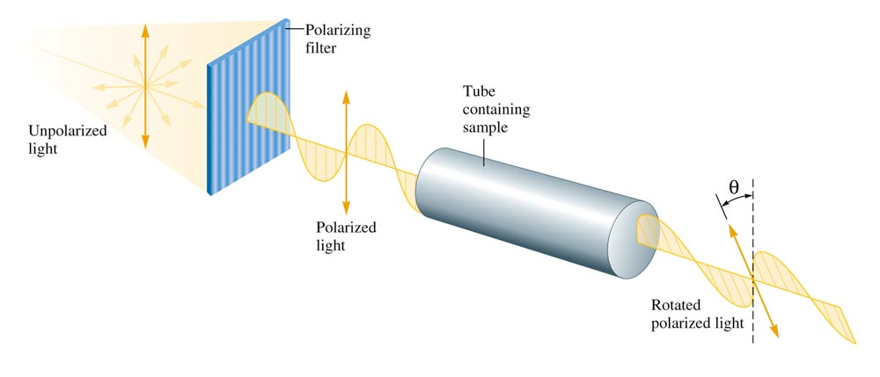
The Rotation of the Plane of Polarized Light by an Optically Active Substance

Slide 43
Optical Activity
Exhibited by chiral molecules – molecules that have nonsuperimposable mirror images.
Enantiomers – nonsuperimposable mirror image isomers.

Slide 44
A Human Hand Exhibits a Nonsuperimposable Mirror Image

Slide 45
Isomerism
Does the compound [Co(en)₂Cl₂]Cl exhibit geometrical isomerism?
Yes
Does it exhibit optical isomerism?
Trans form – No
Cis form – Yes
Explain.

Slide 46
Bonding in Complex Ions
The VSEPR model for predicting structure generally does not work for complex ions. However, we can assume:
All complex ions with a coordination number of 6 will have an octahedral arrangement of ligands.
Complexes with two ligands will be linear.
Complexes with a coordination number of 4 can be either tetrahedral or square planar.

Slide 47
Bonding in Complex Ions
2. The interaction between a metal ion and a ligand can be viewed as a Lewis acid–base reaction with the ligand donating a lone pair of electrons to an empty orbital of the metal ion to form a coordinate covalent bond.

Slide 48
Bonding in Complex Ion: The Localized Electron Model
The interaction between a metal ion and a ligand can be viewed as a Lewis acid-base reaction

Slide 49
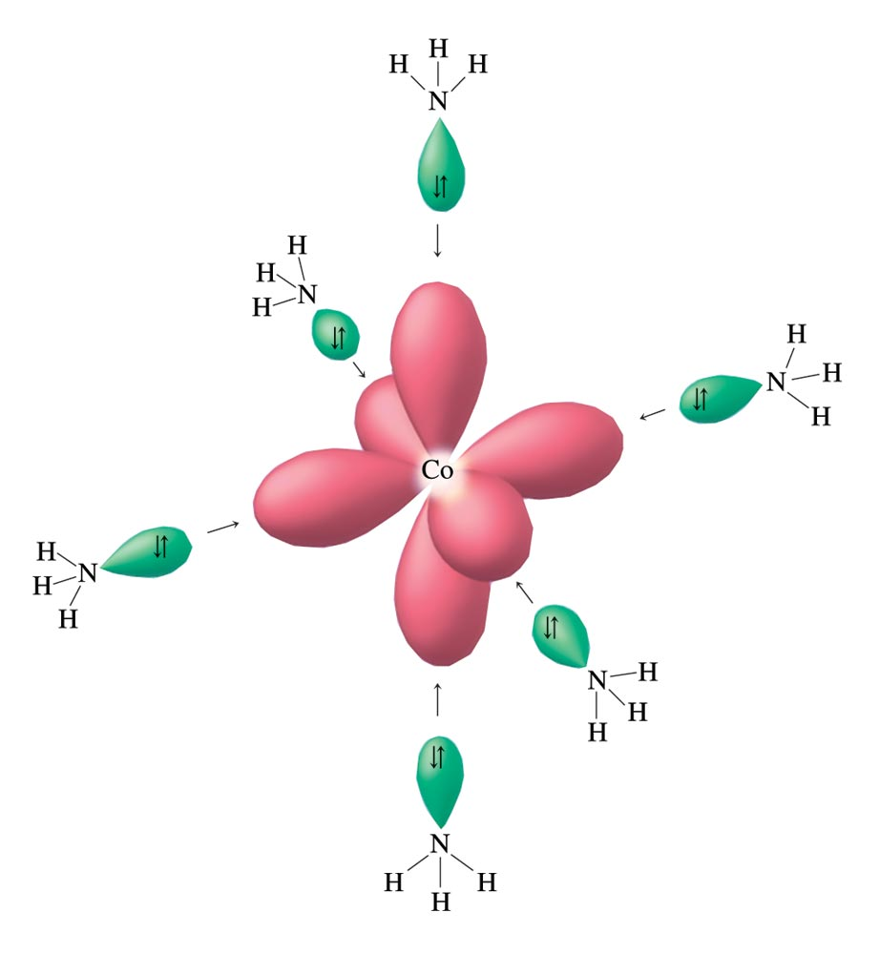
Bonding in Complex Ion: The Localized Electron Model
Co³⁺ ion has 6 empty d²sp³ hybrid orbitals; each can accept an electron pair from a NH₃ ligand.

Slide 50
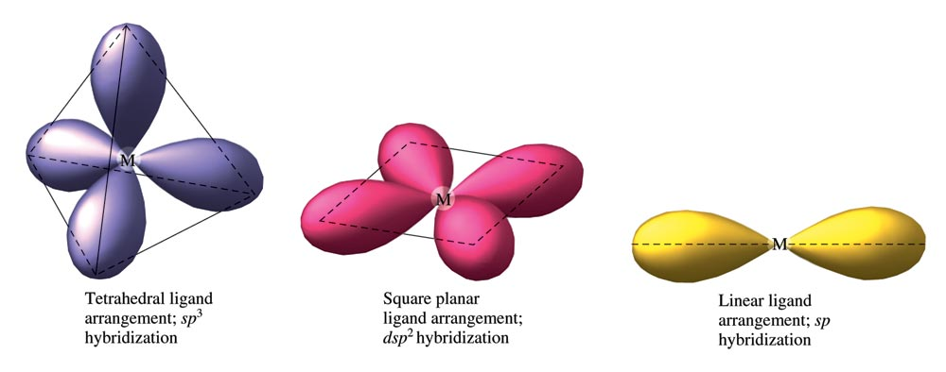
Bonding in Complex Ion: The Localized Electron Model
The diagram below indicates hybrid orbitals required for tetrahedral, square planar, and linear complex ions.

Slide 51
Bonding in Complex Ion: The Crystal Field Model
Model focuses on the splitting of d orbitals energy.
Assumptions
Ligands are negative point charges.
Metal–ligand bonding is entirely ionic:
strong-field ligands cause large splitting of d orbitals; resulting in low–spin state complexes;
weak-field ligands cause small splitting of d orbitals; resulting in high–spin state complexes;

Slide 52
Bonding in Complex Ion: The Crystal Field Model
Octahedral Complexes:
Assumption:
d_{x}2 _{– y}2 and d_{z}2 point their lobes directly at the point-charge ligands.
d_{xy}, d_{xz} and d_{yz} point their lobes between the point charges.

Slide 53
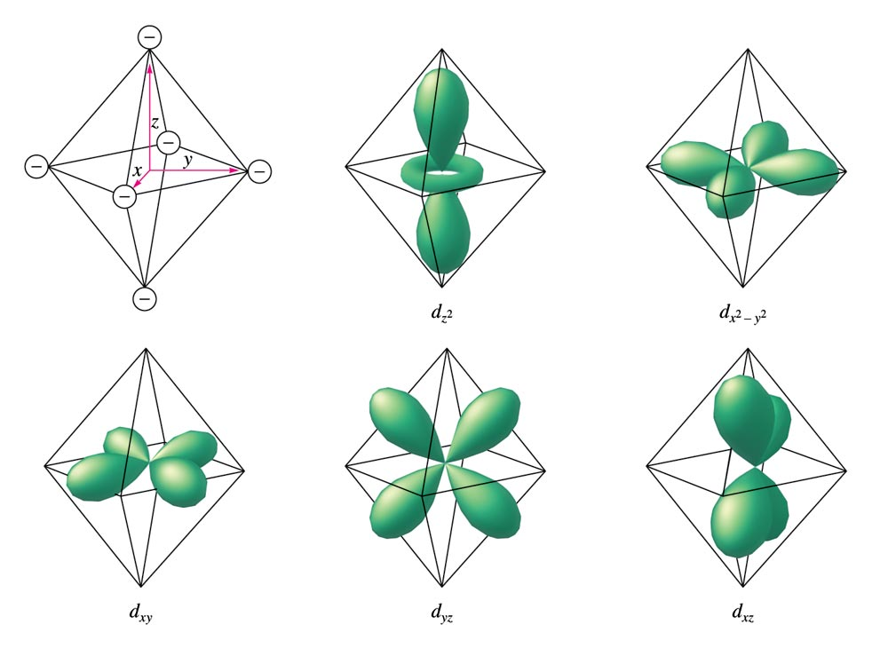
Bonding in Complex Ion: The Crystal Field Model
An Octahedral Arrangement of Point-Charge Ligands and the Orientation of the 3d Orbitals

Slide 54
Bonding in Complex Ion: The Crystal Field Model
Which Type of Orbital is Lower in Energy?
Because the negative point-charge ligands repel negatively charged electrons, the electrons will first fill the d orbitals farthest from the ligands to minimize repulsions.
The d_{xy}, d_{xz} and d_{yz} orbitals are at a lower energy in the octahedral complex than are the d_{x}2 _{– y}2 and d_{z}2 orbitals.

Slide 55
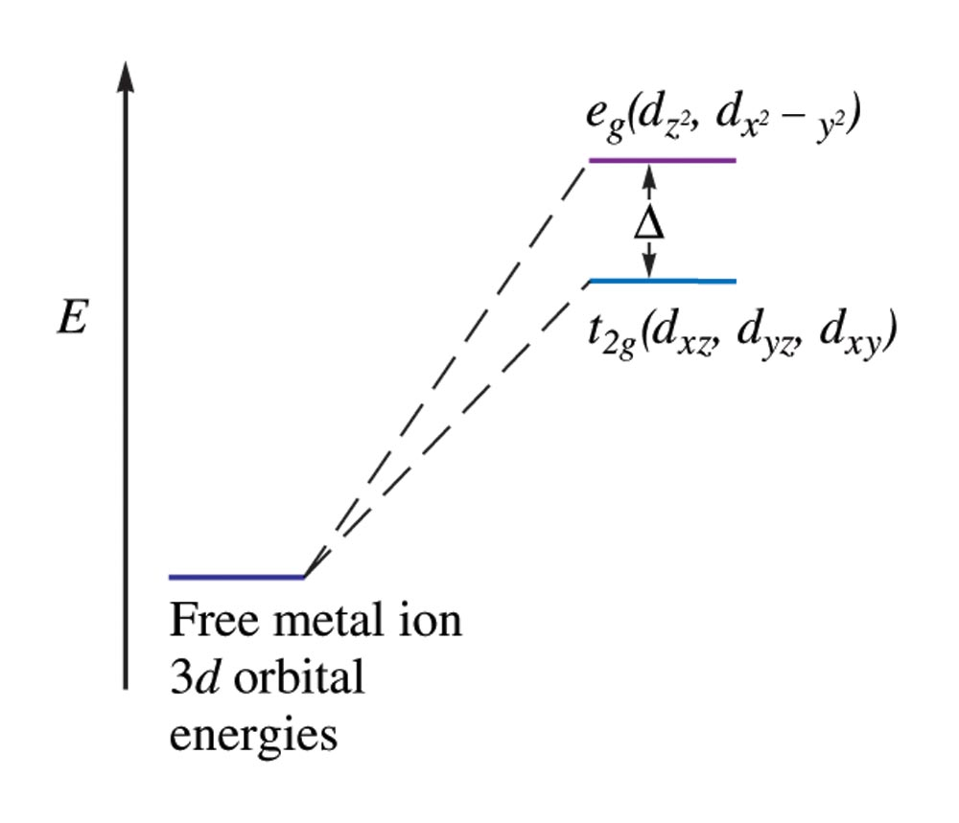
Bonding in Complex Ion: The Crystal Field Model
The Energies of the 3d Orbitals for a Metal Ion in an Octahedral Complex

Slide 56
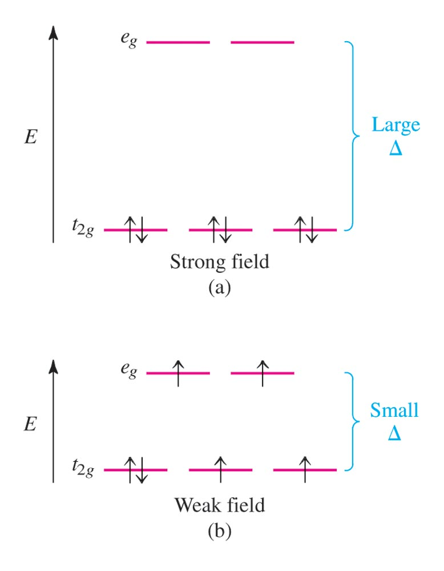
Bonding in Complex Ion: The Crystal Field Model
Possible Electron Arrangements in the Split 3d Orbitals in an Octahedral Complex of Co³⁺

Slide 57
Bonding in Complex Ion: The Crystal Field Model
Magnetic Properties
Strong–field (low–spin):
Yields the minimum number of unpaired electrons.
Weak–field (high–spin):
Gives the maximum number of unpaired electrons.
Hund’s rule still applies.

Slide 58
Bonding in Complex Ion: The Crystal Field Model
Spectrochemical Series of ligands:
Strong–field ligands to weak–field ligands.
(large splitting) (small splitting)
CN– > CO > NO₂– > en > NH₃ > H₂O > OH– > F– > Cl– > Br– > I–
Magnitude of d-orbital energy splitting for a given ligand increases as the charge on the metal ion increases.

Slide 59
Complex Ion Colors
When a substance absorbs certain wavelengths of light in the visible region, the color of the substance is determined by the wavelengths of visible light that remain.
Substance exhibits the color complementary to those absorbed.

Slide 60
Color Wheel

Slide 61
Complex Ion Colors
The ligands coordinated to a given metal ion determine the size of the d–orbital splitting, thus the color changes as the ligands are changed.
A change in splitting means a change in the wavelength of light needed to transfer electrons between the t_{2g} and e_{g} orbitals.

Slide 62
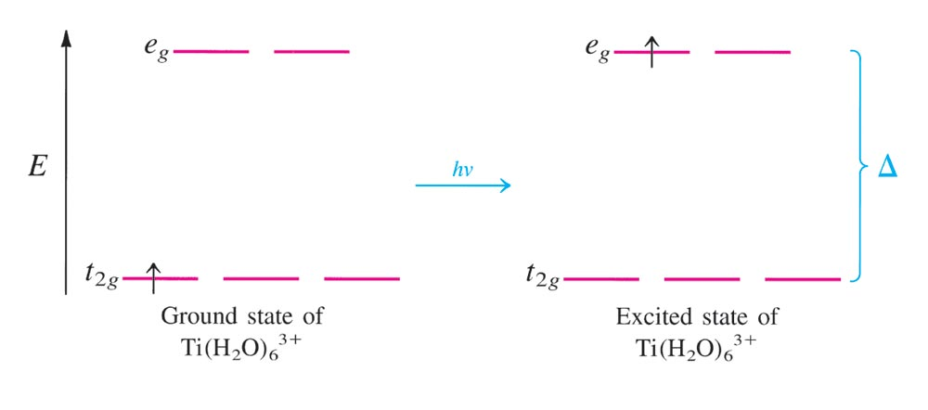
Absorption of Visible Light by the Complex Ion [Ti(H₂O)₆]³⁺

Slide 63
Crystal Field Model for Tetrahedral Complexes
None of the 3d orbitals “point at the ligands”.
Difference in energy between the split d orbitals is significantly less.
d–orbital splitting will be opposite to that for the octahedral arrangement.
Weak–field case (high–spin) always applies.

Slide 64
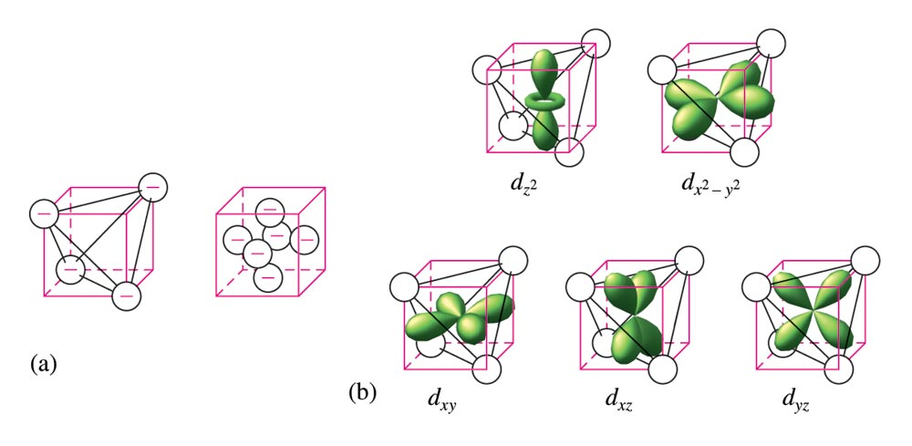
The d Orbitals in a Tetrahedral Arrangement of Point Charges

Slide 65
The Crystal Field Diagrams for Octahedral and Tetrahedral Complexes

Slide 66
The d-Orbital Energy Diagrams for Square Planar Complexes

Slide 67
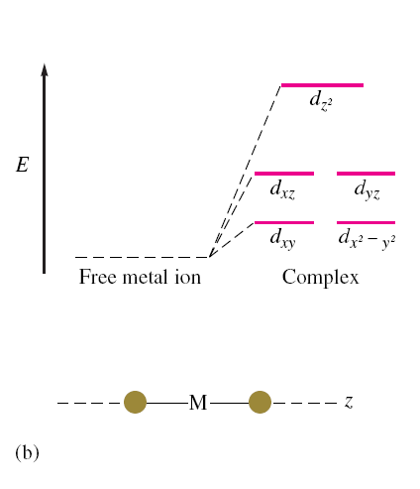
The d-Orbital Energy Diagrams for Linear Complexes where the ligands lie along the z-axis

Slide 68
The Biological Importance of Coordination Complexes
Metal ion complexes are used in humans for the transport and storage of oxygen, as electron-transfer agents, as catalysts, and as drugs.

Slide 69
First-Row Transition Metals and Their Biological Significance

Slide 70
Biological Importance of Iron
Plays a central role in almost all living cells.
Component of hemoglobin and myoglobin.
Involved in the electron-transport chain.

Slide 71
Biological Importance of Iron: The Heme Complex

Slide 72
Biological Importance of Iron: The Heme Complex
Myoglobin
The Fe²⁺ ion is coordinated to four nitrogen atoms in the porphyrin of the heme (the disk in the figure) and on nitrogen from the protein chain.
This leaves a 6th coordination position (the W) available for an oxygen molecule.

Slide 73
Biological Importance of Iron: The Heme Complex
Hemoglobin:
Each hemoglobin has two α chains and two β chains, each with a heme complex near the center.
Each hemoglobin molecule can complex with four O₂ molecules.

Slide 74
Metallurgy and Iron and Steel Production
Metallurgy:
The process of separating metal from their ores and preparing them for use.
Steps involved:
Mining
Pretreatment of the ore
Reduction to the free metal
Purification of the metal (refining)
Alloying

Slide 75
Pyrometallurgy of Iron
Carried in a blast furnace
The charge - a mixture of iron ore, coke, and CaCO₃ - fed into the top of the blast furnace;
A blast of hot air (~2000º C) is forced through the bottom of the furnace;

Slide 76
Pyrometallurgy of Iron
Reactions in the Blast Furnace:
2C(s) + O₂(g) → 2CO(g);
CaCO₃(s) → CaO(s) + CO₂(g);
CO₂(g) + C(s) → 2 CO(g);
3Fe₂O₃(s) + CO(g) → 2Fe₃O₄(s) + CO₂(g);
Fe₃O₄(s) + CO(g) → 3FeO(s) + CO₂(g);
FeO(s) + CO(g) → Fe(l) + CO₂(g);
Overall reaction: Fe₂O₃(s) + 3CO(g) → 2Fe(l) + 3CO₂(g);

Slide 77
Metallurgy and Iron and Steel Production
The Blast Furnace Used In the Production of Iron

Slide 78
Products of Blast Furnace
Pig iron – contains 3 – 4% C, some S, P, and Si;
Slag – a molten waste bi-product containing CaSiO₃

Slide 79
Purification of Pig Iron
carried out in the basic oxygen furnace;
Inorganic impurities (such as C, Si, P, and S) are converted to their oxides;
Volatile oxides, such as CO₂, SO₂ & P₄O₁₀ vaporize,
Nonvolatile oxides, such as SiO₂, reacts with CaO to form CaSiO₃, and are removed from molten iron;
Carbon steel, which contains 1-1.5% C, is produced in the basic oxygen furnace;
Other types of steels are also made by adding other metals such as Mn, Cr and Ni.

Slide 80
The Basic Oxygen Process for Steelmaking
Much faster.
Exothermic oxidation reactions proceed so rapidly that they produce enough heat to raise the temperature nearly to the boiling point of iron without an external heat source.

Slide 81
Types of Streel and Their Uses
Carbon steel (1.3%C & 98.7%Fe); hard steel;
used for tools;
Manganese steel (10-18% Mn, 90-82% Fe, & 0.5% C);
hard steel; resistance to wear;
used for railroad rails, safes, and armor plate;
Stainless steel (14-18% Cr, 7-9% Ni, 97-73% Fe & 0.2% C);
resistant to corrosion; used for Cutlery and instruments;
Nickel steel (2-4% Ni, 98-96% Fe & 0.5% C);
hard, elastic, and resistant to corrosion;
used for drive shafts, gears, and cables.

Slide 82
Metallurgy of Copper
Principal ores for copper: chalcocite (Cu₂S) and chalcopyrite (CuFeS₂);
Ores are roasted to remove sulfur;
2Cu₂S(s) + 3O₂(g) → 2Cu₂O(s) + 2SO₂(g)
2 Cu₂O(s) + Cu₂S(s) → 6Cu(s) + SO₂(g);
Resulting product is called copper matte, which contains 96-99% copper.
Further purification done by electrolysis.

Slide 83
Uses of Copper
Copper is used to make alloys, such as bronze and brass, and in coinage;
Nickel (the coin) composed of 75% Cu and 25% Ni;
Dimes and quarters: made of pure copper sandwiched between thin layers of Cu-Ni alloy, which contains 91.67% Cu.

Slide 84
Important Alloys of Copper

