Slide 1
The representative Elements: Groups 1A – 4A
A Survey of the Representative Elements
The Group 1A Elements
The Chemistry of Hydrogen
The Group 2A Elements
The Group 3A Elements
The Group 4A Elements

Slide 2
The representative Elements: Groups 5A – 8A
The Group 5A Elements
Chemistry of Nitrogen
Chemistry of Phosphorus
The Group 6A Elements
Chemistry of Oxygen
Chemistry of Sulfur
The Group 7A Elements
The Group 8A Elements

Slide 3
Representative Elements
The location of the representative metals is shown in the periodic table. Nonmetals are shown in green, metalloids in purple, and the transition metals and inner transition metals in yellow.

Slide 4
A Review of the Periodic Table
Representative elements:
Groups 1A – 8A (Groups 1, 2, 13-18)
The s and p blocks (subshells ns and np are filled)
Transition elements:
Groups 3B – 2B (Groups 3 – 12)
The d block (orbitals d are filled)

Slide 5
A Review of the Periodic Table
Lanthanides and Actinides:
Listed separately at bottom of the table
The f block (orbitals 4f and 5f are filled)
Metalloids:
Separate metals from nonmetals
B, Si, Ge, As, Sb, Te, Po, & At

Slide 6
The Trends of Nuclear Charge and Atomic Size
Effective nuclear charge: increases left-to-right and decreases top-to-bottom;
Atomic size: decreases left-to-right and increases top-to-bottom;

Slide 7
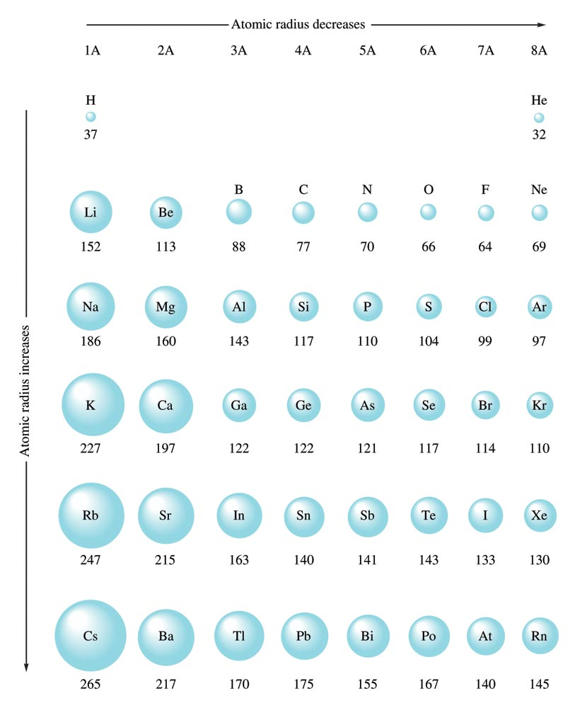
Atomic Radii of Some Representative Elements (in Picometers)

Slide 8
Trends in Ionization Energy
Ionization energy (I_{p}):
M(g) → M⁺(g) + e⁻
Ionization energy increases left-to-right and decreases top-to-bottom.
Li > Na > K > Rb > Cs;
F > Cl > Br > I;
C < O < N < F; (anomaly between N & O)
Li < B < Be < C; (anomaly between Be & B)

Slide 9
Electron Affinity = the energy that is released when an electron is added to a gaseous atom
+ Energy

Slide 10
Trends in Electron Affinity
Electron afffinity (EA) = energy released when an electron is added to gaseous atom;
Electron affinity increases from left to right and decreases from top to bottom:
C < N < O < F;
I < Br < F < Cl (anomaly between Cl and F. Why?)

Slide 11
Trends in Electronegativity
Electronegativity = the relative ability to compete for electrons;
In molecules, bonding electrons are drawn closer to the more electronegative atom.
Electronegativity increases from left to right and decreases top to bottom:
C < N < O < F;
I < Br < Cl < F;

Slide 12
Chemical Reactivity
Reactivity of metals decreases left-to-right and increases top-to-bottom.
Na > Mg > Al;
Li < Na < K;
Reactivity of nonmetals increases left-to-right and decreases top-to-bottom.
N < O < F;
F > Cl > Br;

Slide 13
Concept Check
Which atom is larger, Na or Cl? Why?
Na Cl
Notes:
Na should be the larger atom because the electrons are not bound as tightly due to a smaller effective nuclear charge.

Slide 14
Concept Check
Which atom is larger, Li or Cs? Why?
Li Cs
Notes:
Cs should be the larger atom because of the increase in orbital sizes in successive principal quantum levels (to accommodate more electrons).

Slide 15
Concept Check
Which is more reactive and why?
Li or Cs?
Na or Al?
F or I?
P or Cl?
Notes:
Cs should be the larger atom because of the increase in orbital sizes in successive principal quantum levels (to accommodate more electrons).

Slide 16
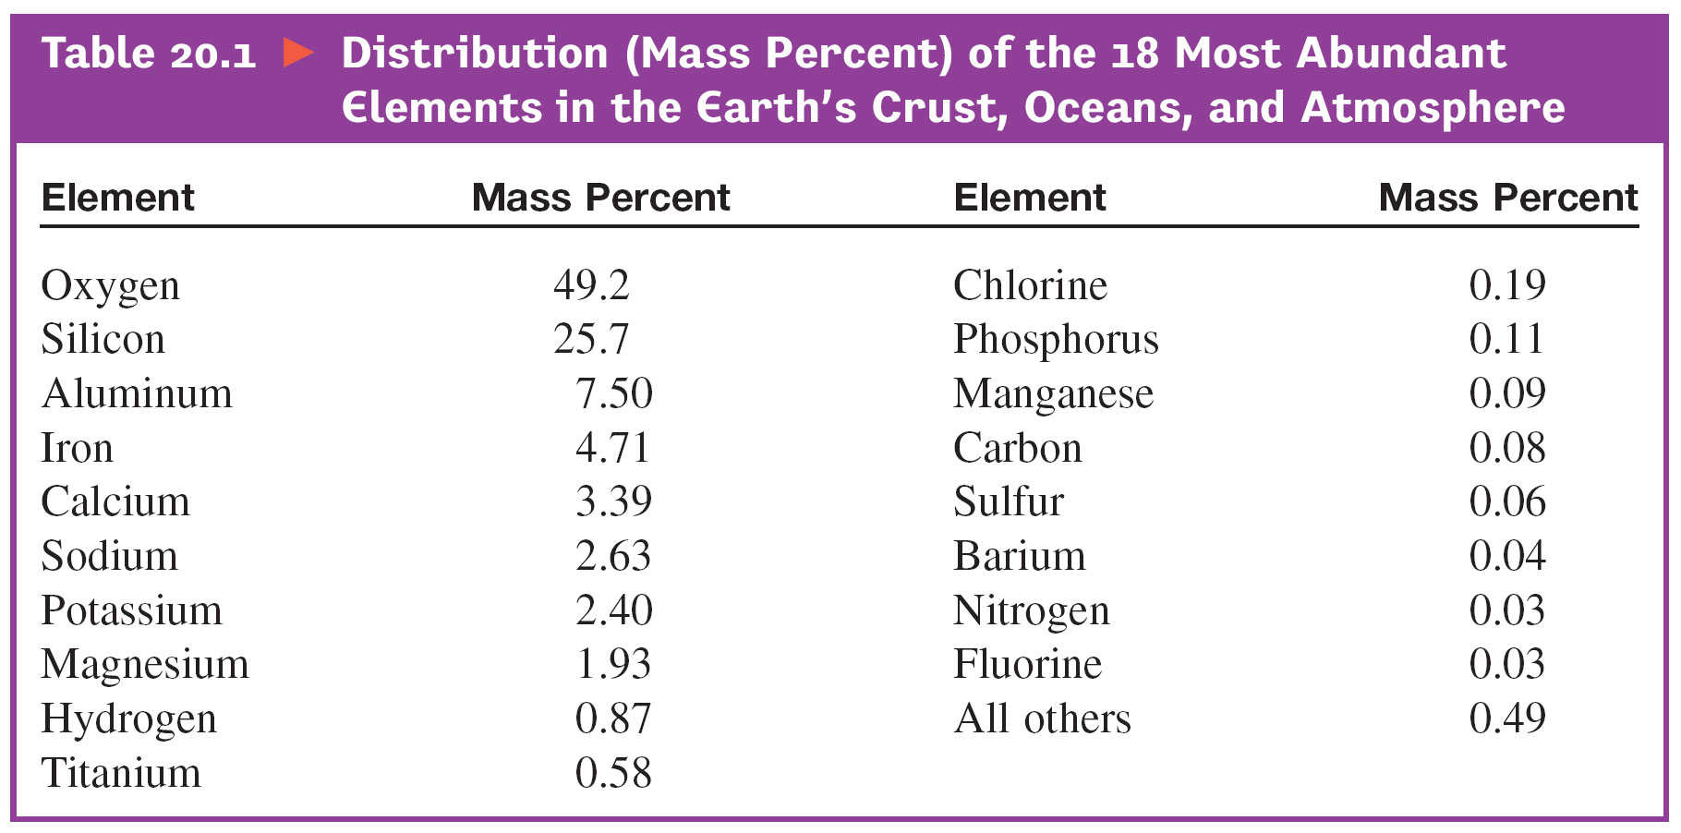
Distribution of 18 Most Abundant Elements

Slide 17
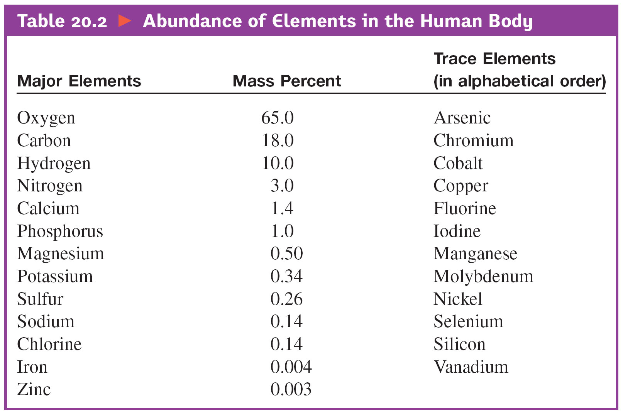
Abundance of Elements in the Human Body

Slide 18
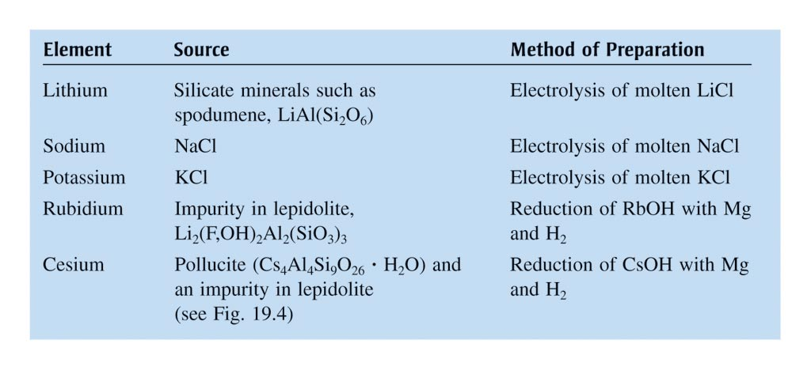
Alkali Metals: Sources and Methods of Preparation

Slide 19
Group 1A Oxides
Reactions of alkali metals with oxygen gas do not produce the same oxides:
4Li(s) + O₂(g) → 2Li₂O(g) (simple oxide)
2Na(s) + O₂(g) → Na₂O₂(s) (peroxide)
K(s) + O₂(g) → KO₂(s) (superoxide)

Slide 20
Production of Alkali Metals
Li, Na and K are produced by electrolysis of molten chlorides (LiCl, NaCl and KCl).
K is also produced by displace method using molten KCl and sodium vapor:
KCl(l) + Na(g) → K(g) + NaCl(l)

Slide 21
Production of Sodium by Electrolysis of Molten NaCl
Pure sodium metal is isolated by electrolysis of molten sodium chloride using a Downs cell. It is not possible to isolate sodium by electrolysis of aqueous NaCl solutions, because hydrogen ions are more easily reduced than are sodium ions; as a result, hydrogen gas forms at the cathode instead of the desired sodium metal. The high temperature required to melt NaCl means that liquid sodium metal forms.

Slide 22
Important Reactions of Alkali Metals
4Li(s) + O₂(g) → 2Li₂O(s)
2Na(s) + O₂(g) → Na₂O₂(s)
K(s) + O₂(g) → KO₂(s)
6M(s) + N₂(g) → 2M₃N(s)
2M(s) + H₂O(l) → MOH(aq) + H₂(g)
2M(s) + X₂(g) → 2MX(s)
(M = Li, Na, K, Rb, Cs; X = F, Cl, Br, I)

Slide 23
Exercise-#1
Complete and balance each of the following equations:
Na(s) + H₂O(l) → ?
Li(s) + N₂(g) → ?
KO₂(s) + CO₂(g) → ?

Slide 24
Exercise-#2
Predict the products formed by the following reactants:
Na₂O₂(s) + H₂O(l) →
NaOH(aq) + H₂O₂(l)
Notes:
NaOH(aq) + H₂O₂(aq)

Slide 25
Uses of Lithium and Lithium Compounds
Lithium mainly used to make lithium batteries;
LiCl is used in air-conditioning units as dehumidifier;
Li₂CO₃ is used in porcelain enamel, manufacture of strong (pyrex) glasses, and as medication for manic depression;

Slide 26
Important Compounds of Sodium
NaCl:
As an ingredient in food – Na⁺ is essential for electrolyte balance;
Production of sodium metal by electrolysis of molten NaCl;
2NaCl(l) → 2Na(s) + Cl₂(g)
Production of NaOH by electrolysis of aqueous NaCl;
2NaCl(aq) → 2NaOH(aq) + H₂(g) + Cl₂(g)

Slide 27
Important Compounds of Sodium
NaHCO₃ – baking soda: used for making cookies and cakes, and in fire-extinguishers
Na₂CO₃ – used in manufacture of ground glasses and as industrial bases;
NaOH – used in manufacture of bleach, as a strong base, and as drain cleaners;
The manufacture of household bleach:
Cl₂(g) + 2NaOH(aq) → NaOCl(aq) + NaCl(aq) + H₂O(l)

Slide 28
Important Compounds of Potassium
K⁺ is essential for nervous system;
K₂O is important component in fertilizers;
KO₂ is used in confined places like submarines for removal of CO₂ and production of O₂:
4KO₂(s) + 2CO₂(g) → 2K₂CO₃(s) + 3O₂(g)

Slide 29
Hydrogen
Most abundant element in the universe, but makes up <1% (by mass) on Earth crust.
Isotopes of hydrogen:
Hydrogen (¹H) - has no neutron; most abundant
Deuterium (²H) - has one neutron
Tritium (³H) – has 2 neutrons; radioactive (half-life ~ 12.3 yrs)

Slide 30
Isotope Effects
Deuterium exhibits significant isotope effects on chemical and physical properties.
Freezing points: H₂O (0.00ºC); D₂O (3.81 ºC)
Boiling points: H₂O (100.0ºC); D₂O (101.42ºC)
Density at 25ºC (g/mL):
H₂O (0.997); D₂O (1.104)

Slide 31
Hydrides
Binary compounds containing hydrogen:
Ionic hydrides: (hydrogen + reactive metals)
Examples: LiH, CaH₂
Covalent hydrides:
(hydrogen + other nonmetals)
Examples: H₂O, CH₄, NH₃)
Metallic (interstitial) hydrides:
H₂ gas in certain transition metal crystals

Slide 32
Production of Hydrogen
Laboratory preparation of hydrogen gas:
Mg(s) + 2HCl(aq) → MgCl₂(aq) + H₂(g)
Zn(s) + H₂SO₄(aq) → ZnSO₄(aq) + H₂(g)
Industrial production method by steam-reformation of hydrocarbon:
CH₄(g) + H₂O(g) → CO(g) + 3H₂(g); ΔH = 205 kJ
CO(g) + H₂O(g) → CO₂(g) + H₂(g); ΔH = -41 kJ

Slide 33
Uses of Hydrogen
Production of Ammonia using the Haber process:
N₂(g) + 3H₂(g) → 2NH₃(g)
Production of Methanol:
CO(g) + 2H₂(g) → CH₃OH(l)
Hydrogenation of vegetable oil:
Vegetable oil + H₂(g) → “Crisco” and Margarine
Manufacture of hydrochloric acid
H₂(g) + Cl₂(g) → 2HCl(g) → HCl(aq)

Slide 34
Exercise-#3
Predict the products formed by the following reactants:
LiH(s) + H₂O(l)
→ H₂(g) + LiOH(aq)
Notes:
H₂(g) + LiOH(aq)

Slide 35
Alkaline Earth Metals
Be, Mg, Ca, Sr, Ba, and Ra (radioactive);
Very reactive elements;
Valence-shell electron configuration: ns²
Cations = M²⁺, has noble gas configuration;
Practical importance:
Ca²⁺ and Mg²⁺ are essential to life;
Mg is a component in light alloys

Slide 36
Occurrence and Preparation
Abundance in Earth’s crust:
Calcium and magnesium rank 5th and 6th, respectively.
Magnesium found in the ocean (~0.055 M) and in MgCO₃ (dolomite)
Seawater important source of Mg;
Calcium found in limestone and sea shells (CaCO₃) – most abundant mineral on Earth
Mg and Ca are prepared by electrolysis of the molten MgCl₂ and CaCl₂, respectively.

Slide 37
Compounds of Alkaline Earth Metals
Except for Be, all oxides and halides of alkaline Earth metals are ionic compounds;
Beryllium forms covalent compounds;
Except for BeO, all oxides of alkaline Earth metals are basic – forms strong basic solutions;
BeO is amphoteric;

Slide 38
Extraction of Mg from Seawater

Slide 39
Electrolysis of Molten MgCl₂

Slide 40
Extraction of Mg from Seawater
Mg²⁺(aq) + CaO(s) + H₂O(l) → Mg(OH)₂(s) + Ca²⁺(aq)
Mg(OH)₂(s) + 2HCl(aq) → MgCl₂(aq) + 2H₂O(l)
MgCl₂(aq) → MgCl₂(s) → MgCl₂(l)
MgCl₂(l) electrolysis → Mg(s) + Cl₂(g);

Slide 41
Extraction of Calcium from CaCO₃
CaCO₃(s) + 2HCl(aq) → CaCl₂(aq) + H₂O(l) + CO₂(g);
CaCl₂(aq) → CaCl₂(s) → CaCl₂(l);
CaCl₂(l) electrolysis → Ca(s) + Cl₂(g)

Slide 42
Uses of Some Alkaline Earth Metals
Beryllium:
a component in alloys for making tough springs and non-sparking tools
Used as X-ray tube window;
A neutron source in nuclear reactor;

Slide 43
Uses of Some Alkaline Earth Metals
Magnesium is used:
in the manufacture of light-weight alloys for aircraft body and parts;
as reducing agent in the extraction of silicon, titanium and beryllium;
in Grignard reagents for organic synthesis;
An ingredient in fireworks and warning flare;
Calcium is also used as reducing agent in the extraction of other metals, such as Sc and W;

Slide 44
Important Compounds of Magnesium
Mg²⁺ is essential to life;
Many enzymes require Mg²⁺; Mg²⁺ is an essential component of chlorophyll;
MgO is a component in ceramic and used in refractory furnace lining;
Mg(OH)₂ is active component of antacid “Milk of Magnesia”
MgSO₄ found in fertilizers and food supplements

Slide 45
Important Compounds of Calcium
Like Mg²⁺, Ca²⁺ is essential to life;
In cell physiology, movements of Ca²⁺ in and out of cytoplasm function as signal for many cellular processes;
Ca₅(PO₄)₃(OH) - in teeth and bone structures;
CaCO₃ – forms protective coverings, as in egg and sea shells;
CaCO₃ (limestone) - most abundant mineral;
Pure CaCO₃ are used as fillers in paint, toothpaste, paper, plastics, etc.;
the source for calcium metal and quicklime:
Calcination: CaCO₃(s) → CaO(s) + CO₂(g)

Slide 46
Important Compounds of Calcium
CaO – also called quicklime, uses:
important ingredient of Portland cement;
industrial base;
extraction of Mg from seawater;
in metallurgy – as base in steel production;
As scrubber to remove toxic gas SO₂ from industrial “flu-gas”:
CaO(s) + SO₂(g) → CaSO₃(s)

Slide 47
Ca²⁺ & Mg²⁺ in Water
Ca²⁺ and Mg²⁺ causes water hardness;
Soaps do not form leather due to formation of precipitates with Ca²⁺ & Mg²⁺;
These ions can be removed by ion-exchange process.
Cation-exchange resins – large molecules that have many -SO₃⁻ sites, with Na⁺ as counter ions;
Ca²⁺ and Mg²⁺ bound more strongly to anionic sites and displace Na⁺.

Slide 48
A Schematic Representation of a Typical Cation Exchange Resin

Slide 49
Exercise-#4
Complete and balance the following equations:
Mg(s) + HCl(aq) → ?
MgH₂(s) + H₂O(l) → ?
Ca(s) + H₂O(aq) → ?
CaO(s) + SO₂(g) → ?

Slide 50
Group 3A
B, Al, Ga, In, and Tl;
Valence-shell electron configuration: ns² np¹
Group 3A elements show increasing metallic character going down the group.
Boron: a metalloid, forms covalent network solid, and highest melting point in the group

Slide 51
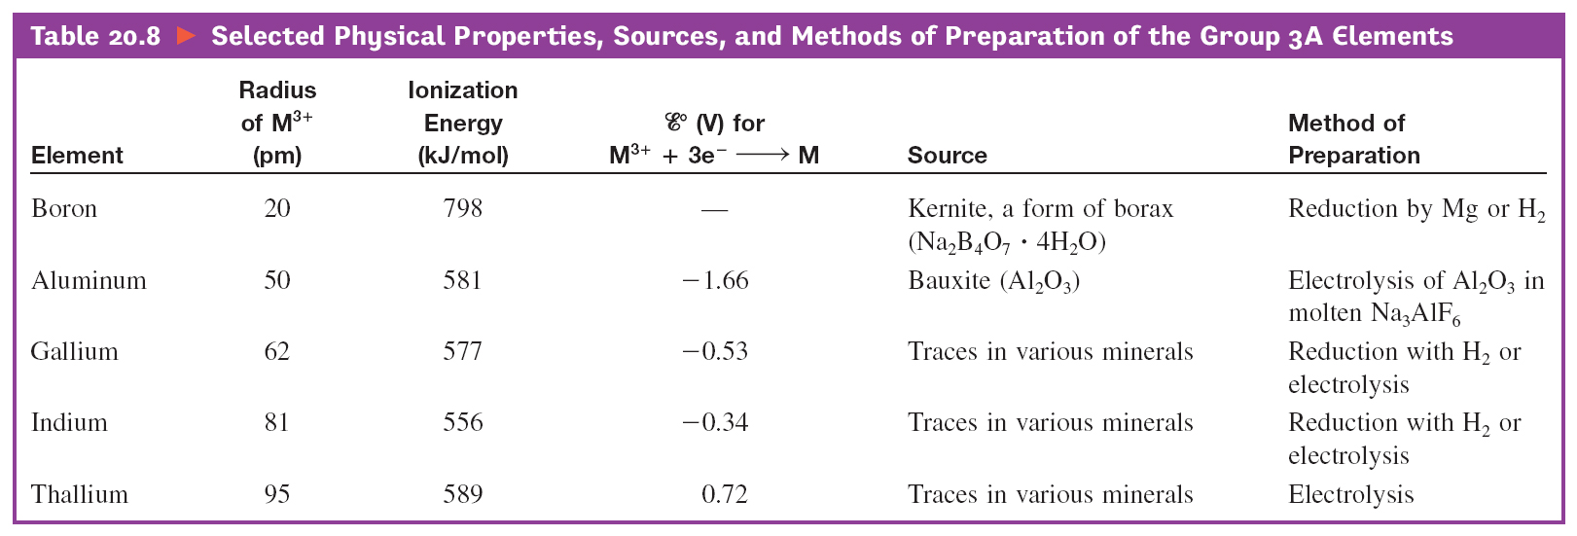
Some Physical Properties, Sources, and Methods of Preparation

Slide 52
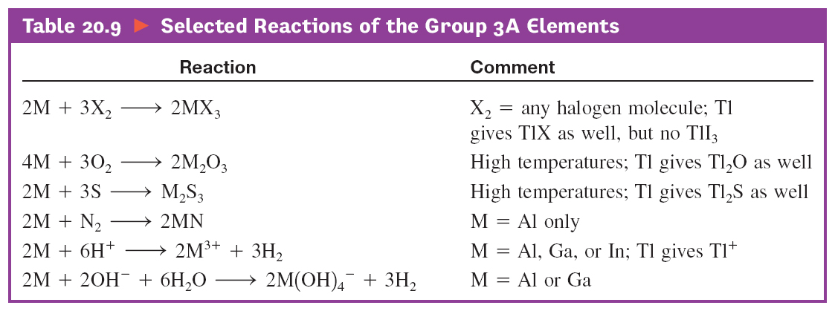
Some Important Reactions

Slide 53
Properties of Boron (1s² 2s² 2p¹)
A metalloid; forms covalent network solid; highest melting point in the group, and the least reactive
All boron compounds are covalent molecules;
Boron molecules, such as BF₃, have incomplete octet and acts as Lewis acid, example:
BF₃ + :NH₃ → F₃B:NH₃
Boron hydrides acquire octet by forming H-bridges;
Boron oxide, B₂O₃, forms weak boric acid, B(OH)₃;

Slide 54
Aluminum
Electron configuration: 1s² 2s² 2p⁶ 3s² 3p¹
or [Ar] 3s² 3p¹
Third most abundant element (and most abundant metal) in the Earth’s crust;
Most important metal of Group 3A;
US annual production: over 5 millions tons;

Slide 55
Aluminum Production
Extracted from bauxite, Al₂O₃⋅nH₂O;
Produced by the Hall-Heroult process - electrolysis of molten Al₂O₃-Na₃AlF₆ (cryolite) mixture at ~ 960ºC
Aluminum production is an energy intensive process
Energy consumption: ~ 54 MJ/kg Al (~3% of electrical energy supply)
Re-cycling saves up to 95% of this energy;
(Re-cycle an aluminum can and power your desk-top monitor up to 3 hours)

Slide 56
Production of Aluminum

Slide 57
Production of Aluminum
An electrolytic cell is used for the production of aluminum. A molten mixture of cryolite, bauxite and calcium fluoride is electrolyzed, which produces aluminum metal at the cathode, and oxygen, carbon monoxide, and carbon dioxide at the anode.

Slide 58
Importance of Aluminum
Lightweight metal (density = 2.70 g/cm³);
Forms strong, lightweight alloys with copper and magnesium for aircraft bodies and parts;
High resistance to corrosion - extensively used to make beverage containers (soda drinks cans);
Also used as reducing agent in the fuel during space shuttle launching.

Slide 59
Chemical Properties of Aluminum
Reactive metal, readily oxidized by atmospheric O₂ to form Al₂O₃;
Al₂O₃ forms protective coating (an anodic protection) that prevents further corrosion of the metal;
Al₂O₃ is amphoteric - reacts with both strong acids & bases;
Aluminum reacts with halogens to form AlX₃;
Al₂O₃ and AlF₃ are strictly ionic compounds;
Other halides are ionic with covalent characteristics.

Slide 60
Reactions of Aluminum
With strong acids:
2Al(s) + 6 HCl(aq) → 2AlCl₃(aq) + 3H₂(g);
2Al(s) + 3H₂SO₄(aq) → Al₂(SO₄)₃(aq) + 3H₂(g);
2Al(s) + 2HNO₃(aq) → Al₂O₃(s) + 2NO(g) + H₂O(l)
(The third reaction does not occur completely because the oxide forms protective coating to prevent further reaction.)
With a strong base:
2Al(s) + 6H₂O(l) + 2NaOH(aq) → 2NaAl(OH)₄(aq) + 3H₂(aq);

Slide 61
Aluminum Halides

Slide 62
Important Compounds of Aluminum
Al₂O₃ – source of aluminum metal and forms protective coating to the metal to prevent corrosion;
Al₂(SO₄)₃ – most important industrial compound;
use in municipal water treatment plants;
Prepared by reaction of H₂SO₄ with Al₂O₃ or Al(OH)₃:
Al₂O₃(s) + 3H₂SO₄(aq) → Al₂(SO₄)₃(s) + 3H₂O(l)
2Al(OH)₃(s) + 3H₂SO₄(aq) → Al₂(SO₄)₃(s) + 6H₂O(l)

Slide 63
Exercise-#5
Classify the following oxides as acidic, basic or amphoteric.
B₂O₃ Al₂O₃ In₂O₃
Balance the following equations:
B(s) + HNO₃(aq) → B₂O₃(s) + NO(g) + H₂O
Al(s) + H₂SO₄(aq) → Al₂(SO₄)₃(aq) + H₂(g)
Al₂O₃(s) + HCl(aq) → AlCl₃(aq) + H₂O(l)

Slide 64
Group 4A (vsec: ns² np²)
Contains: a nonmetal (C), two metalloids (Si & Ge), and two metals (Sn & Pb);
Carbon exists in 3 allotropic forms: graphite, diamond, and the “bucky-ball”.
Graphite has sp² hybridization;
Graphite is soft and conduct electric current;
Diamond contains sp³ hybridization and forms covalent network solids; does not conduct electricity;
Diamond is the hardest material on Earth.

Slide 65
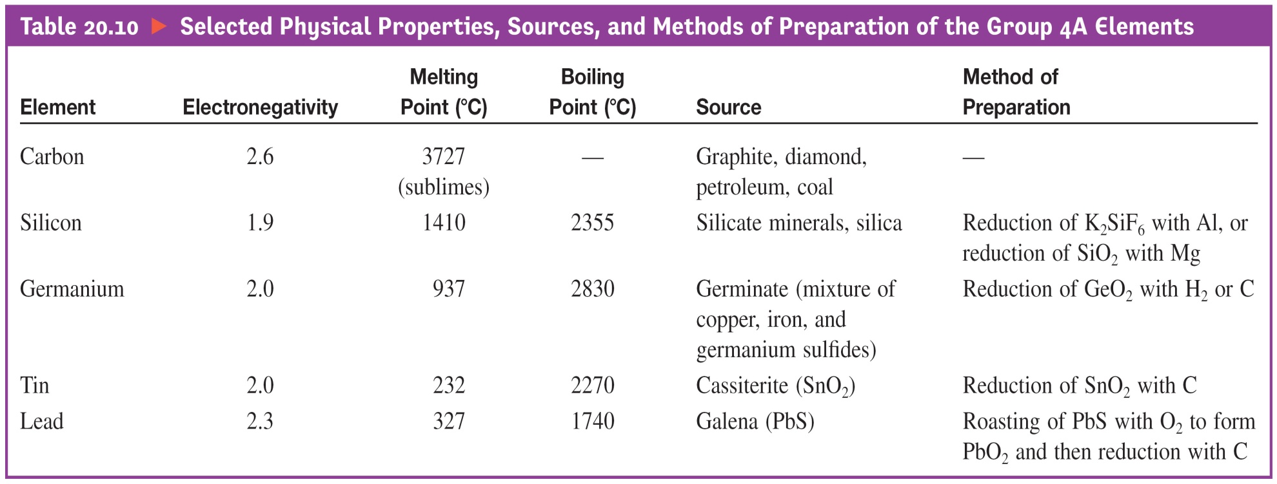
Some Physical Properties, Sources, and Methods of Preparation

Slide 66
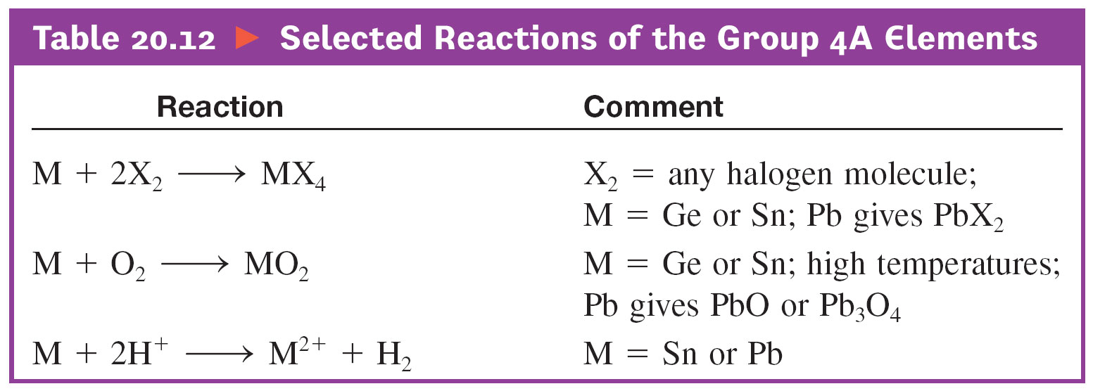
Some Important Reactions

Slide 67
Group 4A
Contains two most important elements on earth: carbon and silicon.
Both form four covalent bonds to nonmetals.
CH₄ and SiF₄

Slide 68
Group 4A (14): Carbon and Silicon

Slide 69
Carbon: 1s² 2s² 2p²
Most important element on Earth – forms the basic skeletal structures of all living things;
Carbon forms strong covalent bonds with many elements and with itself;
Carbon forms sp, sp², and sp³ hybridizations;
In sp hybridization, each carbon forms 2 σ- and 2 π- bonds; example in H―C≡C―H
In sp², each carbon forms 3 σ- and a π- bonds;
In sp³ hybridization each carbon forms 4 σ-bonds;

Slide 70
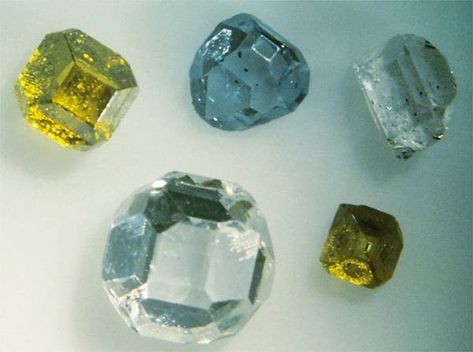
Carbon

Slide 71
Carbon

Slide 72
Important Compounds of Carbon
CO – toxic gas (binds to hemoglobin); forms during combustion of carbon in limited oxygen supply; used in methanol production.
CO₂ – end-product of combustion of carbon or carbon-containing compounds; greenhouse gas that keeps Earth temperature relatively warm;
CO₂ is essential to life – used by plants in photosynthesis;
NaHCO₃ – used as baking soda for cooking and as in fire-extinguishers;
Na₂CO₃ – used in glass manufacture;
CaCO₃ – used in steel production;

Slide 73
Inorganic Compounds of Carbon
CaC₂
Reaction with H₂O produces acetylene.
miner’s lamps.
CS₂
Flammable, volatile, poisonous.
Important solvent.
CCl₄
Known carcinogen.

Slide 74
Exercise-#6
Draw Lewis structures for the following ions and molecule and propose hybridization on the carbon atom in each ion or molecule.
CO₂
CO₃²⁻
HCO₃⁻
H₂CO₃
CF₄

Slide 75
Other Important Compounds of Carbon
CH₄ – major component of natural gas; used as fuel and for the production of hydrogen gas;
C₃H₈ and C₄H₁₀ – used as fuel;
C₆H₁₄, C₇H₁₆, C₈H₁₈, and C₉H₂₀ are components in gasoline, with C₈H₁₈ as the major component;
C₆H₁₂, (cyclohexane), C₆H₁₄ (hexane), and C₆H₆ (benzene) are important organic solvents;
C₂H₄, C₂H₃Cl, C₂F₄, and H₂NCH₂CH₂CH₂CH₂CH₂CH₂NH₂ (among others) are important monomers for polymers, such as polyethylene, PVC, Teflon, nylon, and polyester.

Slide 76
Chemistry of Silicon
Silicon - a metalloid; a covalent network solid with diamond-like structure; used as semi-conductors in the electronic equipment.
Silicon dioxide or silica (SiO₂) - the second most abundant substance on the Earth’s crust; also the source of silicon;
SiO₂ - used in the manufacture of glass and ceramics;
Silicon carbide (SiC) has diamond-like structure; used to make abrasive and heat resistant ceramics.

Slide 77
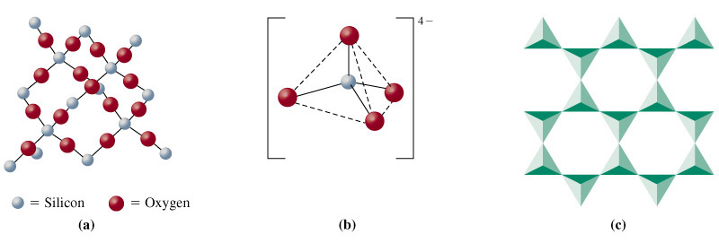
Production and Use of Si
Reduce quartz or sand with C in a furnace.
Oxides of Si, only one is stable, SiO₂.
silicate
mica
silica

Slide 78
Production of Silicon
SiO₂(s) + 2C(s) → Si(s) + 2CO(g);
Si(s) + 2Cl₂(g) → SiCl₄(g);
SiCl₄(g) + 2Mg(s) → Si(s) + 2MgCl₂(s);
Final purification done by “zone-refining”

Slide 79
Purification of Silicon by Zone-refining

Slide 80
Silanes and Silicones

Slide 81
Tin and Lead
Both are soft metals; T_{m}(ºC): Sn (232) & Pb (327)
Both metals form +2 and +4 oxidation states;
Reacts with O₂ → SnO, SnO₂, PbO & PbO₂;
Reacts with Cl₂ → SnCl₂, SnCl₄, PbCl₂ & PbCl₄;
SnO, PbO, SnCl₂, and PbCl₂ are ionic;
SnO₂, PbO₂, SnCl₄, and PbCl₄ are molecular;

Slide 82
Tin and Lead Ores and Uses
Cassiterite ore, SnO₂, reduced with C to Sn.
Galena, PbS, roasted in air then reduced with C.
Alloys of Sn
Solders
Bronze (90% Cu, 10% Sn
Pewter (85% Sn, 7% Cu, 6% Bi, 2% Sb)
Pb
Pimary use in storage batteries.
Radiation shields.

Slide 83
Important Compounds of Tin and Lead
SnCl₂ – used as reducing agent, tin plating, catalyst;
SnF₂ – additive in toothpaste to prevent cavity;
PbO – used in ceramic glaze, and cement;
PbO₂ – oxidizing agent and battery electrodes;
PbCrO₄ – for making yellow pigment for paint;

Slide 84
Group 5A
Valence-shell configuration: ns² np³
Exhibits varied chemical properties.
N and P are nonmetals;
As and Sb are metalloids;
Bi is a metal (the heaviest non-radioactive element)

Slide 85
The Nitrogen Family
Rich chemistry that can only be touched on here.
Nitrogen can exist in many oxidation states.
N and P are nonmetallic.
As and Sb are metalloid.
Bi is metallic.

Slide 86
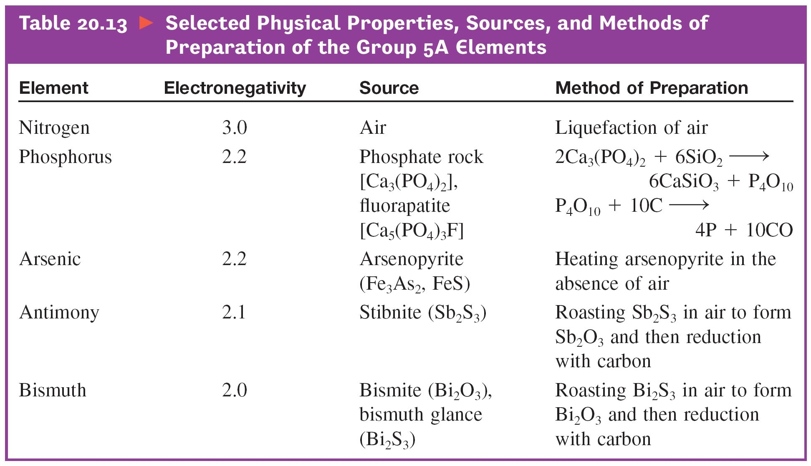
Some Physical Properties, Sources, and Methods of Preparation

Slide 88
Oxides of Group 5A Elements
Nitrogen: N₂O, NO, N₂O₃, NO₂, N₂O₄, N₂O₅;
Phosphorus: P₄O₆ & P₄O₁₀;
Arsenic: As₂O₃ (As₄O₆) & As₂O₅;
Antimony: Sb₂O₃ & Sb₂O₅
Bismuth: Bi₂O₃ & Bi₂O₅

Slide 89
Oxidation States of N

Slide 90
Chlorides of Group 5A Elements
Nitrogen: only NCl₃;
Phosphorus: PCl₃ and PCl₅;
Arsenic: AsCl₃ and AsCl₅;
Antimony: SbCl₃ and SbCl₅;
Bismuth: BiCl₃
All are molecular compounds.

Slide 91
Reactions of Oxides and Chlorides
3NO₂(g) + H₂O(l) → 2HNO₃(aq) + NO(g);
N₂O₅(g) + H₂O(l) → 2HNO₃(aq)
P₄O₁₀(s) + 6H₂O(l) → 4H₃PO₄(aq);
As₂O₅(s) + 3H₂O(l) → 2H₃AsO₄(aq);
PCl₅(s) + 4H₂O(l) → H₃PO₄(aq) + 5HCl(aq);
AsCl₅(s) + 4H₂O(l) → H₃AsO₄(aq) + 5HCl(aq);
2SbCl₅(s) + 5H₂O(l) → Sb₂O₅(s) + 10HCl(aq);

Slide 92
The Nitrogen Chemistry
The triple bonds (N≡N) in N₂ provide high stability to the molecule;
Many reactions involving nitrogen gas are endothermic and compounds containing nitrogen decompose exothermically to the elements.
N₂(g) + O₂(g) → 2NO(g) ΔH° = 180 kJ
2NO₂(g) → N₂(g) + O₂(g); ΔH° = -68 kJ
N₂H₄(g) → N₂(g) + 2H₂(g); ΔH° = -95 kJ

Slide 93
Nitrogen Fixation
The process of transforming N₂ to other nitrogen–containing compounds.
Atmospheric fixation (occurs naturally during thunderstorm):
N₂(g) + O₂(g) → 2NO(g); ΔHº = 180 kJ
2NO(g) + O₂(g) → 2NO₂(g); ΔHº = -112 kJ
3NO₂(g) + H₂O(l) → 2HNO₃(aq) + NO(g); ΔHº = -140 kJ

Slide 94
Biological Nitrogen Fixation
Fixation of atmospheric N₂ by bacteria living in soils and water; some live in root nodules;
Plants such as legumes and alfafa have root nodules that contain nitrogen-fixing bacteria – they benefit directly from these bacteria;
Other plants benefit when the bacteria die and release absorbable forms of nitrogen (NH₃, NH₄⁺, and NO₃⁻) to the soils;

Slide 95
Biological Nitrogen Fixation
In nitrogen-fixing bacteria:
Atmospheric N₂ is first reduced to NH₃;
Then, NH₃ → NH₄⁺ → NO₂⁻ → NO₃⁻;
NH₃, NH₄⁺, and NO₃⁻ released into the surroundings (water or soils) and become available to plants;
In denitrifying bacteria (in soils) the reverse processes occur: NO₃⁻ → NO₂⁻ → NH₃ → N₂;
Biological nitrogen cycle is complete.

Slide 96
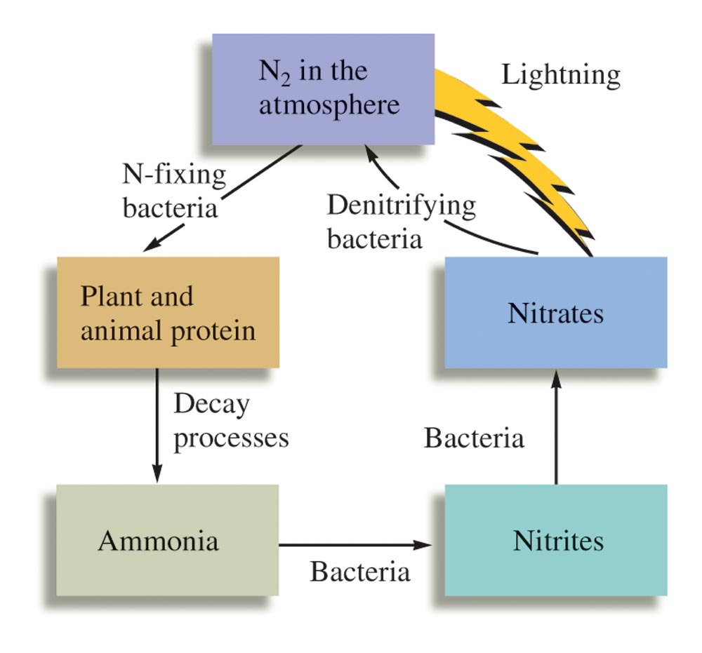
Biological Fixation and The Nitrogen Cycle

Slide 97
Industrial Nitrogen Fixation
Industrial Fixation (the Haber Process):
N₂(g) + 3H₂(g) → 2NH₃(g) ΔH° = -92 kJ
Most NH₃ are converted to:
Fertilizers (~70%)
Nitric acid, HNO₃ (~20%)
Hydrazine, N₂H₄, and monomers for various plastics and nylons.

Slide 98
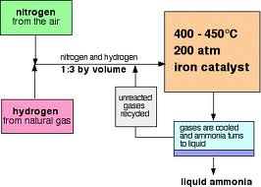
The Haber Process

Slide 99
Nitrogen Cycle

Slide 100
Extraction of Nitrogen and Oxygen Gas from Atmosphere

Slide 101
Important Hydrides of Nitrogen
Ammonia, NH₃ (most important hydride)
Production of fertilizers (NH₄NO₃, (NH₄)₂SO₄, (NH₄)₃PO₄, and CO(NH₂)₂), HNO₃, and N₂H₄
Hydrazine, N₂H₄
Rocket propellant, manufacture of plastics, agricultural pesticides;
Monomethylhydrazine, CH₃N₂H₃
Rocket fuels

Slide 102
Oxides of Nitrogen

Slide 103
Oxides of Nitrogen
In its oxides nitrogen has oxidation states ranging from +1 to +5.
N₂O (+1)
NO (+2)
N₂O₃ & HNO₂ (+3)
NO₂ (+4)
N₂O₅ & HNO₃ (+5)
In other compounds, nitrogen could have oxidation states of -1 to -3.
NH₂OH (-1), N₂H₄ (-2), and NH₃ (-3)

Slide 104
Important Oxo-acids of Nitrogen
Nitric acid, HNO₃
Nitrous acid, HNO₂

Slide 105
Molecular Structure of HNO₃
This image shows the molecular structure (left) of nitric acid, HNO₃ and its resonance forms (right).

Slide 106
Molecular Structure of HNO₂

Slide 107
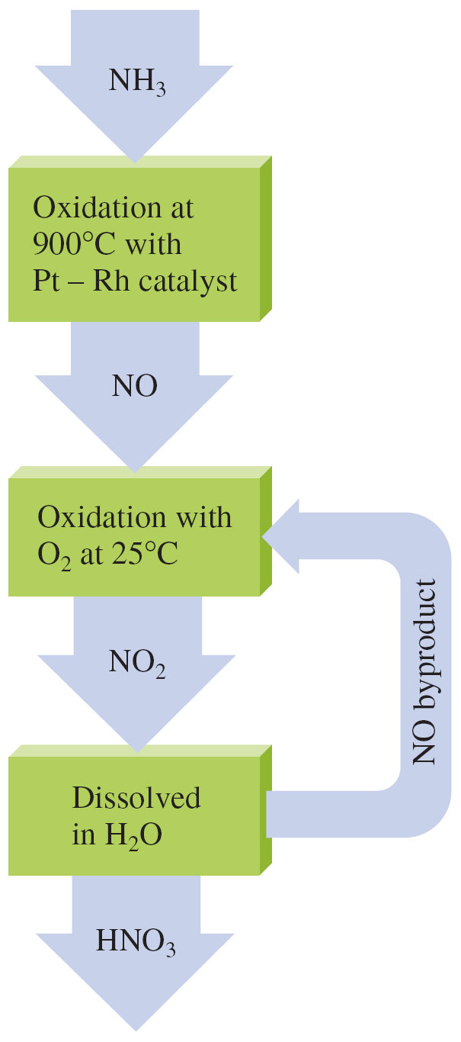
The Ostwald Process for the Production of HNO₃

Slide 108
Production of Nitric Acid
Reactions in the Oswald Process:
4NH₃(g) + 5 O₂(g) → 4NO(g) + 6H₂O(g);
2NO(g) + O₂(g) → 2NO₂(g);
3NO₂(g) + H₂O(l) → 2HNO₃(aq) + NO(g);

Slide 109
Reactions of Nitric Acid
HNO₃ - a strong acid and an oxidizing agent;
Reactions with metals does not produce H₂
Cu(s) + 4HNO₃(16 M) → Cu(NO₃)₂(aq) + 2NO₂(g) + 2H₂O(l);
3Cu(s) + 8HNO₃(aq, 6 M) → 3Cu(NO₃)₂(aq) + 2NO(g) + 4H₂O(l);
4Zn(s) + 10HNO₃(aq, 3 M) → 4Zn(NO₃)₂(aq) + N₂O(g) + 2H₂O(l);

Slide 110
Allotropes of Phosphorus
White Phosphorus: P₄ (tetrahedral) - very reactive
Black Phosphorus: crystalline structure - much less reactive
Red Phosphorus: amorphous with P₄ chains

Slide 111
Allotropes of Phosphorus
(a) White Phosphorus
(b) Black Phosphorus
(c) Red Phosphorus

Slide 112
Allotropy of P

Slide 113
Phosphorus: Production and Uses
Phosphorus is 11th most abundant element in the earths crust (0.11%).
Obtained by heating apatites or phosphate rocks containing Ca₃(PO₄)₂; the reaction is as follows:
2 Ca₃(PO₄)₂(s) + 10 C(s) + 6 SiO₂(s) →
6 CaSiO₃(s) + 10 CO(g) + P₄(s)

Slide 114
Oxides of Phosphorus
Reaction of white phosphorus with oxygen:
P₄(s) + 3O₂(g) → P₄O₆(l); (o.s. of P = +3)
P₄(s) + 5O₂(g) → P₄O₁₀(s); (o.s. of P = +5)
Reactions of phosphorus oxides with water:
P₄O₆(l) + 6H₂O(l) → 4H₃PO₃(aq);
P₄O₁₀(s) + 6H₂O(l) → 4H₃PO₄(aq);

Slide 115
Oxides and Oxoacids of P
+ 6 H₂O(l) → 4 H₃PO₃(l)
phosporus acid
+ 6 H₂O(l) → 4 H₃PO₄(l)
phosporic acid

Slide 116
Oxyacids of Phosphorus
Phosphoric acid, H₃PO₄ - triprotic
Phosphorous acid, H₃PO₃ - diprotic
Hypophosphorous acid, H₃PO₂ - monoprotic

Slide 117
Structure of Phosphoric Acid
Orthophosphoric acid, H₃PO₄, is colorless when pure and has this molecular (left) and Lewis structure (right).

Slide 118
Structure of Phosphorous Acid
In a molecule of phosphorous acid, H₃PO₃, only the two hydrogen atoms bonded to an oxygen atom are acidic.

Slide 119
Polyphosphoric Acids

Slide 120
Phosphorus Halides
Reactions of white phosphorus with halogens:
P₄(s) + 6X₂ → 4PX₃(l);
P₄(s) + 10X₂ → 4PX₅(s);
Examples of reactions:
P₄(s) + 6Cl₂(g) → 4PCl₃(l);
P₄(s) + 10Cl₂(g) → 4PCl₅(s);
PCl₃(l) + Cl₂(g) ⇄ PCl₅(s);

Slide 121
Phosphorus Halides
Reactions of phosphorus chlorides with water:
PCl₃(l) + 3H₂O(l) → H₃PO₃(aq) + 3HCl(aq);
PCl₅(s) + 4H₂O(l) → H₃PO₄(aq) + 5HCl(aq);

Slide 122
Important Compounds of Phosphorus
Ca₃(PO₄)₂ & Ca₅(PO₄)₃F : source of phosphorus
Ca₅(PO₄)₃(OH) : forms bones and teeth structures
P₄O₁₀ : production of H₃PO₄
H₃PO₄ : production of fertilizers & phosphates
H₂PO₄⁻ & HPO₄²⁻ : making phosphate buffers
Na₃PO₄ (TSP): scouring powder and paint remover
Na₅P₃O₁₀ : fabric softeners
ADP & ATP : storage of metabolic energy

Slide 123
Exercise-#7
Draw Lewis structures for the following molecules:
N₂O
NO₂
HNO₃
H₃PO₄ (triprotic acid – 3 ionizable H⁺)
H₃PO₃ (diprotic acid – 2 ionizable H⁺)
H₄P₂O₇ (tetraprotic – 4 ionizable H⁺)
H₅P₃O₁₀ (pentaprotic – 5 ionizable H⁺)
PCl₃ and PCl₅

Slide 124
Exercise-#8
Complete and balance the following equations:
N₂O₅(g) + H₂O(l) →
P₄O₁₀(s) + H₂O(l) →
PCl₅(l) + H₂O(l) →
HNO₃(aq) + NH₃(g) →
H₃PO₄(aq) + NH₃(g) →

Slide 125
Exercise-#9
Name 3 ways in which atmospheric nitrogen is fixed.
What is the major industrial use of atmospheric nitrogen?
Write balanced equations for all reactions that occur in the Oswald process for the production of nitric acid from ammonia.

Slide 126
Group 6A
Valence-shell configuration: ns² np⁴
O, S, Se, Te, Po
None of the Group 6A elements behaves as a typical metal.
Elements form covalent bonds with other nonmetals.

Slide 127
Some Physical Properties, Sources, and Methods of Preparation

Slide 128
Oxygen
O₂ makes up 21% of the Earth’s atmosphere.
O₃ (ozone) exists naturally in the upper atmosphere (the stratosphere) of the Earth.
Ozone layer absorbs dangerous UV light; it serves as a screen that blocks most uv-radiation from reaching the Earth’s surface.
Freons and other CFC compounds used in refrigeration and air-conditioning units promote the destruction of ozone layer.

Slide 129
Various Forms of Oxides
Metal oxides (ionic)
Nonconductor – example: MgO
Semiconductor – example: NiO
Conductor – example: ReO₃
Superconductor – example: YBa₂Cu₃O₇
Nonmetal oxides (covalent):
Molecular oxides – examples: CO₂, NO, NO₂, N₂O, SO₂, P₄O₁₀, etc.
Covalent network oxide – SiO₂

Slide 130
Characteristics of Oxides
Metallic oxides – basic or amphoteric
Examples: Na₂O (basic); Al₂O₃ (amphoteric)
Semi-metallic oxides – mild to weakly acidic
Example: B₂O₃
Nonmetallic oxides – weak to strong acids
Examples:
SO₂(g) + H₂O(l) → H₂SO₃(aq) (weak acid);
SO₃(g) + H₂O(l) → H₂SO₄(aq) (strong acid);

Slide 131
Ozone
3O₂(g) ↔ 2O₃(g) K ≅ 10^{57}

Slide 132
Sulfur
Sulfur is found in nature both in large deposits of the free element and in ores such as:
Galena = PbS,
Cinnabar = HgS,
Pyrite = FeS₂,
Gypsum = CaSO₄⋅2H₂O,
Epsomite = MgSO₄.7H₂O, and
Glauberite = Na₂Ca(SO₄)₂

Slide 133
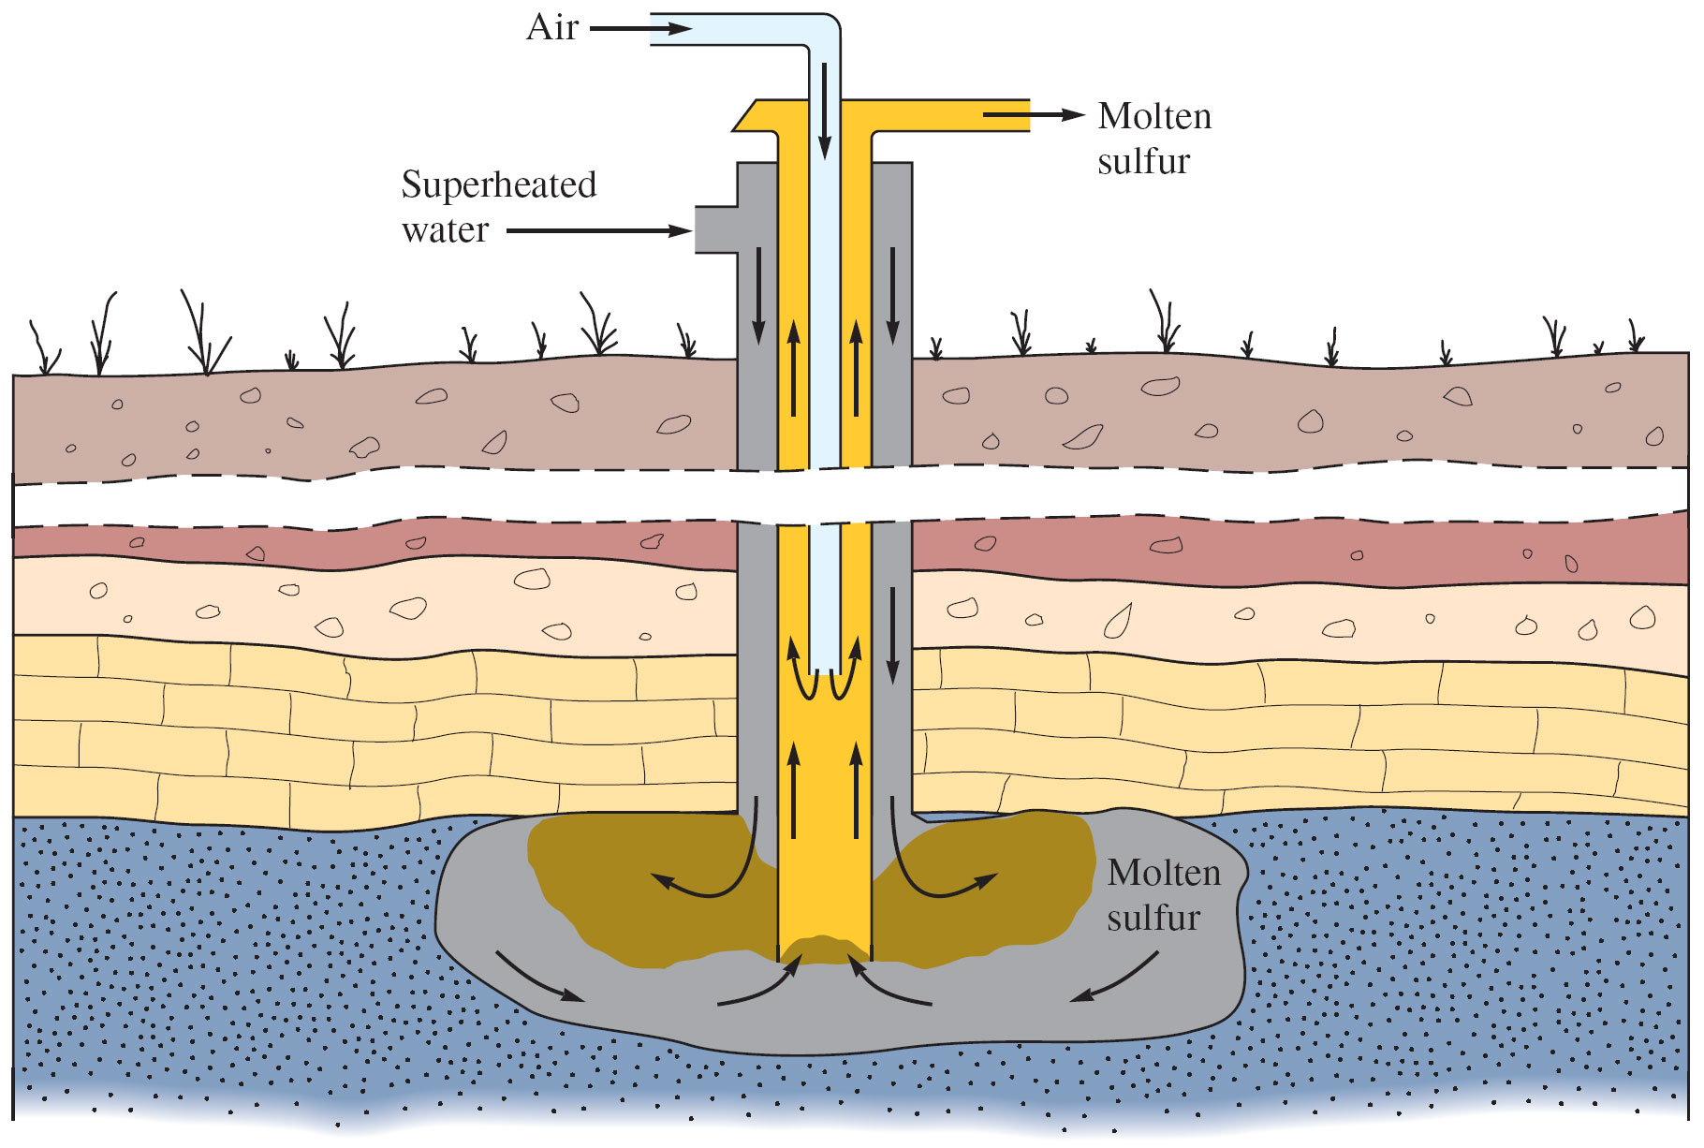
Sulfur Mining: Frasch Process

Slide 134
Aggregates of Sulfur

Slide 135
Sulfur Oxides and Oxyacids
S(s) + O₂(g) → SO₂(g)
2SO₂(g) + O₂(g) → 2SO₃(g)
SO₂(g) + H₂O(l) → H₂SO₃(aq)
SO₃(g) + H₂O(l) → H₂SO₄(aq)
H₂SO₃ – diprotic; weak acid
H₂SO₄ – diprotic; strong acid

Slide 136
Structure of Sulfuric Acid
Sulfuric acid has a tetrahedral molecular structure.

Slide 137
Sulfuric Acid
Productions:
S₈(s) + 8 O₂(g) → 8SO₂(g);
2H₂S(g) + 3 O₂(g) → 2SO₂(g) + 2H₂O(l);
FeS₂(s) + 11 O₂(g) → Fe₂O₃(s) + 8SO₂(g);
2SO₂(g) + O₂(g) → 2SO₃(g); (V₂O₅/K₂O catalyst)
2SO₃(g) + H₂SO₄(l) → H₂S₂O₇(l);
H₂S₂O₇(l) + H₂O(l) → 2H₂SO₄(l);

Slide 138
Important Compounds of Sulfur
H₂SO₄ – most important compound, for manufacture of fertilizer, soap, detergents, metal and textile processing, sugar refinery, and organic syntheses;
SF₄ – for fluoridation
SF₆ – as insulating and inert blanket
Na₂S₂O₃ – as reducing agent and complexing agent for Ag⁺ in photography (called “hypo”);
P₄S₃ – in “strike-anywhere” match heads

Slide 139
Exercise-#10
Draw Lewis structures for the following molecules:
SO₂
SF₂
SF₄
SF₆
H₂SO₄
H₂SO₃
H₂S₂O₇

Slide 140
The Halogens
All nonmetals: F, Cl, Br, I, At
Most reactive nonmetal group;
Not found as free elements in nature. Mainly found as halide ions (X–) in various minerals and in seawater.

Slide 141
Trends in Selected Physical Properties

Slide 142
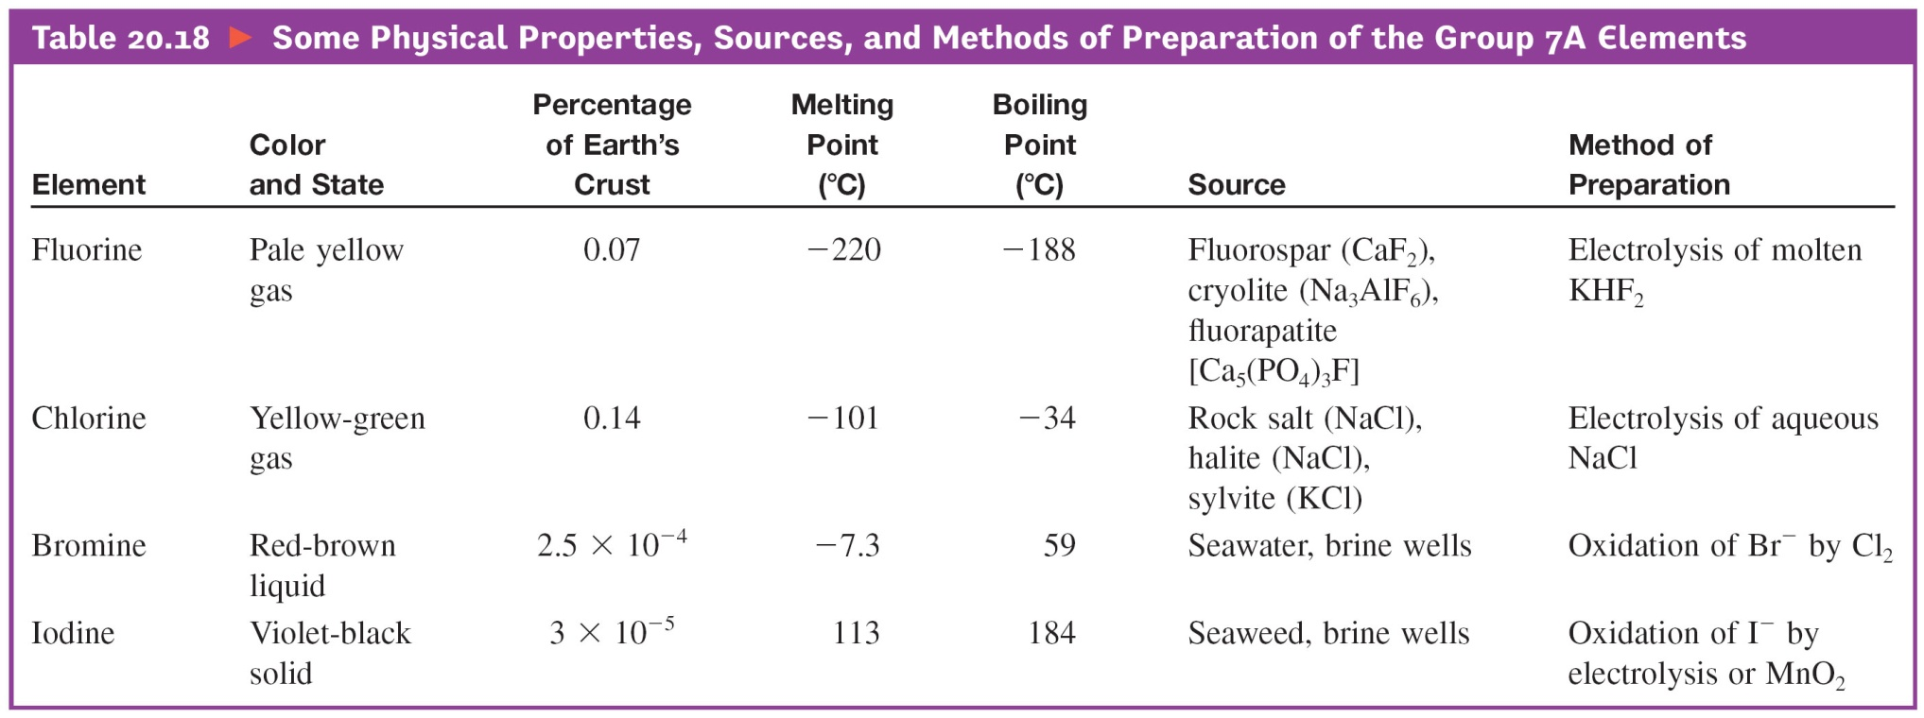
Some Physical Properties, Sources, and Methods of Preparation

Slide 143
Preparation of Hydrogen Halides
H₂(g) + X₂(g) → 2HX(g)
When dissolved in water, the hydrogen halides behave as acids, and all except hydrogen fluoride are completely dissociated.

Slide 144
Halogen Oxyacids and Oxyanions
All halogens except fluorine combine with various numbers of oxygen atoms to form oxyacids.
Strengths of oxyacids vary directly to the number of oxygen atoms bonded to the halogen - acid strength increases as more oxygens are added.

Slide 145
The Known Oxyacids of the Halogens

Slide 146
Interhalogen Compounds
Formation:
Cl₂(g) + 3F₂(g) → 2ClF₃(g);
Br₂(l) + 3Cl₂(g) → 2BrCl₃(l);
Br₂(l) + 5F₂(g) → 2BrF₅(l);

Slide 147
Reactions of Interhalogen Compounds
ClF₃ & BrF₃ as fluoridating agents:
2B₂O₃(s) + 2BrF₃(l) → 4BF₃(g) + Br₂(l) + 3 O₂(g)
P₄(s) + 5ClF₃(g) → 4PF₃(g) + Cl₂(g) + 3ClF(g)
Reaction with water:
ClF₃(g) + 2H₂O(l) → HClO₂(aq) + 3HF(aq);
BrF₅(l) + 3H₂O(l) → HBrO₃(aq) + 5HF(aq);

Slide 148
Chemistry of Chlorine
Most important halogen
Laboratory preparation from NaCl and MnO₂:
2NaCl(s) + MnO₂(s) + 2H₂SO₄(l) → Cl₂(g) + MnSO₄(s) + Na₂SO₄(s) + 2H₂O(l)
Industrial production:
Chlorine is a by-product in the electrolysis of NaCl, MgCl₂, CaCl₂, ScCl₃, etc.

Slide 149
Major Uses of Chlorine
Production of:
chlorinated organic compounds;
hydrochloric acid;
bleach solution and bleach powder;
Treatment of municipal water.

Slide 150
Production of Bleach Solution
Cl₂(g) + 2NaOH(aq) → NaOCl(aq) + NaCl(aq) + H₂O(l)

Slide 151
Production of Bleach Powder
2Cl₂(g) + 2Ca(OH)₂(aq) → Ca(OCl)₂(s) + CaCl₂(aq) + 2H₂O(l)

Slide 152
Production of Other Oxidizing Agents
3Cl₂(g) + 6NaOH(aq) → NaClO₃(aq) + 3NaCl(aq) + 3H₂O(l)
2NaClO₃(s) + SO₂(g) + H₂SO₄(aq) → 2ClO₂(g) + 2NaHSO₄(aq)

Slide 153
Oxides and Oxyacids of Chlorine
Oxides of chlorine and its oxidation number (in parenthesis):
Cl₂O (+1), Cl₂O₃ (+3), ClO₂ (+4; unstable), Cl₂O₅ (+5), Cl₂O₇ (+7; highest possible)
Chlorine oxyacids in increasing acid strength
HOCl < HClO₂ < HClO₃ < HClO₄;
HClO₄ is a strong oxidization agent

Slide 154
Structure of Chlorite Ion
Chlorite ions, ClO₂⁻, are produced when chlorous acid reacts with bases.

Slide 155
Structure of Chlorate ion
Chlorate ions, ClO₃⁻, are produced when halic acids react with bases.

Slide 156
Structure of Perchlorate ion
Perchlorate ions, ClO₄⁻, can be produced when perchloric acid reacts with a base or by electrolysis of hot solutions of their chlorides.

Slide 157
Important Compounds of Chlorine
NaCl – for physiological electrolyte balance
NaOCl – household bleach solution
Ca(OCl)₂ – bleach for swimming pool water & sewage treatment
ClO₂ – industrial bleach for paper production
NaClO₃ – production of industrial bleach (ClO₂)
KClO₃ – oxidizer in fireworks and matches
NaClO₄ – production of HClO₄ and NH₄ClO₄
NH₄ClO₄ – oxidizer in booster rocket fuel

Slide 158
Exercise-#11
Draw Lewis structures for the following molecules:
ClF₃
BrF₅
HOCl
HClO₂
HClO₃
HClO₄

Slide 159
Exercise-#12
In the following reaction for household bleach production:
Cl₂(g) + 2NaOH(aq) → NaOCl(aq) + NaCl(aq) + H₂O(l)
(a) How many kilograms of NaOCl will be produced from the reaction of 1.00 m³ of Cl₂ gas, measured at STP, and excess of NaOH? (b) If beach solution contains 5.25% (w/w) of NaOCl and the solution has density of 1.06 g/mL, how many liters of bleach solution are produced?

Slide 160
Noble Gases
He, Ne, Ar, Kr, Xe and *Rn;
Except for He, the other elements have the valence-shell electron configuration: ns² np⁶
Subshell ns and np are completely filled, which represents the most stable electron configuration for atoms.
Natural compound of noble gas elements does not exist, but some compounds of Xe and Kr have been synthesized in the laboratory.
Radon is radio active.

Slide 161
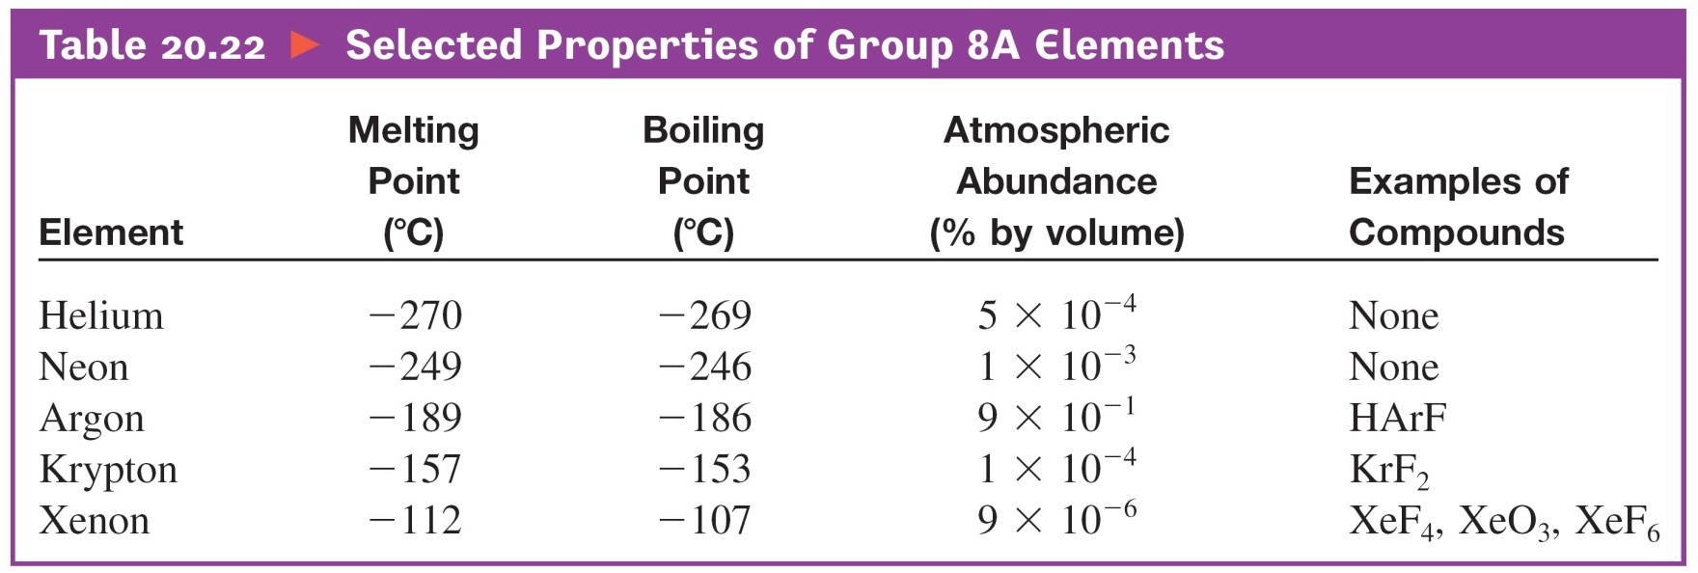
Selected Properties of Noble Gases

Slide 162
Compounds of Noble Gases
He and Ne form no compounds.
Some compounds of Kr and Xe with O₂ and F₂ have been synthesized in the laboratory:
Xe(g) + 2F₂(g) → XeF₄(s)
Xe(g) + 3F₂(g) → XeF₆(s)
XeF₆(s) + 3H₂O(l) → XeO₃(aq) + 6HF(aq)
XeF₆(s) + 2H₂O(l) → XeO₂F₂(aq) + 4HF(aq)
XeF₆(s) + H₂O(l) → XeOF₄(aq) + 2HF(aq)

Slide 163
Exercise-#13
Draw Lewis structures for the following molecules.
XeF₂
XeF₄
XeOF₂
XeO₂F₂
XeOF₄

