Slide 1
Electrochemistry
17.1 Balancing Redox Reactions
17.2 Galvanic Cells
17.3 Standard Reduction Potentials
17.4 Concentration Cells and Nernst Equation
17.5 Batteries and Fuel Cells
17.6 Corrosion and Corrosion Prevention
17.7 Electrolysis and Electroplating

Slide 2
Oxidation-Reduction (Redox) Reactions
Review of Terms:
  Oxidation–reduction (redox) reactions involves transfer of electrons from one reactant (the reducing agent) to another (the oxidizing agent)
  Oxidation – the loss of electrons
  Reduction – the gain of electrons
  Reducing agent – electron donor
  Oxidizing agent – electron acceptor

Slide 3
Redox Reactions
Examples of Redox Reactions:
  Zn(s) + CuSO₄(aq) → ZnSO₄(aq) + Cu(s);
  Zn(s) + Cu²⁺(aq) → Zn²⁺(aq) + Cu(s)
  Cu(s) + 2AgNO₃(aq) → CuSO₄(aq) + 2Ag(s);
  Cu(s) + 2Ag⁺(aq) → Cu²⁺(aq) + 2Ag(s)
  MnO₄־(aq) + 5Fe²⁺(aq) + 8H⁺(aq) →
  Mn²⁺(aq) + 5Fe³⁺(aq) + 4H₂O

Slide 4
Balancing Redox Equations
Half–Reactions Method:
The overall reaction is split into two half–reactions, one involving oxidation and one reduction.
8H⁺ + MnO₄⁻ + 5Fe²⁺ → Mn²⁺ + 5Fe³⁺ + 4H₂O
Reduction: 8H⁺ + MnO₄⁻ + 5e⁻ → Mn²⁺ + 4H₂O
Oxidation: 5Fe²⁺ → 5Fe³⁺ + 5e⁻

Slide 5
Balancing Redox Equations:
The Half-Reaction Method
Write separate equations for oxidation and reduction half–reactions.
For each half–reaction:
  Balance all the elements except H and O.
  Balance O using H₂O.
  Balance H using H⁺.
  Balance the charge using electrons.
If necessary, multiply one or both balanced half–reactions by an integer to make the number of electrons in both half–reactions equal.
Add half–reactions and cancel identical species.

Slide 6
Balancing Redox Equations
Example: balancing a redox reaction under acidic condition
Cr₂O₇²⁻(aq) + HSO₃⁻(aq) → Cr³⁺(aq) + HSO₄⁻(aq)
How can we balance this equation?
First Steps:
  Separate into half-reactions.
  Balance elements except H and O.

Slide 7
Balancing Redox Equation:
The Half-Reaction Method
Cr₂O₇²⁻(aq) → 2Cr³⁺(aq)
HSO₃⁻(aq) → HSO₄⁻(aq)
How many electrons are needed to balance the charge in each half-reaction?

Slide 8
Balancing Redox Equation:
The Half-Reaction Method
Adding electrons:
Cr₂O₇²⁻(aq) + 6e⁻ → 2Cr³⁺(aq)
HSO₃⁻(aq) → HSO₄⁻(aq) + 2e⁻

Slide 9

Balancing Redox Equation:
The Half-Reaction Method
Balance the oxygen atoms by adding H₂O:
6e⁻ + Cr₂O₇²⁻(aq) → 2Cr³⁺(aq) + 7H₂O
H₂O + HSO₃⁻(aq) → HSO₄²⁻(aq) + 2$H^{+}$ + 2e⁻

Slide 10
Balancing Redox Equation:
The Half-Reaction Method
Balance the hydrogen atoms by adding H⁺:
  (This reaction occurs in an acidic solution)
14H⁺ + 6e⁻ + Cr₂O₇²⁻ → 2Cr³⁺ + 7H₂O
H₂O + HSO₃⁻ → HSO₄⁻ + 2e⁻ + 2H⁺

Slide 11
Balancing Redox Equation:
The Half-Reaction Method
Balance the electrons in both half-equations:
14H⁺ + 6e⁻ + Cr₂O₇²⁻ → 2Cr³⁺ + 7H₂O
3[H₂O + HSO₃⁻ → HSO₄²⁻ + 2e⁻ + 2H⁺]
The final balanced equation:
Cr₂O₇²⁻ + 3HSO₃⁻ + 8H⁺ → 2Cr³⁺ + 3HSO₄⁻ + 4H₂O

Slide 12
Sample Exercises
Balance the following redox reactions in acidic solution.
1) Br–(aq) + MnO₄–(aq) → Br₂(l) + Mn²⁺(aq)
2) Cr₂O₇²⁻(aq) + H₂O₂(aq) → Cr³⁺(aq) + H₂O(l) + O₂(g)

Slide 13
Balancing Redox Equations in Basic Solution
Use the half–reaction method as specified for acidic solutions to obtain the final balanced equation as if H⁺ ions were present.
To both sides of the equation, add a number of OH– ions that is equal to the number of H⁺ ions present. (You want to eliminate H⁺ by turning is into H₂O)
Form H₂O on the side containing both H⁺ and OH– ions, and eliminate the number of H₂O molecules that appear on both sides of the equation.
Check that elements and charges are balanced.

Slide 14
Sample Exercises
Balance the following redox reactions in basic solution:
Br₂(aq) + OH⁻(aq) → BrO₃⁻(aq) + Br⁻(aq) + H₂O;
Cr(OH)₄⁻(aq) + OH⁻(aq) → CrO₄²⁻(aq) + H₂O;

Slide 15
Applications of Redox Reactions
Redox reactions such as combustion reactions are very exothermic – they have very large negative ΔH;
Combustion reactions are primary source of energy;
Redox reactions in aqueous solution also have negative ΔH and ΔG (free energy);
Available free energy from spontaneous reactions can be trapped to produce electricity;
Devices that utilize redox reactions to produce electricity are called Galvanic cells or batteries.

Slide 16
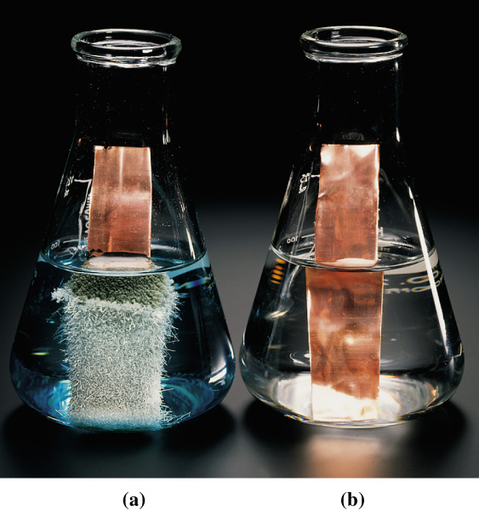
Electrode Potentials and
Their Measurement
Cu(s) + 2Ag⁺(aq)
Cu(s) + Zn²⁺(aq)
Cu²⁺(aq) + 2 Ag(s)
No reaction

Slide 17
Terminology
Galvanic cell (= electrochemical cell)
  A device that produces electricity from spontaneous redox reactions.
Electrolytic cell:
  A device the uses electrical energy to make a nonspontaneous chemical reaction to occur.
Electrode-couple, M|M^{n+}
  A pair of species related by a change in the number of e⁻.

Slide 18
Galvanic Cell
A device in which chemical free energy is converted to electrical energy.
It uses a spontaneous redox reaction to produce a current that can be used to generate energy or to do work.

Slide 19
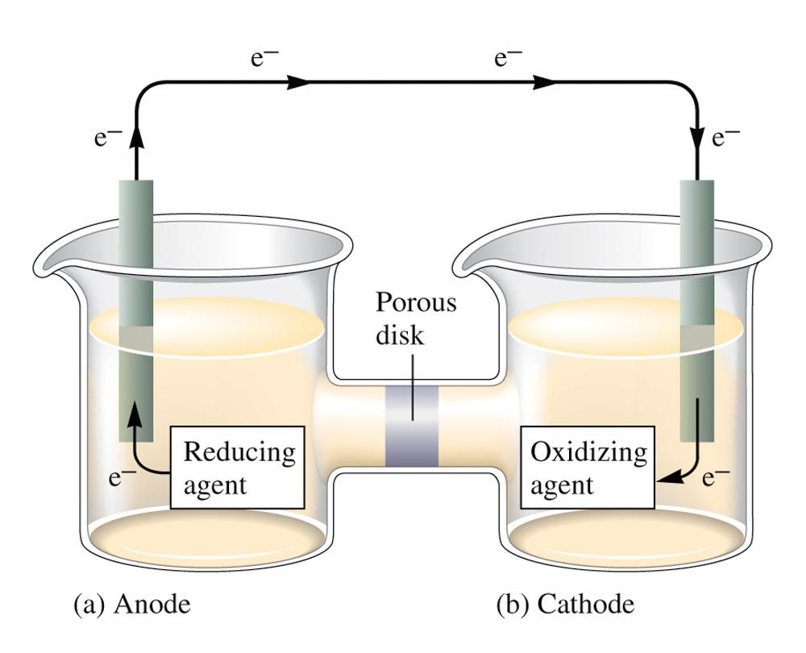
A Galvanic Cell

Slide 20
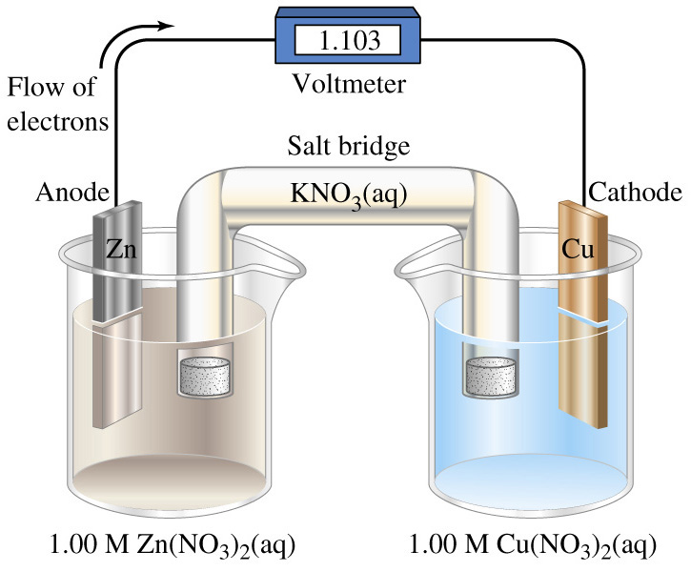
A Cu-Zn Galvanic Cell
Zn(s)|Zn²⁺(aq)||Cu²⁺(aq)|Cu(s); E°_{cell} = 1.103 V

Slide 21
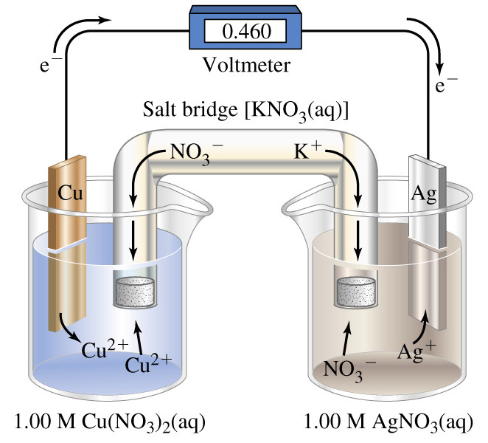
An Ag-Cu Galvanic Cell

Slide 22
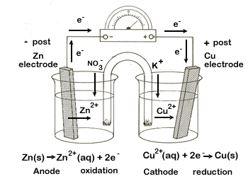

Reactions in a Galvanic Cell
(${Zn|Zn}^{2+}$||${Cu}^{2+}|Cu$)

Slide 23
Calculating Standard Cell Potential
Given the following reduction potentials:
Cu²⁺(aq) + 2e⁻ → Cu(s); Eº = 0.34 V
Zn²⁺(aq) + 2e⁻ → Zn(s); Eº = -0.76 V
The cell potential for the following reaction is shown below.
Zn(s) + Cu²⁺(aq) → Zn²⁺(aq) + Cu(s);
Eº_{cell} = Eº_{Cu}2+ _{|Cu} – Eº_{Zn}2+ _{|Zn} = 0.34 V – (– 0.76 V) = 1.10 V

Slide 24
In Galvanic Cell
Oxidation occurs at the anode.
Reduction occurs at the cathode.
Salt bridge or porous disk allows ions to flow without extensive mixing of the solutions.
  Salt bridge – contains a strong electrolyte held in a gel–like matrix.
  Porous disk – contains tiny passages that allow hindered flow of ions.

Slide 25
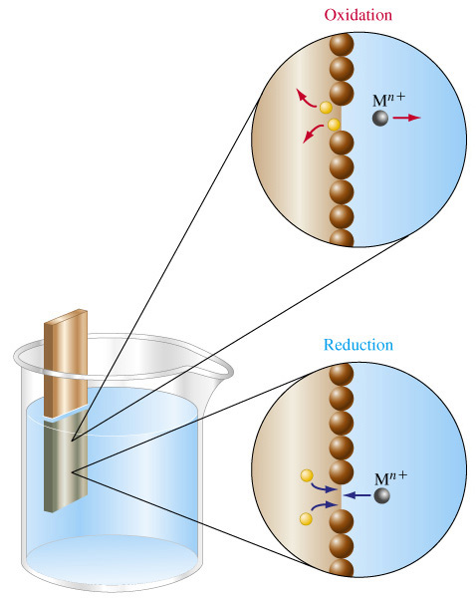
Chemical Processes at Electrodes
Anode
Cathode

Slide 26
Electrochemical Terminologies
Anode half-cell - where oxidation process occurs;
Cathode half-cell - where reduction process occurs;
Electricity – electrons flow in the wire from the anode to the cathode half-cells; in solution, cations and anions flow in opposite directions across the salt bridge.
Cell potential (E_{cell}) - electromotive force (emf) that drives electrons and ions to flow; aka electrical potential.
  The unit of electrical potential is volt (V).
  1 V = 1 J/C (Joule/Coulomb of charge transferred)

Slide 27
Standard Electrode Potentials
Cell voltage: the electrical potential difference of an electrode-pair.
The cell potential of individual electrodes are measured against the Standard Hydrogen Electrode (SHE), which is reference electrode assigned an electrical potential value of 0.00 V.

Slide 28
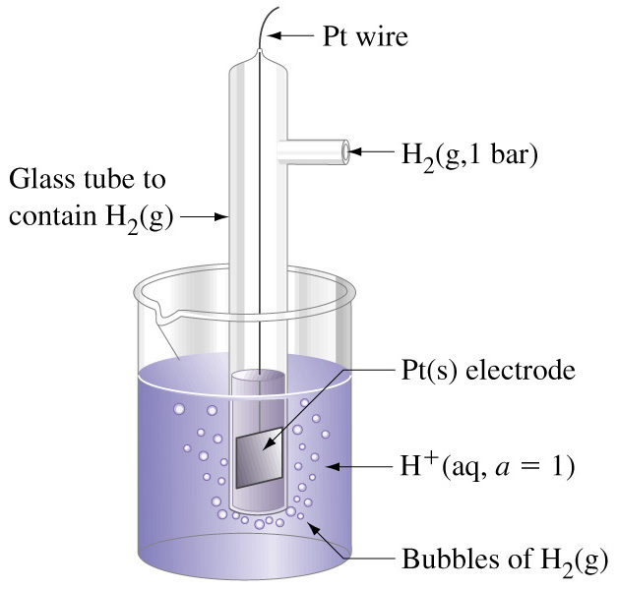
Standard Hydrogen Electrode
2 H⁺(a = 1) + 2 e⁻ → H₂(g, 1 bar) E° = 0 V
Pt|H₂(g, 1 bar)|H⁺(a = 1)
Notes:
The two vertical lines indicate three phases are present.
For simplicity we usually assume that a = 1 at [H+] = 1 M
and replace 1 bar by 1 atm.

Slide 29
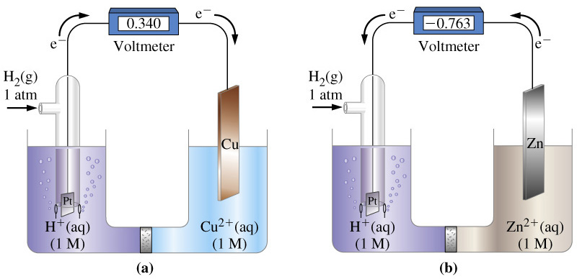
Measuring Standard Reduction Potential
anode
cathode
cathode
anode

Slide 30
Reduction Couples
Cu²⁺(1M) + 2 e⁻ → Cu(s) E°_{Cu}2+_{/Cu} = ?
Pt|H₂(g, 1 bar)|H⁺(a = 1) || Cu²⁺(1 M)|Cu(s); E°_{cell} = 0.340 V
anode
cathode
Standard cell potential: the potential difference of a cell formed from two standard electrodes.
E°_{cell} = E°_{cathode} - E°_{anode}

Slide 31
Standard Cell Potential
Pt|H₂(g, 1 bar)|H⁺(a = 1) || Cu²⁺(1 M)|Cu(s); E°_{cell} = 0.340 V
E°_{cell} = E°_{cathode} - E°_{anode}
E°_{cell} = E°_{Cu}2+_{/Cu} - E°_{H}+_{/H2}
0.340 V = E°_{Cu}2+_{/Cu} - 0 V
E°_{Cu}2+_{/Cu} = +0.340 V
H₂(g, 1 atm) + Cu²⁺(1 M) → H⁺(1 M) + Cu(s); E°_{cell} = 0.340 V

Slide 32
Standard Reduction Potentials
Reduction potential, E°, for other electrons are assigned positive (+) or negative (-) values, depending on whether their reduction potential is greater or smaller than the reduction potential of Hydrogen electrode under standard condition.
  Standard condition implies an electrolyte concentration of 1 M or gas pressure of 1 atm, and the temperature is 25°C (or 298 K)

Slide 33
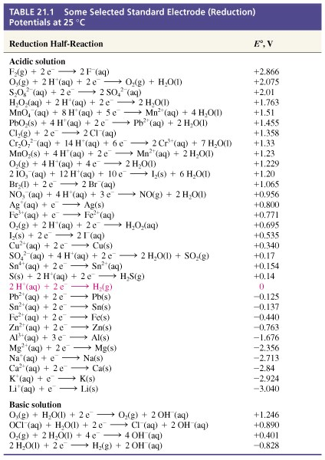

Slide 34
Cell Potential of Galvanic Cell
Values and algebraic sign for half-cell potentials (Eº) are given for reduction process:
  M^{n+} + ne⁻ → M; or X₂ + 2e⁻ → 2X⁻
If the half-reaction is reversed, the algebraic sign of Eº will change, but not the value;
  For example: Zn²⁺ + 2e⁻ → Zn; Eº = -0.76 V
  Zn → Zn²⁺ + 2e⁻; Eº = +0.76 V
Standard cell potential (Eº_{cell}) of a galvanic cell is the sum of the oxidation potential of anode half-cell and the reduction potential of cathode half-cell.

Slide 35
Example: Fe³⁺(aq) + Cu(s) → Cu²⁺(aq) + Fe²⁺(aq)
Given the following half-reactions:
  Fe³⁺ + e– → Fe^{2+;} Eº = 0.77 V (1)
  Cu²⁺ + 2e– → Cu; Eº = 0.34 V (2)
To balance above equation and calculate the cell potential, we must reverse equation (2).
  Cu → Cu²⁺ + 2e– ; – Eº = – 0.34 V
We also need to multiply equation (1) by 2 to balance the electron, but the E° is not multiplied.
  2Fe³⁺ + 2e– → 2Fe²⁺ ; Eº = 0.77 V
  (Note: the half-cell potential (Eº) stays the same when the half-equation is multiplied by a coefficient.)

Slide 36
Standard Cell Potential
2Fe³⁺ + 2e– → 2Fe²⁺ ; Eº = 0.77 V (cathode)
Cu → Cu²⁺ + 2e– ; – Eº = – 0.34 V (anode)
The balanced equation for the cell reaction:
  Cu + 2Fe³⁺ → Cu²⁺ + 2Fe²⁺
Cell Potential:
Eº_{cell} = Eº(cathode) + Eº(anode)
  Eº_{cell} = 0.77 V + (– 0.34 V) = 0.43 V

Slide 37
Predicting Reaction using
Standard Cell Potential
Given the following reduction potentials:
Cu²⁺(aq) + 2e⁻ → Cu(s); Eº = 0.34 V
Ni²⁺(aq) + 2e⁻ → Ni(s); Eº = -0.23 V
Predict whether or not the following reaction will occur:
Cu(s) + Ni²⁺(aq) → Cu²⁺(aq) + Ni(s)

Slide 38
Cell Notations for Galvanic Cells
A short-hand to describe electrochemical cells.
  Anode half-cell on the left.
  Cathode half-cell on the right.
  Half-cells are separated by double vertical lines (||).
  The concentration of each solutions is indicated in the notation if known.
Example: Mg(s)|Mg²⁺(aq)||Al³⁺(aq)|Al(s)
Half-cell reactions:
  Mg → Mg²⁺ + 2e– (at anode)
  Al³⁺ + 3e– → Al (at cathode)

Slide 39
Galvanic Cell Notation
Anode – negative (-) terminal;
Cathode – positive (+) terminal;
Electron flows from the anode to cathode;
Conventional current flows from cathode to anode;
Positive ions flows into cathode half-cell, and negative ions flows into anode half-cell via the “salt bridge”.

Slide 40
Designation of Anode and Cathode
The metal with the less positive or more negative half-reduction potential (E°) will be anode;
The metal with the more positive or less negative half-reduction potential (E°) will be cathode;
Oxidation occurs in the anode half-cell and reduction in the cathode half-cell.
In galvanic cells, anode is the negative(-) and cathode is the positive(+) terminal.

Slide 41
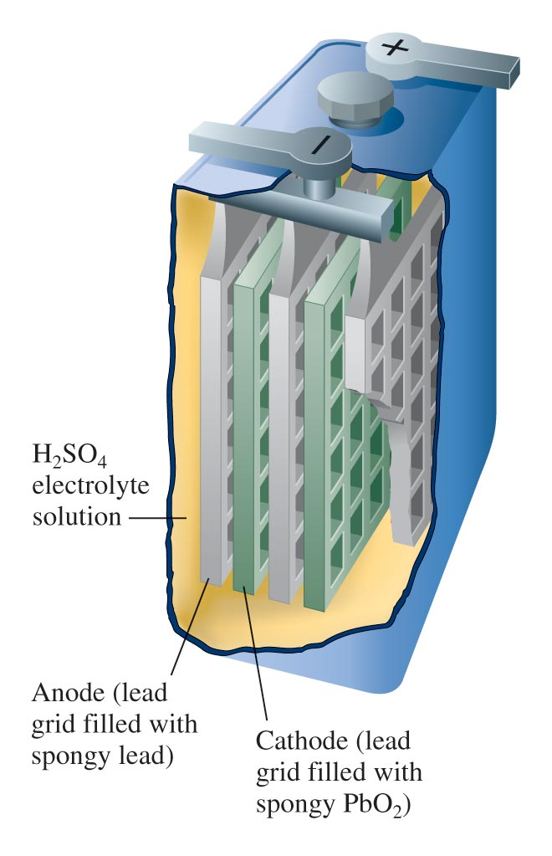
Lead Storage Battery

Slide 42
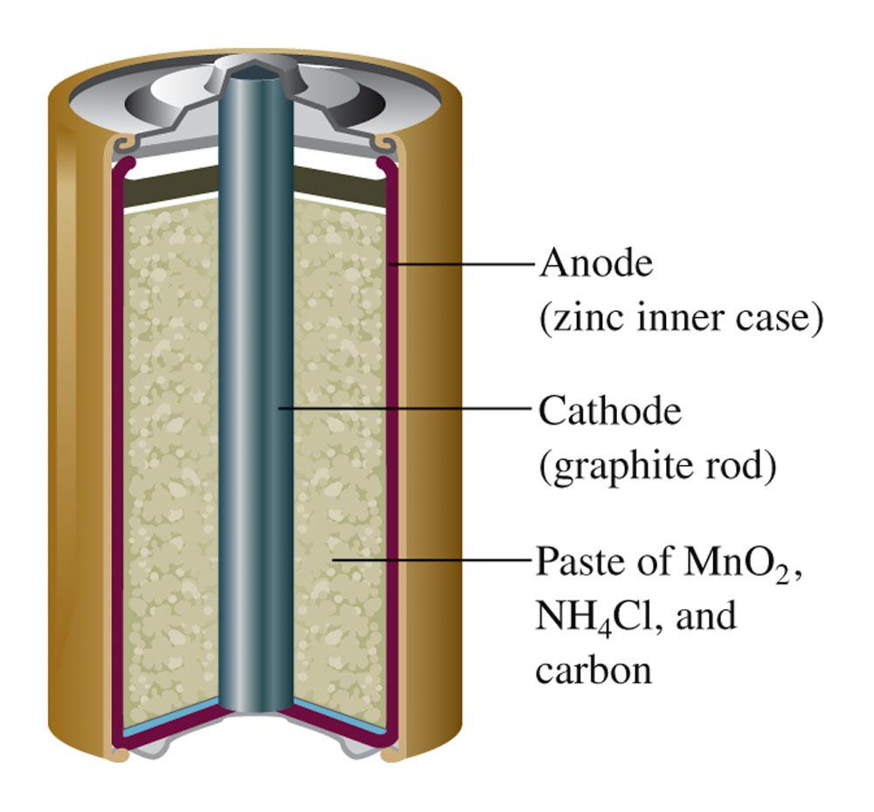
Nonalkaline Dry Cell

Slide 43
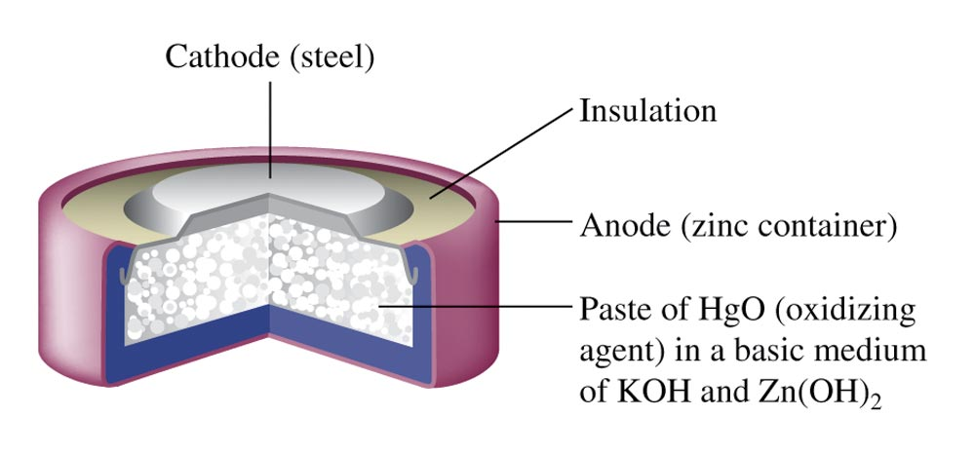
Mercury Battery

Slide 44
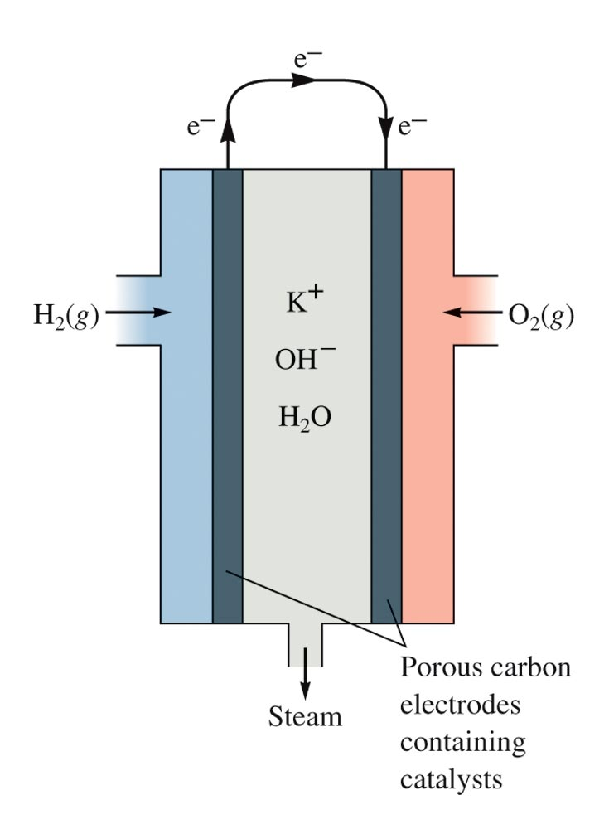
Fuel Cell

Slide 45
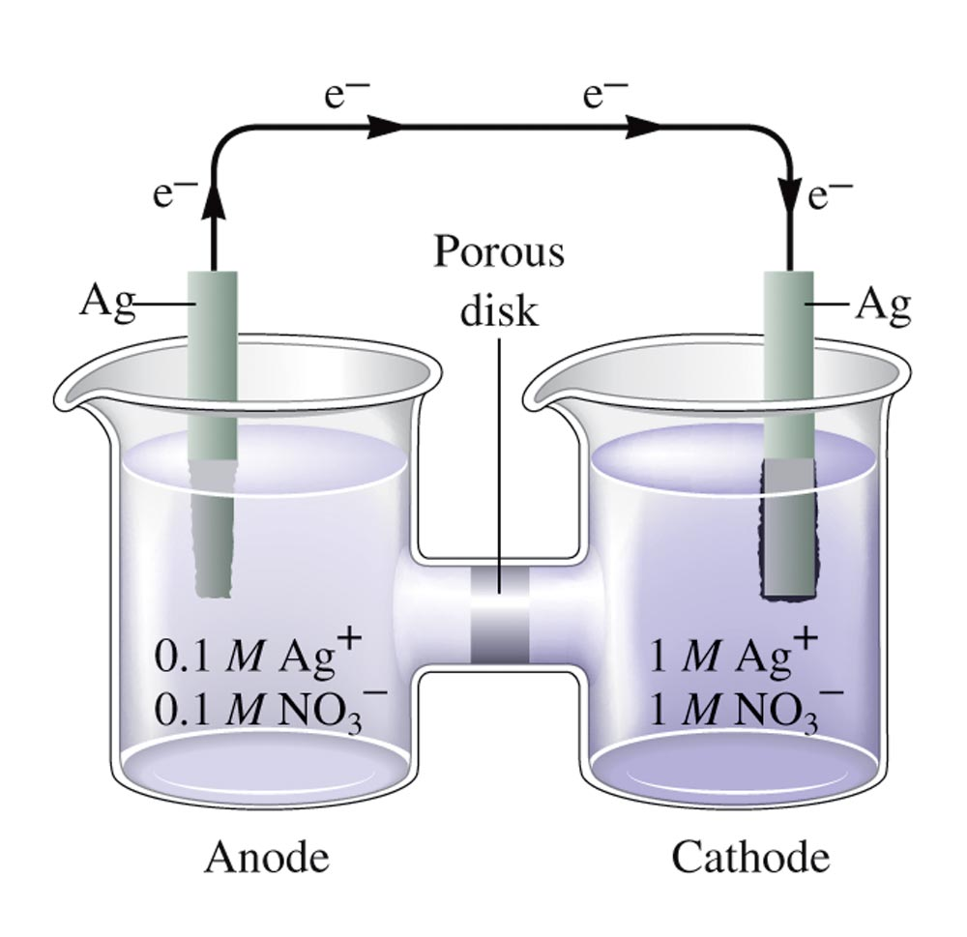
Concentration Cells

Slide 46
Concentration Cell
Indicate the anode and cathode half-cells in the concentration cell shown in the previous diagram.
Calculate the cell potential for the concentration cell depicted in this diagram.

Slide 47
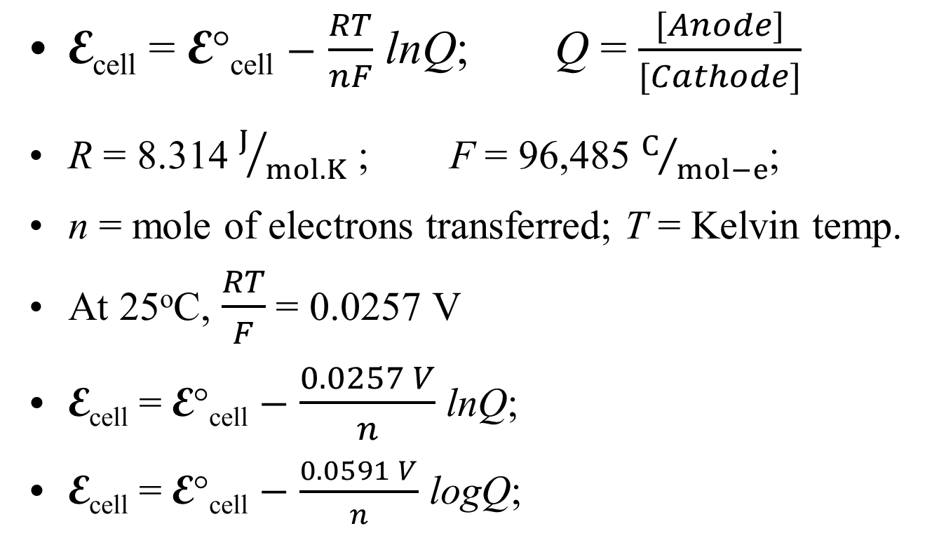
Nernst Equation
E_{cell} = E°_{cell} $−$ $\frac{RT}{nF}$ lnQ; Q = $\frac{[Anode]}{[Cathode]}$
R = 8.314 $J/{mol.K}$ ; F = 96,485 $C/{mol−e}$;
n = mole of electrons transferred; T = Kelvin temp.
At 25ºC, $\frac{RT}{F}$ = 0.0257 V
E_{cell} = E°_{cell} $−$ $\frac{0.0257 V}{n}$ lnQ;
E_{cell} = E°_{cell} $−$ $\frac{0.0591 V}{n}$ logQ;

Slide 48
Cell Potential for Concentration Cells
A concentration cell is set up with one of the half-cells consists of a silver electrode in 1.0 M AgNO₃ and other other half-cell contains silver electrode in saturated solution of AgCl (K_{sp} = 1.6 x 10⁻¹⁰ at 25ºC).
  Sketch a diagram for this concentration cell, and identify the anode and cathode half-cells.
  Determine the cell potential (E_{cell})

Slide 49
Concentration Cell and Determination of K_{sp}
In another set up of a concentration cell, one of the half-cells contains 1.0 M CuSO₄ and the other contains saturated solution of CuCO₃. Copper metal is used as the electrode in each half-cell. (a) If the cell potential at 25ºC is 0.28 V, calculate the concentrations of Cu²⁺ and CO₃²⁻ in the saturated CuCO₃ solution. (b) What is the K_{sp} of CuCO₃ at 25ºC?

Slide 50
Cell Potential, Free Energy, and Electrical Work
Maximum cell potential and free energy
  ΔG° = –nFEº
    F = 96,485 C/mol e– (Faraday’s constant)
ΔG° for spontaneous process = maximum energy that can be converted to the work form of energy.
Actual amount of energy can be converted to do work is always less than what is calculated, because some energy is always lost to surrounding.

Slide 51
Corrosion
Corrosion is an electrochemical process in which the metal is oxidized.
To prevent corrosion, the metal must be protected from being oxidized.

Slide 52
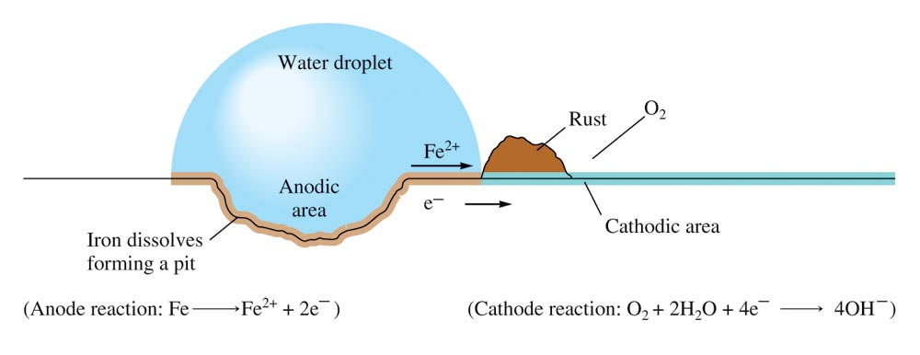
Corrosion of Iron

Slide 53
Corrosion Prevention
Apply coating (such as paint or metal plating)
  Galvanizing (covering with zinc)
Alloying that prevent the metal of interest from being oxidized;
Anodic protection – corrosion protection for some metals by their oxide coating;
Cathodic protection;
  used to protects underground steel pipes from corrosion.

Slide 54
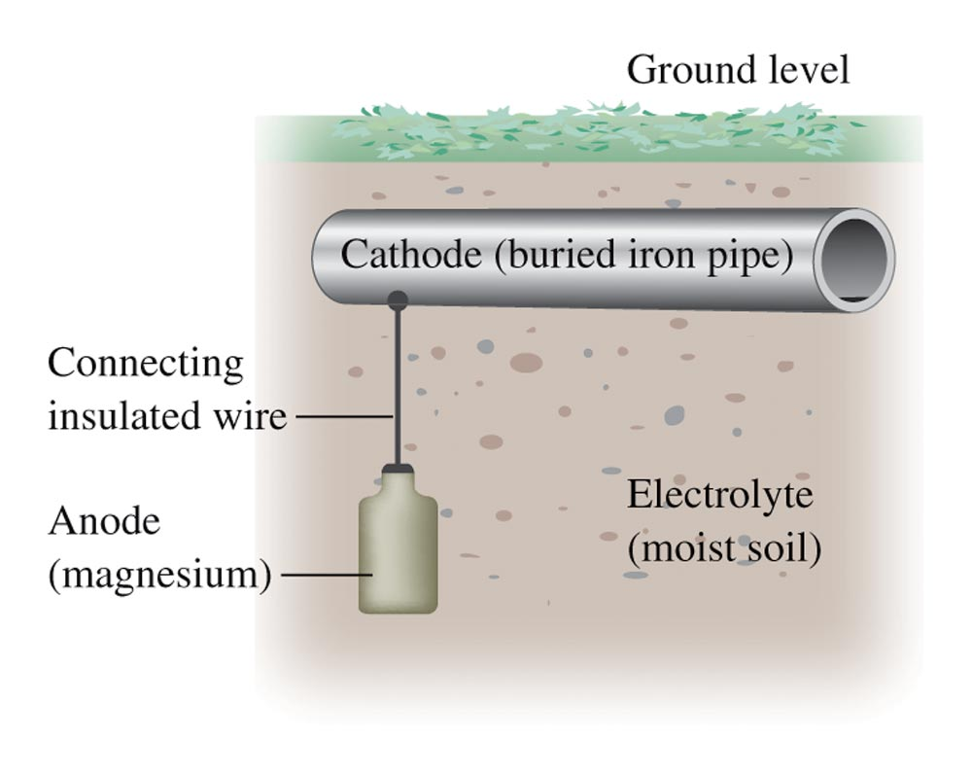
Cathodic Protection

Slide 55
Electrolysis
A process that forces a current through a cell to produce a chemical change for which the cell potential is negative.

Slide 56
Electrolysis
Consider a solution containing 0.10 M of each of the following: Ni²⁺, Cu²⁺, Zn²⁺, Sn²⁺, and Pb²⁺.
Predict the order in which the metals plate out as the voltage is applied.
Do the metals form on the cathode or the anode? Explain.

Slide 57
Commercial Electrolytic Processes
Production of aluminum
Purification of metals
Metal plating
Electrolysis of sodium chloride
Production of chlorine and sodium hydroxide

Slide 58
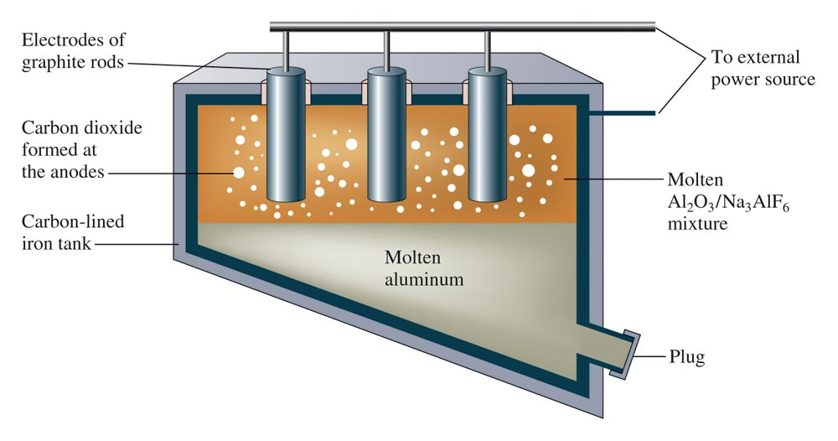
The Hall-Heroult Process for Al Production

Slide 59
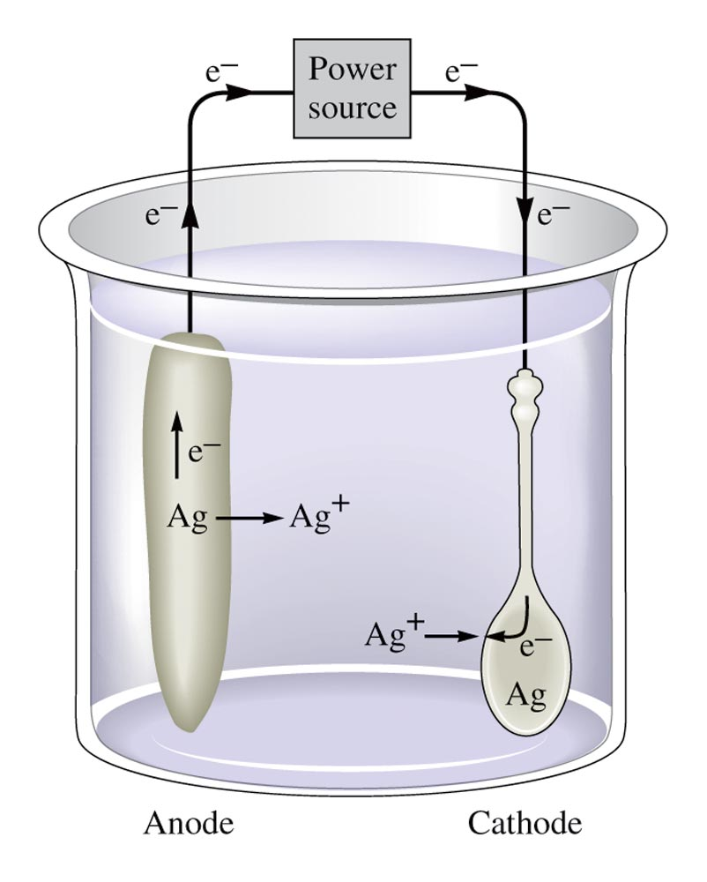
Electroplating/Silver Plating a Spoon

Slide 60
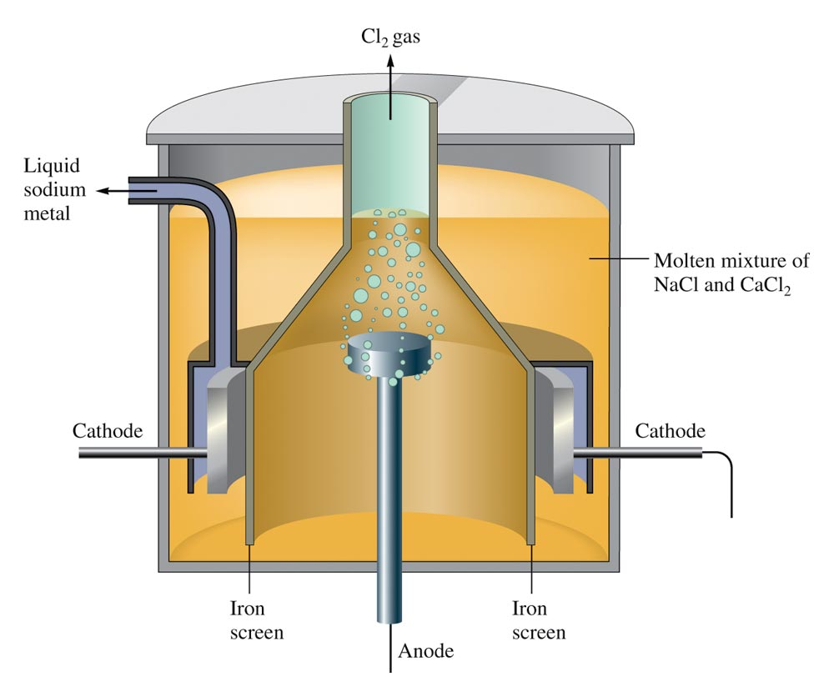
The Downs Cell for the Electrolysis of Molten Sodium Chloride

Slide 61
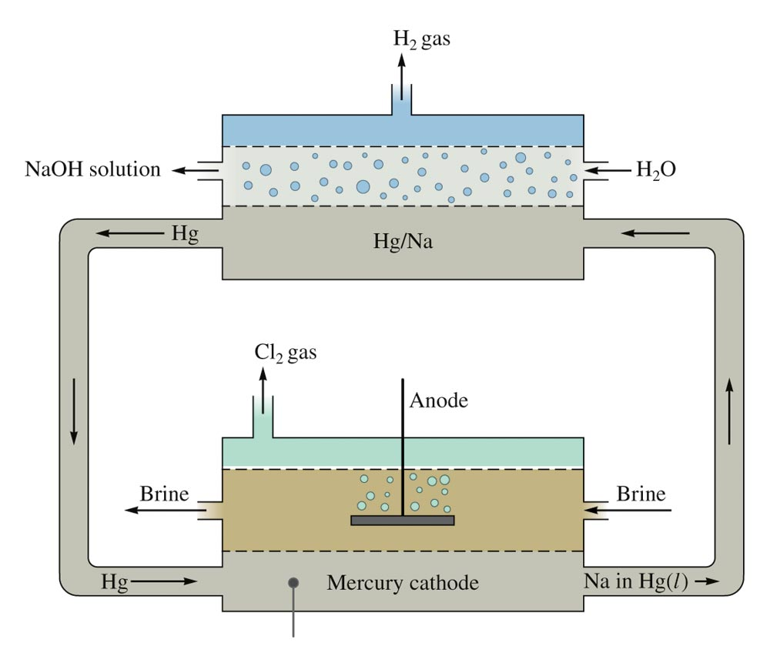
The Mercury Cell for Production of Chlorine and Sodium Hydroxide

