Slide 1
THERMODYNAMICS
Spontaneity
Entropy: Criteria for Spontaneity
Second Law of Thermodynamics
Third Law of Thermodynamics
Free Energy
Coupled Reactions

Slide 2
Thermodynamics
The chemistry that deals with the flow of energy during a chemical or physical process;
Determine whether a reaction is endothermic or exothermic;
Provide criteria to predict whether a reaction is spontaneous or non-spontaneous;
Provide relationship between free energy and work;

Slide 3
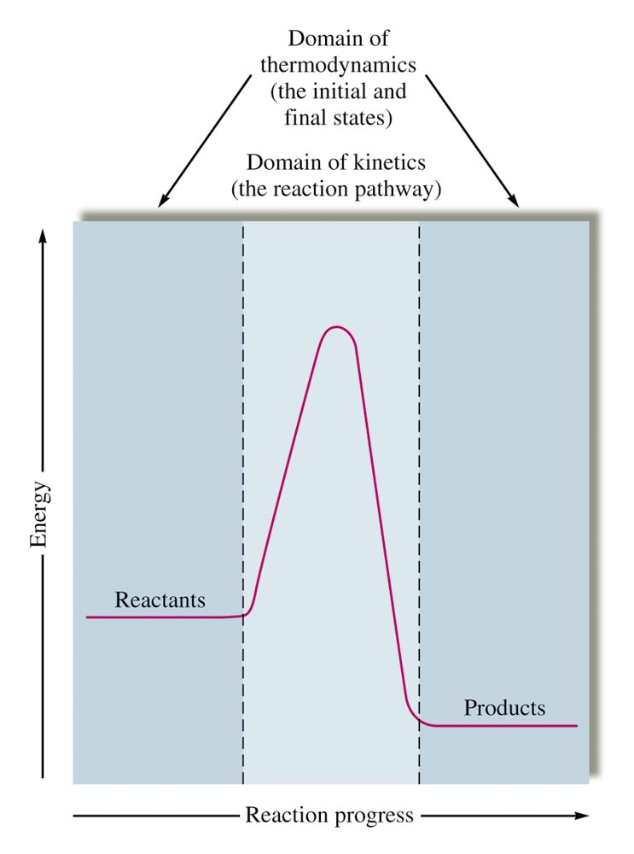
Thermodynamics vs. Kinetics
Kinetics Domain
Reaction rates depend on the path from reactants to products.
Thermodynamics domain:
tells us in which direction energy flows during changes, and whether a reaction is spontaneous or non-spontaneous;

Slide 4
First Law of Thermodynamics
This is the law of conservation of energy ➔
Energy cannot be created or destroyed;
The energy content of a thermodynamic universe is constant.
For a system that absorbs q amount of heat and does W amount of work, the change in its internal energy (ΔE) is:
ΔE = q + W
For work that only involves gas expansion or compression,
W = -pΔV; (p = pressure exerted on the system)

Slide 5
Enthalpy versus Energy
ΔE = energy change for a process at constant constant volume;
ΔE = q + W = q_{v}; (at constant volume, W = 0)
ΔH = enthalpy or energy change for a process at constant pressure P;
ΔH = q_{p} = ΔE – W = ΔE + PΔV;
q > 0: system absorbs heat; q < 0: system loses heat
W < 0: work done by system; W > 0: work done on system;

Slide 6
Predicting Spontaneous Processes
Thermodynamics allows us to predict whether a process will take occur spontaneously, but it does not tell us how fast it will occur;
A spontaneous process is one that, once it starts, will continue to occur without outside intervention;
like a ball rolling down a slope;
A nonspontaneous process one that requires a continuous external intervention to occur;
like pushing a bicycle uphill;

Slide 7
A spontaneous but very slow process
The conversion of carbon from the diamond to graphite is predicted to be spontaneous at ambient pressure, but its rate is immeasurably slow at low to moderate temperatures. The rate becomes measurable only at temperatures in the 1000–2000 K range.
(credit “diamond” photo: modification of work by “Fancy Diamonds”/Flickr; credit “graphite” photo: modificaton of work by images-of-elements.com/carbon.php)

Slide 8
Expansion of Gas into a Vacuum (Spontaneous and relatively fast)
An isolated system consists of an ideal gas in one flask that is connected by a closed valve to a second flask containing a vacuum. Once the valve is opened, the gas spontaneously becomes evenly distributed between the flasks.

Slide 9
The Flow of Heat
When two objects at different temperatures come in contact, heat spontaneously flows from the hotter to the colder object.

Slide 10
Scientists responsible for introducing criteria for spontaneity
(a) Nicholas Léonard Sadi Carnot’s extensive research on the efficiency of steam-powered machinery led to the concept of heat flow and spontaneous process;
(b) Rudolf Clausius’s study on Carnot’s work resulted in the introduction of “Entropy” as thermodynamic function for predicting spontaneous processes.

Slide 11
Spontaneous Processes
Some examples of spontaneous processes/reactions:
The corrosion of iron is spontaneous, but the reverse is not:
4Fe(s) + 3 O₂(g) → 2Fe₂O₃(s)
Ice melts spontaneously at room temperature, but water will not freeze at room temperature:
H₂O(s) → H₂O(l)
Heat spontaneously flows from a hot object to a cold object if the objects are in contact.

Slide 12
Entropy
A thermodynamic function related to the distribution of heat:
A process that is accompanied by an increase in the heat distribution or dispersion implies an increase in entropy, and is a spontaneous process;
Ludwig Boltzmann described entropy as the number of microstates of energy in which a system can exist;
A system that can exist in many different microstates of energy has a very high entropy.
Entropy is related to the degree of energy states a thermodynamic universe can exist.

Slide 13
What is the significance of entropy?
Nature spontaneously progress into a “situation” that has the highest probability of energy states or highest entropy;
Entropy change is used to predict whether a given process/reaction is thermodynamically possible;

Slide 14
Microstates for 4 Particles in 2 Boxes
The sixteen microstates associated with placing four particles in two boxes are shown. The microstates are grouped into five distributions: (a), (b), (c), (d), and (e), based on the numbers of particles in each box.

Slide 15
Microstates for Heat Flow
This is a microstate model describing the flow of heat from a hot object to a cold object.
Before the heat flow occurs, the object comprised of particles A and B contains both units of energy and as represented by a distribution of three microstates.
If the heat flow results in an even dispersal of energy (one energy unit transferred), a distribution of four microstates results.
If both energy units are transferred, the resulting distribution has three microstates.

Slide 16
Physical States and Entropy
Entropy can be related to the degree of freedom a system can exist in its microstate.
The more degree of freedom the microstate of a system can exist, the higher its entropy.
S_{gas} >> S_{liquid} > S_{solid}

Slide 17
Changes in Entropy with Phase Changes
The entropy of a substance increases (ΔS > 0) as it transforms from a relatively ordered solid, to a less-ordered liquid, and then to a still less-ordered gas. The entropy decreases (ΔS < 0) as the substance transforms from a gas to a liquid and then to a solid.

Slide 18
Entropy as a Function of Temperature
Entropy increases as the temperature of a substance is raised, which corresponds to the greater spread of kinetic energies. When a substance melts or vaporizes, its entropy increases significantly.

Slide 19
Relative Entropy of Substances
Entropy:
increases from solid-to-liquid-to-vapor/gas;
increases when temperature is increased;
increases as gas volume is increased at constant temperature;
increases when gases are mixed.
increases from top to bottom down a group in the periodic table;
increases as the structure of a compound becomes more complex.

Slide 20
Concept Check-#1
Consider 1.0 moles of a gas contained in a 1.0-L bulb at a constant temperature of 25°C. This bulb is connected by a valve to an evacuated 5.0-L bulb. At constant temperature,
What should happen to the gas when the valve is opened?
What are the values of ΔH, ΔE, q, and w for this process?
Base on the answers given to parts (a) and (b), what is the driving force for the process?
Notes:
The gas should spread evenly throughout the two bulbs.

Slide 21
Concept Check-#2
Predict the sign of ΔS for each of the following, and explain:
The evaporation of alcohol;
Snowing;
Compressing an ideal gas at constant temperature;
Mixing of gases;
Dissolving NaCl in water.
Notes:
a) + (a liquid is turning into a gas)
b) - (more order in a solid than a liquid)
c) - (the volume of the container is decreasing)
d) + (the volume of the container is increasing)
e) + (there is less order as the salt dissociates and spreads throughout the water)

Slide 22
Standard Entropy Values, Sº
This is the entropy of a substance in its most stable state at 1 atm and 25ºC.
For ionic species in solution, it is the entropy of ions in 1 M solution at 25ºC relative to that of H⁺(aq), which is assigned zero entropy value.

Slide 23
Standard Entropy Change (ΔS°)
The standard entropy change (ΔSº) for a reaction is calculated using the following equation:
ΔS°_{reaction} = Σn_{p}S°_{products} – Σn_{r}S°_{reactants}

Slide 24
Entropy Change in Chemical Reactions
At constant temperature and pressure,
ΔSº_{rxn} = Σn_{p}Sº_{products} – Σn_{r}Sº_{reactants}
In general, ΔSº_{rxn} > 0 if Σn_{p} > Σn_{r}
Example-1:
C₃H₈(g) + 5O₂(g) → 3CO₂(g) + 4H₂O(g), (Σn_{p} > Σn_{r})
ΔSº_{rxn} = {(3 x SºCO₂) + (4 x SºH₂O)} – {(SºC₃H₈) + (5 x SºO₂)}
= {(3 x 214) + (4 x 189)}J/K – {270 + (5 x 205)}J/K
= (642 + 756) J/K – (270 + 1025) J/K
= 103 J/K

Slide 25
Entropy Change in Chemical Reactions
Example-2:
CO(g) + 2H₂(g) → CH₃OH(g), (Σn_{p} < Σn_{r})
ΔSº_{rxn} = (SºCH₃OH) – {(SºCO) + (2 x (SºH₂)}
= 240 J/K – {198 J/K + 2 x (131 J/K)}
= 240 J/K – 460 J/K = -220 J/K
ΔSº_{rxn} < 0 (has a negative value) if Σn_{p} < Σn_{r}

Slide 26
Second Law of Thermodynamics
A spontaneous process is always accompanied by an increase in the entropy of the universe.
The entropy of universe always increases.
ΔS_{universe} = ΔS_{system} + ΔS_{surroundings}

Slide 27
Second Law of Thermodynamics
Energy flows from a concentrated energy state to a diffused energy state;
Diffusion of energy state is a spontaneous process.
Diffusion of energy state represents increase in entropy;
According to SLoT, a process is spontaneous if the entropy of the universe increases.

Slide 28
Third Law of Thermodynamics
A perfect crystalline solid at 0 K has no kinetic energy;
A perfect crystalline solid at 0 K with no kinetic energy has only one microstate (W = 1)
According to Boltzmann equation, entropy
S = k ln W = k ln (1) = 0
The entropy of a pure, perfect crystalline solid at 0 K is zero.

Slide 29
Δs_{sys} versus ΔS_{surr}
The algebraic sign of ΔS_{sys} (+ or -) depends on relative energy distribution before and after the change;
The algebraic sign of ΔS_{surr} (+ or -) depends on the direction of the heat flow;
Heat flows from system to surrounding, ΔS_{surr} > 0;
Heat flows from surrounding to system, ΔS_{surr} < 0;
Magnitude of ΔS_{surr} also depends on the temperature at which the exchange of heat occurs.

Slide 30
Magnitude & Algebraic Sign of ΔS_{surr}

Slide 31
Magnitude & Algebraic Sign of ΔS_{surr}
ΔS_{surr} = − $\frac{∆Hsys}{T}$
For exothermic reactions, ΔH_{sys} < 0, ΔS_{surr} > 0;
For endothermic reactions, ΔH_{sys} > 0, ΔS_{surr} < 0;

Slide 32
Conditions for Spontaneous Process
Predicting spontaneity of a process using ΔSuniv:
ΔSuniv = ΔSsys + ΔSsurr > 0; ➔ spontaneous;
ΔSuniv = ΔSsys + ΔSsurr < 0; ➔ nonspontaneous;
ΔSuniv = ΔSsys + ΔSsurr = 0; ➔ state of equilibrium;
ΔSuniv = ΔSsys + ΔSsurr = ΔSsys − $\frac{∆Hsys}{T}$

Slide 33
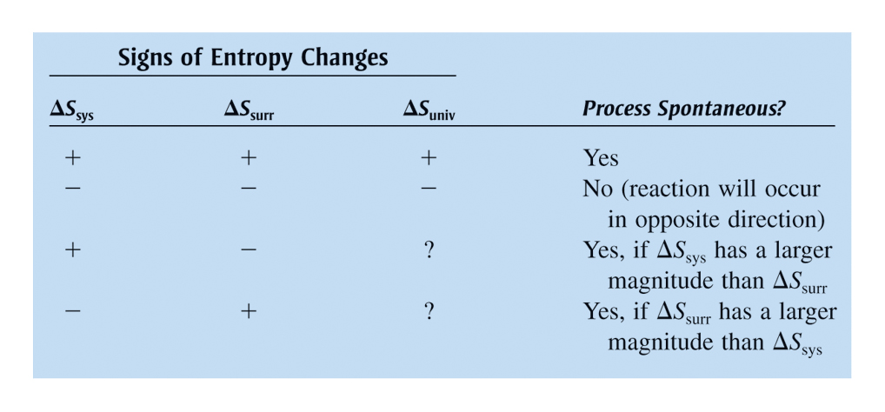
Interplay of ΔS_{sys} and ΔS_{surr} in Determining the Sign of ΔS_{univ}

Slide 34
Gibbs Free Energy, ΔG
ΔSuniv = ΔSsys + ΔSsurr
ΔSuniv = ΔSsys − $\frac{∆Hsys}{T}$ > 0; ➔ spontaneous
TΔSuniv = TΔSsys − ΔHsys
ΔG = − TΔSuniv
ΔG = ΔHsys − TΔSsys
ΔG < 0; ➔ a spontaneous process

Slide 35
Effect of ΔH and ΔS on Spontaneity

Slide 36
Concept Check-#3
Describe the following as spontaneous/non-spontaneous/cannot tell, and explain.
A reaction that is:
(a) Exothermic and becomes more random
Spontaneous
(b) Exothermic and becomes less random
Cannot tell
(c) Endothermic and becomes more random
Cannot tell
(d) Endothermic and becomes less random
Not spontaneous
Explain how temperature would influence your answers.
Notes:
a) Spontaneous (both driving forces are favorable). An example is the combustion of a hydrocarbon.
b) Cannot tell (exothermic is favorable, positional randomness is not). An example is the freezing of water, which becomes spontaneous as the temperature of water is decreased.
c) Cannot tell (positional randomness is favorable, endothermic is not). An example is the vaporization of water, which becomes spontaneous as the temperature of water is increased..
d) Not spontaneous (both driving forces are unfavorable).
Questions "a" and "d" are not affected by temperature. Choices "b" and "c" are explained above.

Slide 37
Free Energy (G)
ΤΔS_{univ} = - ΔG (at constnt T and P)
At constant temperature and pressure, a process is spontaneous if ΔG is negative (ΔG < 0 ;
A process progress spontaneous in the direction that decreases the free energy, G, until it react equilibrium.

Slide 38
Solar Energy is Free

Slide 39
What Free Energy?

Slide 40
Free Energy, ΔG
It is the maximum amount of chemical energy from a spontaneous reaction that can be utilized to do work or to drive a nonspontaneous process;
W_{max} = ΔG
It is the minimum amount of energy that must be supplied to make a nonspontaneous reaction occur.

Slide 41
Free Energy and Work
Maximum work from free energy of a spontaneous process is only achievable in a hypothetical slow reversible process.
In a real process occurring at normal, measurable rate, only a fraction of the free energy can be converted into work; most of it is lost as heat, which is a waste form of energy.

Slide 42
Temperature Dependence of ΔG
These plots show the variation in ΔG with temperature for the four possible combinations of arithmetic sign for ΔH and ΔS.

Slide 43
Algebraic Signs of ΔS, ΔH and ΔG
There are four possibilities regarding the signs of enthalpy and entropy changes.

Slide 44
Effect of Temperature on ΔG and Spontaneity
——————————————————————————————————
ΔH ΔS T ΔG Comments Examples
——————————————————————————————————
- + high - spontaneous at 2H₂O₂(l) → 2H₂O(l) + O₂(g)
or low all temperature
+ + high - spontaneous at CaCO₃(s) → CaO(s) + CO₂(g)
high temperature
- - low - spontaneous at N₂(g) + 3H₂(g) → 2NH₃(g)
low temperature
+ - high + nonspontaneous at 2H₂O(l) + O₂(g) → 2H₂O₂(l)
or low all temperature
________________________________________________________

Slide 45
Standard Free Energy (ΔG°)
Under standard condition,
ΔG° = ΔH° – TΔS°
For a reaction under standard condition,
ΔG°_{reaction} = Σn_{p}G°_{products} – Σn_{r}G°_{reactants}

Slide 46
General Expression for ΔG
For a reaction under any condition:
ΔG = ΔGº + RTlnQ
For a reaction at equilibrium:
ΔG = ΔGº + RTlnK = 0;
lnK = - $\frac{ΔG^{o}}{RT}$
lnK = - $\frac{∆H^{o}}{R}$($\frac{1}{T}$) + $\frac{∆S^{o}}{R};$ (R = 8.314 J/K.mol)

Slide 47
ΔG and Pressure for Phase Equilibrium
For liquid-vapor equilibrium at any temperature,
ΔG = ΔGº + RTlnP = 0; (P = vapor pressure in atm)
lnP = - $\frac{∆H^{o}}{R}$($\frac{1}{T}$) + $\frac{∆S^{o}}{R};$ (T is in Kelvin)
(In this case, ΔHº = ΔH_{vap} = enthalpy of vaporization)
If lnP is plotted against 1/T,
the slope = - $\frac{∆Hvap}{R}$; the intercept = $\frac{∆Svap}{R}$

Slide 48
Estimating boiling point from ΔH_{vap} and ΔS_{vap}
For phase equilibrium between liquid and vapor at 1 atm, the equilibrium temperature is also the boiling point of the liquid.
At phase equilibrium: ΔGº = ΔHº $−$ TΔSº = 0; T = $\frac{∆H}{∆S}$;
For liquid-vapor equilibrium, T_{b} = $\frac{∆Hovap}{∆Sovap}$ ;
(ΔHº_{vap} and ΔSº_{vap} are standard enthalpy and standard entropy of vaporization, and T_{b} = boiling point.)

Slide 49
Estimating Boiling Point
Consider the process: C₂H₅OH(l) $⇌$ C₂H₅OH(g)
at 1 atm (standard pressure condition)
Given:
ΔHº_{f}[C₂H₅OH(l)] = -277.6 kJ/mol;
ΔHº_{f}[C₂H₅OH(g)] = -234.8 kJ/mol;
Sº[C₂H₅OH(l)] = 160.7 J.mol⁻¹.K⁻¹;
Sº[C₂H₅OH(g)] = 281.6 J.mol⁻¹.K⁻¹;
Calculate ΔHº_{vap} and ΔSº_{vap}, and estimate the boiling point of ethanol, C₂H₅OH.

Slide 50
Estimating Boiling Point
(Solution to previous problem):
For the process: C₂H₅OH(l) $⇌$ C₂H₅OH(g)
at 1 atm (standard pressure condition)
ΔHº_{vap} = (-234.8) – (-277.6) = 42.8 kJ.mol⁻¹;
ΔSº_{vap} = (281.6 – 160.7) = 120.9 J.mol⁻¹.K⁻¹;
T_{b} = $\frac{∆H^{o}vap}{∆S^{o}vap}$ = $\frac{42.8 kJ.mol^{−1}}{0.1209 kJ.mol^{−1}.K^{−1}}$ = 354 K ~ 81 ºC
(This is an estimate, because we use ΔHº_{vap} and ΔSº_{vap} values at 25 ºC)

Slide 51
Concept Check-#4
A liquid is vaporized at its boiling point. Predict the signs of:
w
q
ΔH
ΔS_{sys}
ΔS_{surr}
ΔG
Explain your answers.
–
+
+
+
–
0
Notes:
As a liquid goes to vapor, it does work on the surroundings (expansion occurs). Heat is required for this process. Thus, w = negative; q = ΔH = positive. ΔS = positive (a gas is more disordered than a liquid), and ΔS_{surr} = negative (heat comes from the surroundings to the system); ΔG = 0 because the system is at its boiling point and therefore at equilibrium.

Slide 52
Transition Temperature
T = $\frac{∆H}{∆S}$ is also the transition temperature when a reaction changes from spontaneous to nonspontaneous, and vice versa;
At transition temperature, T_{r}, ΔGº = 0;
ΔGº = ΔHº – T_{r}ΔSº = 0; ➔ T_{r} = $\frac{ΔH^{o}}{ΔS^{o}}$

Slide 53
Estimating Transition Temperature
Consider the reaction: N₂(g) + 3H₂(g) → 2NH₃(g)
where ΔHº = -91.8 kJ and ΔSº = -198.1 J/K = -0.1981 kJ/K
At 298, TΔSº = 298 K x (-0.199 J/K) = -59.3 kJ
ΔGº = ΔHº - TΔSº = -92 kJ – (-59.3 kJ) = -33 kJ;
➔ Reaction is spontaneous at 298 K under standard condition;
Transition temperature, T_{r} = $\frac{−91.8 kJ}{−0.1981 kJ/K}$ = 463 K ~ 190 ºC
This reaction will become nonspontaneous above 463 K if carried out under standard condition, (such that Q_{p} = 1)

Slide 54
Estimating Transition Temperature
Consider the reaction: CH₄(g) + H₂O(g) → CO(g) + 3H₂(g),
where ΔHº = 205.9 kJ and ΔSº = 214.7 J/K = 0.2147 kJ/K
At 298 K, TΔSº = 298 K x (0.2147 J/K) = 64.0 kJ
ΔGº = ΔHº - TΔSº = 205.9 kJ – (64.0 kJ) = 141.9 kJ;
➔ Reaction is not spontaneous at 298 K (under standard condition)
Transition temperature, T_{r} = $\frac{205.9 kJ}{0.2147 kJ/K}$ = 959.0 K ~ 686 ºC
This reaction will become spontaneous above 959 K if carried out under standard condition, (such that Q_{p} = 1)

Slide 55
Reaction spontaneous at low temperature but not at high temperature (ΔH < 0; ΔS < 0)
Consider the following reaction:
N₂(g) + 3H₂(g) → 2NH₃(g),
ΔHº = -91.8 kJ and ΔSº = -198.1 J/K = -0.1981 kJ/K
At 298 K, TΔSº = 298 K x (-0.1981 J/K) = -59.0 kJ
ΔGº = ΔHº - TΔSº = -91.8 kJ – (-59.0 kJ) = -32.8 kJ;
ΔGº < 0 ➔ reaction is spontaneous at 298 K;
At 500 K, TΔSº = 500 K x (-0.1981 J/K) = -99.0 kJ;
ΔGº = ΔHº - TΔSº = -91.8 kJ – (-99.0 kJ) = 7.2 kJ;
ΔGº > 0 ➔ reaction is nonspontaneous at 500 K

Slide 56
Reaction spontaneous at high temperature but not at low temperature (ΔH > 0; ΔS > 0)
Consider the following reaction:
CH₄(g) + H₂O(g) → CO(g) + 3H₂(g),
where ΔHº = 205.9 kJ and ΔSº = 214.7 J/K = 0.2147 kJ/K
At 298 K, TΔSº = 298 K x (0.2147 J/K) = 64.0 kJ
ΔGº = ΔHº - TΔSº = 205.9 kJ – 64.0 kJ = 141.9 kJ;
ΔGº > 0 ➔ reaction is nonspontaneous at 298 K.
At 1000 K, TΔSº = 1000 K x (0.2147 J/K) = 214.7 kJ;
ΔGº = ΔHº - TΔSº = 205.9 kJ – 214.7 kJ) = -8.8 kJ;
ΔGº > 0 ➔ reaction is spontaneous at 1200 K

Slide 57
ΔG under Nonstandard Conditions
Free energy also depends on concentration and partial pressure;
ΔG = ΔGº + RTlnQ_{p},
Under nonstandard conditions (Q_{p} $≠$ 1),
Consider the reaction: N₂(g) + 3H₂(g) → 2NH₃(g) at 500 K,
where P_{N2} = 40. atm; P_{H2} = 120. atm, and P_{NH3} = 20. atm
Q_{p} = $\frac{{\left(PNH3\right)}^{2}}{\left(PN2\right){\left(PH2\right)}^{3}}$ = $\frac{{\left(20\right)}^{2}}{\left(40\right){\left(120\right)}^{3}}$ = 5.8 x 10⁻⁶
At 500 K, ΔG = 7.2 kJ + (0.008314 kJ/(mol.K))(500 K)ln(5.8 x 10⁻⁶)
= 7.2 kJ + (-50. kJ) ~ $−$ 43 kJ
ΔG < 0 ➔ reaction is spontaneous under above pressure conditions;

Slide 58
Free Energy and Equilibrium
Equilibrium occurs when reaction/process reaches the lowest possible value of free energy available to the system.
ΔG = ΔG° + RT lnK = 0;
ΔG° = –RT lnK;
lnK = $−\frac{ΔG^{o}}{RT}$

Slide 59
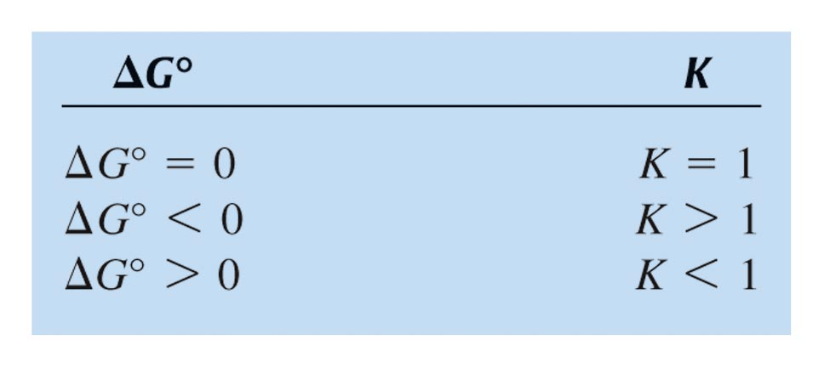
Qualitative Relationship Between ΔGº and K for Reaction

Slide 60
Calculating K from ΔGº
Consider the reaction: N₂(g) + 3H₂(g) → 2NH₃(g),
At 298 K, ΔGº = -32.8 kJ
lnK = $−$ $\frac{(−32.8 kJ}{(298 K)(0.008314 kJ.mol^{−1}.K^{−1})}$ = 13.2
K = e^{13.2} = 5.40 x 10⁵ (large K at low temperature)
At 500 K, ΔGº = 7.2 kJ;
lnK = $−$ $\frac{7.2 kJ}{(500 K)(0.008314 kJ.mol^{−1}.K^{−1})}$ = -1.7
K = e^{-1.7} = 0.18 (small K at high temperature)
For exothermic reactions, K values decreases as the temperature is increased.

Slide 61
Coupling Reactions
A nonspontaneous reaction can be coupled to a spontaneous one to make it happen.
Example:
Fe₂O₃(s) → 2Fe(s) + ³/₂ O₂(g); ΔGº = 742.2 kJ (1)
3CO(g) + ³/₂O₂(g) → 3CO₂(g); ΔGº = -771.6 kJ (2)
Coupling reactions (1) and (2) yields a net reaction that is spontaneous:
Fe₂O₃(s) + 3CO(g) → 2Fe(s) + 3CO₂(g); ΔGº = -29.4 kJ

Slide 62
Coupling Reactions in Biological System
The formation of ATP from ADP and H₂PO₄⁻ is nonspontaneous, but it can be coupled to the hydrolysis of creatine-phosphate that has a negative ΔGº.
ADP + H₂PO₄⁻ → ATP + H₂O; ΔGº = +30 kJ
Creatine-phosphate → creatine + phosphate; ΔGº = -43 kJ
Coupling the two reactions yields a spontaneous overall reaction:
Creatine-phosphate + ADP → Creatine + ATP; ΔGº = -13 kJ

