Slide 1
Other Ionic Equilibria
Solubility Equilibrium
Complex Ion Formation
Multiple Equilibria
Factors Affecting Solubility

Slide 2
Solubility Equilibrium
Equilibrium between precipitates or solid compounds and their ionic species in aqueous solutions;
The solid continues to dissolve and ions continue to recombine to form the solid.
The rate of dissolution is equal to the rate of precipitation.

Slide 3
Solubility Equilibrium for AgCl
Silver chloride, AgCl, is only slightly soluble in water. When it is added to water, it dissolves slightly and forms a saturated solution containing a very dilute Ag⁺ and Cl– ions in equilibrium with undissolved AgCl: AgCl(s) $⇌$ Ag⁺(aq) + Cl⁻(aq)

Slide 4
Precipitation of Lead(II) Chromate
The chrome yellow paint contains lead(II) chromate, PbCrO₄, which readily forms a precipitate when solutions of Pb(NO₃)₂ and K₂CrO₄ are mixed. In the saturated solution of lead(II) chromate, equilibrium exists between solid PbCrO₄ and the ions Pb²⁺ and CrO₄²⁻ :
PbCrO₄(s) $⇌$ Pb²⁺(aq) + CrO₄²⁻(aq)

Slide 5
Solubility Product Constant
General expression:
M_{m}X_{n}(s) ⇄ mM^{n+}(aq) + nX^{m-}(aq)
Solubility product expression:
K_{sp} = [M^{n+}]^{m}[X^{m-}]^{n}

Slide 6
Calculating Molar Solubility from K_{sp}
Example-1:
AgCl(s) ⇌ Ag⁺(aq) + Cl⁻(aq);
K_{sp} = 1.6 x 10⁻¹⁰
If the solubility of AgCl = s mol/L, then the ion concentrations at equilibrium are:
[Ag⁺] = [Cl⁻] = s mol/L
K_{sp} = [Ag⁺][Cl⁻] = s² = 1.6 x 10⁻¹⁰
s = 1.3 x 10⁻⁵ mol/L

Slide 7
Calculating Molar Solubility from K_{sp}
Example-2:
Ag₂CrO₄(s) ⇌ 2Ag⁺(aq) + CrO₄²⁻(aq);
K_{sp} = 9.0 x 10⁻¹²
If the solubility of Ag₂CrO₄ = s mol/L, the ion concentrations at equilibrium are:
[Ag⁺] = 2s mol/L; and [CrO₄²⁻] = s mol/L
K_{sp} = [Ag⁺]²[CrO₄²⁻] = (2s)²(s) = 4s³ = 9.0 x 10⁻¹²
s = 1.3 x 10⁻⁴ mol/L

Slide 8
Solubility and Solubility Products
Example-3:
Ca(IO₃)₂(s) $⇌$ Ca²⁺(aq) + 2 IO₃⁻(aq);
K_{sp} = 7.1 x 10⁻⁷
If solubility of Ca(IO₃)₂ = s mol/L,
[Ca²⁺] = s mol/L, and [IO₃⁻] = 2s mol/L
K_{sp} = [Ca²⁺][IO₃⁻]² = 4s³ = 7.1 x 10⁻⁷
s = 5.6 x 10⁻³ mol/L

Slide 9
Calculating Solubility from K_{sp}
Example-4:
Ag₃PO₄(s) ⇌ 3Ag⁺(aq) + PO₄³⁻(aq)
K_{sp} = 1.8 x 10⁻¹⁸
Solubility of Ag₃PO₄ = s mol/L,
[Ag⁺] = 3s mol/L, and [PO₄³⁻] = s mol/L
K_{sp} = [Ag⁺]³[PO₄³⁻] = (3s)³(s) = 27s⁴ = 1.8 x 10⁻¹⁸
s = 1.6 x 10⁻⁵ mol/L

Slide 10
Solubility from Solubility Products
Example-5:
Cr(OH)₃(s) ⇌ Cr³⁺(aq) + 3OH⁻(aq);
K_{sp} = 6.7 x 10⁻³¹
Solubility of compound = s mol/L;
[Cr³⁺] = s mol/L; [OH⁻] = 3s mol/L
K_{sp} = [Cr³⁺][OH⁻]³ = (s)(3s)³ = 27s⁴ = 6.7 x 10⁻³¹
s = 1.3 x 10⁻⁸ mol/L

Slide 11
Calculating Solubility from K_{sp}
Example-6:
Ca₃(PO₄)₂(s) ⇌ 3Ca²⁺(aq) + 2PO₄³⁻(aq);
K_{sp} = 1.3 x 10⁻³²
If solubility of Ca₃(PO₄)₂ = s mol/L,
[Ca²⁺] = 3s mol/L, and [PO₄³⁻] = 2s mol/L
K_{sp} = [Ca²⁺]³[PO₄³⁻]² = (3s)³(2s)² = 108s⁵ = 1.3 x 10⁻³²
s = 1.6 x 10⁻⁷ mol/L

Slide 12
Solubility and Solubility Products
PbCrO₄(s) ⇌ Pb²⁺(aq) + CrO₄²⁻(aq)
K_{sp} = [Pb²⁺][CrO₄²⁻] = s²
If the solubility of PbCrO₄ is s mol/L, then
Then, [Pb²⁺] = s and [CrO₄²⁻] = s
K_{sp} = s²

Slide 13
Calculating K_{sp} from Solubility
Example-1: Suppose that saturated solution of lead(II) chromate contains 4.6 μg of PbCrO₄ in 1.0 L of solution. Calculate: (a) the solubility of PbCrO₄ in mol/L, and (b) the K_{sp} value for this compound.

Slide 14
Calculating K_{sp} of PbCrO₄ from Solubility
Example-7:
PbCrO₄(s) ⇌ Pb²⁺(aq) + CrO₄²⁻(aq)
K_{sp} = [Pb²⁺][CrO₄²⁻] = s²
(a) Solubility of PbCrO₄ in mol/L =
$\frac{4.6 μg}{L}$ x $\frac{{10}^{−6} g}{μg}$ x $\frac{1 mole}{323.2 g}$ = 1.4 x 10⁻⁸ mol/L
[Pb²⁺] = [CrO₄²⁻] = 1.4 x 10⁻⁸ mol/L
K_{sp} = s² = (1.4 x 10⁻⁸)² = 2.0 x 10⁻¹⁶

Slide 15
Calculating K_{sp} from Solubility
Example-8:
The solubility of calcium hydroxide, Ca(OH)₂, is 0.51 g/L. What is the solubility in mol/L? Calculate the K_{sp} of Ca(OH)₂.
Solution:
Solubility, s, in mol/L = $\frac{0.51 g}{L}$ x $\frac{1 mole}{74.096 g}$ = 6.9 x 10⁻³ mol/L;
Ca(OH)₂(s) ⇌ Ca²⁺(aq) + 2 OH⁻(aq);
[Ca²⁺] = 6.9 x 10⁻³ mol/L; [OH⁻] = 2(6.9 x 10⁻³) mol/L;
K_{sp} = [Ca²⁺][OH⁻]² = 4s³ = 4(6.9 x 10⁻³)³ = 1.3 x 10⁻⁶

Slide 16
Calculating K_{sp} from Solubility
Example-9:
Saturated solution of magnesium hydroxide has pH = 10.42. What is the solubility in mol/L and the K_{sp} of Mg(OH)₂ ?
Solution: solubility equilibrium of magnesium hydroxide:
Mg(OH)₂(s) ⇌ Mg²⁺(aq) + 2 OH⁻(aq);
pH = 10.42, ➔ pOH = 3.58; ➔ [OH⁻] = 10^{-3.58} = 2.6 x 10⁻⁴ M
[Mg²⁺] = ½ (2.6 x 10⁻³ M = 1.3 x 10⁻⁴ mol/L = s
K_{sp} = [Mg²⁺][OH⁻]² = 4s³ = 4(1.3 x 10⁻⁴)³ = 8.8 x 10⁻¹²

Slide 17
Predicting Formation of Precipitate
Q_{sp} = K_{sp} ➔ solution is saturated, but no precipitate;
Q_{sp} > K_{sp} ➔ precipitate will form;
Q_{sp} < K_{sp} ➔ solution is unsaturated; solid dissolves;
Q_{sp} is ion product expressed in the same way K_{sp} is expressed for a particular system.

Slide 18
Predicting Precipitation
Example-1: Consider the following
Suppose that 20.0 mL of 0.10 M Pb(NO₃)₂ is added to 20.0 mL of 0.10 M NaCl. Predict if precipitate of PbCl₂ will form. (Ksp for PbCl₂ = 1.6 x 10⁻⁵)
Calculations:
After mixing: [Pb²⁺] = 0.050 M and [Cl⁻] = 0.050 M;
Q_{sp} = [Pb²⁺][Cl⁻]² = (0.050)(0.050)² = 1.2 x 10⁻⁴ ;
Q_{sp} > K_{sp} ➔ PbCl₂ precipitate will form;

Slide 19
Predicting Precipitation
Example-2: Consider the following
Suppose that 20.0 mL of 0.050 M Pb(NO₃)₂ is added to 20.0 mL of 0.050 M NaCl. Predict if precipitate of PbCl₂ will form. (Ksp for PbCl₂ = 1.6 x 10⁻⁵)
Calculations:
After mixing: [Pb²⁺] = 0.025 M and [Cl⁻] = 0.025 M;
Q_{sp} = [Pb²⁺][Cl⁻]² = (0.025)(0.025)² = 1.6 x 10⁻⁵ ;
Q_{sp} ~ K_{sp} ➔ PbCl₂ precipitate will NOT form; solution is almost saturated.

Slide 20
Predicting Precipitation
Example-3: Consider the following
Suppose that 20.0 mL of 0.040 M Pb(NO₃)₂ is added to 20.0 mL of 0.040 M NaCl. Predict if precipitate of PbCl₂ will form. (Ksp for PbCl₂ = 1.6 x 10⁻⁵)
Calculations:
After mixing: [Pb²⁺] = 0.020 M and [Cl⁻] = 0.020 M;
Q_{sp} = [Pb²⁺][Cl⁻]² = (0.020)(0.020)² = 8.0 x 10⁻⁶ ;
Q_{sp} < K_{sp} ➔ precipitate of PbCl₂ will NOT form; solution is unsaturated.

Slide 21
Factors that affect solubility
Temperature
Solubility generally increases with temperature;
Common ion effect
Common ions reduce solubility
Salt effect
This slightly increases solubility
pH of solution
pH affects the solubility of ionic compounds in which the anions are conjugate bases of weak acids;
Formation of complex ion
The formation of complex ion increases solubility

Slide 22
Common Ion Effect
Consider the following solubility equilibrium:
AgCl(s) ⇌ Ag⁺(aq) + Cl⁻(aq); K_{sp} = 1.6 x 10⁻¹⁰;
Solubility of AgCl in water = 1.3 x 10⁻⁵ mol/L at 25ºC.
Adding NaCl, increase in [Cl⁻] and equilibrium shifts left to form AgCl(s); solubility of AgCl decreases in NaCl solution;
For example, in 0.010 M NaCl, [Cl⁻] = 0.010 M,
Solubility of AgCl in 0.010 M NaCl
= $\frac{Ksp}{[Cl^{−}]}$ = $\frac{1.6 x {10}^{−10}}{0.010}$ = 1.6 x 10⁻⁸ mol/L

Slide 23
Effect of pH on Solubility
Consider the following equilibrium:
Ag₃PO₄(s) ⇌ 3Ag⁺(aq) + PO₄³⁻(aq);
Adding HNO₃, the following reaction occurs:
H₃O⁺(aq) + PO₄³⁻(aq) $⇌$ HPO₄²⁻(aq) + H₂O
Reaction reduces [PO₄³⁻] and more Ag₃PO₄ dissolves to maintain equilibrium.
In general, the solubility of an ionic compound such as Ag₃PO₄, in which the anion is a conjugate base of a weak acid, increases is acidic solutions.

Slide 24
Effect of pH on Solubility
Consider the following equilibrium:
Mg(OH)₂(s) ⇌ Mg²⁺(aq) + 2 OH⁻(aq);
Increasing the pH will increase [OH⁻] and equilibrium will shift left; more Mg(OH)₂ will precipitate;
If pH is lowered, [OH⁻] decreases and equilibrium shifts right; more Mg(OH)₂ will dissolve.
The solubility of hydroxide compounds of the type M(OH)_{n} decreases as pH is increased, and increases as pH is decreased.

Slide 25
Effect of pH on Ocean Environment
Healthy coral reefs (a) support a dense and diverse array of sea life across the ocean food chain. But when coral are unable to adequately build and maintain their calcium carbonite skeletons because of excess ocean acidification, the unhealthy reef (b) is only capable of hosting a small fraction of the species as before, and the local food chain starts to collapse. (credit a: modification of work by NOAA Photo Library; credit b: modification of work by “prilfish”/Flickr)

Slide 26
Complex Ion Equilibria
Complex ions are ions composed of cations, normally transition metals, and ligands that are covalently bonded to the cations;
Ligands are neutral molecules such as H₂O, CO, and NH₃, or anions such as Cl⁻, F⁻, OH⁻, and CN⁻;
Formation of complex ions increases the solubility of slightly soluble ionic compounds;
For example, AgCl is more soluble in ammonia solution than in pure water because Ag⁺ forms complex ion Ag(NH₃)₂⁺ in the presence of excess NH₃.

Slide 27
Stepwise Formation of Complex Ion
Stepwise equilibria:
Ag⁺(aq) + NH₃(aq) $⇌$ Ag(NH₃)⁺(aq); K₁ = 2.1 x 10³;
Ag(NH₃)⁺(aq) + NH₃(aq) $⇌$ Ag(NH₃)₂⁺(aq); K₂ = 8.2 x 10³
Combining (1) and (2) yields:
Ag⁺(aq) + 2NH₃(aq) $⇌$ Ag(NH₃)₂⁺(aq);
K_{f} = $\frac{[Ag\left(NH3\right)2^{+}]}{\left[Ag^{+}\right]{\left[NH3\right]}^{2}}$ = K₁ x K₂ = 1.7 x 10⁷;

Slide 28
Stepwise complex ion formation for Cu(NH₃)₄²⁺
Individual equilibrium steps:
Cu²⁺(aq) + NH₃(aq) ⇌ Cu(NH₃)²⁺(aq); K₁ = 1.9 x 10⁴
Cu(NH₃)²⁺(aq) + NH₃(aq) ⇌ Cu(NH₃)₂²⁺(aq); K₂ = 3.9 x 10³
Cu(NH₃)₂²⁺(aq) + NH₃(aq) ⇌ Cu(NH₃)₃²⁺(aq); K₃ = 1.0 x 10³
Cu(NH₃)₃²⁺(aq) + NH₃(aq) ⇌ Cu(NH₃)₄²⁺(aq); K₄ = 1.6 x 10²
Combining equilibria, yields:
Cu²⁺(aq) + 4NH₃(aq) ⇌ Cu(NH₃)₄²⁺(aq);
K_{f} = $\frac{[Cu\left(NH3\right){4^{2}}^{+}] }{\left[C{u^{2}}^{+}\right]{\left[NH3\right]}^{4} }$ = K₁ x K₂ x K₃ x K₄ = 1.2 x 10¹³ ;

Slide 29
Formation of complex ion and solubility
Example-1: Consider the following equlibria
AgCl(s) ⇌ Ag⁺(aq) + Cl⁻(aq); K_{sp} = 1.6 x 10⁻¹⁰;
Ag⁺(aq) + 2NH₃(aq) $⇌$ Ag(NH₃)₂⁺₍aq); K_{f} = 1.7 x 10⁷;
Combining the two equations yields:
AgCl(s) + 2NH₃(aq) $⇌$ Ag(NH₃)₂⁺₍aq) + Cl⁻(aq);
K_{net} = K_{sp} x K_{f} = (1.6 x 10⁻¹⁰) x (1.7 x 10⁷) = 2.7 x 10⁻³
K_{net} >> K_{sp}, ➔ AgCl is more soluble in NH₃ solution than in pure water.

Slide 30
Formation of complex ion and solubility
Example-2: Consider the following equilibria
Cu(OH)₂(s) $⇌$ Cu²⁺(aq) + 2OH⁻(aq); K_{sp} = 2.2 x 10⁻²⁰;
Cu²⁺(aq) + 4NH₃(aq) $⇌$ Cu(NH₃)₄²⁺₍aq); K_{f} = 1.2 x 10¹³;
Combining the two equations yields:
Cu(OH)₂(s) + 4NH₃(aq) $⇌$ Cu(NH₃)₄²⁺(aq) + 2OH⁻(aq);
K_{net} = K_{sp} x K_{f} = (2.2 x 10⁻²⁰) x (1.2 x 10¹³) = 2.6 x 10⁻⁷
K_{net} >> K_{sp}, ➔ Cu(OH)₂ is more soluble in NH₃ solution than in pure water.

Slide 31
Formation of complex ion and solubility
Example-3: Consider the following equilibria
Zn(OH)₂(s) $⇌$ Zn²⁺(aq) + 2OH⁻(aq); K_{sp} = 4.5 x 10⁻¹⁷;
Zn²⁺(aq) + 4OH⁻(aq) $⇌$ Zn(OH)₄²⁻₍aq); K_{f} = 2 x 10¹⁵;
Combining the two equations yields:
Zn(OH)₂(s) + 2OH⁻(aq) $⇌$ Zn(OH)₄²⁻(aq);
K_{net} = K_{sp} x K_{f} = (4.5 x 10⁻¹⁷) x (2 x 10¹⁵) = 9 x 10⁻²
K_{net} >> K_{sp}, ➔ Zn(OH)₂ is more soluble in excess NaOH solution than in pure water.

Slide 32
Sample Exercise-#1
Calculate the solubility of AgCl in water and in 1.0 M NH₃ solution at 25ºC.
Solutions:
Solubility in water = √(K_{sp})
= √(1.6 x 10⁻¹⁰) = 1.3 x 10⁻⁵ mol/L

Slide 33
Sample Exercise-#2
Solubility of AgCl in 1.0 M NH₃:
AgCl(s) + 2NH₃(aq) ⇌ Ag(NH₃)₂⁺(aq) + Cl⁻(aq)
⎯⎯⎯⎯⎯⎯⎯⎯⎯⎯⎯⎯⎯⎯⎯⎯⎯⎯⎯⎯⎯⎯⎯⎯
[Initial], M - 1.0 0.0 0.0
[Change] - -2S +S +S
[Equilm.] - (1 – 2S) S S
⎯⎯⎯⎯⎯⎯⎯⎯⎯⎯⎯⎯⎯⎯⎯⎯⎯⎯⎯⎯⎯⎯⎯⎯⎯⎯⎯⎯
K_{net} = $\frac{\left[Ag\left(NH3\right)2^{+}\right][Cl^{−}]}{{\left[NH3\right]}^{2}}$ = $\frac{S^{2}}{{\left(1 −2S\right)}^{2}}$ = 2.7 x 10⁻³
$\frac{S}{(1−2S)}$ = $√$(2.7 x 10⁻³) = 0.052; ➔ S = 0.047 mol/L

Slide 34
Use of pH and Complex Ion on Solubility
Solubility of slightly soluble ionic compounds:
If the anion is a strong conjugate base (i.e. conjugate base of a weak acid), the solubility will increase in acidic solution;
If the cation forms complex ion with certain ligands, adding reagents containing those ligands will increase its solubility.

Slide 35
Practical Applications of Solubility Equilibria
Qualitative Analyses
Isolation and identification of cations and/or anions in unknown samples
Synthesis of Ionic Solids of commercial interest
Selective Precipitation based on K_{sp}

Slide 36
Solubility and Formation of Complex Ion in Qualitative Analysis
Separation and identification of cations, such as Ag⁺, Ba²⁺, Cr³⁺, Fe³⁺, Cu²⁺, etc. can be carried out based on their different solubility and their ability to form complex ions with specific reagents, such as HCl, H₂SO₄, NaOH, NH₃, and others.
Separation and identification of anions, such as Cl⁻, Br⁻, I⁻, SO₄²⁻, CO₃²⁻, PO₄³⁻, etc., can be accomplished using reagents such as AgNO₃, Ba(NO₃)₂ under neutral or acidic conditions.

Slide 37
Selective Precipitation
Compounds with different solubility can be selectively precipitated by adjusting the concentration of the precipitating reagents.
For example, AgCl has a much lower K_{sp} than PbCl₂
If Ag⁺ and Pb²⁺ are present in the same solution, AgCl can be selective precipitated by controlling the ammount of Cl⁻ added to the solution.

Slide 38
Selective Precipitation (Mixtures of Metal Ions)
This involves using specific reagents containing anions that form precipitates with selected cations in the mixture, and leaving the rest in solution.
For example,
If a solution contains Ba²⁺ and Ag⁺ ions, adding HCl or NaCl will precipitateAgCl;
BaCl₂ is soluble.

Slide 39
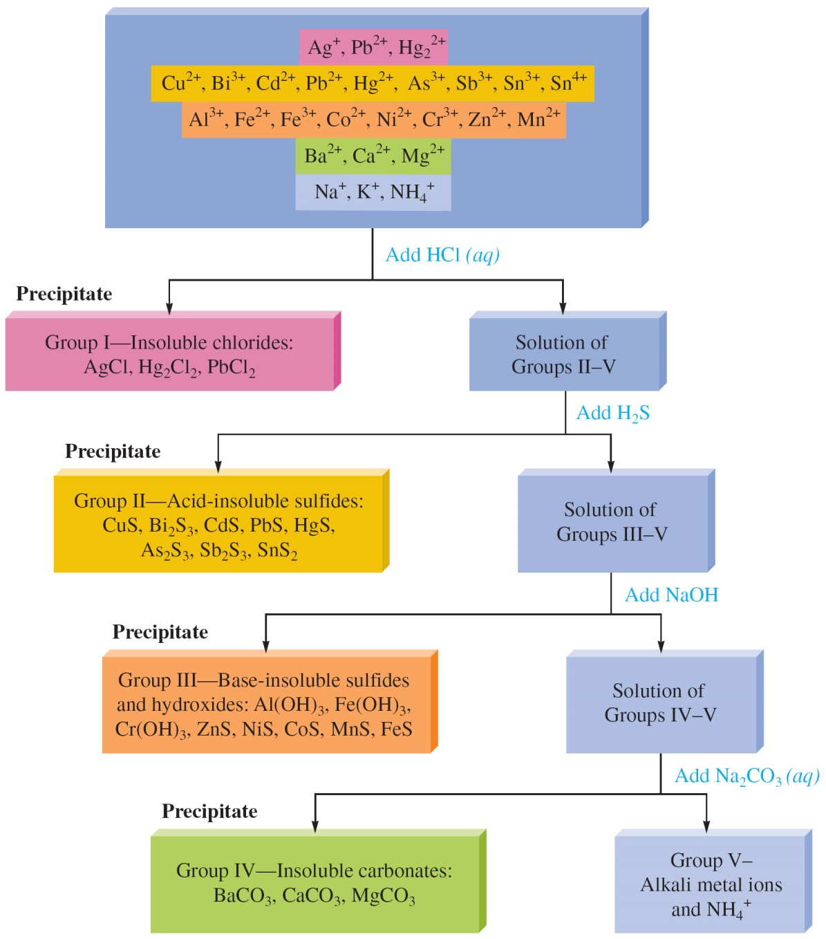
Separation of Cations by Selective Precipitation

Slide 40
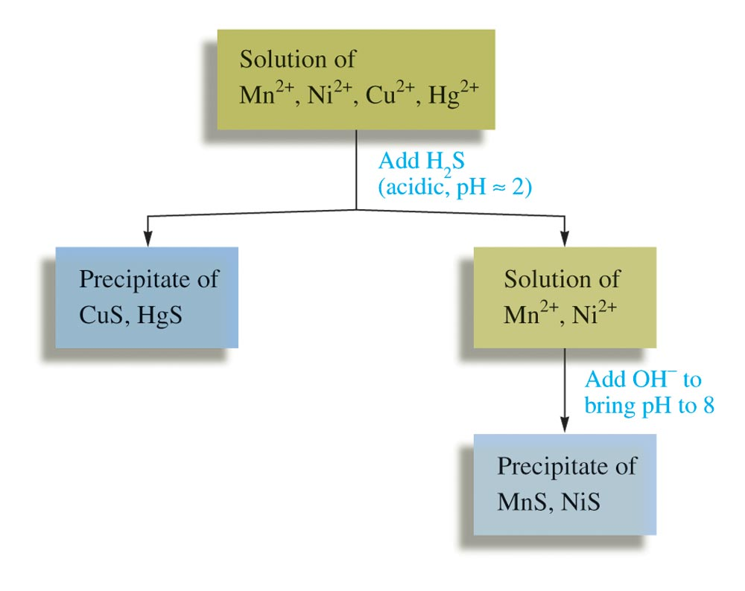
Separating Cu²⁺ and Hg²⁺ from Ni²⁺ and Mn²⁺ using H₂S

Slide 41
Separating Cu²⁺ and Hg²⁺ from Ni²⁺ and Mn²⁺ using H₂S
At low pH (pH ~ 3), [S^{2–}] is very low, and only the very insoluble HgS and CuS will form precipitate; MnS and NiS will not precipitate;
When pH is increased to about 8, [H⁺] decreases and the concentration of S^{2–} increases, which causes MnS and NiS to precipitate.

Slide 42
Synthesis of Ionic Solids
Chemicals such as AgCl, AgBr, and AgI that are important in photography are prepared by precipitation method.
AgNO₃(aq) + KBr(aq) → AgBr(s) + KNO₃(aq)

