Slide 1
Chemical Kinetics
Expression of rates.
Stoichiometric relationships of rates of different substances in a reaction.
Determination of reaction orders, rate laws, and rate constant by method of initial rate.
Determination of rate laws by graphical or integration method.
Determination of half-lives
Determination of activation energy
Elementary steps and reaction mechanism
Effect of catalysts

Slide 2
Chemical Kinetics
The study of reaction rates;
How fast does a reaction proceeds and what factors affecting it;
A measure of the change of the concentration of a reactant (or a product) as a function of time.
The study of rate yields information on the mechanism by which a reaction occurs at molecular level.

Slide 3
Types of Rates
Initial Rates
Rates measured at the beginning of the reaction;
Instantaneous Rates
Rates measured at any point of time during the reaction; obtained from the slope of a line tangent to the curve at that point.
Average Rates
An overall rate measured over a period or time interval.

Slide 4
Instantaneous Rate: The decrease in Phenolphthalein Concentration

Slide 5
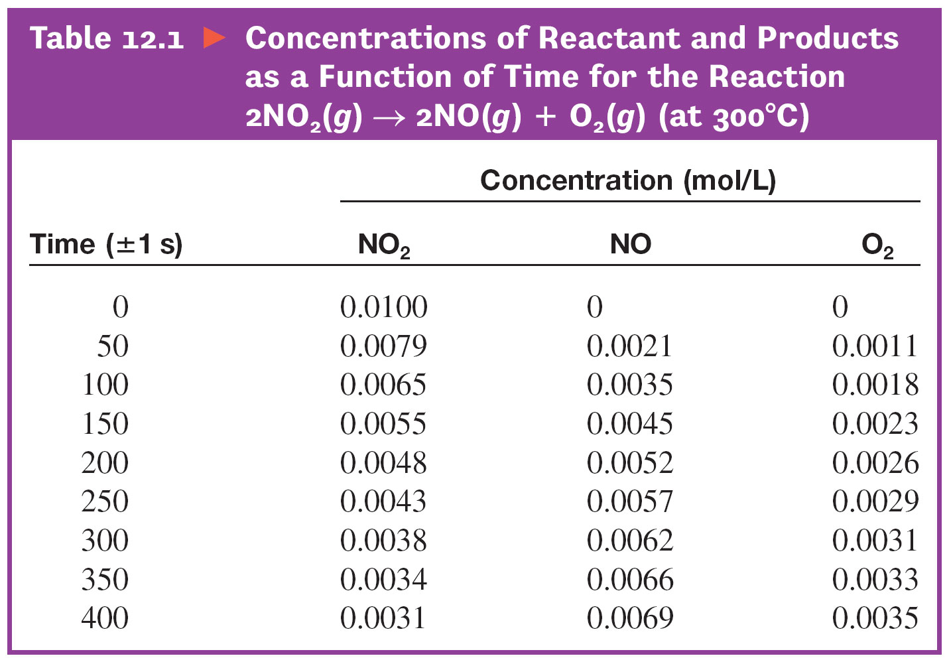
The Decomposition of Nitrogen Dioxide

Slide 6
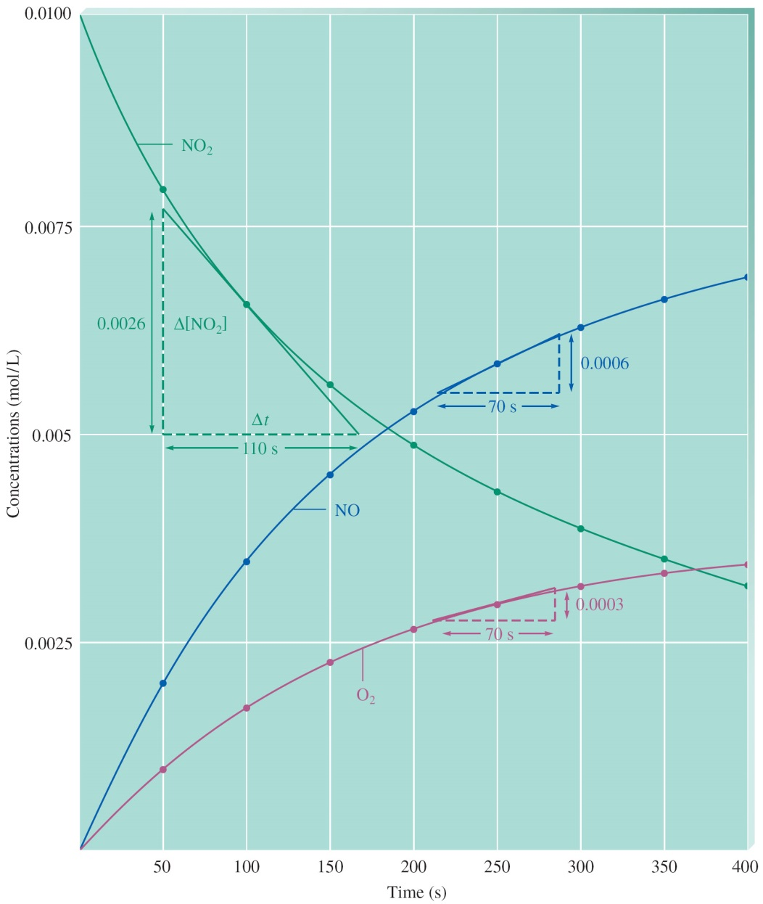
The Decomposition of Nitrogen Dioxide

Slide 7
Average Rate
Consider the following reaction at 300ºC:
2 NO₂(g) → 2 NO(g) + O₂(g)
The initial concentration of NO₂ is 0.0100 mol/L and its concentration after 150 s is 0.0055 mol/L. What are the average rates for this reaction during the first and the second 150 s?

Slide 8
Average rate during the first 150 s
Solution:
Average rate =
=
=
= 3.0 x 10⁻⁵ mol/(L.s)

Slide 9
Average rate during the second 150 s
Solution:
Average rate =
=
=
= 1.1 x 10⁻⁵ mol/(L.s)
Average rate decreases as reaction progresses because the reactant concentration has decreased

Slide 10
Stoichiometric Relationships of Reaction Rates
For a general reaction,
aA + bB → cC + dD,
The stoichiometric relationships of the rates disappearance of reactants and rates of formation of products are as follows:

Slide 11
Expressions of Reaction Rates and Their Stoichiometric Relationships
Consider the reaction:
2N₂O₅ → 4NO₂ + O₂
Rate of disappearance of N₂O₅ =
Rate of formation of NO₂ =
Rate of formation of O₂ =
Stoichiometric relationships of these rates is:

Slide 12
Differential Rate Law
A mathematical expression that relates reaction rate to reactant concentrations at constant temperature.
For example, for the reaction:
aA + bB + cC → Products
Rate = k[A]^{x}[B]^{y}[C]^{z};
k = rate constant;
x, y & z = rate orders with respect to individual reactants; they are determined experimentally.

Slide 13
Rate Law
For the decomposition of nitrogen dioxide:
2NO₂(g) → 2NO(g) + O₂(g)
Rate = k[NO₂]^{n}:
k = rate constant
n = the rate order with respect to [NO₂ concentration;
rate order is determined experimentally;
Rate order indicates the degree in which the rate depends on the concentration of a particular reactant.

Slide 14
Rate Laws: A Summary
Differential Rate Law only shows concentrations of reactants;
We assume the reverse reaction has not occurred or is negligible.
Integrated Rate Law shows how the concentration of a reactant is dependent on the time of reaction.

Slide 15
Types of Rate Laws
Consider a general reaction:
aA + bB → Products
The rate law is expressed as,
Rate = k[A]^{x}[B]^{y},
Where the exponents x and y are called the rate order of the reaction w.r.t. the respective reactants;
These exponents are usually small integers or simple fractions.

Slide 16
Types of Rate Laws
Zero-Order Reactions
In a zero order reaction the rate does not depend on the concentration of reactant,
For example, the decomposition of HI(g) on a gold catalyst is a zero-order reaction;
2 HI(g) → H₂(g) + I₂(g)
Rate = k[HI]⁰ = k;
(The rate is independent on the concentration of HI)

Slide 17
Types of Rate Laws
First Order Reactions
In a first order reaction the rate is proportional to the concentration of one of the reactants.
Example, for first-order reaction:
2N₂O₅(g) → 4NO₂(g) + O₂(g)
Rate = k[N₂O₅],
The rate of decomposition of N₂O₅ is proportional to [N₂O₅], the molar concentration of N₂O₅

Slide 18
Types of Rate Laws
Second Order Reactions
In a second order reaction, the rate is proportional to the second power of the concentration of one of the reactants.
Example, for the decomposition of NO₂ follows second order w.r.t. [NO₂]
2NO₂(g) → 2NO(g) + O₂(g)
Rate = k[NO₂]²

Slide 19
Determination of Rate Law using Initial Rate
Consider the following reaction:
S₂O₈²⁻(aq) + 3I⁻(aq) → 2SO₄²⁻(aq) + I₃⁻(aq)

Slide 20
Determination of Rate Law using Initial Rate
Reaction: S₂O₈²⁻(aq) + 3I⁻ (aq) → 2SO₄²⁻ (aq) + I₃⁻ (aq)
The following data were obtain.
⎯⎯⎯⎯⎯⎯⎯⎯⎯⎯⎯⎯⎯⎯⎯⎯⎯⎯⎯⎯⎯⎯⎯
Expt. [S₂O₈²⁻] [I⁻] Initial Rate,
# (mol/L) (mol/L) (mol/L.s)
⎯⎯⎯⎯⎯⎯⎯⎯⎯⎯⎯⎯⎯⎯⎯⎯⎯⎯⎯⎯⎯⎯⎯
1 0.036 0.060 1.5 x 10⁻⁵
2 0.072 0.060 2.9 x 10⁻⁵
3 0.036 0.120 2.9 x 10⁻⁵
⎯⎯⎯⎯⎯⎯⎯⎯⎯⎯⎯⎯⎯⎯⎯⎯⎯⎯⎯⎯⎯⎯⎯

Slide 21
Determination of Rate Law using Initial Rate
Reaction: S₂O₈²⁻(aq) + 3I⁻(aq) → 2SO₄²⁻(aq) + I₃⁻(aq)
Determine the order of the reaction w.r.t. each reactant. Write the rate law for the above reaction.
Calculate the rate constant, k, and give its appropriate units.
Calculate the reaction rate when each reactant concentration is 0.20 M

Slide 22
Determination of Rate Law using Initial Rate
Solution: The rate law = Rate = k[S₂O₈²⁻]^{x}[I⁻]^{y},
here x and y are rate orders.
(a) Calculation of rate order, x:

Slide 23
Determination of Rate Law using Initial Rate
(b) Calculation of rate order, y:
This reaction is first order w.r.t. [S₂O₈²⁻] and [I⁻]
Rate = k[S₂O₈²⁻][I⁻]

Slide 24
Calculating rate constant and rate at different concentrations of reactants
Rate constant, k =
= 6.6 x 10⁻³ L.mol⁻¹.s⁻¹
If [S₂O₈²⁻] = 0.20 M, [I⁻] = 0.20 M, and
k = 6.6 x 10⁻³ L.mol⁻¹.s⁻¹
Rate = (6.6 x 10⁻³ L.mol⁻¹.s⁻¹)(0.20 mol/L)²
= 2.6 x 10⁻⁴ mol/(L.s)

Slide 25
Integrated Rate Law
Graphical method to derive the rate law of a reaction:
Consider a reaction with single reactant:
R → Products
If the reaction is zero-order w.r.t. [R],
Then,

Slide 26
Integrated Rate Law for Zero-Order Reactions
Δ[R] = -kΔt, and [R]_{t} = [R]₀ = kt;
A plot of [R]_{t} versus t yields a straight line with k = -slope.

Slide 27
Linear Plot for Zero-order Reactions
Plot of [R]_{t} versus t:
slope = -k
[R]_{t}
t

Slide 28
Integrated Rate Law for First Order
If the reaction: R → Products is a first order reaction, then
Which yields:
And a plot of ln[R]_{t} versus t will yield a straight line with slope = -k and y-intercept = ln[R]₀

Slide 29
Linear Plot of First Order Reactions
Plot of ln]R]_{t} versus t:
slope = -k
ln[R]_{t}
t

Slide 30
Integrated Rate Law for Second Order
If the reaction: R → Products follows second-order kinetics, then
or
and
A plot of 1/[R]_{t} versus t will yield a straight line with slope = k and y-intercept = 1/[R]₀

Slide 31
Linear Plot for Second-order Reactions
Plot of 1/[R]_{t} versus time:
slope = k
time

Slide 32
Equations for Rate Laws w.r.t. [R]:
Differential Rate Laws:
Zero order reaction: Rate = k;
First order reaction: Rate = k[R];
Second order reaction: Rate = k[R]²;
Integrated Rate Laws:
Zero order reaction: [R]_{t} = kt + [R]₀
First order reaction: ln[R]_{t} = -kt + ln[R]₀
Second order reaction: Rate =

Slide 33
Half-Lives of Reactions
For zero-order reaction: t_{1/2} = [R]₀/2k;
For first-order reaction: t_{1/2} = 0.693/k;
For second-order reaction: t_{1/2} = 1/(k[R]₀)
Note: For first-order reaction, the half-life is independent of the concentration of reactant, but for zero-order and second-order reactions, the half-lives are dependent on the initial concentrations of the reactants.

Slide 34
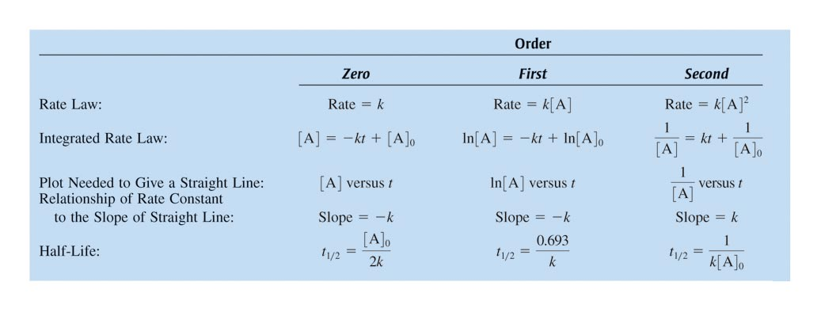
Summary of the Rate Laws

Slide 35
Exercise-#1
Consider the reaction aA → Products. [A]₀ = 5.0 M and k = 1.0 x 10^{–2} (assume the units are appropriate for each case). Calculate [A] after 30.0 seconds have passed, assuming the reaction is:
Zero order
First order
Second order
4.7 M
3.7 M
2.0 M
Notes:
a) 4.7 M
[A] = –(1.0×10^{–2})(30.0) + 5.0
b) 3.7 M
ln[A] = –(1.0×10^{–2})(30.0) + ln(5.0)
c) 2.0 M
(1 / [A]) = (1.0×10^{–2})(30.0) + (1 / 5.0)

Slide 36
A Model for Chemical Reactions
For a reaction to occur:
Reactant molecules must collide with one another;
Molecular collisions must occur in a proper orientations to cause a reaction;
Collisions must produce sufficient energy to overcome the energy barrier, called the activation energy (E_{a}), and form the transition-state complex;
The rate of formation of the transition-state complex is the rate determining step for the reaction.

Slide 37
The Collision Theory of Reactions
All reactions are preceded by molecular collisions;
Molecular collisions must be energetic and have proper orientation;
Effective collision produces transition-state complex;
The rate of transition-state complex formation is dependent on:
the frequency of effective molecular collisions, which depends on concentrations, and temperature.

Slide 38
Orientation Factor in Collision
Illustrated are two collisions that might take place between carbon monoxide and oxygen molecules. The orientation of the colliding molecules partially determines whether a reaction between the two molecules will occur.

Slide 39
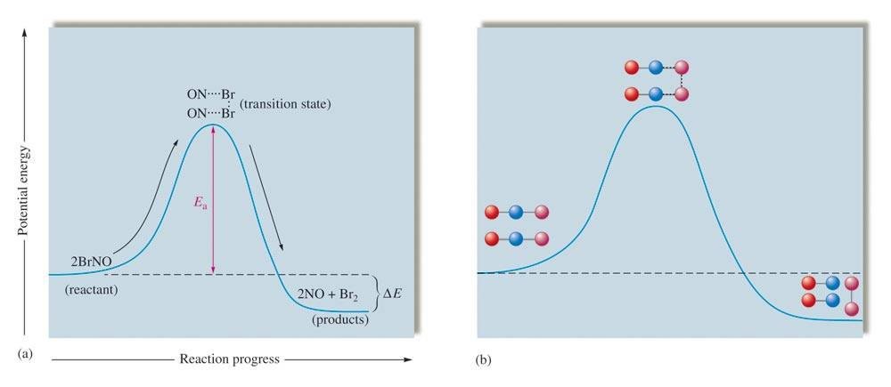
Change in Potential Energy

Slide 40
Dependence of Rate on Temperature
Reaction rates depend on the activation energy, E_{a}, and the temperature, T, such that:
Higher activation energy implies a high reaction barrier and a small fraction of reactant molecules will be able to form the transition-state complex, which results in a slower rate of reaction;
Increasing the reaction temperature results in a larger fraction of reactant molecules having sufficient energy to overcome the energy barrier; this results in a faster rate of reaction.

Slide 41
Rate Constant, Activation Energy & Temperature
The activation energy and temperature influence the rate constant, and hence the rate of reaction according to the following Arrhenius equation:
k = Ae^{-Ea/RT}
where A is Arrhenius frequency factor for effective molecular collisions;
T is the Kelvin temperature and R is gas constant (R = 8.314 J/K.mol)

Slide 42
Energy Profile for An Exothermic Reaction

Slide 43
Energy Profile of An Endothermic Reaction

Slide 44
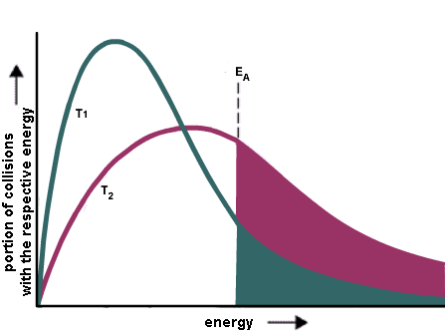
Effect of Temperature on Rates
The Boltzmann distribution of energy shows that the fraction of molecules with energy greater than E_{a} increases with temperature.

Slide 45
Graphical Relationships of k, E_{a}, and T
From the Arrhenius equation: k = Ae^{-(Ea/RT)}
ln(k) = $−$ $\frac{Ea}{R}$ ($\frac{1}{T}$) + ln(A); (R 8.314 J.mol⁻¹.K⁻¹)
Plot of ln(k) versus $\frac{1}{T}$ will yield a straight line with the slope = −(E_{a}/R), or E_{a} = − slope x R
If k values at two different temperatures are known, the following formula may be used to determine E_{a}.
ln($\frac{k2}{k1}$) = $\frac{Ea}{R}$ ($\frac{1}{T1}$ - $\frac{1}{T2}$);

Slide 46
Exercise-#2
Chemists commonly use a rule of thumb that an increase of 10 K in temperature doubles the rate of a reaction. What must the activation energy be for this statement to be true for a temperature increase from 25°C to 35°C?
E_{a} = 53 kJ
Notes:
E_{a} = 53 kJ
ln(2) = (E_{a} / 8.3145 J/K·mol)[(1/298 K) – (1/308 K)]

Slide 47
Reaction Mechanism
Shows the detail pictures of how a given reaction occurs at molecular level
It consists of a set of elementary steps that shows probable reactions involving molecular species – including reaction intermediates.
The sum of these elementary steps yields the overall balanced equation for the reaction.

Slide 48
Elementary Steps
For example, the reaction:
2A + B → C + D
may involves the following elementary steps in the reaction mechanism:
Step-1: A + B → X;
Step-2: X + A → Y;
Step-3: Y → C + D
Overall reaction: 2A + B → C + D;
X and Y are reaction intermediates

Slide 49
Molecularity in Elementary Steps
Molecularity is the number of molecular species that react in an elementary process.
Rate Law for an elementary steps follows the molecularity:
Elementary Reactions Molecularity Rate Law
⎯⎯⎯⎯⎯⎯⎯⎯⎯⎯⎯⎯⎯⎯⎯⎯⎯⎯⎯⎯⎯⎯⎯⎯⎯⎯⎯⎯⎯⎯⎯
A → product Unimolecular Rate = k[A]
2A → product Bimolecular Rate = k[A]²
A + B → product Bimolecular Rate = k[A][B]
2A + B → product Termolecular Rate = k[A]²[B]
⎯⎯⎯⎯⎯⎯⎯⎯⎯⎯⎯⎯⎯⎯⎯⎯⎯⎯⎯⎯⎯⎯⎯⎯⎯⎯⎯⎯⎯⎯⎯⎯

Slide 50
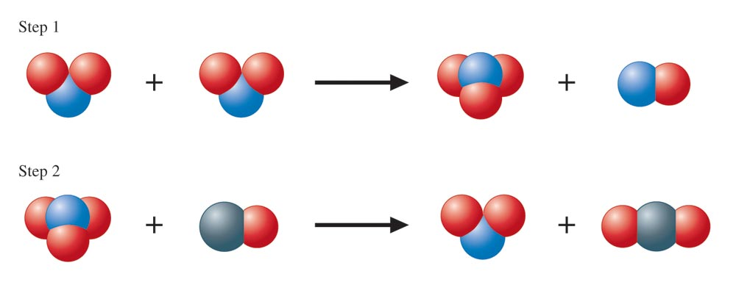
A Molecular Representation of the Elementary Steps in the Reaction of NO₂ and CO
NO₂(g) + CO(g) → NO(g) + CO₂(g)

Slide 51
Reaction Mechanism
Step-1: NO₂ + NO₂ → NO₃ + NO
Step-2: NO₃ + CO → NO₂ + CO₂
Overall: NO₂ + CO → NO + CO₂
Experimental rate law: Rate = k[NO₂]²
The overall reaction is second-order w.r.t. [NO₂], but is zero-order in [CO].

Slide 52
Acceptable Reaction Mechanism
The sum of the elementary steps must yield the overall balanced equation for the reaction.
The rate law derived from reaction mechanism must agree with the experimentally determined rate law.

Slide 53
Decomposition of N₂O₅
Overall reaction: 2N₂O₅(g) → 4NO₂(g) + O₂(g)
Proposed mechanism involved the following elementary steps
Step-1: 2[N₂O₅ ⇌ NO₂ + NO₃] (fast)
Step-2: NO₂ + NO₃ → NO + O₂ + NO₂ (slow)
Step-3: NO₃ + NO → 2NO₂ (fast)

Slide 54
Catalysts
Catalysts are substances that added to a reaction mixture to increase its rate;
Catalyst is involved in the elementary steps, but does not get used in the overall reaction.
Catalyst functions by providing an alternative reaction pathways with lower activation energy.
At equilibrium, catalyst increases the rates of both forward and reverse reactions equally - the state of equilibrium is not altered.

Slide 55
Energy Plots of Catalyzed and Uncatalyzed Exothermic Reactions

Slide 56
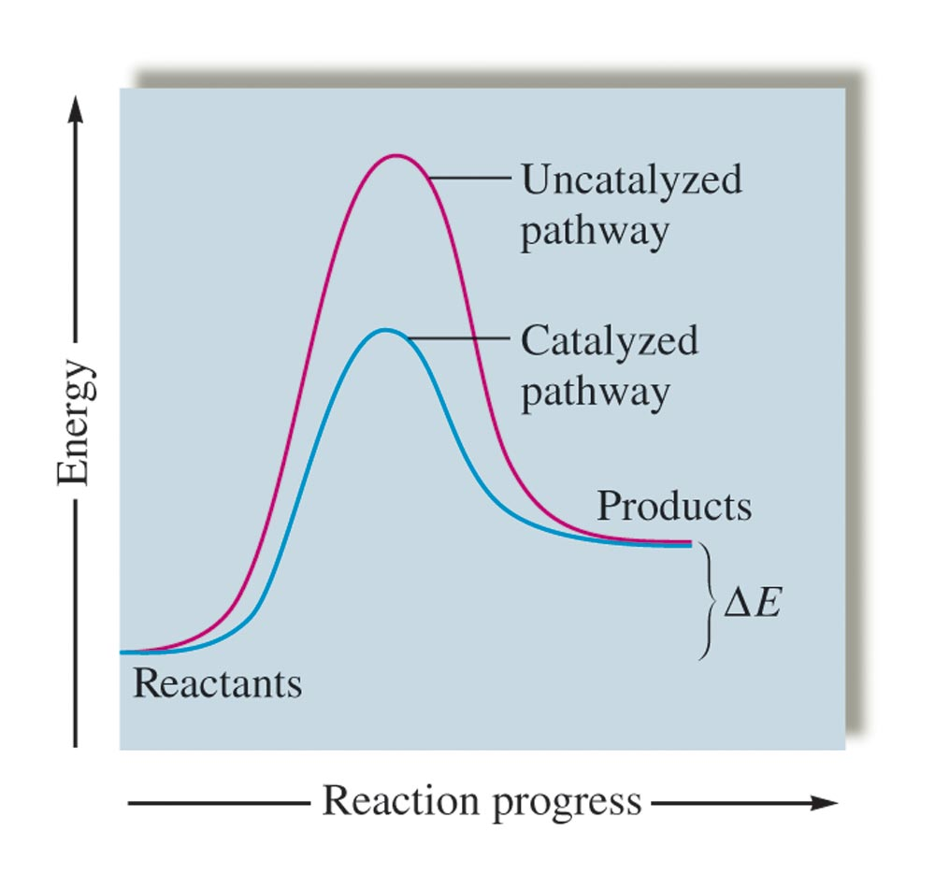
Energy Plots of Catalyzed and Uncatalyzed Endothermic Reactions

Slide 57
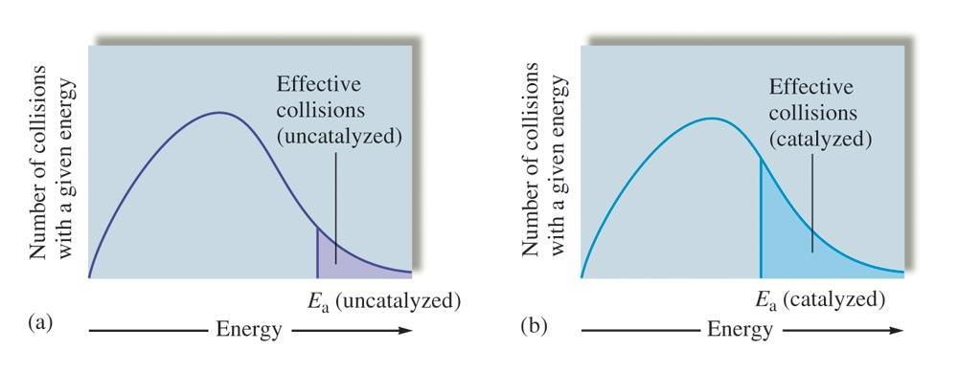
Effect of Catalyst on the fraction of Effective Collisions

Slide 58
Homogeneous Catalysts
These are catalysts that have the same phase as the reactants.
Example:
The formation of SO₃ from SO₂ and O₂ is an exothermic reaction, but the activation energy is very high.
The reaction is very slow at low temperature.
Increasing the temperature increases the reaction rate, but lowers the yield.
Adding nitric oxide, which leads to the formation of transition-state complexes that have lower activation energy, makes the reaction go faster at a moderate temperature.

Slide 59
Mechanism of catalytic reaction by nitric oxide on the formation of SO₃
Step-1: 2NO + O₂ → 2NO₂
Step-2: 2NO₂ + 2SO₂ → 2NO + 2SO₃
⎯⎯⎯⎯⎯⎯⎯⎯⎯⎯⎯⎯⎯⎯⎯⎯⎯
Overall: 2 SO₂(g) + O₂(g) → 2SO₃(g)
⎯⎯⎯⎯⎯⎯⎯⎯⎯⎯⎯⎯⎯⎯⎯⎯⎯

Slide 60
Heterogeneous Catalysis
Most reactions involving gases use inert metals or metal oxides as catalysts.
These solid catalysts provide surface areas for effective molecular to interactions.
The solid surface facilitates the breaking and formation of bonds.
For examples, Ni, Pd and Pt are often used in the hydrogenation of vegetable oil to make margarine and Crisco oil.

Slide 61
Heterogeneous Catalysis
There are four steps in the catalysis of the reaction; C₂H₄ + H₂ ⟶ C₂H₆ by nickel.
(a) H₂ is adsorbed on the metal surface, breaking the H–H bonds and forming Ni–H bonds.
(b) Ethylene is adsorbed on the surface, breaking the π-bond and forming Ni–C bonds.
(c) Atoms diffuse across the surface and form new C–H bonds when they collide.
(d) C₂H₆ molecules, not strongly attracted to Ni, escape from the nickel surface.

Slide 62
Polyunsaturated, cis- and trans-Monounsaturated and Saturated Fatty Acids

Slide 63
Hydrogenation of Monounsaturated Fatty Acid

Slide 64
Catalytic Converter in Automobile
A catalytic converter allows for the combustion of all carbon-containing compounds to carbon dioxide, while at the same time reducing the output of nitrogen oxide and other pollutants in emissions from gasoline-burning engines.

Slide 65
Catalytic Converter
Catalytic converters in automobile use heterogeneous catalyst, which is a mixture of Pd, Pt, and Rh, embedded in ceramic honeycombs.
This catalyst catalyzes the following reaction, which converts toxic carbon monoxide gas to CO₂ and nitrogen oxides to N₂:
2CO(g) + 2NO(g) → 2CO₂(g) + N₂(g)

Slide 66
Catalytic Reactions in Industrial Processes
Some reactions require specific catalyst. For example, Ni catalyzes the following reaction:
While ZnO-Cr₂O₃ mixture catalyzes the formation of methanol from the same reactants:

Slide 67
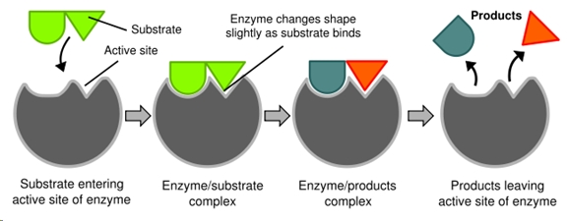
Enzyme-catalyzed Reactions
In enzymatic reactions, the molecules at the beginning of the process (the substrates) are converted by the enzyme into different molecules (the products).

Slide 68
Activation Energy in the presence and absence of Enzyme

