Slide 1
Liquids and Solids
10.1 Intermolecular Forces
10.2 The Liquid State
10.3 An Introduction to Structures and Types of Solids
10.4 Structure and Bonding in Metals
10.5 Carbon and Silicon: Network Atomic Solids
10.6 Molecular Solids
10.7 Ionic Solids
10.8 Vapor Pressure and Changes of State
10.9 Phase Diagrams

Slide 2
Intra-molecular Forces
Forces “within” molecules.
Covalent bonds are “intra-molecular forces – forces that hold atoms together in a molecule.
The strength of covalent bonds determine the stability of the molecule.

Slide 3
Intermolecular Forces
Forces that hold molecules together in liquids and solids;
much weaker forces compared with covalent or ionic bonds – energy: 5-15 kJ/mol
The strength of intermolecular forces determine the physical states of substances and their physical properties:
Such as melting point, boiling point, vapor pressure, etc.

Slide 4
Types of Intermolecular Forces
Dipole–dipole attractions
Hydrogen bonding
London dispersion forces

Slide 5
Dipole-Dipole Forces
Dipole moment – in an electric field polar molecules often behave as if they have centers of positive and negative charges.
Molecules with dipole moments are attracted to each other by electrostatic forces - positive ends attract negative ends.
This force is only about 1% as strong as covalent or ionic bonds.

Slide 6
Dipole-Dipole Attraction

Slide 7
Dipole-Dipole Attractions

Slide 8
Hydrogen Bonding
Strong dipole-dipole forces.
Hydrogen is bound to a highly electronegative atom – nitrogen, oxygen, or fluorine.

Slide 9
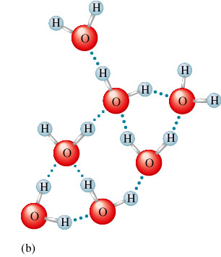
Hydrogen Bonding in Water
Blue dotted lines are the intermolecular forces between the water molecules.

Slide 10
London Dispersion Forces
Instantaneous dipole-dipole attractions between molecules due to charge polarization in a molecule;
One polarized molecule then induces neighboring molecules to be polarized, which results in dipole-dipole interactions between neighboring molecules.
LDF occurs in all molecules – polar and nonpolar.
It is very important in nonpolar and in large molecules.

Slide 11
London Dispersion Forces

Slide 12
Attraction of Temporary Dipoles

Slide 13
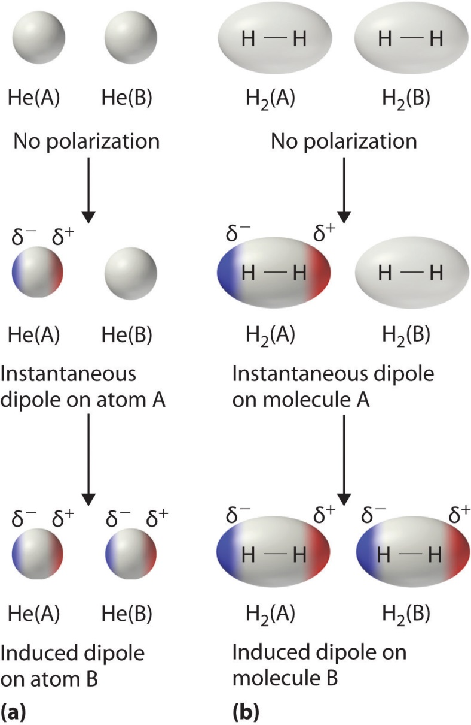
London Dispersion Force

Slide 14
Physical Properties of Liquids
The following properties are directly influenced by intermolecular forces:
Vapor pressure
Boiling point
Enthalpy of vaporization (ΔH_{vap})
Viscosity
Surface tension
Capillary action

Slide 15
Intermolecular Forces and Physical Properties of Liquids
Strong intermolecular forces lead to:
Low vapor pressure for liquids
High boiling point
High enthalpy of vaporization
High viscosity
High surface tension
High capillary action

Slide 16
Melting and Boiling Points
In general, the stronger the intermolecular forces, the higher the melting and boiling points.

Slide 17
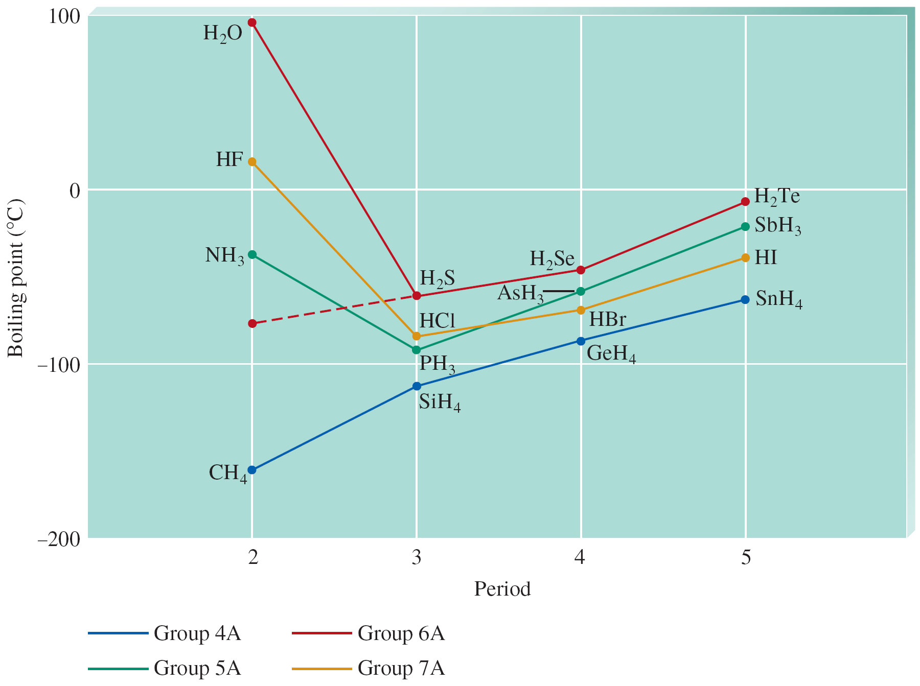
Boiling Points of Covalent Hydrides of Elements in Groups 4A, 5A, 6A, and 7A

Slide 18
Viscosity
Liquid’s resistance to flow:
Liquids with large intermolecular forces or molecular complexity tend to be highly viscous.

Slide 19
Properties of Liquids
Low compressibility, lack of rigidity, and higher density compared with gases.
Surface tension – force that holds molecules on liquid surface together, which resists a liquid to increase its surface area:
Liquids with strong intermolecular forces have high surface tension.

Slide 20
Surface Tension

Slide 21
Surface Tension

Slide 22
Water forms Spherical Droplets due to High Surface Tension

Slide 23
Capillary Action
Spontaneous rising of liquid inside capillaries;
Capillary action due to:
Cohesive forces – intermolecular forces among molecules of liquids, and
Adhesive forces – forces between liquid molecules and container walls.

Slide 24
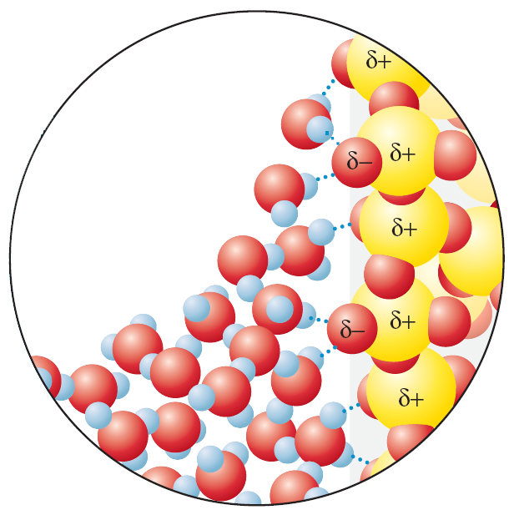
Concave Meniscus Formed by Polar Water
Adhesive force dominates over cohesive force, which allows water molecules to crawl up the glass wall of a capillary tube.

Slide 25
Concave Meniscus (left) and Convex Meniscus (right)
When adhesive forces dominate over cohesive forces, a concave meniscus is formed.
If cohesive forces dominate over adhesive forces, a convex meniscus is obtained.

Slide 26
Concept Check-#1
As intermolecular forces increase, what happens to each of the following? Why?
Boiling point
Viscosity
Surface tension
Enthalpy of fusion
Freezing point
Vapor pressure
Heat of vaporization
Notes:
Boiling point increases
Viscosity increases
Surface tension increases
Enthalpy of fusion increases
Freezing point increases
Vapor pressure decreases
Heat of vaporization increases

Slide 27
Concept Check-#2
Draw two Lewis structures for the formula C₂H₆O and compare the boiling points of the two molecules.
Notes:
One Lewis structure could be ethanol and one Lewis structure could be dimethyl ether. Ethanol will have a higher boiling point than dimethyl ether because ethanol exhibits hydrogen bonding and dimethyl ether exhibits dipole-dipole interactions. Hydrogen bonding is an especially strong type of dipole-dipole interaction and will thus raise the boiling point of ethanol.

Slide 28
Concept Check-#3
Which molecule is capable of forming stronger intermolecular forces?
N₂ H₂O
Explain.
Notes:
H₂O has the stronger intermolecular forces because it exhibits hydrogen bonding, whereas N₂ only exhibits London dispersion forces.

Slide 29
Concept Check-#4
Which gas would behave more ideally at the same conditions of P and T?
CO or N₂
Why?
Notes:
N₂ would behave more ideally because it is nonpolar and only exhibits London dispersion forces, therefore the intermolecular forces between N₂ molecules are weak (and thus the collisions will be more “elastic”). CO also exhibits dipole-dipole interactions.

Slide 30
Concept Check-#5
The vapor pressure of water at 25°C is 23.8 torr, and the heat of vaporization of water at 25°C is 43.9 kJ/mol. Calculate the vapor pressure of water at 65°C.
194 torr
Notes:
ln(23.8 torr/P_{vap,T2}) = [(43900 J/mol)/(8.3145 J/K·mol)][(1/338 K) – (1/298)]
P_{vap,T2} = 194 torr

Slide 31
Concept Check-#6
Which would you predict should be larger for a given substance: ΔH_{vap} or ΔH_{fus}?
Explain why.
Notes:
ΔH_{vap} should be larger because it will take a lot more energy to break the intermolecular forces between the liquid molecules to completely break apart to form a gas.

Slide 32
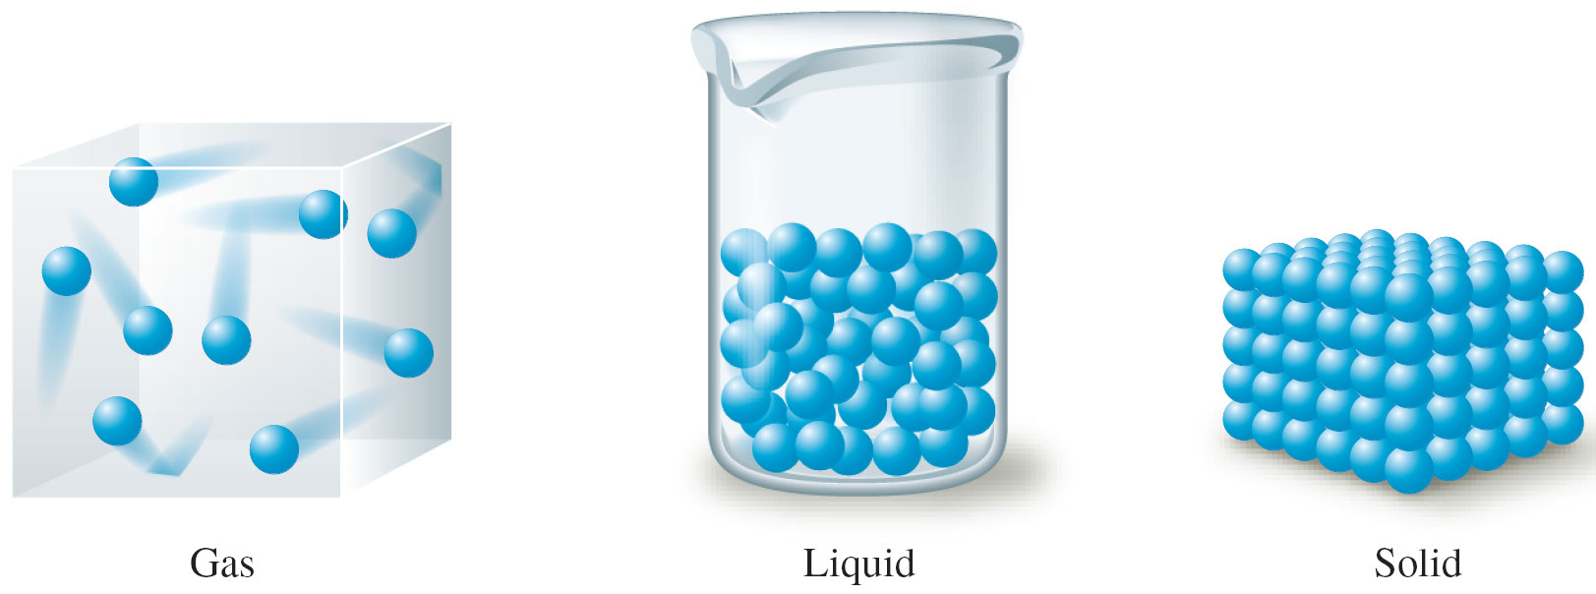
Schematic Representations of the Three States of Matter

Slide 33
Phase Changes
When a substance changes from solid to liquid to gas, the molecules remain intact.
Phase Changes are due to changes in the forces between molecules, but not those within molecules.

Slide 34
Phase Changes
Solid to Liquid
As a substance absorbs energy, molecular motions within the substance increase, which eventually a disorder characteristic of a liquid.
Liquid to Gas
As more energy is absorbed, molecular motions and disorder continue to increase;
Eventually all intermolecular forces are broken and molecules break away from each other - a gaseous state is formed.

Slide 35
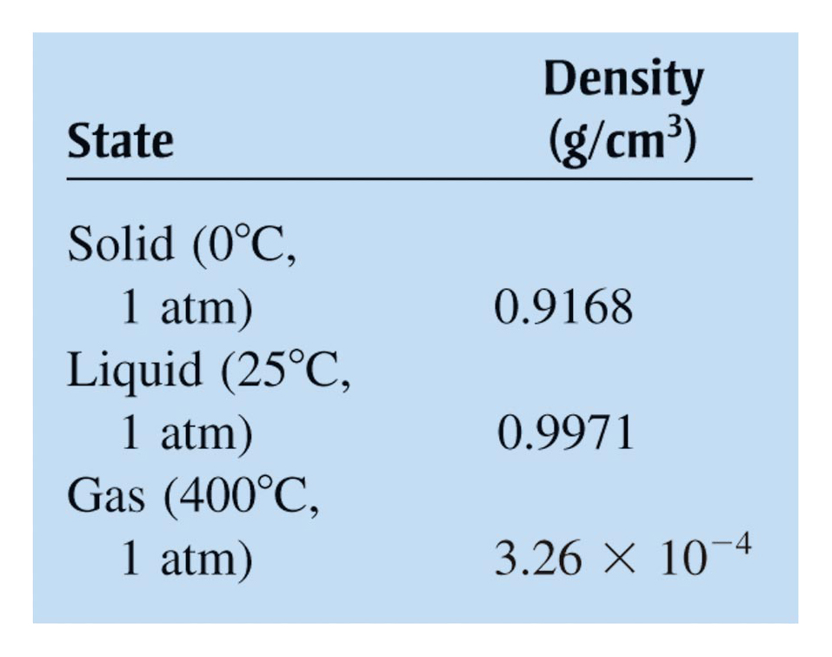
Densities of the Three States of Water

Slide 36
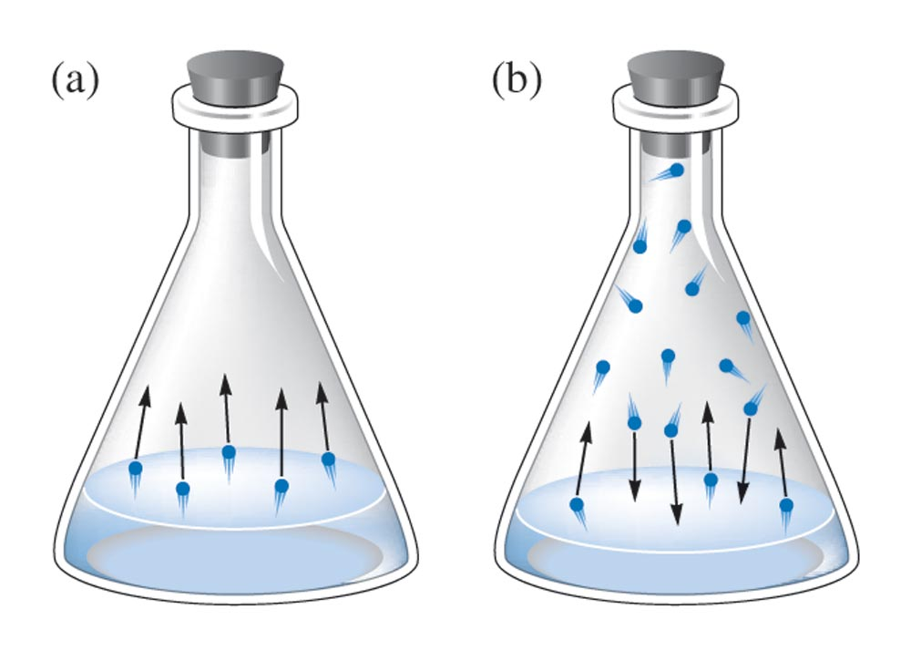
Behavior of a Liquid in a Closed Container (a) Initially (b) at Equilibrium

Slide 37
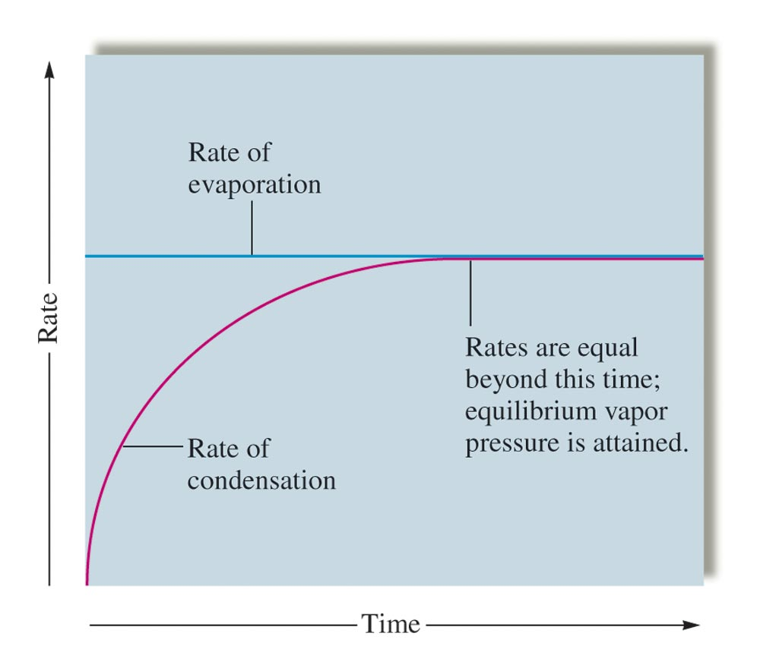
The Rates of Condensation and Evaporation

Slide 38
Vapor Pressure
Pressure of vapor in equilibrium with the liquid.
At equilibrium ➔ no net change in the amount of liquid or vapor
Evaporation rate = Condensation rate.

Slide 39
Vapor Pressure
Liquids with strong intermolecular forces have relatively low vapor pressures.
Vapor pressure increases as the temperature increases.

Slide 40
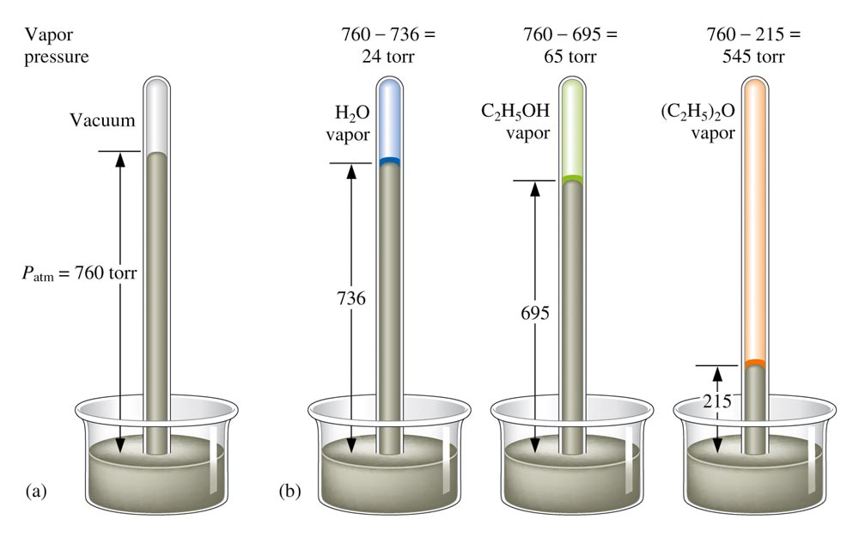
Vapor Pressure

Slide 41
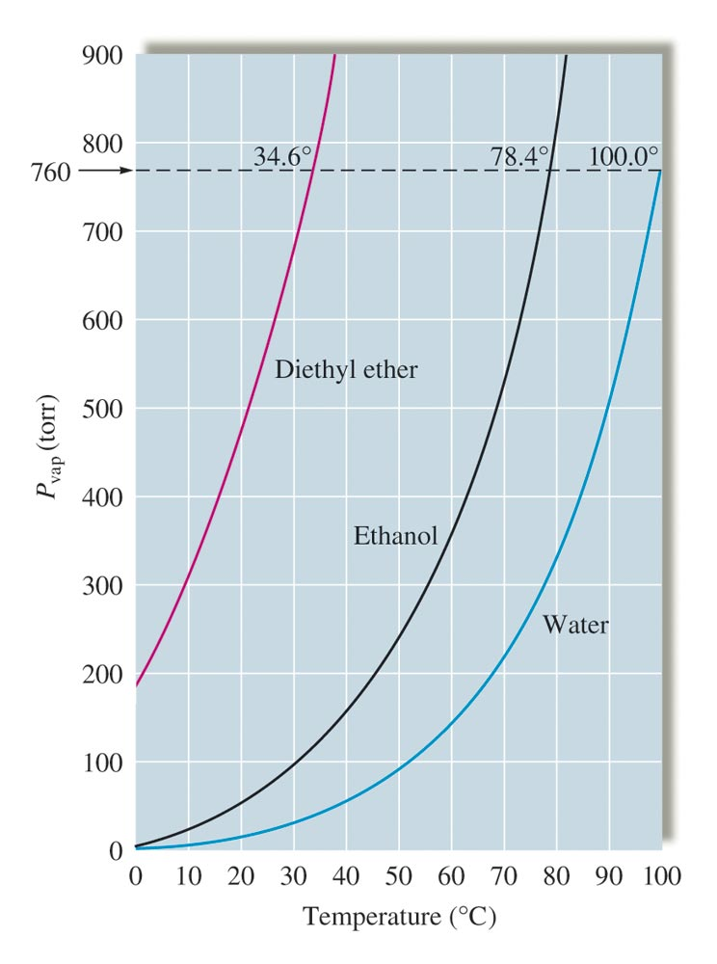
Vapor Pressure versus Temperature

Slide 42
Clausius–Clapeyron Equation
P_{vap} = vapor pressure
ΔH_{vap} = enthalpy of vaporization
R = 8.3145 J/K·mol
T = temperature (in Kelvin)

Slide 43
Concept Check
What is the vapor pressure of water at 100°C? How do you know?
1 atm
Notes:
The vapor pressure of water at 100ºC is 1 atm. You know this because atmospheric pressure is 1 atm and this is the temperature at which we observe water to boil.

Slide 44
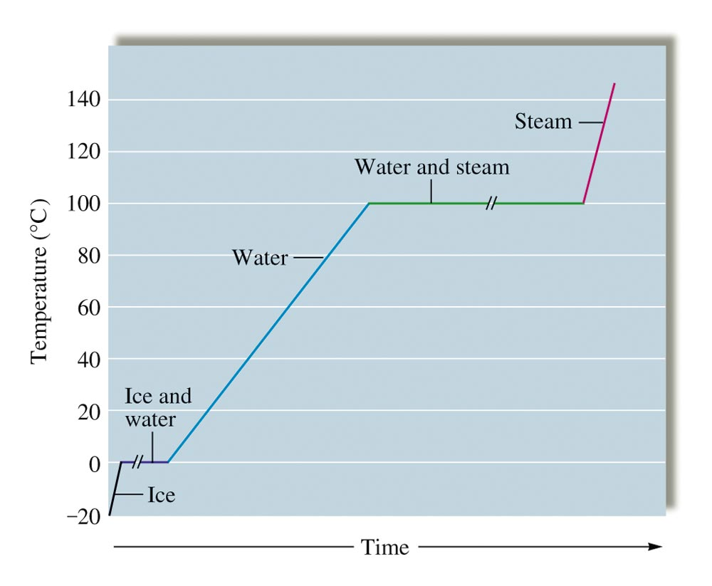
Heating Curve for Water

Slide 45
Calculating Heat Absorbed
Calculate the total amount of heat (in kJ) absorbed when 25.0 g of ice, initially at -20.0ºC, is completely converted into steam at 120.0ºC?
(Specific heat (J/g.ºC):
ice = 2.1; steam = 2.0; water = 4.184;
ΔH_{fus} = 6.02 kJ/mol; ΔH_{vap} = 40.6 kJ/mol)

Slide 46
Phase Diagram
A convenient way of representing the phases of a substance as a function of temperature and pressure:
Triple point
Critical point
Phase equilibrium lines

Slide 47
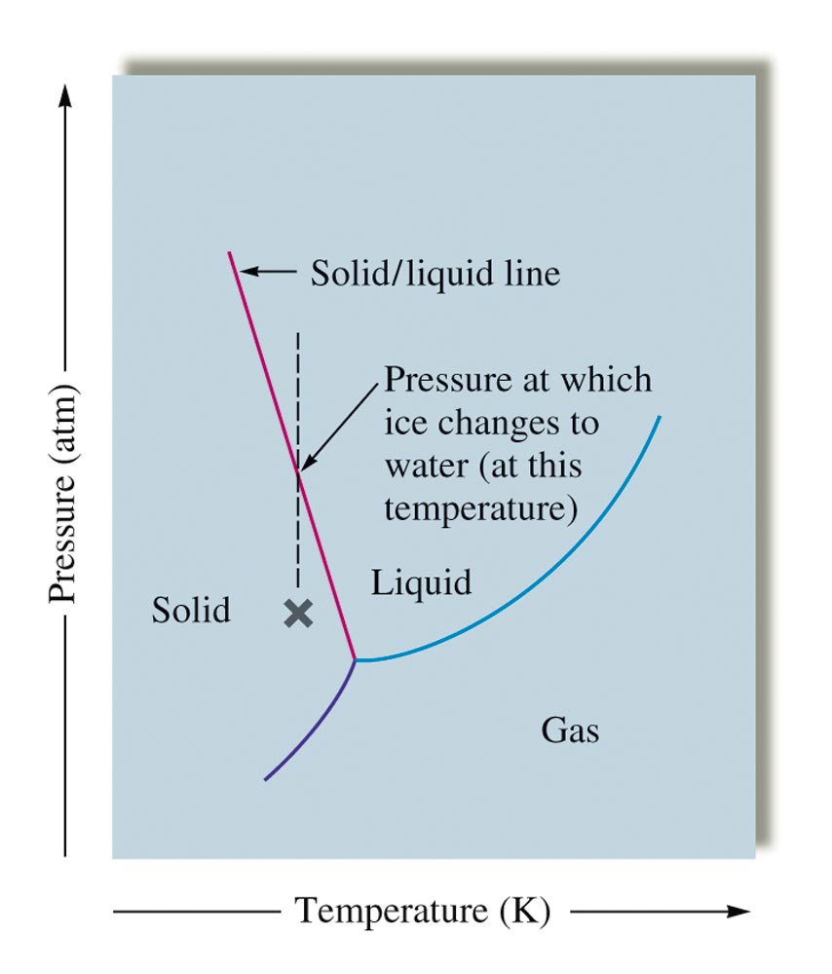
Phase Diagram for Water

Slide 48
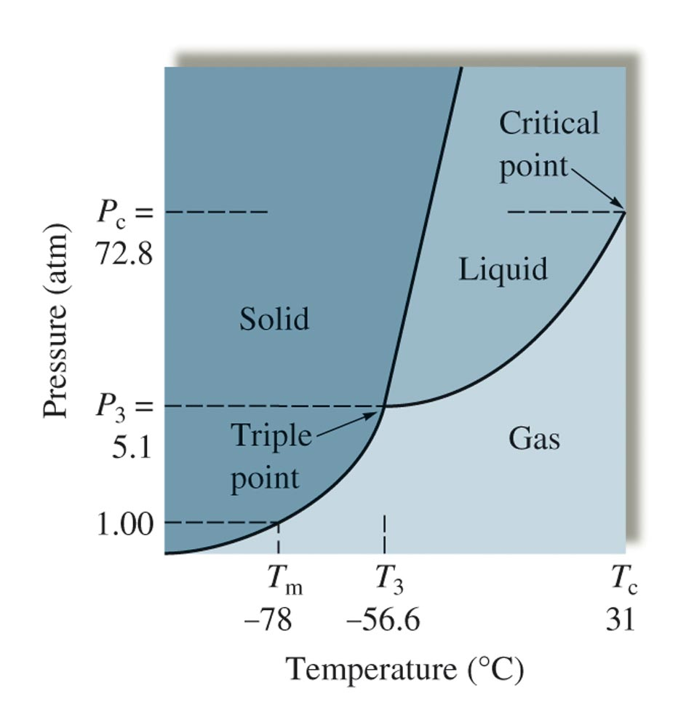
Phase Diagram for Carbon Dioxide

Slide 49
Amorphous & Crystalline Solids
Amorphous Solids:
Disorder in the structures
Glass
Crystalline Solids:
Ordered Structures
Unit Cells

Slide 50
Classification of Solids

Slide 51
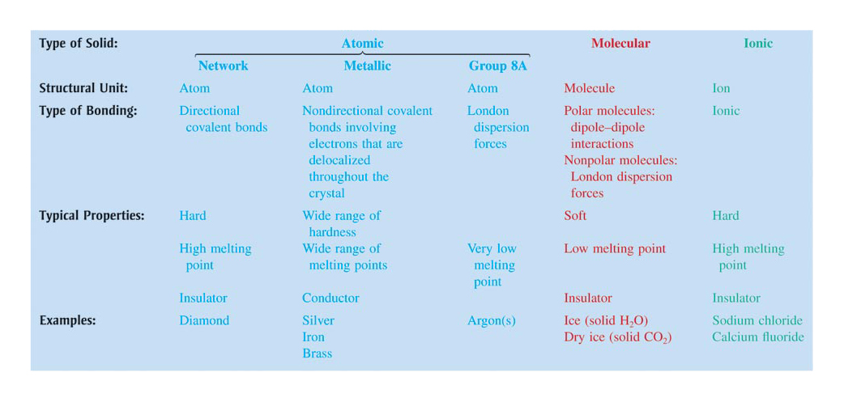
Types and Properties of Solids

Slide 52
Types of Crystalline Solids
Ionic Solids – ions at lattice points that describe the structure of the solid.
Molecular Solids – covalent molecules at of its lattice points.
Atomic Solids – atoms at the lattice points that describe the structure of the solid.

Slide 53
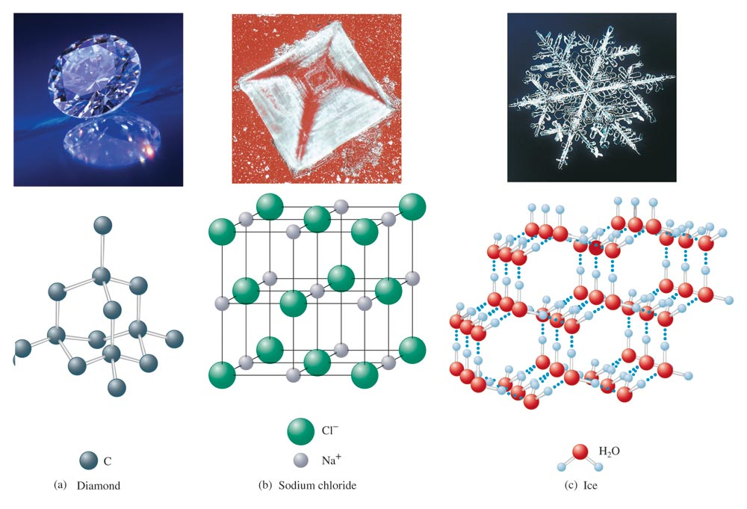
Examples of Three Types of Crystalline Solids

Slide 54
Lattice Structure & Unit Cell
Lattice Structures:
Repeating pattern in which solid particles (atoms, ions, molecules) are arranged in 3-dimensional arrangement;
Unit Cell:
The smallest group of particles in the material that constitutes the repeating pattern

Slide 55
Closest-packed Structure
Packing that results with the smallest void volume
Cubic Closest-packed;
ABCABC… (layers pattern)
Hexagonal Closest-packed
ABABAB… (layers pattern)

Slide 56
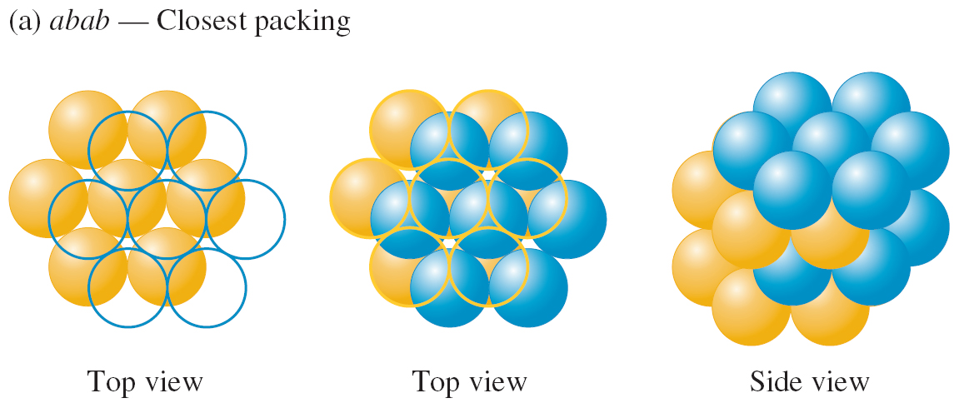
The Closest Packing Arrangement of Uniform Spheres
abab packing – each sphere in the 2nd layer occupies a dimple in the 1st layer.
Spheres in the 3rd layer occupy dimples in the 2nd layer, such that spheres in the 3rd layer lie directly above those in the 1st layer.

Slide 57
The Closest Packing Arrangement of Uniform Spheres
abc packing – spheres in the 3rd layer occupy dimples in the 2nd layer, such that no spheres in the 3rd layer lie directly above those in the 1st layer.
The 4th layer is identical the 1st.

Slide 58
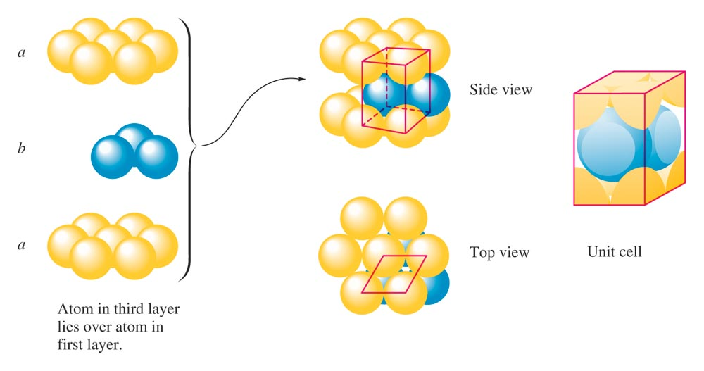
The abab… packing produces the Hexagonal Closest Packing (hcp)

Slide 59
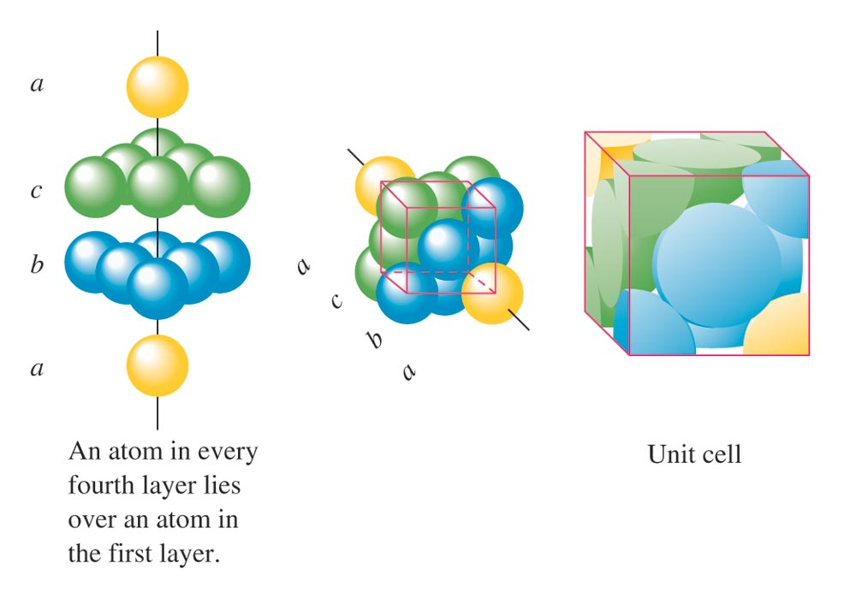
The abcabc… packing produces the Cubic Closest Packing (ccp)

Slide 60
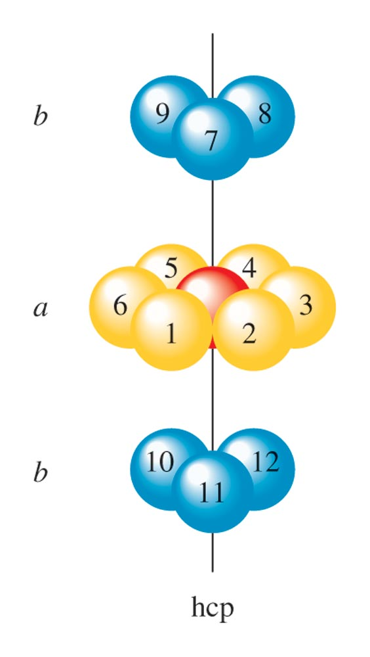
Nearest Neighbors in Closest Packing Structures
Each sphere in both ccp and hcp has 12 equivalent nearest neighbors.

Slide 61
Three Types of Holes in Closest Packed Structures
Trigonal holes are formed by three spheres in the same layer.

Slide 62
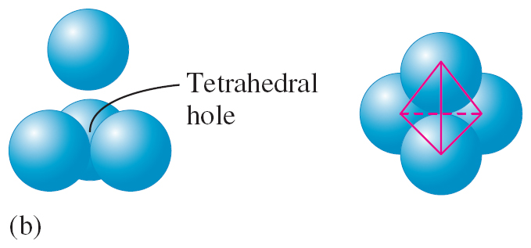
Three Types of Holes in Closest Packed Structures
Tetrahedral holes are formed when a sphere sits in the dimple of three spheres in an adjacent layer.

Slide 63
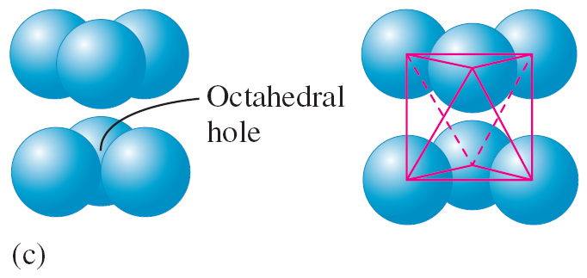
Three Types of Holes in Closest Packed Structures
Octahedral holes are formed between two sets of three spheres in adjoining layers of the closest packed structures.

Slide 64
For spheres of a given diameter, the holes increase in size in the order:
trigonal < tetrahedral < octahedral

Slide 65
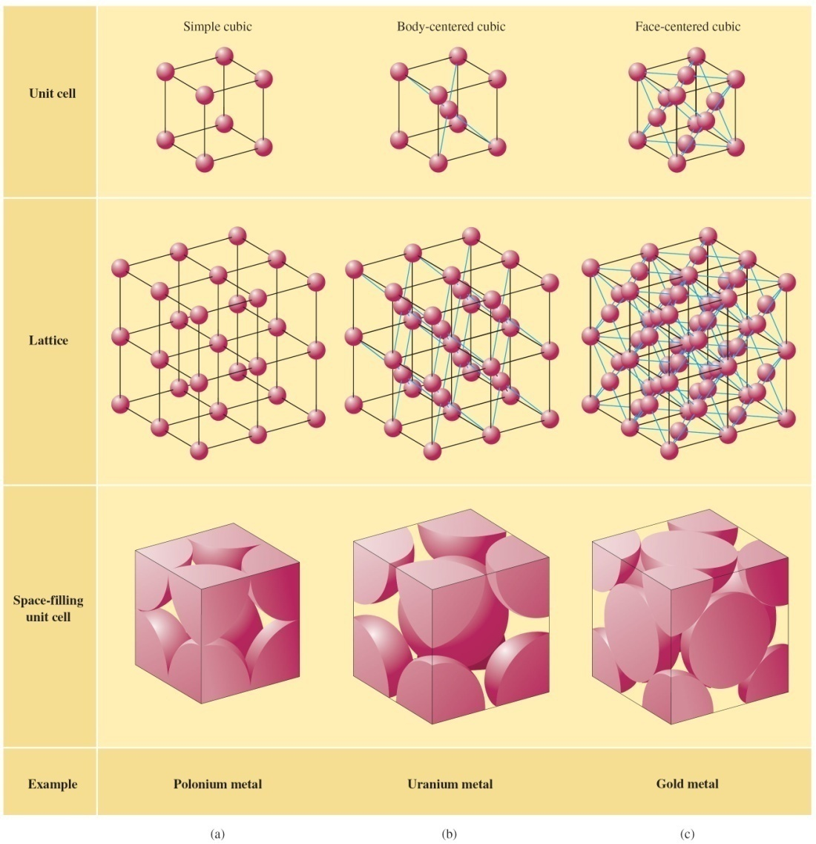
Cubic Lattice Structures and Unit Cells

Slide 66
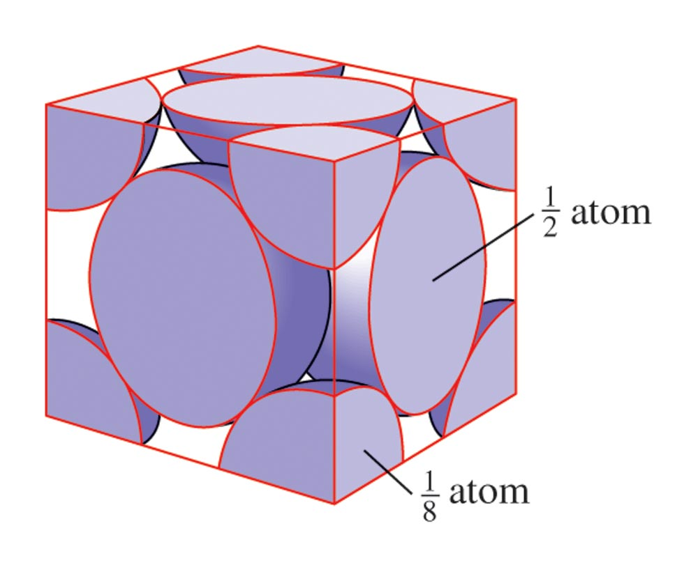
The Cubic Closest Packing produces the Face-Centered Cubic Unit Cell

Slide 67
Face-centered Cubic Unit Cell

Slide 68
Body-Centered Cubic Unit Cell

Slide 69
Body-centered Cubic Unit Cell

Slide 70
Concept Check-#1
Determine the number of metal atoms in a unit cell if the packing is:
Simple cubic
Cubic closest packing
1 metal atom
4 metal atoms
Notes:
1 metal atom
4 metal atoms

Slide 71
Concept Check-#2
A metal crystallizes in a face-centered cubic structure. Determine the relationship between the radius of the metal atom and the length of an edge of the unit cell.
Notes:
Length of the edge = r×sqrt(8)

Slide 72
Concept Check-#3
Silver metal crystallizes in a cubic closest packed structure. The face centered cubic unit cell edge is 409 pm.
Calculate the density of the silver metal.
Density = 10.5 g/cm³
Notes:
The density is 10.5 g/cm³. There are four silver atoms per unit cell.
The volume of the unit cell is d³, which is (409 pm)³, or 6.84 × 10⁷ pm³. This is equivalent to 6.84 × 10⁻²³ cm³.
Density = mass/volume = [(4 atoms)(107.9 g/mol)(1 mol/6.022×10²³ atoms)] / 6.84 × 10⁻²³ cm³ = 10.5 g/cm³

Slide 73
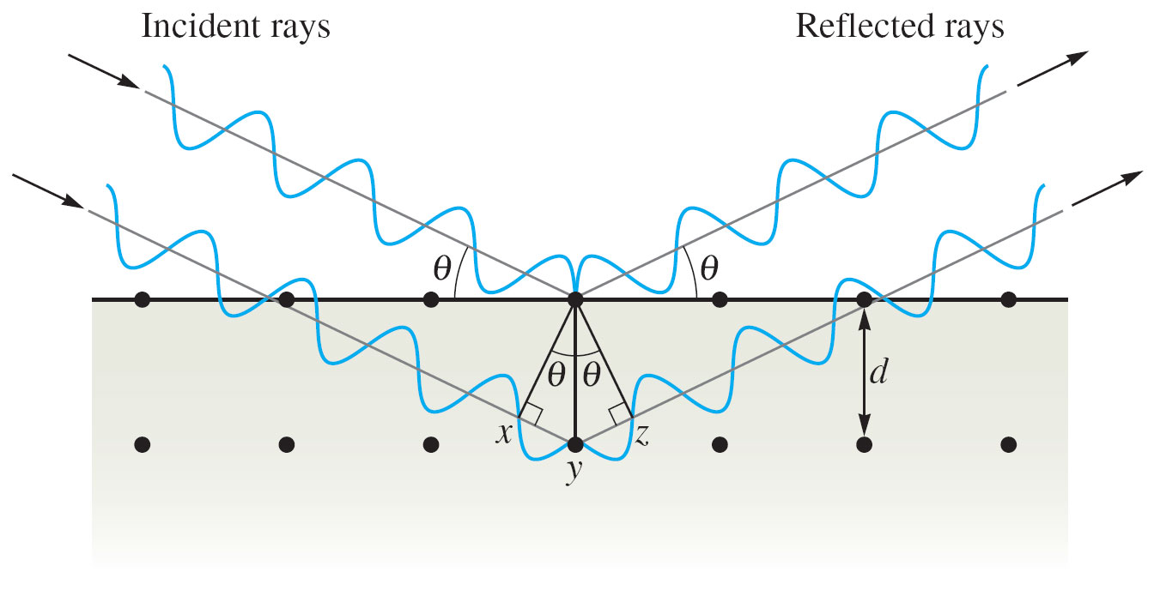
Bragg Equation

Slide 74
Bragg Equation
Used to determine the interatomic spacings.
n = integer
= wavelength of the X rays
d = distance between the atoms
= angle of incidence and reflection

Slide 75
X-ray Defraction

Slide 76
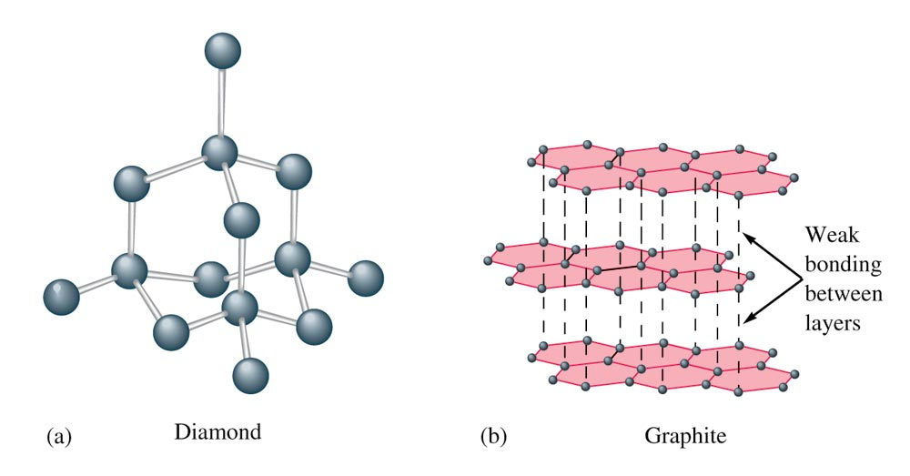
The Structures of Diamond and Graphite

Slide 77
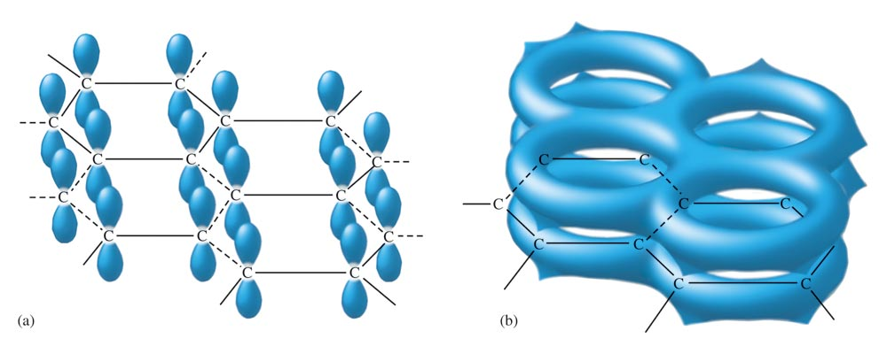
The p Orbitals and Pi-system in Graphite

Slide 78
Bonding Models for Metals
Electron Sea Model
Band Model (MO Model)

Slide 79
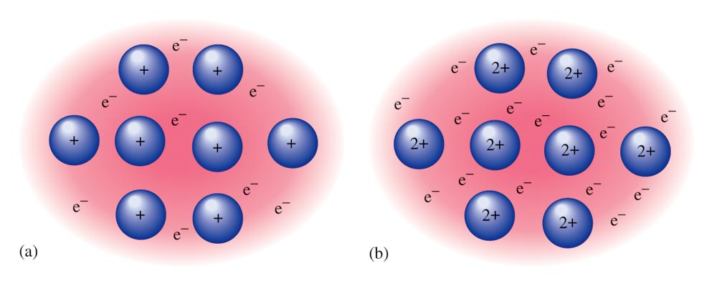
The Electron Sea Model
A regular array of cations in a “sea” of mobile valence electrons.

Slide 80
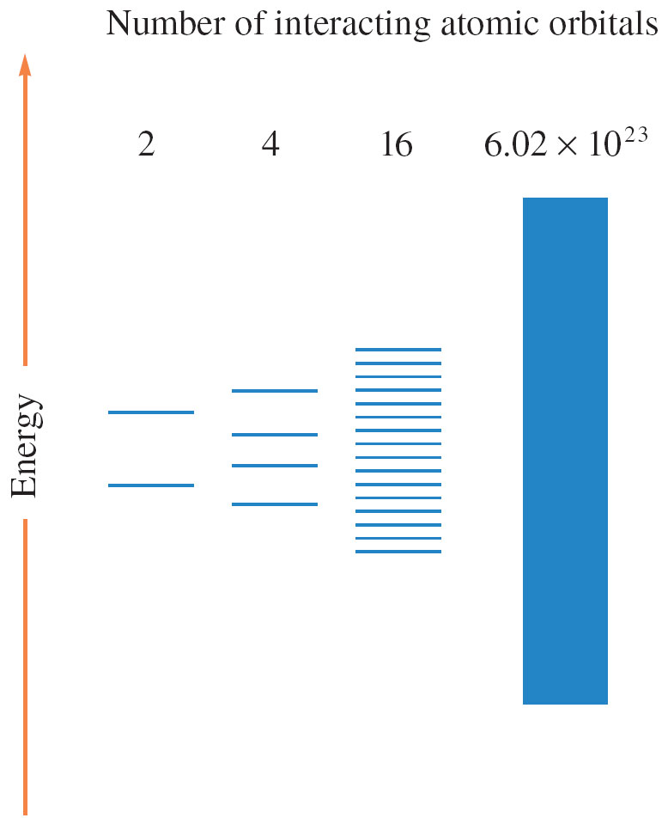
Molecular Orbital Energy Levels Produced When Various Numbers of Atomic Orbitals Interact

Slide 81
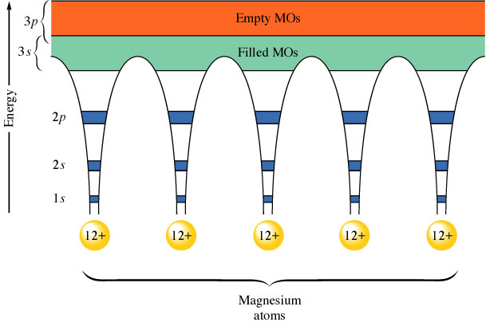
The Band Model for Magnesium
Virtual continuum of levels, called bands.

Slide 82
Metal Alloys
Substitutional Alloy – some of the host metal atoms are replaced by other metal atoms of similar size.
Interstitial Alloy – some of the holes in the closest packed metal structure are occupied by small atoms.

Slide 83
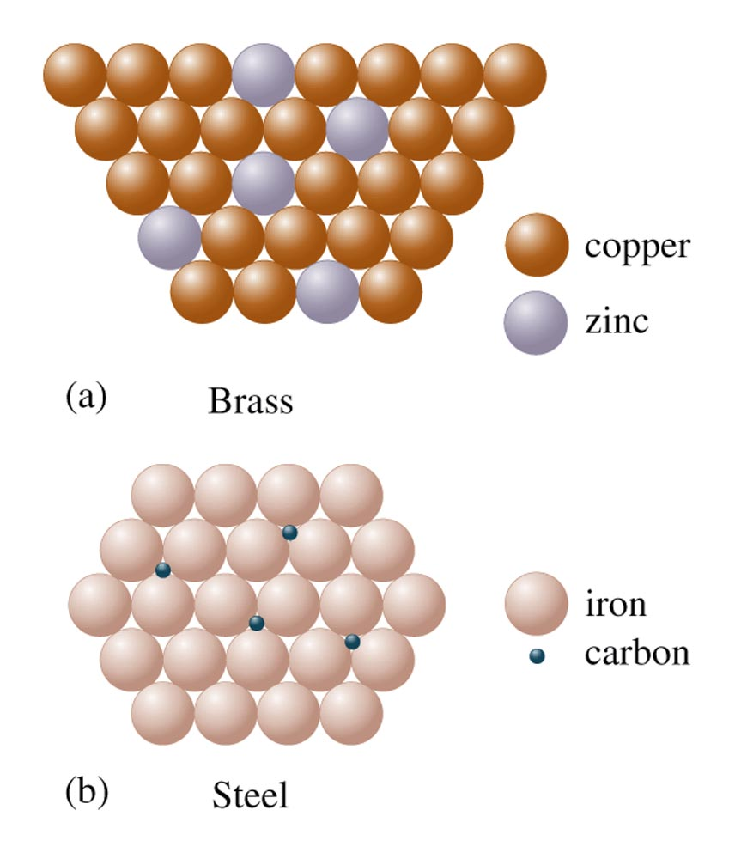
Two Types of Alloys
Brass is a substitutional alloy.
Steel is an interstitial alloy.

Slide 84
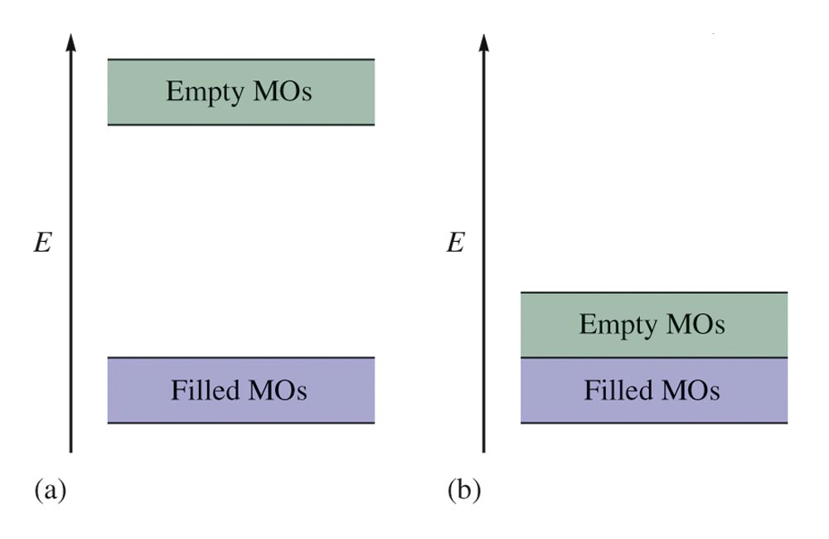
Partial Representation of the Molecular Orbital Energies in: (a) Diamond (b) a Typical Metal

Slide 85
Semiconductors
n-type semiconductor – substance whose conductivity is increased by doping it with atoms having more valence electrons than the atoms in the host crystal.
p-type semiconductor – substance whose conductivity is increased by doping it with atoms having fewer valence electrons than the atoms of the host crystal.

Slide 86
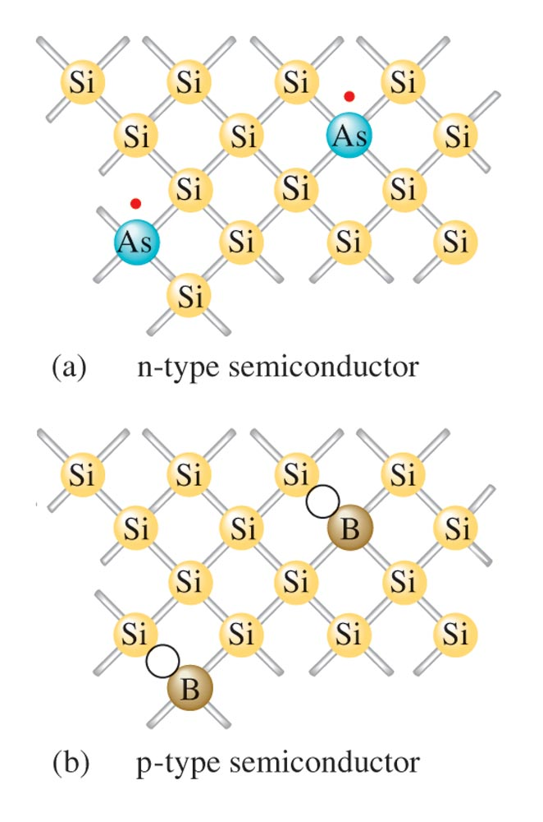
Silicon Crystal Doped with (a) Arsenic and (b) Boron

Slide 87
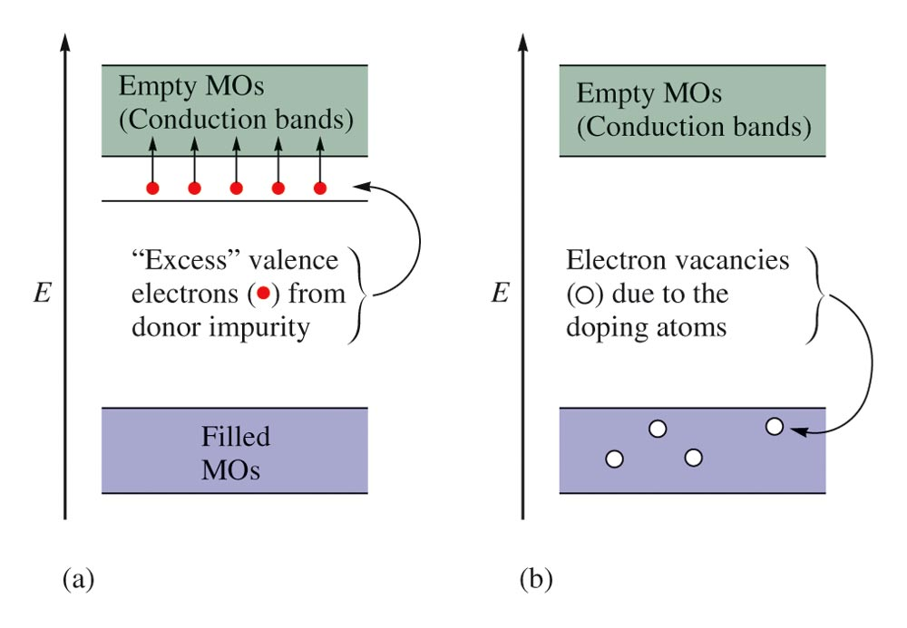
Energy Level Diagrams for: (a) an n-type Semiconductor (b) a p-type Semiconductor

Slide 88
Ceramics
Typically made from clays (which contain silicates) and hardened by firing at high temperatures.
Nonmetallic materials that are strong, brittle, and resistant to heat and attack by chemicals.

