Slide 1
ACCJC
2022 ANNUAL & FISCAL REPORTS
Kuni Hay
Vice President of Instruction
Dr. Phoumy Sayavong
Senior Research & Planning Analyst
Sean Brooks
Vice President of Administrative Servies

Slide 2
2021- 2022 Annual & Fiscal Reports
Timeline
College President submits both reports to ACCJC by April 8, 2022
Roundtable review, April 4, 2022
Fiscal Reports are developed in conjunction with the District's Finance Department
Areas to cover today
Annual Report - Data that needs attention:
Headcount Enrollment
Distance Education
Federal Data on the graduation rate
Institution set standards for Achievement
Completion of programs
Degrees/Certificates awarded
Job placement rates – CE programs
Fiscal Report - VPAS Brooks

Slide 3
Why Annual Reports? ACCJC’s Policy on Monitoring Institutional Performance
Each year, ACCJC requires its member institutions to submit both an Annual Fiscal Report and Annual Report to the Commission in accordance with the Policy on Monitoring Institutional Performance.
Determine whether an institution is in compliance with Eligibility Requirements, Accreditation Standards and Commission policies and to assist institutions, through established procedures, in the improvement of quality.
The Commission applies a set of annual monitoring and evaluation approaches that assess an institution’s continued compliance with the Commission’s Standards, and that take into account institutional strengths and stability.
It is the responsibility of the institution to inform the Commission of any circumstance that significantly impacts the institution’s operational, academic and student services, or fiscal strength and stability or its compliance with the Commission’s Standards.

Slide 4
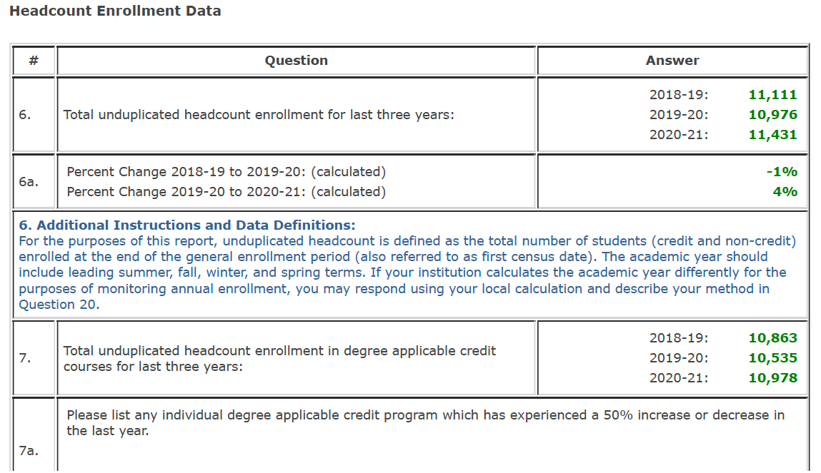
HEADCOUNT ENROLLMENT DATA

Slide 5
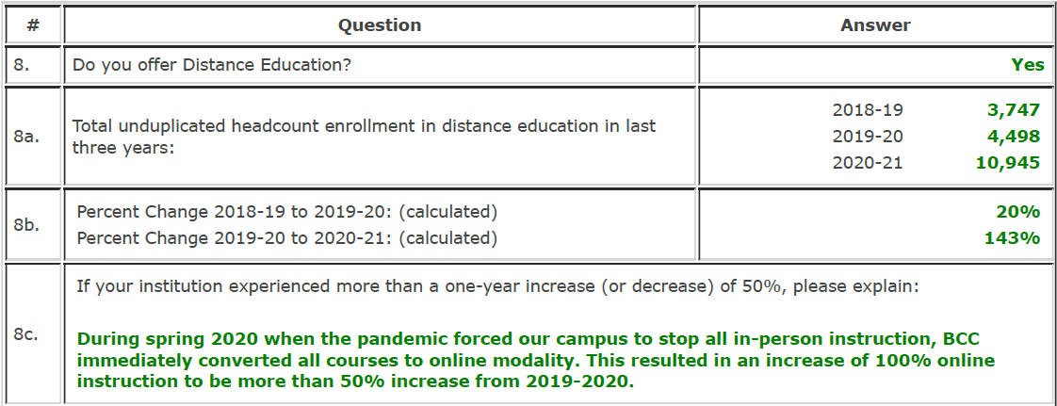
DISTANCE EDUCATION

Slide 6
FEDERAL DATA
*
*DOE Scorecard Graduation Rate: Proportion of ALL entering students that graduated at this school within 8 years of entry, regardless of their full-time/part-time status or prior postsecondary experience.
IPEDS Graduation Criteria (e.g. 2020-21 graduation rate is based on the first-time cohort from 2012-13).
IPEDS Graduation Rate: first time, full-time students who began their program in fall 2016 or fall 2017 to time of completion. The IPEDS graduation rate for 2020-21 is 35% for 2-years and 44% for 4-years.

Slide 7
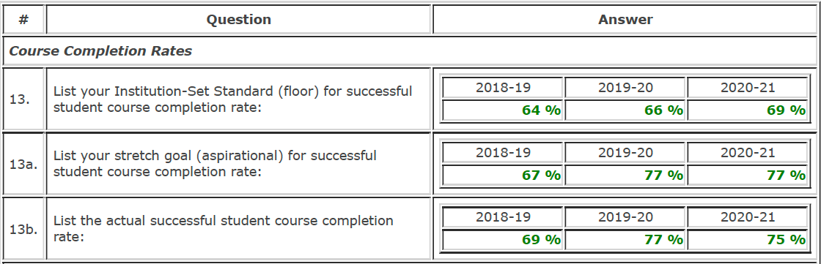
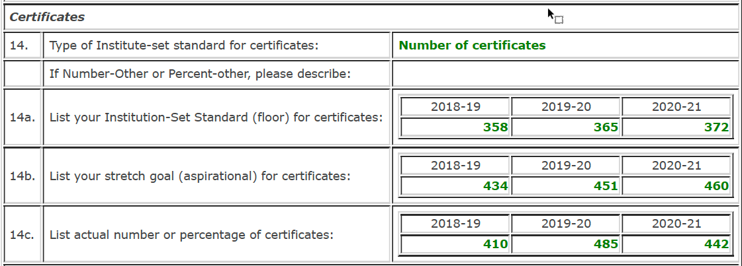
INSTITUTION SET STANDARDS FOR ACHIEVEMENT
+3%
+2%
During the pandemic, students were offered more P/NP and Excused withdrawals (EW) which led to higher completion rates.
*#14: The numbers of certificates provided in our 2022 Annual Report excludes a few awards due to the state's reporting of certificates using a cut point of "6 to less than 18 units" achieved.
For consistency and reliability purposes, we use the same state data sources with the same category for exclusion in this Annual Report.
+10%
+0%
+8%
-2%
+2%
+2%, 7 students
+4%
+2%, 9 students
+18%
-9%, 43 students

Slide 8
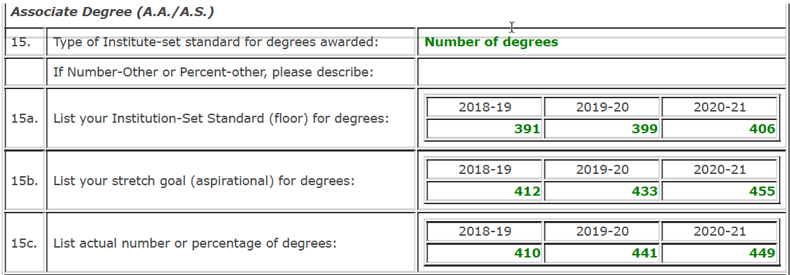
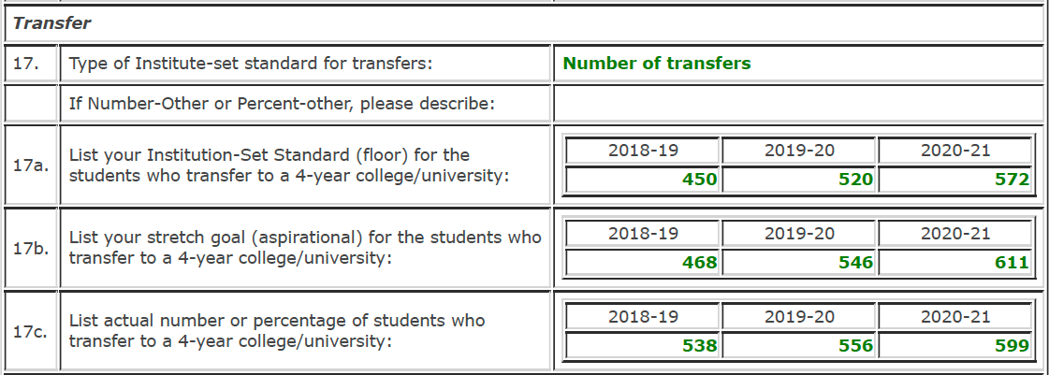
INSTITUTION SET STANDARDS FOR ACHIEVEMENT
+2%
+2%
During the pandemic, we enrolled more students but they took fewer classes, reducing completion of courses for their degrees or transfer requirements.
+5%
+5%, 22 students
+8%
+2%, 8 students
+16%
+10%, 52 students
+17%
+12%, 52 students
+3%
+8%, 43 students

Slide 9
INSTITUTION SET STANDARDS FOR ACHIEVEMENT
*#19: Data were only available up to 2017-18 therefore the other years will show 0% placement rates. (Source data from the CA State Chancellor's Office CTE Perkins reporting web portal.)

Slide 10
2022 ACCJC FISCAL REPORT
Sean Brooks
Vice President of Administrative Servies

Slide 11
District Revenues
4. Total Unrestricted General Fund Revenues (excluding account 8900)
FY 18/19 FY 19/20 FY 20/21
$ 141,592,515 $ 147,153,473 $ 144,605,192
Other Unrestricted Financing Sources (Account 8900)
FY 18/19 FY 19/20 FY 20/21
$ 9,989,588 $ 4,103,141 $ 6,515,725
5. Net (Adjusted) Unrestricted General Fund Beginning Balance FY 18/19 FY 19/20 FY 20/21 $14,058,224 $22,219,749 $24,089,875
Net Unrestricted General Fund Ending Balance, including transfers in/out FY 18/19 FY 19/20 FY 20/21 $19,898,560 $24,908,962 $25,947,285

Slide 12
District Expenditures
6. Total Unrestricted General Fund Expenditures (including account 7000)
FY 18/19 FY 19/20 FY 20/21
$ 145,741,767 $ 148,567,401 $ 149,263,507
Total Unrestricted General Fund Salaries and Benefits (accounts 1000, 2000, 3000) $ 123,539,442 $ 120,914,326 $ 113,772,453
Other Unrestricted General Fund Outgo
$ 63,602,325 $ 27,653,075 $ 35,491,054
Unrestricted General Fund Ending Balance
$ 19,898,560 $ 24,908,962 $ 25,947,285

Slide 13
Cash Position
14. Cash Balance at June 30 from Annual CCFS-311 Report (Combined General Fund Balance Sheet Total — Unrestricted and Restricted- accounts 9100 through 9115)
FY 18/19 FY 19/20 FY 20/21
$ 18,394,640 $ 2,230,141 $ 11,692,238

Slide 14
District & College Data
18. Final Adopted Budget — budgeted Full Time Equivalent Students (FTES) (Annual Target)
FY 18/19 FY 19/20 FY 20/21
18,723 16,861 16,950
Actual Full Time Equivalent Students (FTES) from Annual CCFS 320
16,551 16,118 13,184
21. Final Adopted Budget – budgeted Full Time Equivalent Students (FTES) (Annual Target
3,924 3,587 3,248
Actual Full Time Equivalent Students (FTES) from Annual CCFS 320
3,363 2,131 2,820

Slide 15
Unrestricted General Fund Allocation
22. Final Unrestricted General Fund allocation from the District (for Single College Districts, use the number in 4a.)
FY 18/19 FY 19/20 FY 20/21
$ 18,672,863 $ 19,875,657 $ 20,324,891

