Slide 1
Guided Pathways
UPDATES AND NEXT STEPS

Slide 2
Updates Fall 2021
Informational Presentations
Classified Senate 11/10
Faculty Senate 11/3
ASBCC 11/18
IPC 12/9
Endorsement of Spring 22 Work Plan
Faculty Senate 12/1
ASBCC 12/9
Pilot ACP Working Group (People, Society and Public Service, Arts and Culture)
Identified questions and challenges to address
Mapped success pathway for:
Philosophy
HUSV
Political Science
Global Studies

Slide 3
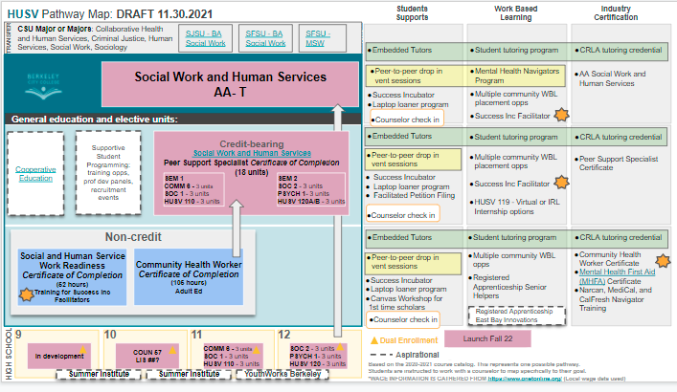

Slide 4
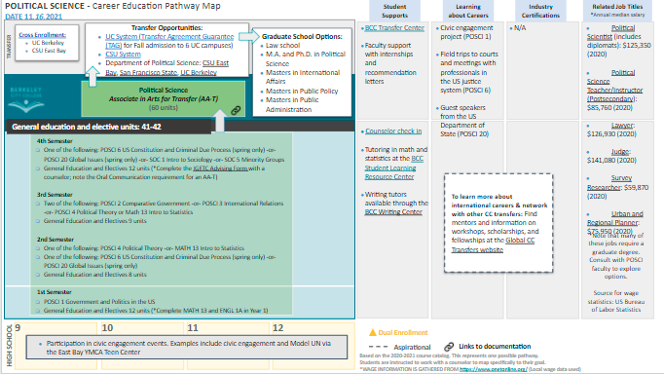

Slide 5
PLAN OF ACTION 2022
Faculty and Staff Professional Development Day (1/21): Community activity and discussion around programs in relation to drafted ACPs
Call out for 12 faculty to serve as ACP representatives and workgroup leads
Finalize names and descriptors ACPs
Develop institutional (spring ‘22) and student facing success maps (fall ‘22) for within ACPs and by program
Focus groups and 2+ town hall forums for students
Connect ACPs with ongoing BCC projects (dual enrollment on ramps, peer “success incubators”, HSI programming)
*support from First Floor Consulting group

Slide 6
QUESTIONS AND THANK You
Questions or comments:
Melina Bersamin – mbersamin@peralta.edu
Linda McAllister - lmcallister@peralta.edu

