Slide 1
Grant Year 2
Planning & Administration
A Presentation to:
College Roundtable
for Planning and Budget
Berkeley City College
Monday, December 13, 2021

Slide 2
Grant Goals
1
3
Latinx Freshmen Retention Rate
5% increase over baseline of 81%
Latinx and Low-income student employment preparation
10% increase over baseline of 58%
Student Success
Career & Job Placement
Latinx Graduation, Completion Rate
24 Latinx student increase over the baseline of 237
2
4
Latinx Transfer Rate
55 Latinx student increase over the baseline of 91
Faculty and Staff Professional Development
40 Faculty and staff to participate in professional development
activities over baseline of 0
Transfer Success
Professional Development

Slide 3
Objectives & Targets
1
3
Objective 1
By September 30, 2025, achieve a 5% increase in the Hispanic freshman retention rate to 81% over 2019 baseline of 76%
Objective 5
By Sept. 30, 2025, increase preparation of Hispanic and low-income students for employment from 58% to 68%
Student Success
Career & Job Placement
Objective 2
By September 30, 2025, increase the annual rate of degree or certificate completion for Hispanic students by 10% over a baseline of 237 students
2
4
Objective 3
Objective 4
Transfer Success
By September 30, 2025, increase the annual number of Hispanic students who transfer from BCC to a four-year institution to 146 from a 2019 baseline of 91
By Sept. 30, 2025, a total of 40 faculty and staff will participate in pedagogy-focused professional development activities
Professional Development

Slide 4
Obj 1 – GY1 Milestones & GY2 Planning
Objective 1
Achieve a 5% increase in the Hispanic freshman retention rate to 81% over 2019 baseline of 76%
1
DCAC/EAOP Partnership
2
Finalize Outreach & Retention position
DCAC/EAOP Partnership
Berkeley High, Oakland Tech, Skyline, Emery High, Castlemont
5 College Advisors
HS Outreach Workshop Curriculum
Financial literacy, financial aid, career pathways, dual enrollment support
3
Latinx Heritage Month
4
“Bienvenida de BCC”, Latinx Welcome event
77%
78%
79%
80%
81%

Slide 5
Obj 2 – GY1 Milestones & GY2 Planning
Objective 2
Increase annual rate of degree or certificate completion for Latinx students by 10% over 237 baseline
1
Continue Puente Cohort(s)
Career Pathways Workshop Curriculum
Financial literacy, financial aid, career pathways
2
Puente Project – F21
Fall 2021 Cohort - 34 students
Embedded in COUNS 24 – College Success Courses
First Orientation – 95 attendees
773 drop-ins, 218 unduplicated
Finalize Research Specialist position
Support outreach efforts, targeted Latinx efforts
3
4
Raíces Latinx Graduation
241
246
251
256
261
Notes:
Goal: 90% completion rates for SEPs
The Puente Community Collab Lab – meets once a weeks, space to receiving counseling services, resources, information on the transfer process
Developed the Umoja & Puente
Supported BCC’s Express Registration
General BCC Counseling support
Including the Embedded Counseling Projected as part of Guided Pathways – provide embedded counseling support across English 1 A to promote campus programs/resources, share upcoming campus events, highlight certificate and degree pathways, discuss the transfer process, provide campus/district policy updates, and encourage all students to meet with a counselor by the end of the semester to develop their Student Education Plan, 13 synchronous English 1A section
GUIDED PATHWAYS: Dri’s involvement in pathway mapping, identify potential areas of overlap

Slide 6
Obj 3 – GY1 Milestones & GY2 Planning
Objective 3
1
Retention & Completion position
Increase annual number of Latinx students who transfer from BCC to a four-year from 91 to 146
Transfer Workshop Support
Targeted outreach, social media, campaign support
2
Transfer Success
Fall 2021 Outreach Support
200 calls made
Support for Virtual Transfer Day
Social media
Latinx student email campaign
Targeted Outreach
Outreach campaign, targeted Latinx efforts
3
4
Planning for additional closed cohort
5
Potential Transfer/Articulation event
102
113
124
135
146
Notes:
Goal: 90% completion rates for SEPs
The Puente Community Collab Lab – meets once a weeks, space to receiving counseling services, resources, information on the transfer process
Developed the Umoja & Puente
Supported BCC’s Express Registration
General BCC Counseling support
Including the Embedded Counseling Projected as part of Guided Pathways – provide embedded counseling support across English 1 A to promote campus programs/resources, share upcoming campus events, highlight certificate and degree pathways, discuss the transfer process, provide campus/district policy updates, and encourage all students to meet with a counselor by the end of the semester to develop their Student Education Plan, 13 synchronous English 1A section
GUIDED PATHWAYS: Dri’s involvement in pathway mapping, identify potential areas of overlap

Slide 7
Obj 4 – GY1 Milestones & GY2 Planning
Objective 4
Complete January Workshop with Dr. Garcia
Continue Transforming Institutions model and BCC inventory
40 Faculty and staff will participate in pedagogy-focused professional development activities
1
Professional Development
Partnership with BCC PD Committee, Dr. Gina Garcia
Two Flex Day (Aug 20, October 20) on Transforming Institutions
More than 200 participants
March Flex Day Workshop Development
Focus on Assessment using Transforming Institutions model
2
3
AY 2021-2022 Closing Event
4
Ongoing PD Planning, Advisory Group
8
16
24
32
40
Notes:
Goal: 90% completion rates for SEPs
The Puente Community Collab Lab – meets once a weeks, space to receiving counseling services, resources, information on the transfer process
Developed the Umoja & Puente
Supported BCC’s Express Registration
General BCC Counseling support
Including the Embedded Counseling Projected as part of Guided Pathways – provide embedded counseling support across English 1 A to promote campus programs/resources, share upcoming campus events, highlight certificate and degree pathways, discuss the transfer process, provide campus/district policy updates, and encourage all students to meet with a counselor by the end of the semester to develop their Student Education Plan, 13 synchronous English 1A section
GUIDED PATHWAYS: Dri’s involvement in pathway mapping, identify potential areas of overlap

Slide 8
Obj 5 – GY1 Milestones & GY2 Planning
Objective 5
Complete first annual BCC
Career Fair event
Increase preparation of Latinx and low-income students for employment from 58% to 68%
1
Career Pathways Workshop Curriculum
Financial literacy, financial aid, career pathways for Fair
2
Career Development
Initiated planning for first Annual Career Fair
Partnership building with Career & Transfer Center, Career Education
Financial Aid, Literacy Workshop Curriculum
Support financial aid efforts, targeted Latinx efforts
3
4
Develop Social Media, web presence
60%
62%
64%
66%
68%
Notes:
Goal: 90% completion rates for SEPs
The Puente Community Collab Lab – meets once a weeks, space to receiving counseling services, resources, information on the transfer process
Developed the Umoja & Puente
Supported BCC’s Express Registration
General BCC Counseling support
Including the Embedded Counseling Projected as part of Guided Pathways – provide embedded counseling support across English 1 A to promote campus programs/resources, share upcoming campus events, highlight certificate and degree pathways, discuss the transfer process, provide campus/district policy updates, and encourage all students to meet with a counselor by the end of the semester to develop their Student Education Plan, 13 synchronous English 1A section
GUIDED PATHWAYS: Dri’s involvement in pathway mapping, identify potential areas of overlap

Slide 9
Budget Overview

Slide 10
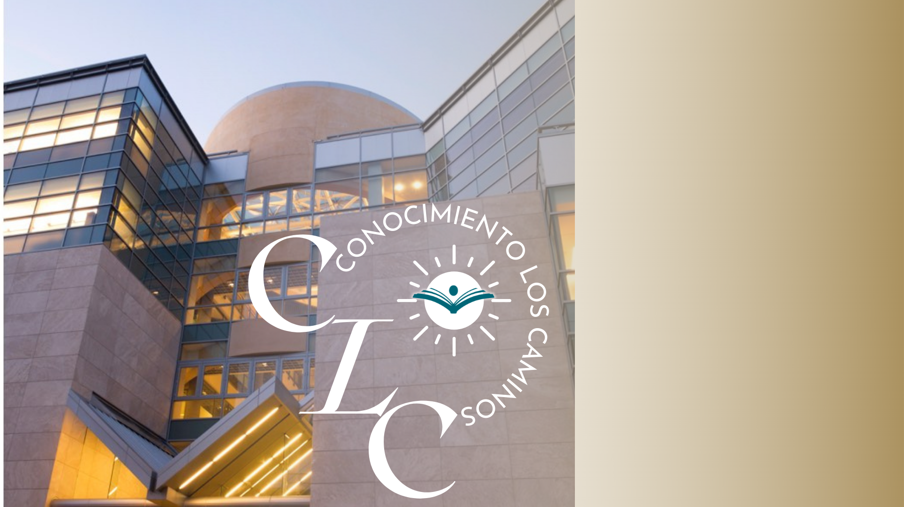
Thank You
Questions?
For any questions or more information, please contact:
Verónica Montoya vmontoya@peralta.edu

