Slide 1
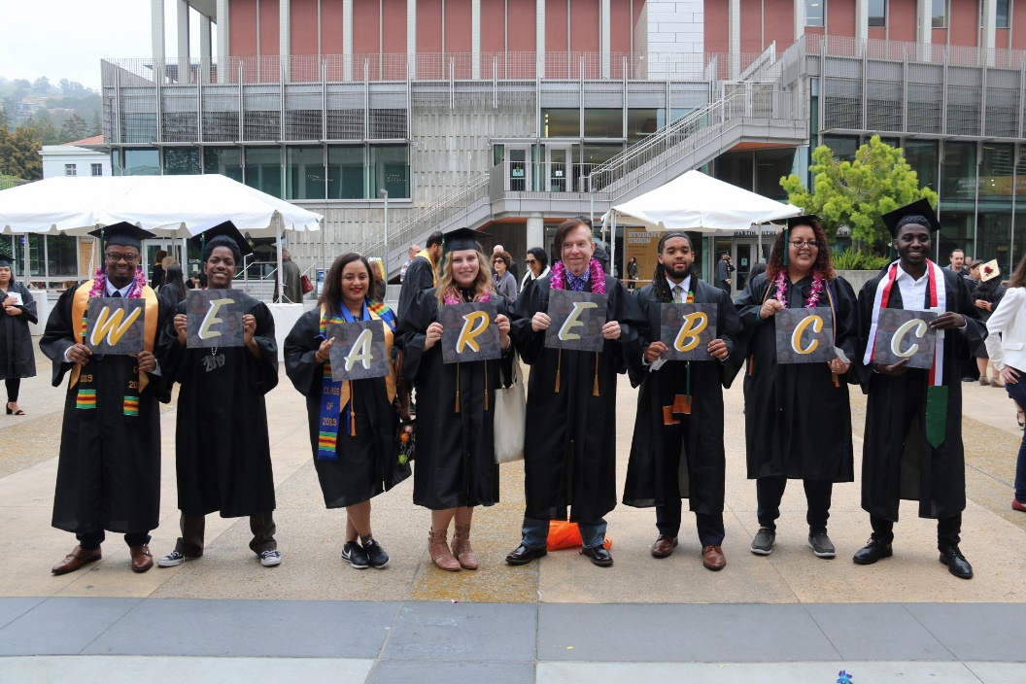
Virtual Graduation
May 22nd, 2020

Slide 2
Student Input

Slide 4
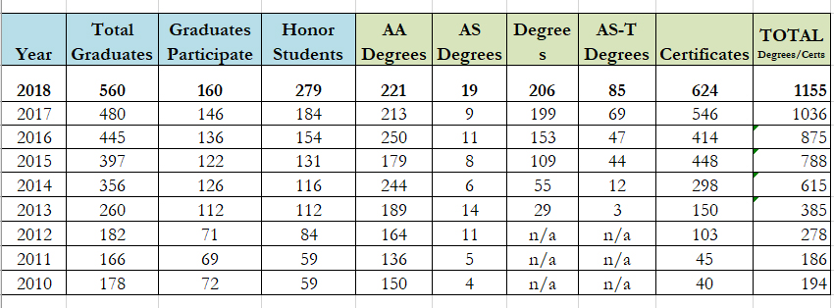
Data from 2010 - 2018

Slide 5
Current Amount of Student Participants
90

Slide 6
Speeches
Welcoming Remarks – President: Dr. Angélica Garcia
Faculty Speaker: Janine Greer
Classified Speaker: Felicia Bridges
Valedictorian: Jyoti Tuladhar
Salutatorian: Violet Murov
Closing Remarks – President: Dr. Angélica Garcia

Slide 8
Sample of Virtual Commencement Webpage
https://virtualgrad.marchingorder.com/

Slide 9
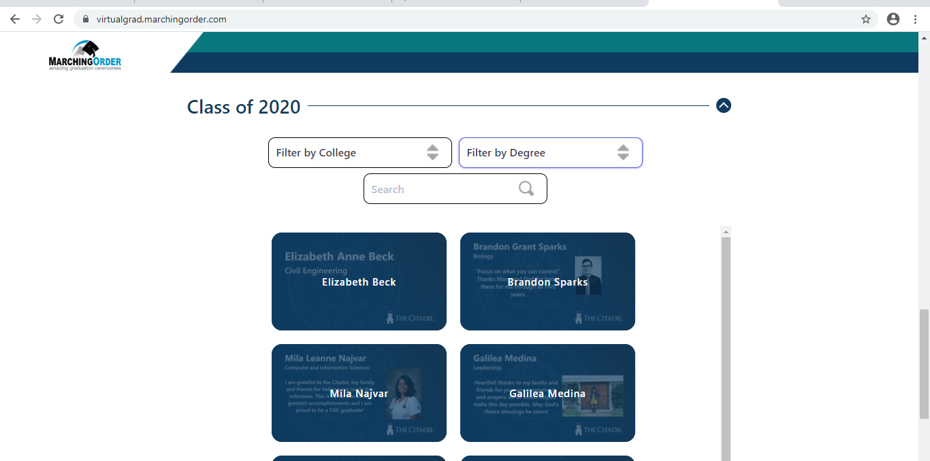
Sample of Virtual Commencement Webpage Continued…
https://virtualgrad.marchingorder.com/

Slide 10
Video of the Commencement
Peralta TV will be putting all the speeches and slides together in a video and will be available for the public to view on YouTube on May 22nd.

Slide 11
Questions?

