Slide 1
PUENTÉ
Data Inquiry

Slide 2
Enrollment Trend

Slide 3
2018-19 Enrollment by Ethnicity

Slide 4
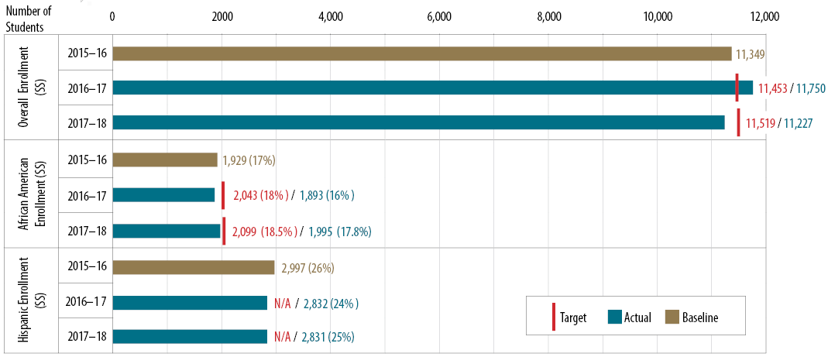
Participation in BCC (instructional and student service) programs that lead to the completion of a certificate, degree, or transfer

Slide 5
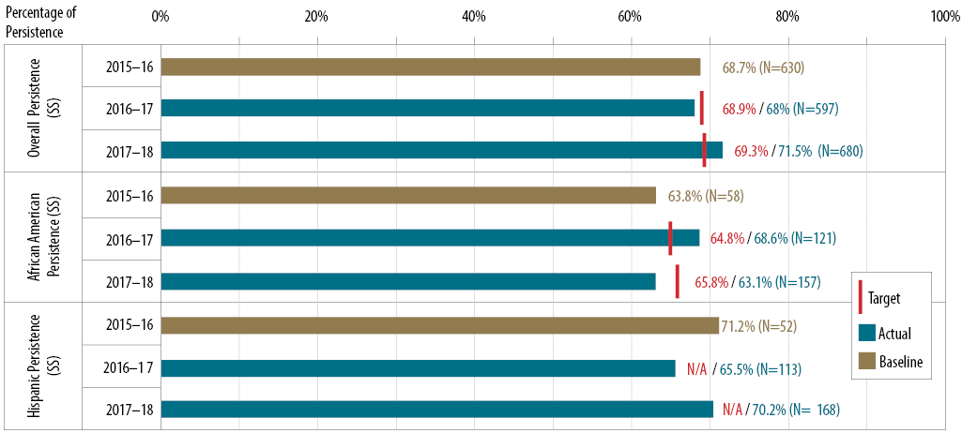
Persistence in the first three consecutive terms

Slide 6
67% Avg
65% Avg
AVG 67% (2017-18 & 2018-19)
AVG 65% (2016-17)

Slide 8
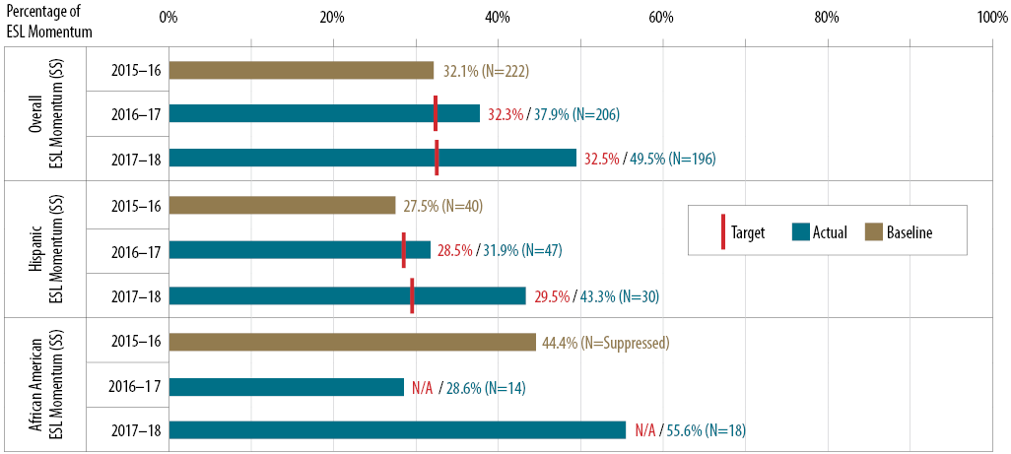
ESL momentum (students first enrolled in an ESL credit course who completed a college-level English course)

Slide 9
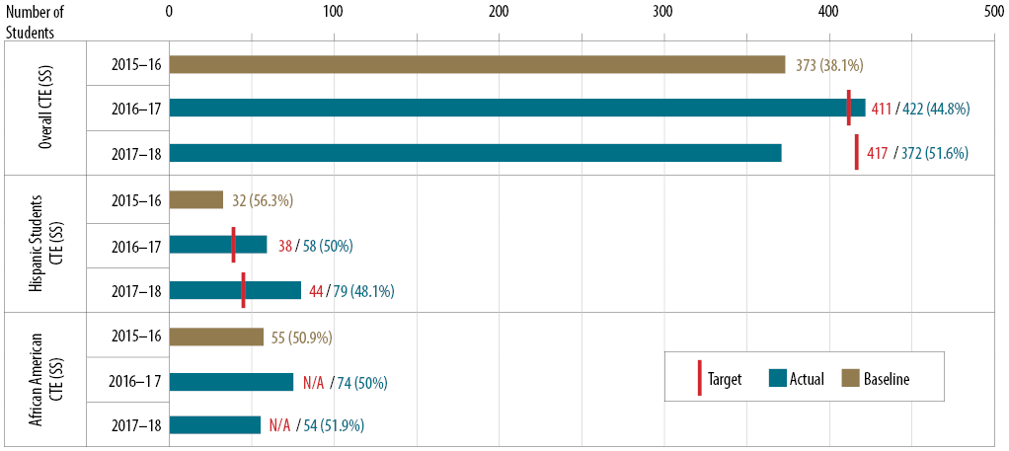
CTE participation (access) rate

Slide 10
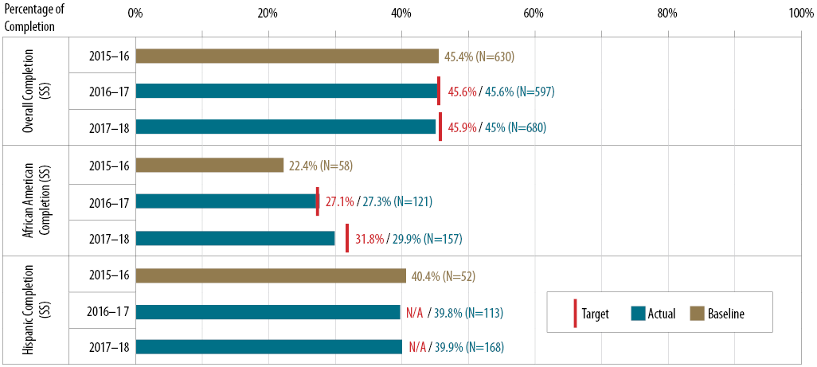
Completion rate of degrees or transfers

Slide 11
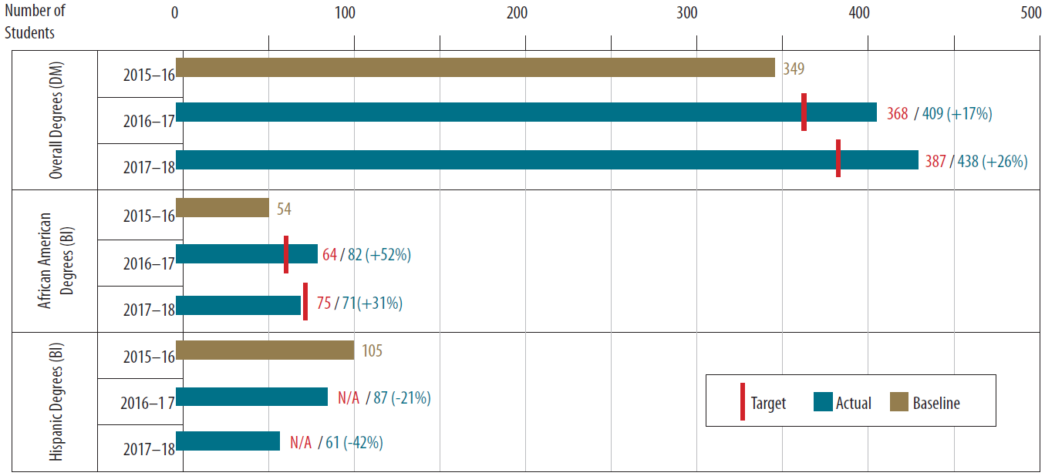
Students Earning Degrees

Slide 12
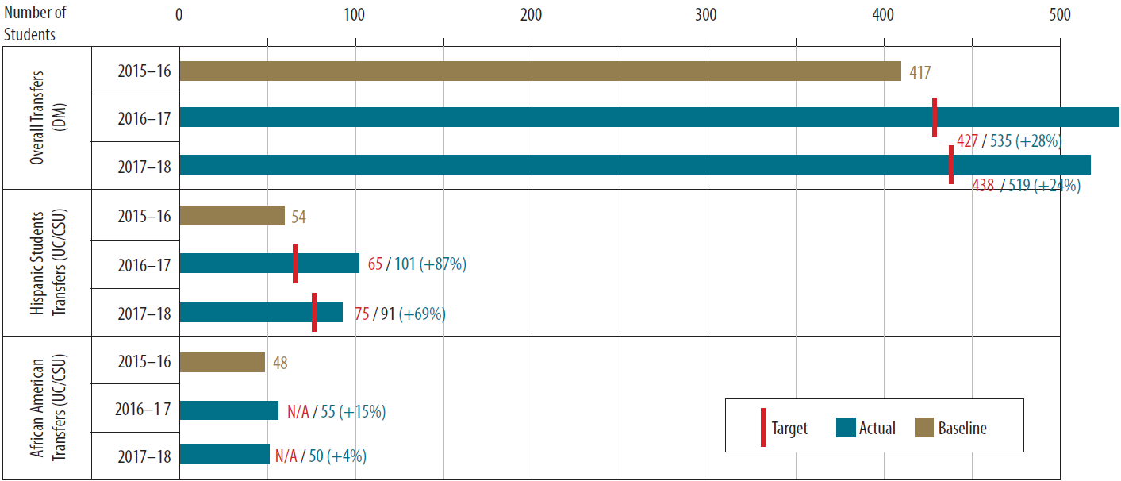
Transfers from BCC who enrolled at any 4-year college or university
19% of Overall
18% of Overall

Slide 13
AB705: Disproportionately Impacted Groups
First time students who completed both transfer-level math and English within the District in their first year (2017-18)
AY 2017-18
4% Pt Gap
4% Pt Gap
7% Pt Gap
9% Pt Gap

Slide 14
AB540: Enrollment

Slide 15
High School Demographics
2% increase
2% decline
1% decline
No Change
1% increase

Slide 16
Adult Education
Total Enrollment (Ages 18+)
6,060
6,501
5,413
2016-17 2017-18 2018-19

