Slide 1
Guided Pathways Berkeley City College
BCC Governance Retreat
May 29, 2019

Slide 2
GP
Purpose:
Multi-year state program designed to provide all CCCs with the opportunity to implement Guided Pathways for the purpose of significantly improving student outcomes and success.
Are students ready for the College? X
Are we ready for the students? O
Re-imagining and re-designing the way we think about student success.
Faster, cost-effective, and focused way to get to a certificate, degree, transfer, or
a job
No more Cafeteria choices, streamlined choices of study students can identify and see where they are going. Focused approach.

Slide 3
GP
AB 288 (CCAP), AB 705, GP CTE, SEA, SCFF are all part of the GP Framework!
AB 288 (CCAP)- helps us reach out to underserved and unprepared students in HS to ensure that they will be college-ready (Getting ready)
AB 705 – ensures that students start off at the right place, college level (Getting ready, Moving in)
GP CTE – ensures that there are clearly identified CTE pathways for students to be able to choose (Getting ready, moving in)
SEA – ensures that funding supports elimination of achievement gap
SCFF – all about accountability for the colleges! If all students we serve succeed, the colleges get funding.

Slide 4
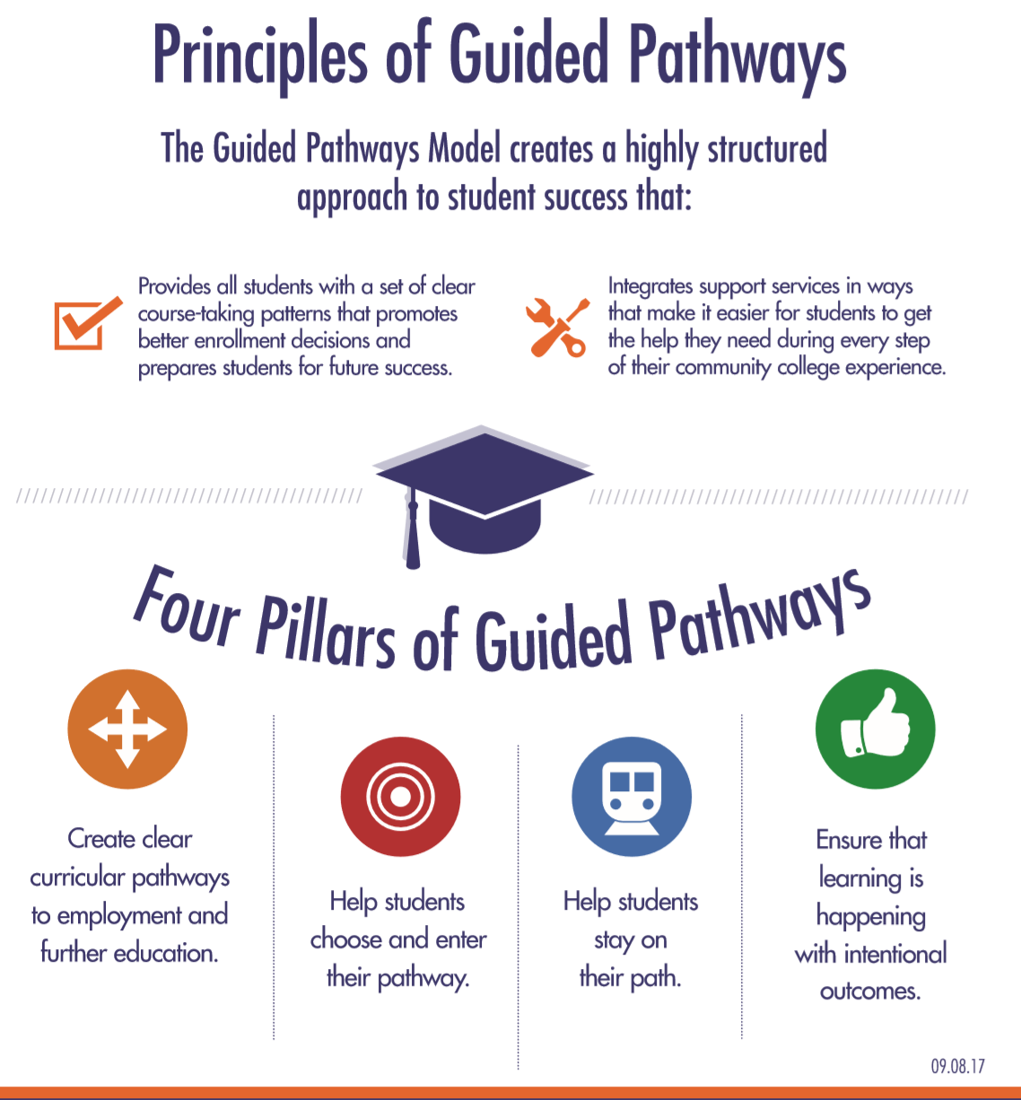
GP CCCCO visual

Slide 5
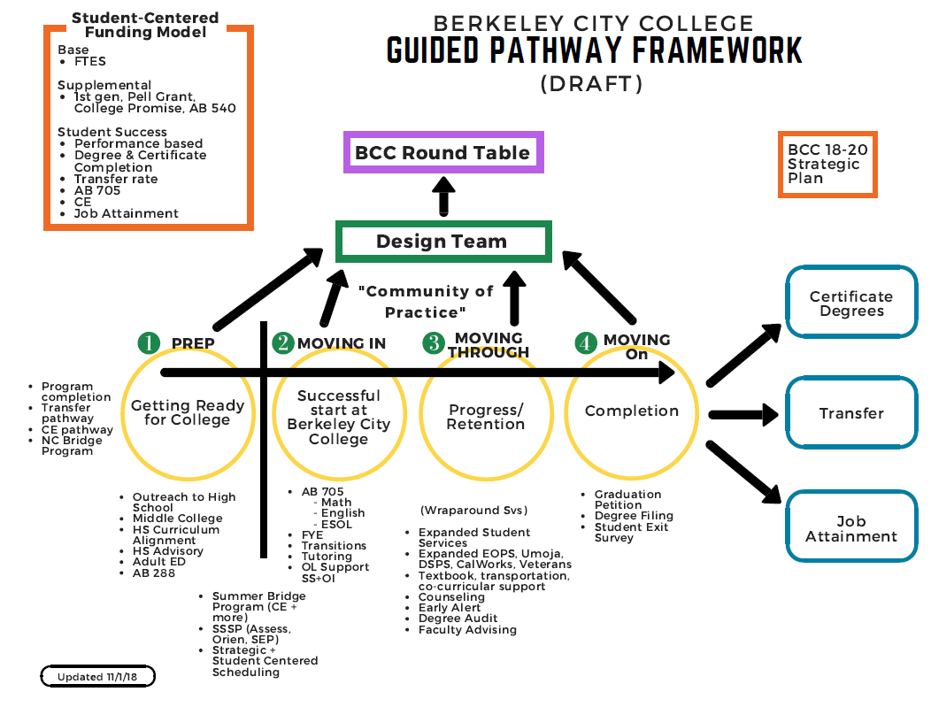
GP BCC Visual

Slide 6
GP
Funding:
$150M in one-time fund for all 114 colleges
Self Assessment with key indicators (12, 2017)
Initial work plan submission (3, 2018)
College allocation release (6, 2018) upon completion of the assessment and work plan
Workshops, training, understanding of GP (statewide, 18-19)
Scale of Adoption report submission (4-30-19)
Comprehensive report due (9-30-19)

Slide 7
GP: BCC 5 year GP funding plan (original)
BCC Guided Pathway (GP) 5 year Budget Plan (V.3)
2017-2018 (15%) $157,176 |  |  |  | 2018-2019 (30%) $188,611 ($345.787 with 17-18 & 18-19) |  |  |  | 2019-2020 (25%) $157,176 |  |  |  | 2020-2021 (10%) $62,870 |  |  |  | 2021-2022 (10%) $62,870
Positions/Activities | Category | Type of expense | Cost | Positions/Activities | Category | Type of expense | Cost | Positions/Activities | Category | Type of expense | Cost | Positions/Activities | Category | Type of expense | Cost | Positions/Activities | Category | Type of expense | Cost
 |  |  |  |  |  |  | 345.787 |  |  |  | 157,176 |  |  |  | 152,447.20 |  |  |  | 152,447.20
 |  |  |  | Faculty Leads for Sub-committee teams (4) | faculty | 0.2 FTE/Sem | 40,916.40 | Faculty Leads for Sub-committee teams (4) | faculty | 0.2 FTE/Sem | 40,916.40 | Faculty Leads for Sub-committee teams (4) | faculty | 0.2 FTE/Sem | 40,916.40 | Faculty Leads for Sub-committee teams (4) | faculty | 0.2FTE/Sem | 40,916.40
 |  |  |  | Research Data Specialist (50%) , C3 | classified | 0.5 FTE | 32,579 | Research Data Specialist (50%) , C3 | classified | 0.5 FTE | 32,579 | Research Data Specialist (50%) , C3 | classified | 0.5 FTE | 30,456 | Research Data Specialist (50%) , C3 | classified | 0.5 FTE | 30,456
 |  |  |  | Staff Assistant (50%), C3 | classified | 0.5 FTE | 25,462 | Staff Assistant (50%), C3 | classified | 0.5 FTE | 25,462 | Staff Assistant (50%), C3 | classified | 0.5 FTE | 23,802 | Staff Assistant (50%), C3 | classified | 0.5 FTE | 23,802
 |  |  |  | Faculty stipend for participationin the committees (10 per sub committee x 4 committees) | Faculty | $200 per semester per facuilty | 16,000 | Faculty stipend for participationin the committees (10 per sub committee x4 committees) | Faculty | $200 per semester per facuilty | 16,000 | Faculty stipend for participationin the committees (5 per sub committee) | Faculty | $200 per semestre per facuilty | 8,000 | Faculty stipend for participationin the committees (5 per sub committee) | Faculty | $200 per semestre per facuilty | 8,000
 |  |  |  | PD | All |  | 21,819 | PD | All |  | 17,069 | PD | All |  | 16,819 | PD | All |  | 16,819
 |  |  |  | Consultants & activities | All |  | 21,819 | Consultants & activities | All |  | 17,069 | Consultants & activities | All |  | 16,819 | Consultants & activities | All |  | 16,819
 |  |  |  | Other (i.e. Classified OT, etc.) | All |  | 11,819.40 | Other (i.e. Classified OT, etc.) | All |  | 11,819.40 | Other (i.e. Classified OT, etc.) | All |  | 15,632.00 | Other (i.e. Classified OT, etc.) | All |  | 15,632.00
 |  |  |  |  |  | Total Expenses | 170,415.60 | Total Expenses |  |  | 160,915.60 | Total Expenses |  |  | 152,445.20 | Total Expenses |  |  | 152,445.20
 |  |  |  | Carry over for year 4 & 5 | all |  | 175,371.40 |  |  |  |  | Carry over from year 1&2 | All |  | 87,685.70 | Carry over from year 1&2 | All |  | 87,685.70
 |  |  |  |  |  |  |  |  |  |  |  |  | $62,870 + $ 87,665.70 = $150,535.7 |  |  |  | $62,870 + $ 87,665.70 = $150,535.70

Slide 8
GP BCC Funding (original) update as of May 2019
BCC Original allocation of GP Funds (year 1, 2018-2019) still in process
Positions/Activities | Category | Type of Expense | Status
Faculty co-lead work group | Faculty | 0.2 FTE/semester | Expended for 3 faculty leads
Research Data Specialist (50%) | Classified | 0.5 FTE | Re-assess Stopped recruitment
Staff Assistant (50%) | Classified | 0.5 FTE | Re-assess Stopped recruitment
Faculty stipend Participation in the work group | Faculty | $200 per semester | Expenditures in progress
PD | All | $3328.80 PD Day food 10-2018
Consultants & activities | All
Other (Classified OT) | All |  | No reporting

Slide 9
GP: GP Expenditure Guidelines
Must be used for rethinking and redesigning programs and services into cohesive, campus-wide strategies to achieve the outcomes expected by the state, CCCCO, and our students. Funds to be used to directly support the implementation of the GP framework.
It is subject to audit and it will be included in the District Audit Manual.
Be ready for the audit.
Non-Allowable expenditures:
Gifts
Stipend for students
Political contributions
Courses
Supplanting (especially with the categorical programs)

Slide 10
GP: Outcomes met per the Grant
1. Completion of required reports
Self Assessment
Work plan
Scale of Adoption
Development of cross-pollinated work group & the development of the Design team
Addressing the need for Technology infrastructure, support and development of key tools
(Application and registration tools, Degree Audit, and enrollment management data tool in
alignment with SCFF) – requires help from the District.
Continue to provide an overall institutional framework to redesign programs and services into
cohesive college-wide strategies that help students obtain their goals in a timely fashion.

Slide 11
GP: Rough Benchmark of Activities
Rough plans for activities | (2017-2018 and 2018-2019) | 2019-2020 | 2020-2021 | 2021-2022
 | Move the needle on work plan 1,2, and 10 | Exploration and identification of BCC Equity framework | Community of Practice at BCC: Infuse Equity Framework into college practices as part of the accountability (for us) | BCC GP becomes college’s sustainable continuous improvement practice and norm on behalf of our students.
 | BCC Work group and Design team operations | Develop bucket of study that will be tied with SEP. | Clarification, communication and marketing of the program of study at BCC to all communities around and beyond.
 | Exploration of Equity Framework for BCC | Implementation of AB 288 to Berkeley, Albany, Richmond, and Emeryville – identify under prepared students to be college ready | Serving unprepared, underserved and marginalized students to be college ready.
 |  | Implementation of Degree Audit | Streamlined Degree Audit
 |  | Technology Support (Work plan 10): Customization of CCC Apply, smooth translation to BCC application, CE employment data | Technology Support for smooth registration process.
 |  | Block Scheduling – offer courses students need when they need them | Schedule development with clear direction for students. Sequence makes sense for completion of the program.
 |  | PD – community of practice for BCC | PD | PD

Slide 12
GP – College-wide needs
Support for the upgrade for research position
Professional Development throughout the year to achieve specific outcomes:
Equity Framework
Community of practice
Bucket cluster building for Academic programs and student services
Revamping of course offerings, sequencing, and block schedule
In reach and outreach

