Slide 1
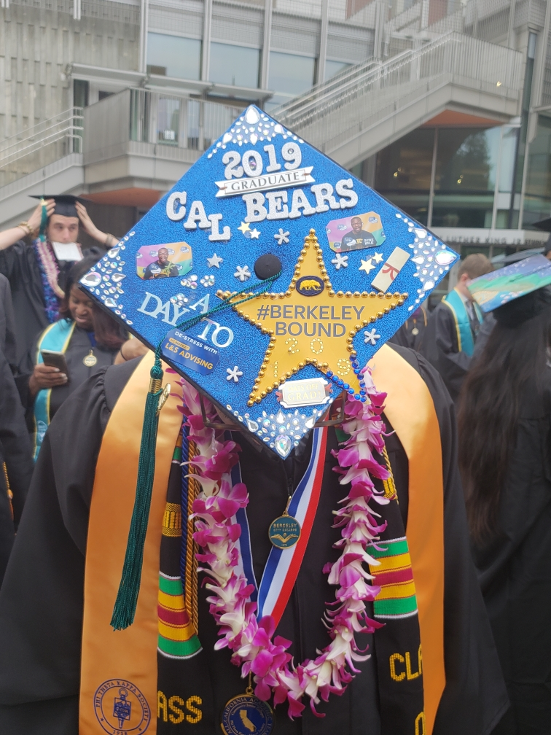
Berkeley City College
CalWORKs Funding Presentation

Slide 2
California Work Opportunity and Responsibility to Kids
CalWORKs
State Funded Program
The CalWORKs program provides services to parents receiving Temporary Aid to Needy Families (TANF) in conjunction with the surrounding counties. The CalWORKs program provides students receiving TANF an opportunity to obtain an education and earn a vocational certificate or degree in a variety of occupational fields.

Slide 3
CalWORKs 2017-2018 Allocation & Program Requirements
CalWORKs Total Amount: $175,034
Program Funds $88,514
Work Study Funds $6,506
Child Care Funds $49,269
Federal TANF Funds $30,745

Slide 4
Allowable CalWORKs Expenditures
The CalWORKs program funds are allocated specifically to support student parent needs. With state approval, funds can be moved around in three of the four categories based on program needs.
Funds can be returned without penalty and redistributed to other colleges that request additional funds.

Slide 5
CalWORKs Measurable Outcomes
Student Participation - 19
Counseling – Counseling for participants to assist with county requirements and connect them more effectively with educational opportunities and changing the mindset
Tutoring – Math and English
Outreach – Assessment & Orientation, Financial Aid Query, County Meet and Greet, Word of mouth

Slide 6
EOPS Measurable Outcomes
Workshops- Partner with the Wellness Center, and CARE program to create workshops tailored to student parent needs.
Healthy relationships
Self Care & Parenting
Time management
Campus Tours- UCB Parent Center tour
Grads and Transfers – 2 Transfers

Slide 7
Alignment with BCC’s Mission & Strategic Goals
Goal I
The CalWORKs program partners with CARE, Mental Health Services, and Transfer & Career Center to provide workshops that support personal and academic development and address some of the challenges that often interrupts student parent academic success.
The CalWORKs program provides academic and career counseling, and works closely with Social Service professionals to provide support for student success by changing the mindset of our students.
Goal II
Midterm progress reporting for all program participants.
Requiring CalWORKs participants to check-in monthly and assist with required county documents, SEP updates, parenting challenges, and all other concerns.

Slide 8
Alignment with BCC’s Mission & Strategic Goals
Goal III
CalWORKs provides Career-Technical Education ( C.E.) materials to program participants.
CalWORKs staff provide written materials to county employment counselors to familiarize them with our C.E. programs and encourage them to refer students to Berkeley City College.
Goal IV
The CalWORKs program is a diverse program. Staff are equipped with cultural sensitivity and competency, and understand student parent needs.
With the adoption of AB 705 the CalWORKs program and the Jerry L. Adams Learning Resources Center will partner up to provide additional academic support for students.

Slide 9
Program Flexibility Marketing
The CalWORKs program allows for marketing materials to be purchased and distributed for program outreach. Berkeley City College programs and services can be an intrical part of that promotion as long as the CalWORKs program is the focus.

Slide 10
Program Flexibility Student Employment
The CalWORKs program is committed to student employability. CalWORKs students can work on or off campus with CalWORKs funds.
Program funds can pay up to 75% of the student's salary.
All student workers must be in good standing and meet Satisfactory Academic Progress
Tutors can be hired to assist CalWORKs students and not be a CalWORKs participant.

Slide 11
Program Flexibility Professional Development
Professional Development funding is available for CalWORKs staff, faculty, and students
Funding for independent contractors
Funding for staff and student travel
Funding for refreshments

