Slide 1


ADULT
EDUCATION

Slide 2
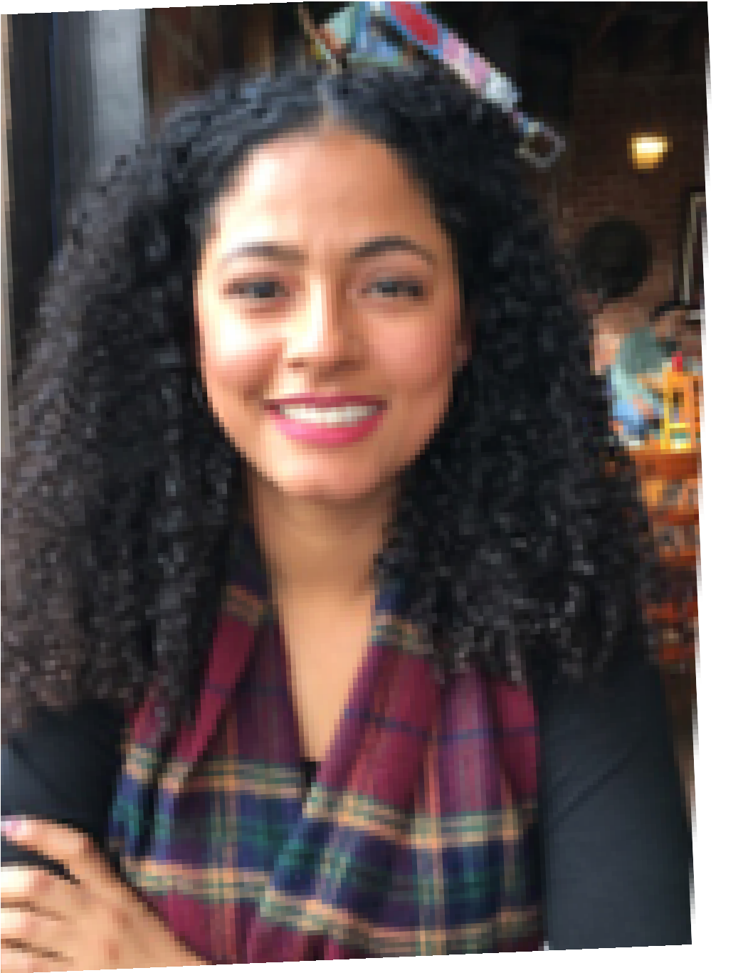
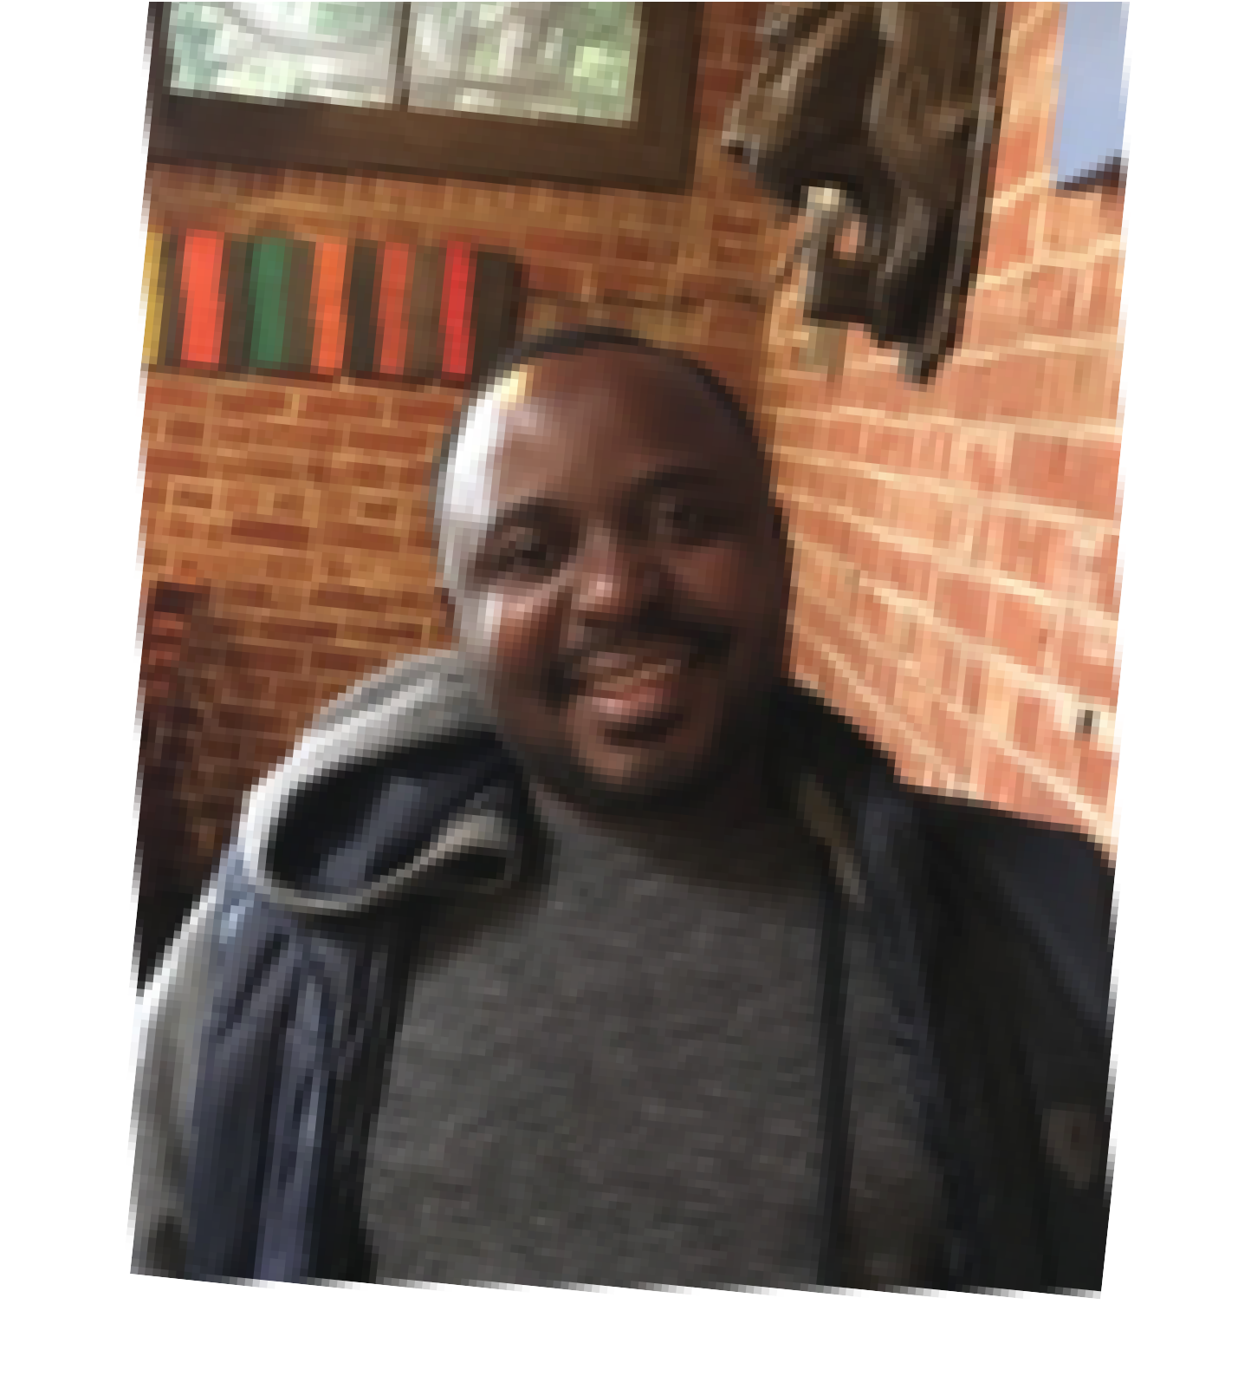
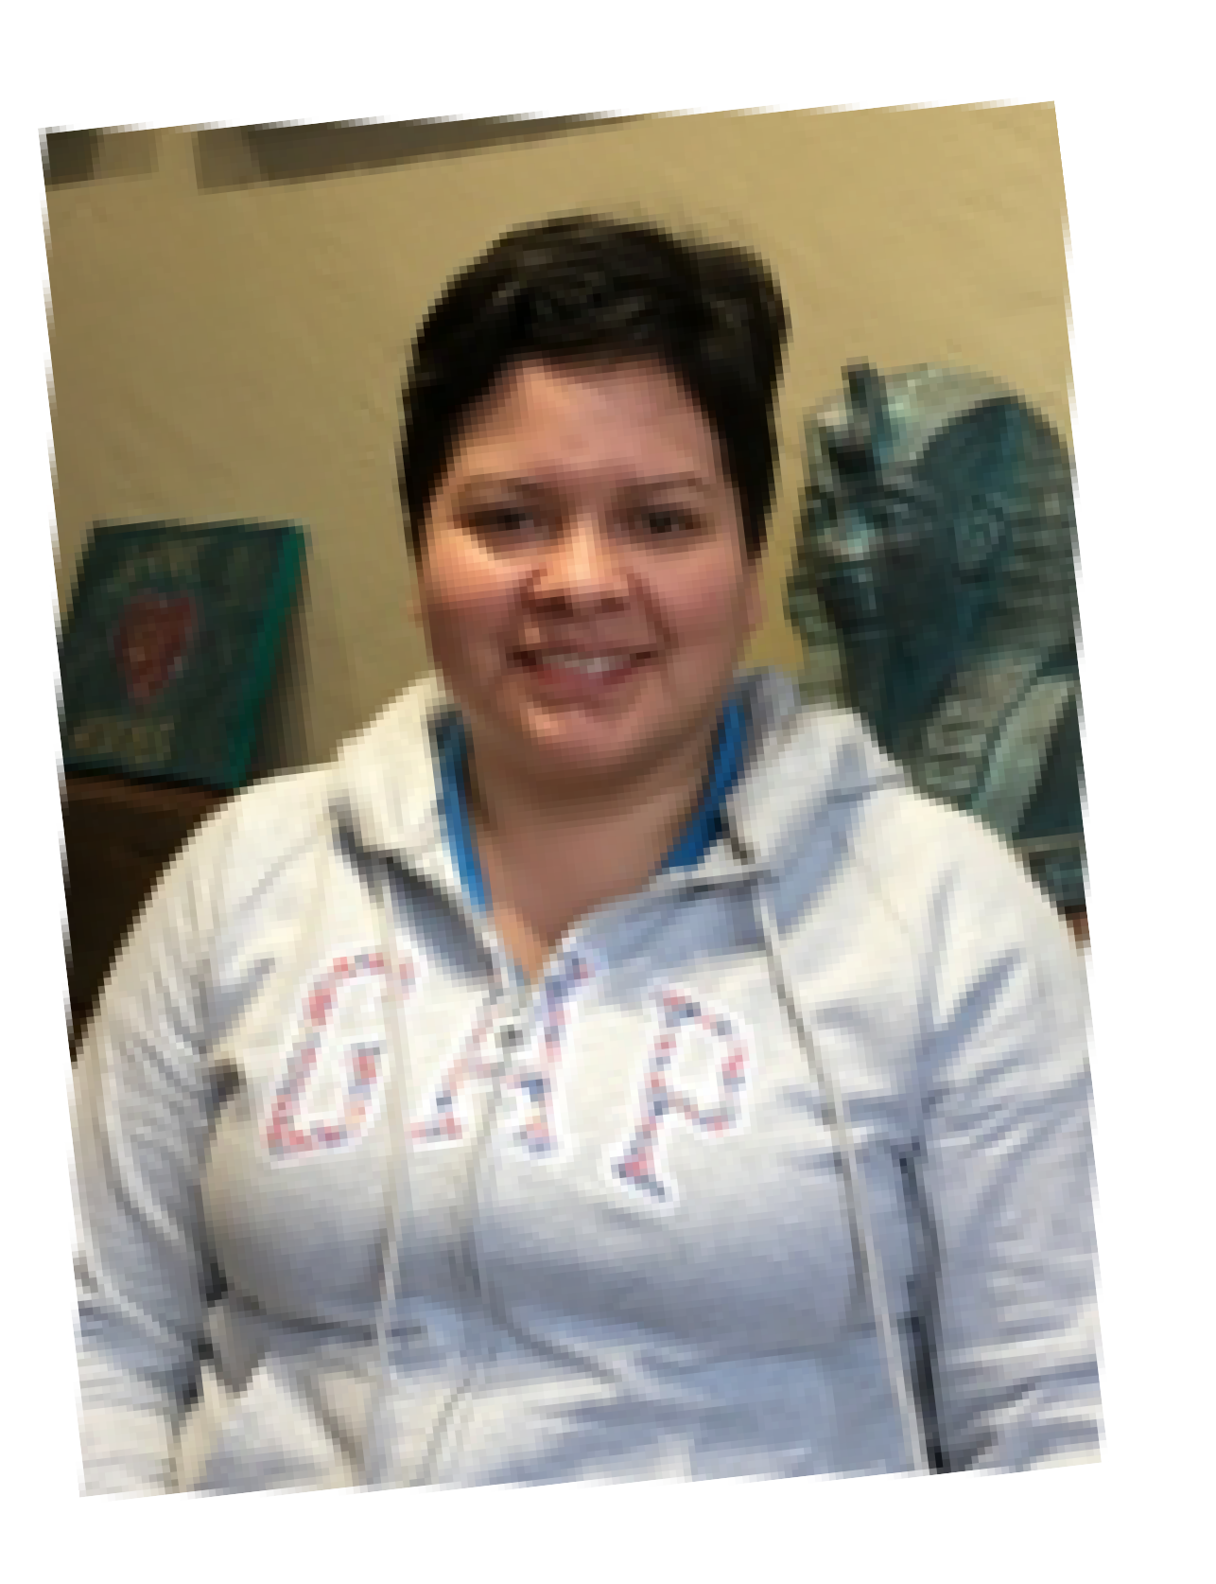


Overview
CA Adult Ed Objectives (AB 104)
AB 104 Program Area
BCC Program and Alignment
Accomplishments and Data
Allocation and Expenses
Adult Education | Berkeley City College
Notes:
Different Journeys
1 – physician in home country
2 – undocumented student
3 – has left but has plan to come back
4 – came to bcc completed a degree and then went to BAS now at UCB

Slide 3
ADULT ED STATE OBJECTIVES
Improve Literacy Skills
High School Diploma Completion
Transition into Post-Secondary Study
Post-Secondary
Completion
Placement
Into Jobs
Improved
Wages

Slide 4
AB 104 PROGRAM AREAS
Adult Basic Education & Adult Secondary Education
Programs for Immigrants
Programs for Adults
Programs for
Adults With
Disabilities
Programs for Career Education
Pre-apprenticeship
Notes:
Programs for immigrants: ESL, Citizenship, Workforce Development
Program for adults – focus on entry and re-entry into the workforce & that are designed to develop knowledge and skills to assist elementary and secondary school children to succeed academically in school.
Entry and Rentry defined as: Displaced homemaker, Ex-offender, Foster care youth, Homeless , Low income-economically disadvantaged , Long unemployed, Migrant farmworker, Seasonal farmworker, Single parent
CE – focus on short term and high employment potentential

Slide 5
BCC PROGRAM AREAS & ALIGNMENT
Program
Increase
number of adult students transitioning to college
Intentional partnership with BAS
Developing pathways for students at BAS
Identify gaps in services
Strategic Plan
Strengthen Resilience; Raise College Competence; Enhance CE
Ensure Institutional Stability
Strengthen Resilience; Raise College Competence; Enhance CE
Strengthen Resilience; Raise College Competence

Slide 6
18 -19 ACCOMPLISHMENTS
Counseling 200/207 Class
Berkeley Adult School
Spring 2019
TL Office Hours
Weekly at Berkeley Adult School
Campus Tours and Class Visits
New Student Orientation
Community Health Worker Non-Credit Class
Fall 2019
Program Alignment
Transition Support Non- Credit
Student Case Management/ Referals

Slide 7

STUDENT DATA
Referrals 12.3%
200
CBO 7.4%
BAS ESL to Peralta 39.3%
150
N=166
BAS High School Grads 11.7%
₁₀₀ N=115
50
OACC ESL to Peralta 1.2%
BAS High School Concurrent 27.6%
0
2018 Fall 2019 Spring
2018-2019 Students
Where students are coming from
Spring 2019 | N=166 |Students transitioning thru BCC TL

Slide 8

STUDENT DATA
_{ESL}Psychology
English 4%
4%
3%
Laney 23.4%
MMART 4%
Nursing 4%
Liberal Arts: Arts and Humanities 33%
Undecided 5%
COA
8.6%
BCC 59.8%
Business 15%
Merritt 8.1%
Transfer Studies 28%
Declared Majors
College of attendance
Spring 2019 | N=166 |Students transitioning thru BCC TL

Slide 9

EXPENSES
CRITERAIA FOR ALLOWABLE EXPENSES
The community college district, county office, JPA and K-12 district must be a member of a regional consortium.
The member district must be located within the regional boundaries of the consortia as determined by the Chancellor and the Superintendent, with the advice of the executive director.
Each regional consortium must have an approved adult education plan (the annual plan template) that addresses the fiscal year in which the funds will be expended.
Funds may only be expended in the seven program areas as prescribed in the AB104 budget language (Section 84913).
Each regional consortium must have an approved 3-year consortia plan that includes any amendments.
Expenditure of AB104 Block Grant Funds must match the objectives and activities listed in the annual plan template for that specific fiscal year.
All members shall participate in expenditure decisions made by the consortium.
Expenditure decisions are made adhering to the AB104 legislation on public notice and public comment.
Expenditure decisions made by consortium members are final and binding.
Expenditure decisions are made adhering to the AB104 legislation definitions.
UNALLOWABLE EXPENSES
Example of Expenses Not Allowed or that Need Prior Approval (specific to AB104) include, but are not limited to:
Construction
Other Staff Salaries and Benefits
Political or Professional Dues, Memberships, or Contributions
Unrelated Travel Costs
Vehicles
Clothing
Entertainment Costs
Fines and Penalties
Travel
Out of State Travel:
Out of Country Travel

Slide 10
ALLOCATION & EXPENSES
19 – 20 PRELIMINARY
$156,468
COLA
$5,414
PRELIMINARY W/ COLA
$161,882
19 – 20 DISTRIBUTION OF FUNDS
STAFFING (1000 – 3000)
$153,788
OTHER EXPENSES (4000-5000)
$8094
18 – 19 CARRYFORWAD
$105,551
*MUST BE SPENT BY JUNE 2020
Notes:
FLEXIBILITY IN FUNDING IS IN CARRYFORWARD – other uses not identified in current plan would need to go to working group and board for prior approval. Funds could be used for marketing, in-reach and outreach focused on adult ed population identified in AB 104.

