Slide 1
Berkeley City College
Town Hall
September 24, 2014
Dr. Deborah Budd, President
Tram Vo Kumamoto- Vice President of Instruction
Dr. May Chen- Vice President of Student Services

Slide 2
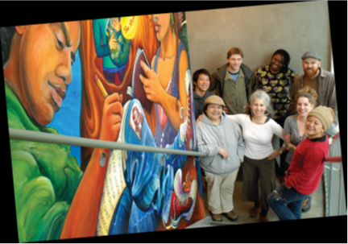
Our Mission
Berkeley City College’s mission is to promote student success, to provide our diverse community with educational opportunities, and to transform lives.

Slide 3
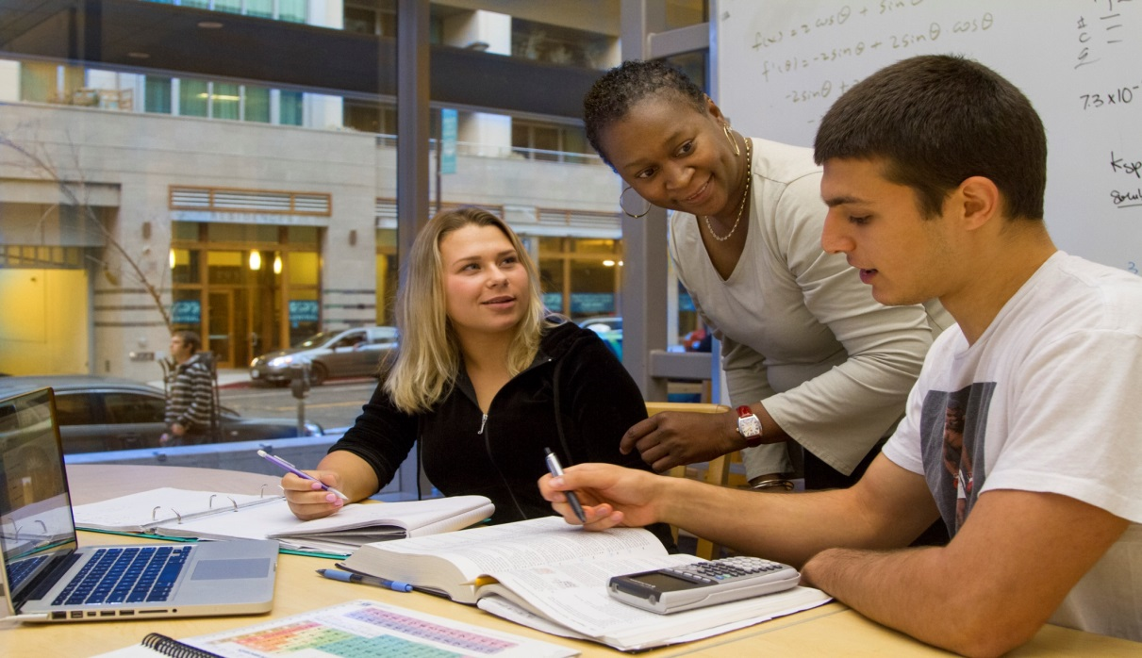
Our Vision
Berkeley City College is a premier, diverse, student-centered learning community, dedicated to academic excellence, collaboration, innovation and transformation.

Slide 4
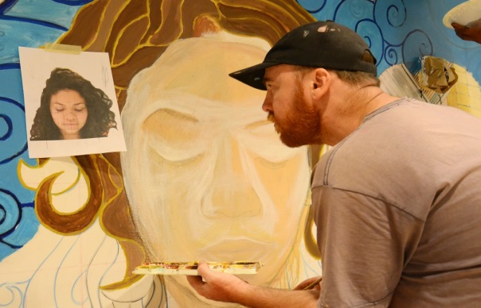
Our Values
Berkeley City College embraces values which allow all members of our college community to grow and thrive. Our values include the following:
A Focus on Academic Excellence and Student Learning.
A Commitment to Multiculturalism and Diversity.
A Commitment to Preparing Students for Citizenship in a Diverse and Complex Changing Global Society.
A Commitment to a Quality and a Collegial Workplace.
The Importance of Innovation and Flexibility.

Slide 5
Student Story
How educational opportunities at Berkeley City College transform lives…

Slide 6
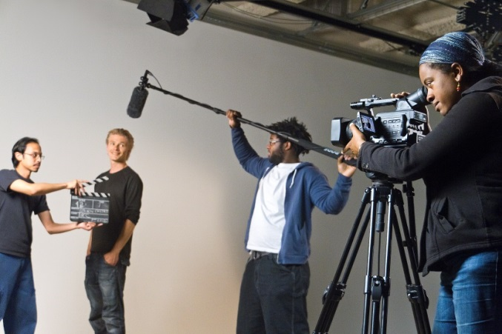
We achieve our Mission and Goals by…
Providing exemplar programs and services that meet student needs, and
Ensuring fiscal stability by meeting our student enrollment and faculty assignment targets.
Notes:
We have worked with faculty and staff and are instituting Faculty Advising Programs.
We have Expanded our Learning Communities and Programs and Services, and expanded our Learning Resource Center.
The LRC currently offers math and other designated subject tutoring services, embedded tutors, one-on-one and small group tutoring with writing coaches, an early alert system with homework labs for learning communities, expanded hours, a new site on south campus, and an online tutoring pilot

Slide 7
2013-2014 Recap
GOALS
HIGHLIGHTS OF ACCOMPLISHMENTS
GOAL 1: Preserve and nourish resources to ensure access, equity and success for all students.
GOAL 2: Increase certificate/degree completion and transfers to 4-year colleges or universities by inspiring and supporting students.
GOAL 3: Improve career and college-preparation progress and success rates.
GOAL 4: Ensure BCC programs and services reach sustainable, continuous quality improvement level.
GOAL 5: Collaborate to ensure fiscal stability.
Exceeded growth target and assisted the district in reaching its student enrollment target.
BCC awarded 244 degrees and 298 certificates, and transferred 171 to UCs and 117 to CSUs for a total of 288 transfers in state alone.
BCC counselors provided counseling to 7,232 unduplicated applicants/students, and assisted students in developing and updating 3,065 Student Education Plan (SEP), this is a 14% increase from 2,682 SEPs developed in 2012-13.
Expanded Learning Communities
Expanded Learning Resource Center Services
Increased Associate Degrees for Transfers(ADT) to 13 programs!
Notes:
A significant jump from the previous years.

Slide 8
Associate Degree for Transfer Programs
Associate in Science for Transfer (AS-T)
Business Administration
Mathematics
Associate in Arts for Transfer (AA-T)
Art History
Communication Studies
Elementary Teacher Education
English
History
Philosophy
Political Science
Psychology
Sociology
Spanish
Studio Arts
Under Development
Anthropology
Computer Science

Slide 9
Student Story
How educational opportunities at Berkeley City College transform lives…

Slide 10
OUR UPCOMING 2014-2015 GOALS
GOAL 1: Preserve and nourish resources to ensure access, equity and success for all students.
GOAL 2: Increase certificate/degree completion and transfers to 4-year colleges or universities by inspiring and supporting students.
GOAL 3: Improve career and college-preparation progress and success rates.
GOAL 4: Ensure BCC programs and services reach sustainable, continuous quality improvement level.
GOAL 5: Collaborate to ensure fiscal stability.

Slide 11
2014-15 FISCAL STABILITY GOALS
Meet or exceed estimated Student Enrollment Targets
3939 Resident Student Enrollments (200 over FY 13-14)
541 Non-Resident Student Enrollments (100 over FY 13-14)
4480 Total Full-time Equivalent Student Enrollments
Strive to ensure the district achieves its target
Maintain average class size approximately 35 students per class.
Net additional funding of $932,000 for resident student enrollment and $720,000 for non-resident over and above 2013-14.
Approximately $1.6 million total.
Notes:
Where are we going to spend this additional money???

Slide 12
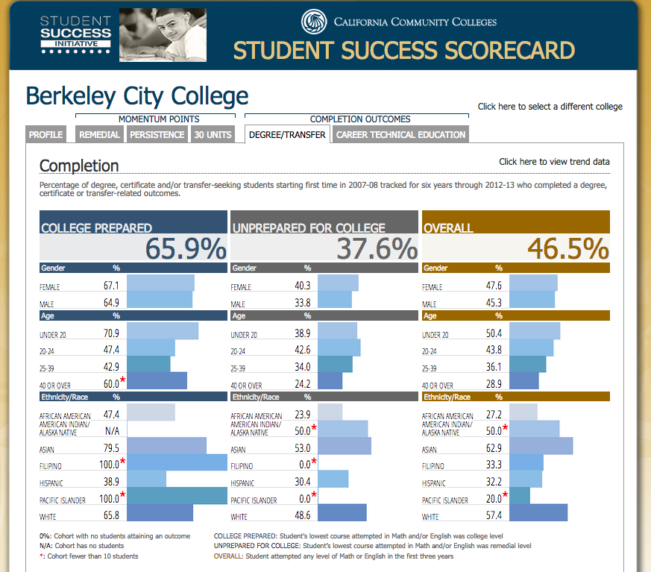
A FOCUS ON EQUITY & THE GAP
Notes:
Not sure what you want to talk about here? Did you want to present the

Slide 13
Peralta Accountability for Student Success (PASS) Funds
To create community, increase engagement and success:
Bridge Programs
Faculty Advising
Peer Mentoring
Embedded Tutoring
Funding for our Veterans Center and DSPS
Various Arts, Culture and Program Enrichment projects
To provide access to necessary resources and tools:
A Pilot to address the technology and resources gaps for students
Funds for additional library books, reserve textbooks and open source textbooks
To assess and evaluate our efforts
Funding for research and data analysis
Notes:
Are we handing out the allocations?? I think people want to see it.

Slide 14
Student Story
How educational opportunities at Berkeley City College transform lives…

Slide 15
Berkeley City College: Vision 2024
Eliminate the Achievement Gap &
Advance Student Access, Equity, and Success

Slide 16
BIG AUDACIOUS GOALS TO ELIMINATE THE ACHIEVEMENT GAP
Ensure ALL New, First Time to College Students (approx. 3000 students/year):
Enter a Program of Study by their second semester
Complete 20 transferable units or a stackable certificate by the end of their first year
Are a part of at least one outside of the classroom learning environment on campus (i.e. learning communities, student life, student support programs, etc.) or working off campus
Ensure ALL students have at least a 70% successful course completion
Notes:
Talk about how every year we have approx. 1261 new, first time in spring and 2159 new, first time in fall

Slide 17
PLANNING FOR ACTION TO ELIMINATE THE ACHIEVEMENT GAP
Ed Master Plan (every 10 years)
Accreditation Self-Study & Action Plan
(every 6 years)
Program Review & Action Plans
(every 3 years)
Annual Program Updates and Action Plans & Reports
(every year)
Shared Governance

Slide 18
How do all these plans and reports connect to our Big Audacious Goals?
BCC Vision 2024: Education Master Plan to…
Eliminate the Achievement Gap
Access
SSSP report
Equity
Equity Plan
Success
BSI & Perkins Report
Excellence
Accreditation
Self-Study and Program Review/APU

Slide 19
Timeline for Fall 2014 Planning-October 3, 2014
Information Gathering & Collaborations
Aug/Sept
Writing
Sept/Oct
Vetting
Oct/Nov/Dec
Pull previous reports/assessments/reviews
Compose the report/plan
To shared governance (October)
Board (Nov/Dec)
Facilitated conversations & Information Gathering
Designated writers

Slide 20
BCC continues to meet its mission by transforming lives.

