Slide 1
Vision 2024: Education Master Plan
Update 3/23/15
Roundtable

Slide 2
Where are we now?
February: Education Committee already recommended approval and provided suggestions.
March: EMP Goal & Indicators discussion item Senate/Roundtable.
April: EMP Goal & Indicators approved by Senates/Roundtable
May: Set goals and outcomes based on goals and indicators for 15-16 and prepare for year 1 of program review

Slide 3
Goal
Eliminate the education gap and advance student access, equity and success with exemplary programs

Slide 4
Student Performance and Outcomes Indicators
Core
Milestone
Increase successful course completion rate to 70% for all students.
Increase the number of students who receive a certificate, degree and/or transfer by 5%.
Enter a program of study & complete a comprehensive Student Ed. Plan (SEP) by end of the 2nd semester.
Complete a stackable certificate or 20 transferable units by end of the 1st year, including summer
Complete college-level math by end of 3rd semester.
Participate in work-based learning opportunities on and off-campus

Slide 5
Institutional Performance Indicators
Accreditation Status
Fully Accredited, Reaffirmed
Fiscal Viability
FTES
Fund Balance
Audit Findings

Slide 6
How does the EMP tie into our other plans and strategies?
Indicator | SSSP | Equity | BSI | PASS
Increase successful course completion rate to 70% for all students. | Implementation of Multiple Measures Assessment | BCC Scholars & LC’s - Connect Student Support and Instruction | Embedded tutoring | Embedded tutoring Open Education Resources
Increase the number of students who receive a certificate, degree and/or transfer by 5%. | Increased Counseling Services | Degree/Certificate Completion Cohorts | Contextualized Lessons Curriculum to support degree/cert program | Faculty Advising Student Ambassadors

Slide 7
BCC Prepared for Statewide Conversation

Slide 8
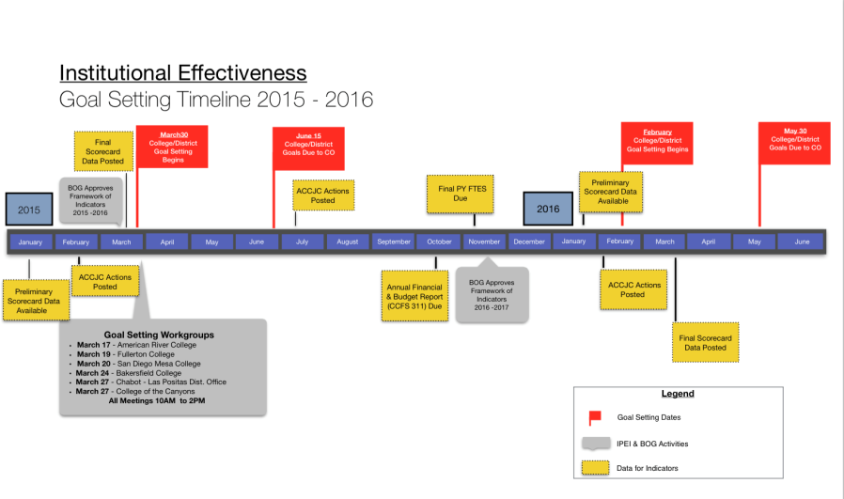

Slide 9
