Slide 1
EDUCATION MASTER PLAN
VISION 2024 PROPOSAL 10.3.14

Slide 2
“Education is a human right with immense power to transform. On its foundation rest the cornerstones of freedom, democracy and sustainable human development.” Kofi Annan
Notes:
At Berkeley City our mission is to
promote student success,
provide educational opportunities and
TRANSFORM LIVES.
Transforming lives through education

Slide 3
Transforming lives is complex work
Collaboration
Coordination & Alignment
Notes:
Needing lots of hands and connections

Slide 4
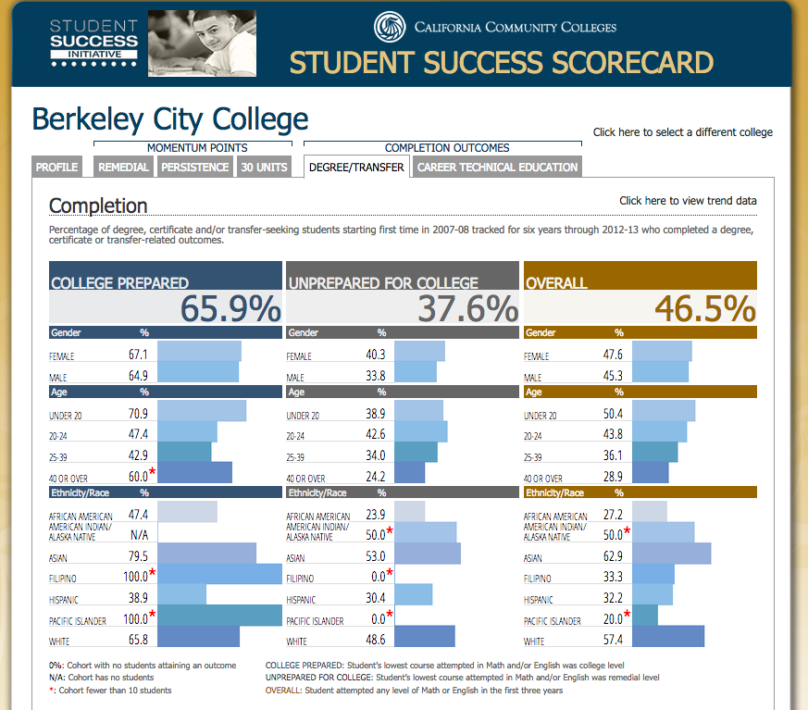
ACHIEVEMENT AFTER 6 YRS & THE GAP
Notes:
Not sure what you want to talk about here? Did you want to present the

Slide 5
Berkeley City College: Vision 2024
Eliminate the Achievement Gap &
Advance Student Access, Equity, and Success

Slide 6
BIG AUDACIOUS GOALS (BAGs)
Ensure ALL students have at least a 70% successful course completion (w/”c” or better)
Ensure ALL New, First Time to College Students (approx. 3000 students/year):
Enter a Program of Study by their second semester
Complete 20 transferable units or a stackable certificate by the end of their first year
Are a part of at least one outside of the classroom learning environment on campus (i.e. learning communities, student life, student support programs, work-study etc.) or working off campus
Notes:
Talk about how every year we have approx. 1261 new, first time in spring and 2159 new, first time in fall

Slide 7
PLANNING FOR ACTION
Ed Master Plan (every 10 years)
Accreditation Self-Study & Action Plan
(every 6 years)
Program Review & Action Plans
(every 3 years)
Annual Program Updates and Action Plans & Reports
(every year)
Mission, Vision, Values and Learning Outcomes
Shared Governance

Slide 8
Astin’s Environment Outcomes Model
Notes:
Share and gather information on…
The school environment, the environment that students need to manage
The learning environment, the environment that students need to learn in

Slide 9
FALL 2014 STUDENTS
7,279 Total Students
2,184 students New, First Time Students
approx. 1139 students exploring with major focus
135 with a choice of an AA-T/AS-T
approx. 1045 students students exploring without a major focus
Data from BI Tool

Slide 10
THE STUDENT EXPERIENCE

Slide 11
PROGRAM OF STUDY ACTIVITY
AT YOUR TABLE:
-Identify a note-taker, reporter, time-keeper, facilitator
-Look over the 4 phases and answer the questions on the handout. (15-20 minutes)
-Present your group’s discussion and any themes that came up. (2-3 minutes)
Organize your groups thoughts in anyway you want on the poster paper.

Slide 12
RP Group – 6 Factors to Success

Slide 14
Faculty Advisor Design Team Activity
AT YOUR TABLE:
-Identify a note-taker, reporter, time-keeper, facilitator
-Look over the 6 factors of success handout and answer the questions provided. (20-30 minutes)
-Present your group’s discussion and any themes that came up. (3-5 minutes)
Organize your groups thoughts in anyway you want on the poster paper.

