Slide 1
Selected BCC Environmental Scan
BCC Enrollment Trend, Students by Zip Code, Bay Area Population Shift, Labor/Housing Forecast, etc.
August 11, 2014

Slide 2
The unduplicated annual student headcount doubled over the last two decades. The biggest growth occurred between 5,155 in 1996-97 and 12,723 in 2009-10, with the increase of 7,568 or 147%

Slide 3
Back in Fall 1994, BCC students’ goal was transfer (33%), career (23%), and cultural enrichment (24%). In Fall 2013, 65% attending BCC to receive a baccalaureate degree: 48% to transfer, 17% were 4-year college/university students attending BCC to meet their education requirement.

Slide 4
BCC’s student population twenty years ago was much more homogeneous, age-wise. Over the 20 years, student body of 24 years or younger increased, while older student population decreased.

Slide 5
BCC Student Race/Ethnicity, 1992-93 to 2012-13

Slide 7
In comparison with population in its service areas, BCC serves a higher proportion of females, African Americans, Hispanics, and students from multiple racial/ethnic backgrounds. Male: Female= 43:53.

Slide 8
African Americans at both Berkeley High (22%) and Everyville Unified (64%) are much higher than the % in BCC’s tri-city services area (9.7%), while % of Hispanics at all three schools (13%, 16%, and 20%) is also higher than that (10.6%) in the service area.
 | Total Population | Asian/Pacific Islander | African American | Hispanic/Latino | Native American | White | Multiple
Albany High School | 1,198 | 467 | 96 | 156 | 12 | 443 | 12
 | % of Total | 39% | 8% | 13% | 1% | 37% | 1%
Berkeley High School | 3,150 | 284 | 693 | 504 | 32 | 1,260 | 378
 | % of Total | 9% | 22% | 16% | 1% | 40% | 12%
Emeryville Unified | 337 | 43 | 214 | 66 | - | 14 | -
 | % of Total | 13% | 64% | 20% |  | 4%

Slide 9
BCC Fall 2013 First-time College and Transfer Students Mainly Came from North/Central Alameda and West Contra Costa Counties

Slide 10
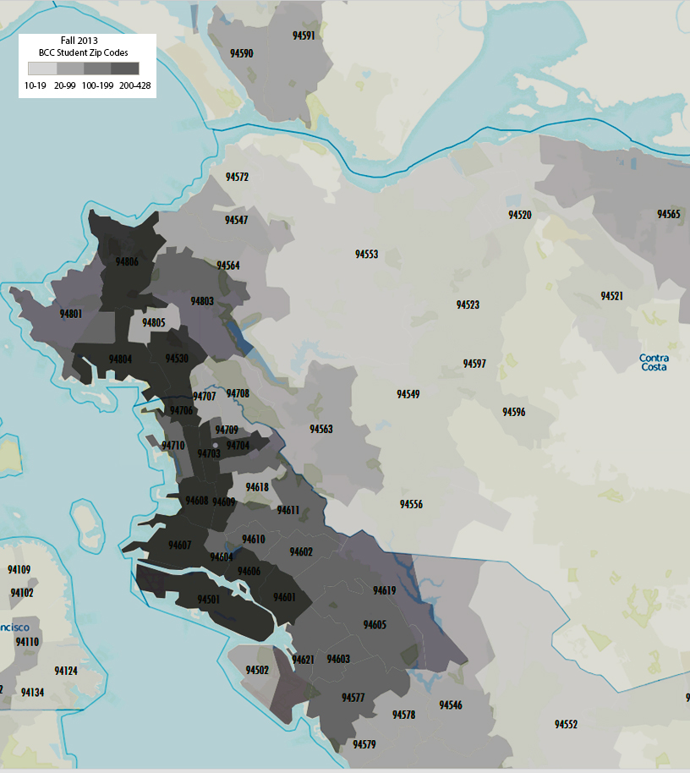
BCC Fall 2013 Total Students Also Mainly Came from North/Central Alameda and West Contra Costa Counties

Slide 11
SF Bay Area County Housing and Job Growth, 2010-2040
County | 2010 | Employment 2010-2040 2040 Total %* |  |  | 2010† | Housing Units 2010-2040 Total %* |  |  | 2010 | Households 2010-2040 2040 Total %* |  |  | 2010 | Population 2040 2010-2040 Total %*
Alameda | 694,000 | 948,000 | 253,000 | 36% | 583,000 | 731,000 | 148,000 | 25% | 545,000 | 705,000 | 160,000 | 29% | 1,510,000 | 1,988,000 | 478,000 | 32%
Contra Costa | 345,000 | 467,000 | 122,000 | 35% | 400,000 | 480,000 | 80,000 | 20% | 375,000 | 463,000 | 88,000 | 23% | 1,049,000 | 1,335,000 | 286,000 | 27%
Marin | 111,000 | 129,000 | 18,000 | 17% | 111,000 | 119,000 | 8,000 | 7% | 103,000 | 112,000 | 9,000 | 9% | 252,000 | 285,000 | 33,000 | 13%
Napa | 71,000 | 90,000 | 19,000 | 27% | 55,000 | 61,000 | 6,000 | 11% | 49,000 | 56,000 | 7,000 | 15% | 136,000 | 164,000 | 27,000 | 20%
San Francisco | 569,000 | 759,000 | 191,000 | 34% | 377,000 | 469,000 | 92,000 | 25% | 346,000 | 447,000 | 101,000 | 29% | 805,000 | 1,086,000 | 280,000 | 35%
San Mateo | 345,000 | 445,000 | 100,000 | 29% | 271,000 | 327,000 | 56,000 | 21% | 258,000 | 316,000 | 58,000 | 22% | 718,000 | 906,000 | 188,000 | 26%
Santa Clara | 926,000 | 1,230,000 | 304,000 | 33% | 632,000 | 843,000 | 211,000 | 33% | 604,000 | 819,000 | 215,000 | 36% | 1,782,000 | 2,426,000 | 644,000 | 36%
Solano | 132,000 | 180,000 | 48,000 | 36% | 153,000 | 176,000 | 23,000 | 15% | 142,000 | 169,000 | 27,000 | 19% | 413,000 | 511,000 | 98,000 | 24%
Sonoma | 192,000 | 257,000 | 65,000 | 34% | 205,000 | 236,000 | 32,000 | 16% | 186,000 | 221,000 | 35,000 | 19% | 484,000 | 598,000 | 115,000 | 24%
REGION* | 3,385,000 | 4,505,000 | 1,120,000 | 33% | 2,786,000 | 3,446,00 | 660,00 | 24% | 2,608,000 | 3,308,000 | 700,000 | 27% | 7,151,000 | 9,299,000 | 2,148,000 | 30%

Slide 12
Alameda County Population Projection by Age, 2010-2060

Slide 13
Contra Costa County Population Projection by Age, 2010-2060

Slide 14
SF Bay Area Population Shift
Age. The number of seniors will more than double from under 900,000 today to nearly 2.1 million by 2040. The North Alameda County is home to 43% of the County’s senior population.
Increased Racial and Ethnic Diversity. Latinos will increase from 23 percent to 35 percent of the total population. Asians increase from 21 percent to about 24 percent of the population. Non-Hispanic whites will drop from 45 percent to about 31 percent. The African-Americans will decline from 6 percent to 5 percent.
The Latinos and Asians prefer multifamily housing and from multigenerational households.

Slide 15
SF Population SES Shift

Slide 16
Forecast of Jobs in the Bay Area – 2010-2040
The nine-county San Francisco Bay Area is projected to add 1.1 million jobs, 2.1 million people and 660,000 homes, for a total of 4.5 million jobs, 9.3 million people and 3.4 million homes.
Strong job growth is expected in the professional services, health and education, and leisure and hospitality sectors. High-skill, high-tech service and manufacturing sector continues to be the drivers of job growth in the Bay Area. Higher-income residents requires services (retail, nursing and child care, education, fire, and police, etc.) so low-middle-income jobs will be retained and created.
The existing transit network and connecting homes and jobs, San Francisco, San Mateo, Santa Clara and Alameda counties account for the majority of housing growth (77percent) and job growth (76 percent). Albany is project to grow 1,400, Berkeley 22,210, and Oakland 85,240 jobs in the next 30 years.
The Bay Area’s three regional centers—San Francisco, San Jose, and Oakland—will accommodate 42 percent of housing growth and 38 percent of total job growth by 2040.
Draft Plan Bay Area Forecast of Jobs, Population, and Housing by Association of Bay Area Governments and Metropolitan Transportation Commission, March 2013. http://onebayarea.org/pdf/Draft_Plan_Bay_Area/Draft_PBA_Forecast_of_Jobs_Population_and_Housing.pdf

Slide 17
Bay Area Employment by Sector, 2010–2040, Ranked by Job Growth
Growth (Loss) Percent Change
Sector 2010 2040 2010–2040 2010–2040
Professional Services 596,700 973,600 376,900 +63%
Health and Education 447,700 698,600 250,900 +56%
Leisure and Hospitality 472,900 660,600 187,600 +40%
Construction 142,300 225,300 82,900 +58%
Government 499,000 565,400 66,400 +13%
Retail 335,900 384,400 48,500 +14%
Finance 186,100 233,800 47,700 +26%
Information 121,100 157,300 36,300 +30%
Transportation and Utilities 98,700 127,400 28,600 +29%
Manufacturing/Wholesale 460,200 456,100 (4,100) -1%
Agriculture/Natural Resources 24,600 22,700 (1,900) -8%
All Jobs 3,385,300 4,505,200 1,119,900 +33%

Slide 18
STEM
2013 East Bay Venture Capital Funding by Startup Stage ($ Millions)
Sector | Seed | Early Stage | Expansion | Later Stage
Biotechnology |  | $32.4 | $81.8 | $108.1
Computers & Peripherals |  | $35.0
Consumer Products & Services |  |  | $5.0 | $60.9
Electronics Instrumentation |  |  | $10.0
Financial Services
IT Services |  | $0.4 | $24.5
Industry Energy |  | $6.5 | $24.7 | $18.2
Media & Entertainment |  | $9.8
Medical Devices & Equipment |  | $5.2 |  | $37.4
Networking & Equipment |  |  |  | $1.4
Semiconductors | $14.8 | $22.7 | $19.0 | $1.0
Software |  | $15.6 | $50.1 | $38.5
Telecommunications |  | $0.5 |  | $1.5
TOTAL | $14.8 | $128.1 | $215.1 | $267.0
Source: MoneyTree

Slide 19
Gross and Available Square Footage by College, 2013
 | # of Buildings | GSF | Available SF | Fall 2013 Enrollment | ASF/Student
BCC | 1 | 165,000 | 87,037 | 6,751 | 12.9
COA | 11 | 290,607 | 217,398 | 6,233 | 34.9
Laney | 15 | 501,276 | 365,305 | 11,949 | 30.6
Merritt | 10 | 353,797 | 225,058 | 6,211 | 36.2
TOTAL | 37 | 1,310,680 | 894,798 | 31,144 | 28.7

Slide 20
New Directions for BCC
Outreach and recruitment
Instructional programs and courses
Student support services
Career Pathways linking K-12 – BCC – 4-Year colleges and universities
BCC student learning environment
Facilities
Technology
More
And more

