Slide 1
Shared Governance
Self-Evaluation Survey
Spring 2025
Dr. Phoumy Sayavong
Senior Research & Planning Analyst

Slide 2
Overview
Survey was developed by Integrated Planning Committee
Survey administered May 9-21, 2025
Total responses: 65 (Participants can responded more than once if they belong to more than one committee.)

Slide 3
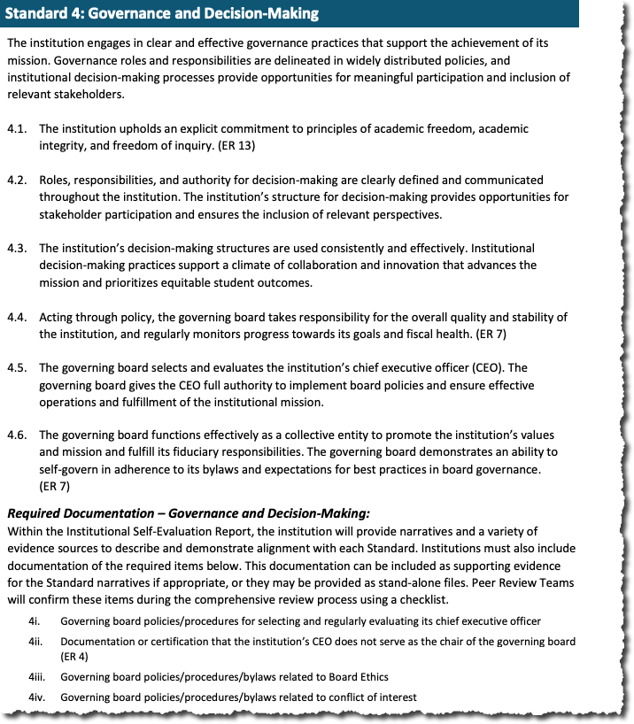

Slide 19
Academic Senate

Slide 20
Budget Advisory Committee

Slide 21
Classified Senate

Slide 22
College Roundtable for Planning & Budgeting

Slide 23
Curriculum

Slide 24
Distance Education

Slide 25
Distance
Education

Slide 26
Integrated Planning Committee

Slide 27
Technology

