Slide 1
BCC
Budget Advisory Committee
Tuesday, September 9, 2025

Slide 2
Hiring Updates
Vice President of Instruction
Director of Campus Life & Student Activities
EOPS Coordinator
SAS Staff Assistant
A&R Specialist
Centralization of Custodial, IT, A&R technicians

Slide 3
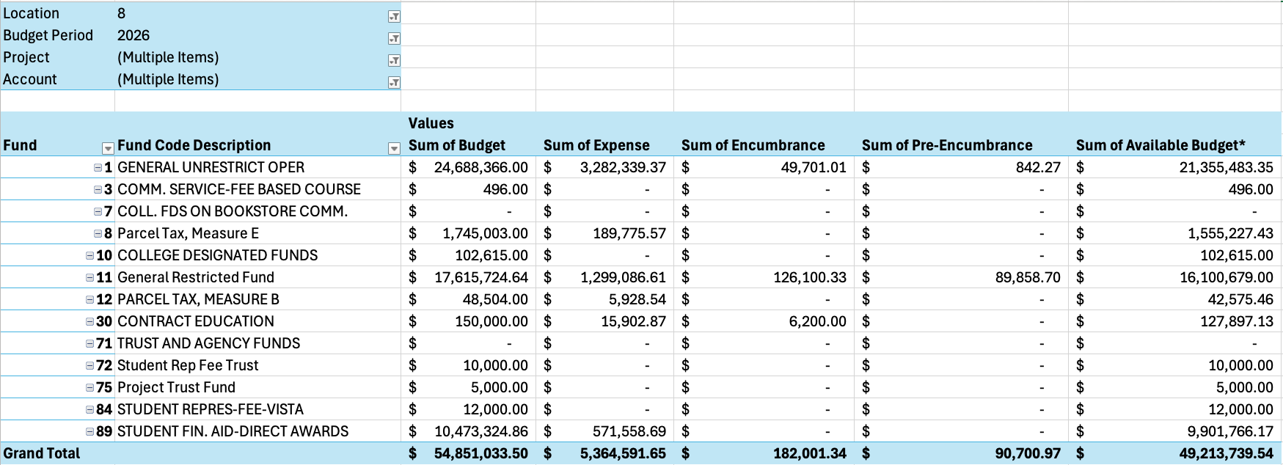
FY26 BCC Budget by Fund – 9/8/2025
89.72% of our budget by Fund remaining

Slide 4
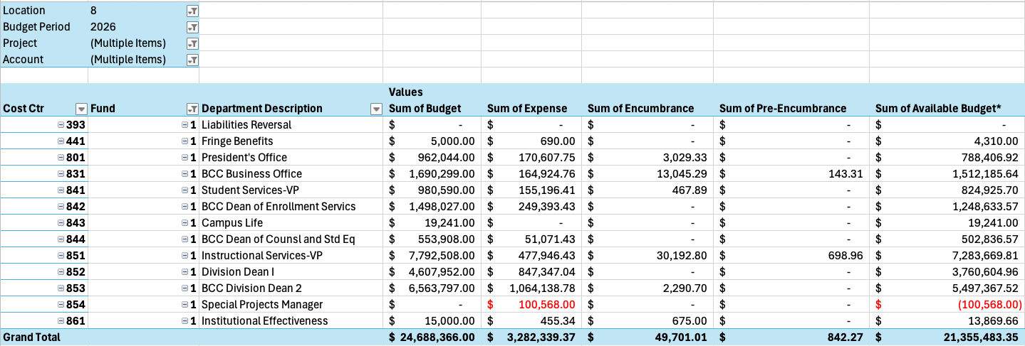
FY26 BCC Budget by Cost Center – 2/11/2025
86.5% of our budget by Cost Center remaining

Slide 5
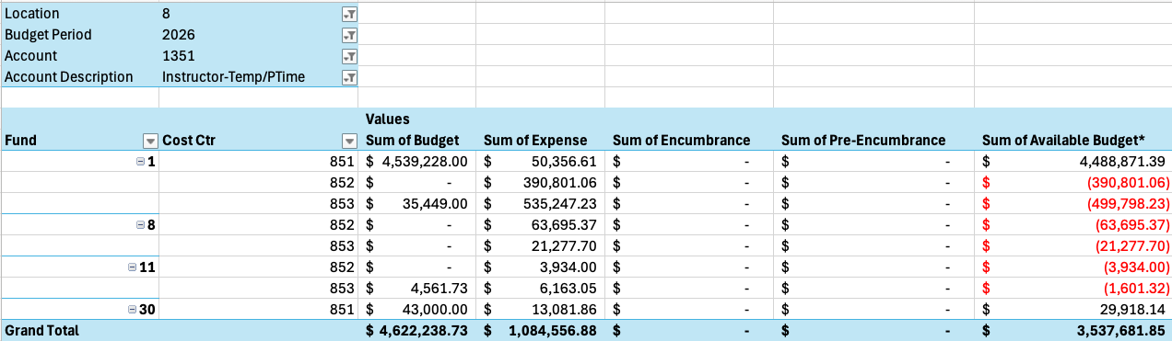
FY26 BCC Budget by 1351 – 9/8/2025
76.53% of our 1351 budget remaining

Slide 6
Announcements
PCCD District Roadshow 9/10/2025, 3pm, Auditorium
BCC Town Hall 10/9/2025, 12:30-1:30pm, Auditorium

