Slide 1
BCC Budget Advisory Committee
Tuesday, November 18th, 2025

Slide 2
Staffing Updates
Acting Dean of Enrollment Services
Office of Instruction Coverage
Acting Vice President of Student Services
Director of Student Activities and Campus Life
EOPS Coordinator
SAS Staff Assistant
Chemistry FT Instructor

Slide 3
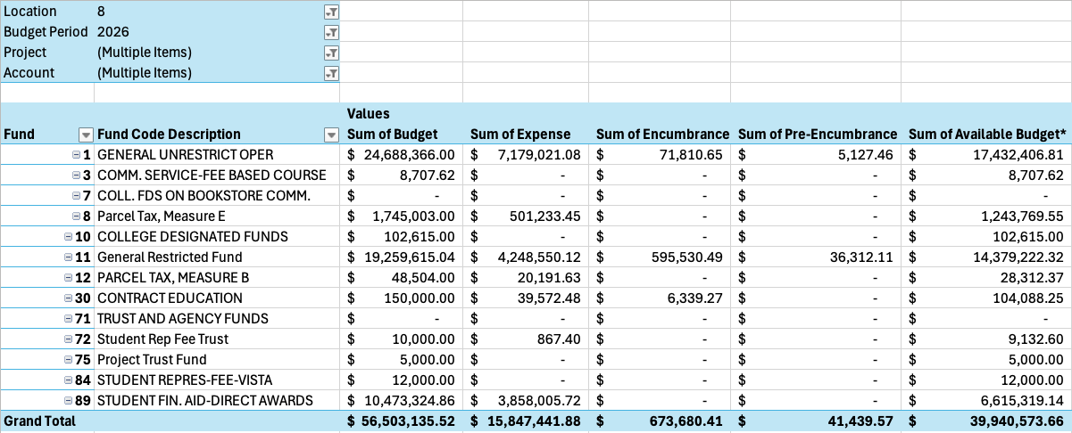
FY26 BCC Budget by Fund – 11/17/2025
70.68% of our budget by Fund remaining

Slide 4
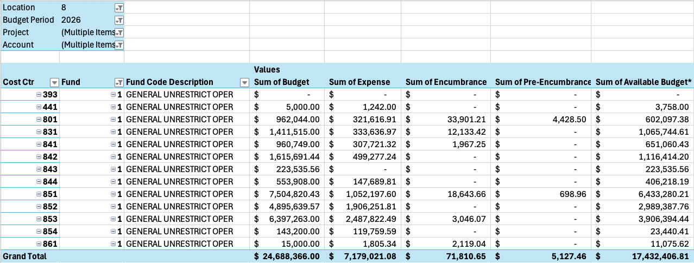
FY26 BCC Budget by Cost Center – 11/17/2025
70.61% of our budget by Cost Center remaining

Slide 5
Cost Center Descriptions
Cost Ctr | Department Description
392 | Districtwide Utilities
801 | President's Office
831 | BCC Business Office
841 | Student Services-VP
842 | BCC Dean of Enrollment Servics
843 | Campus Life
844 | BCC Dean of Counsl and Std Eq
851 | Instructional Services-VP
852 | Division Dean I
853 | BCC Division Dean 2
854 | Special Projects Manager
861 | Institutional Effectiveness

Slide 6
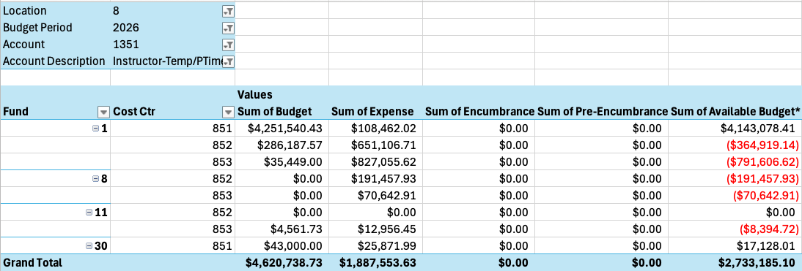
FY26 BCC Budget by 1351 – 11/17/2025
59.15% of our budget by 1351 remaining

Slide 7
Announcements

