Slide 1
BCC Budget Advisory Committee
Tuesday, October 28, 2025

Slide 2
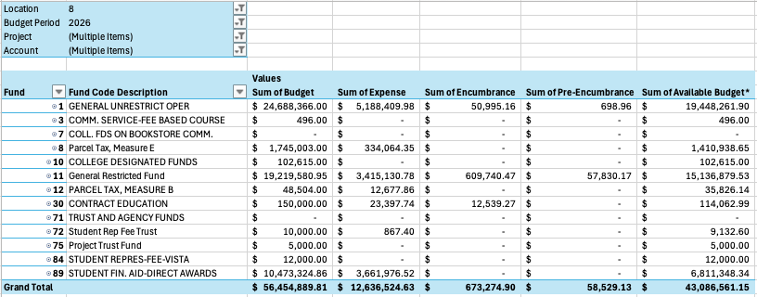
2025-2026 BCC Budget by Fund – 10/27/2025
76.32% of our budget by Fund remaining

Slide 3
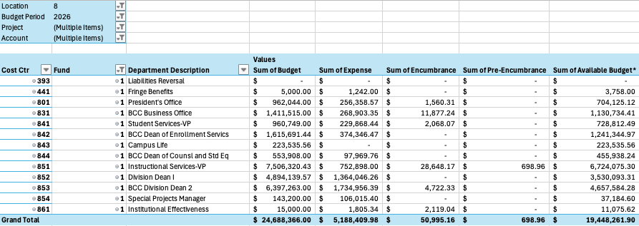
2025-2026 BCC Budget by Cost Center – 10/27/2025
78.78% of our budget by Cost Center remaining

Slide 4
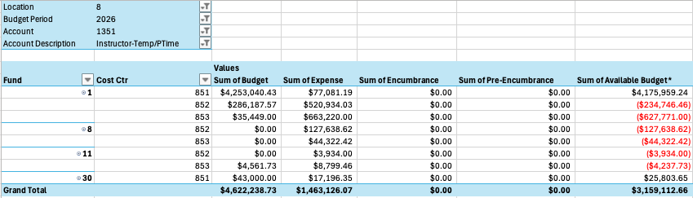
2025-2026 BCC Budget by 1351 – 10/27/2025
68.35% of our budget by 1351 remaining

