Slide 1
BCC Budget Advisory Committee
Tuesday, October 14, 2025

Slide 2
Hiring Updates

Slide 3
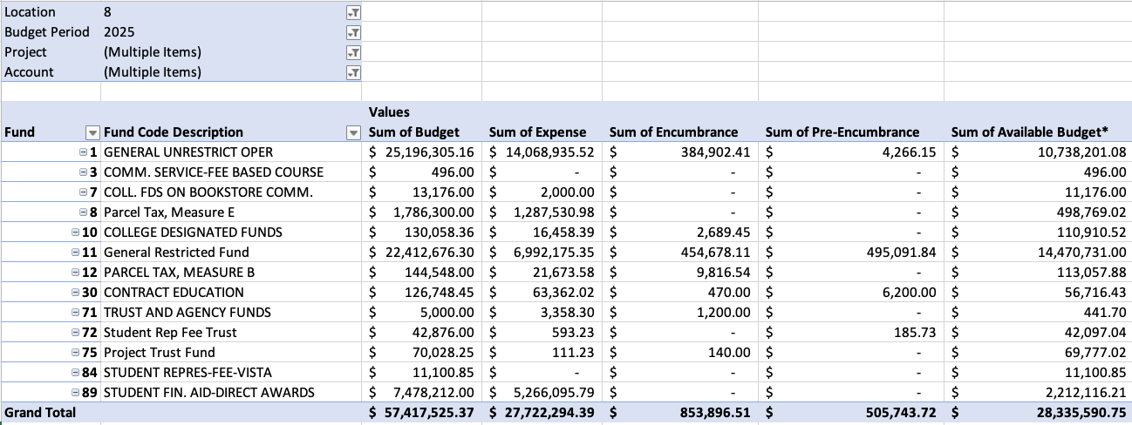
2025-2026 BCC Budget by Fund – 10/14/2025
49.35% of our budget by Fund remaining

Slide 4
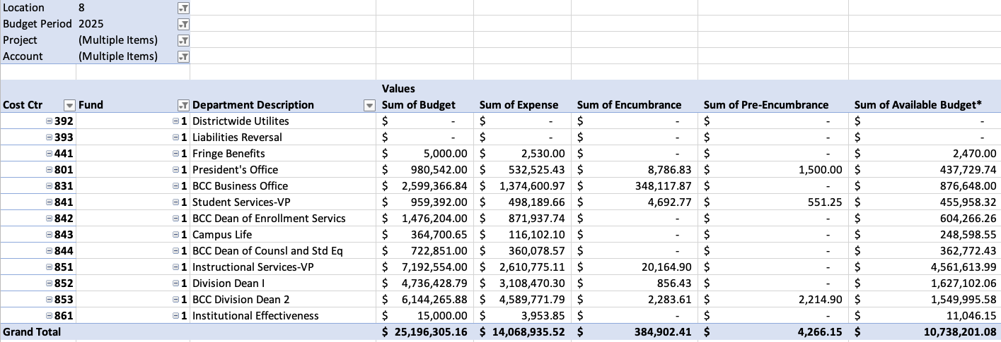
2025-2026 BCC Budget by Cost Center – 10/14/2025
42.6% of our budget by Cost Center remaining

Slide 5
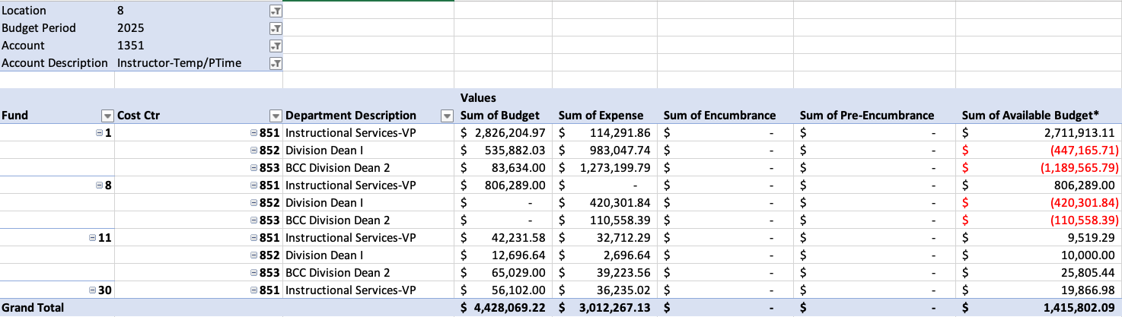
2025-2026 BCC Budget by 1351 – 10/14/2025
31.97% of our budget by 1351 remaining

Slide 6
2025-2026 BCC Budget by Grant – 10/14/2025
31.97% of our budget by grant remaining

Slide 7
Announcements

