Slide 1
BCC Budget Advisory Committee
Tuesday, September 23, 2025

Slide 2
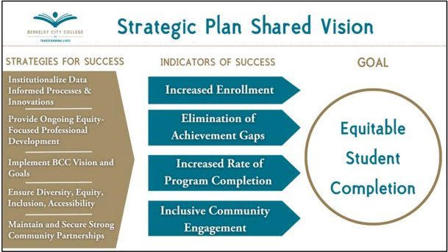
Institutional Self-Evaluation

Slide 3
Hiring Updates
VPI interviews are currently underway
EOPS Coordinator
Student Accessibility Services Staff Assistant
Director of Campus Life & Student Activities

Slide 4
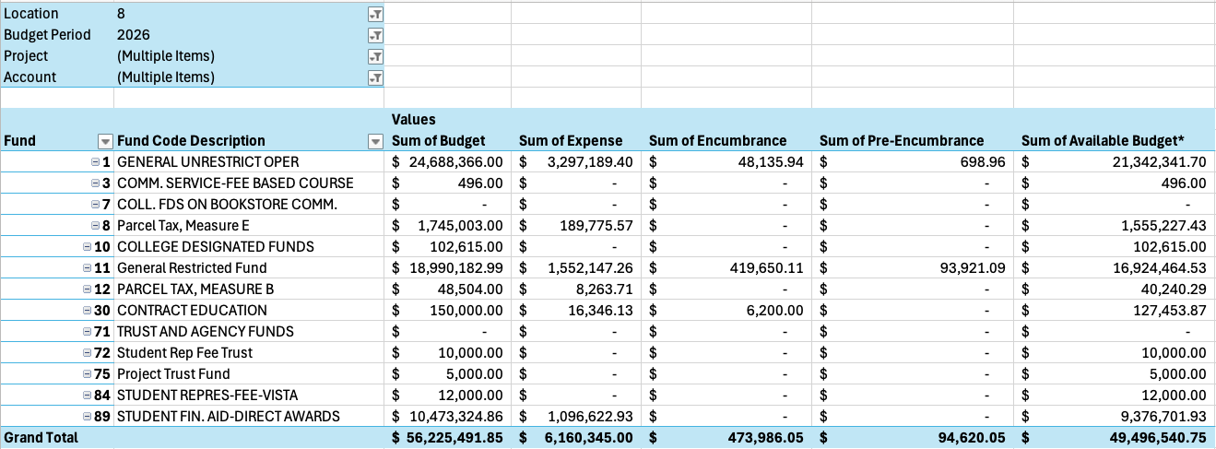
2025-2026 BCC Budget by Fund – 9/22/2025
88.03% of our budget by Fund remaining

Slide 5
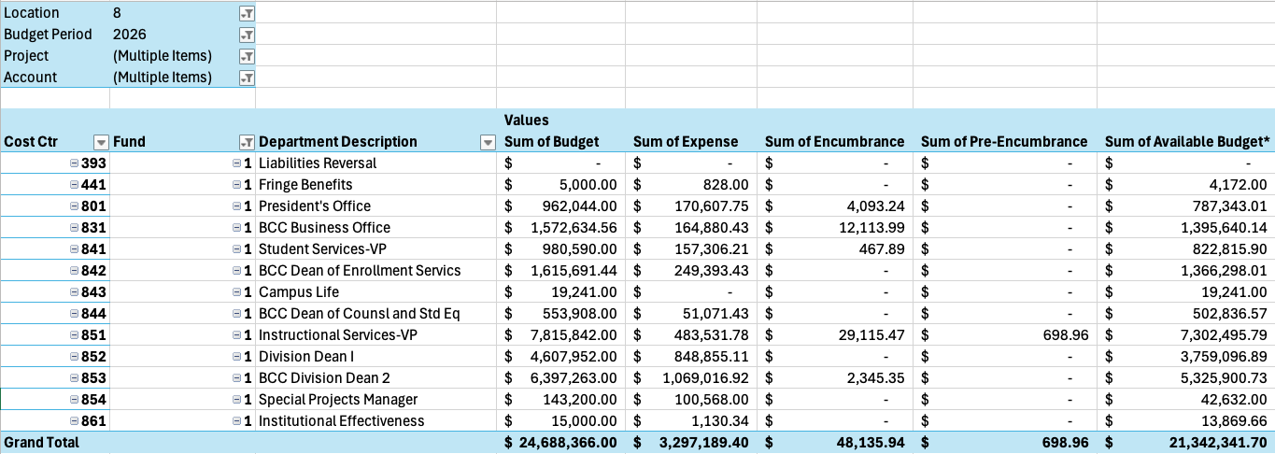
2025-2026 BCC Budget by Cost Center – 9/22/2025
88.44% of our budget by Cost Center remaining

Slide 6
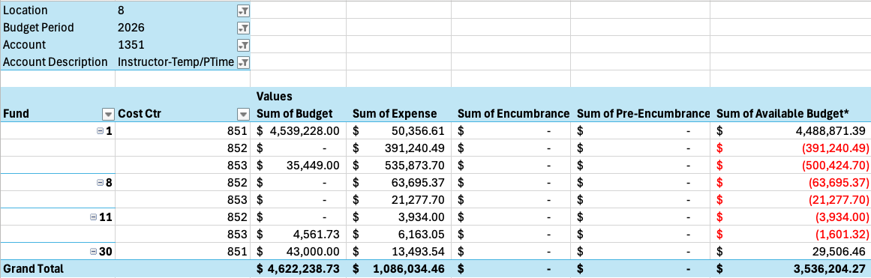
2025-2026 BCC Budget by 1351 – 9/22/2025
76.5% of our budget by 1351 remaining

Slide 7
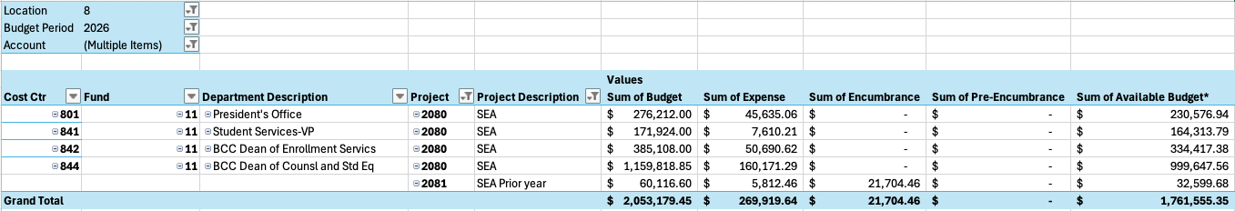
2025-2026 BCC Grant List – 9/22/2025
85.79% of our budget by grants remaining

Slide 8
Announcements
BCC Townhall: Thursday, 10/9/2025, 12:30-1:30pm Atrium

