Slide 1
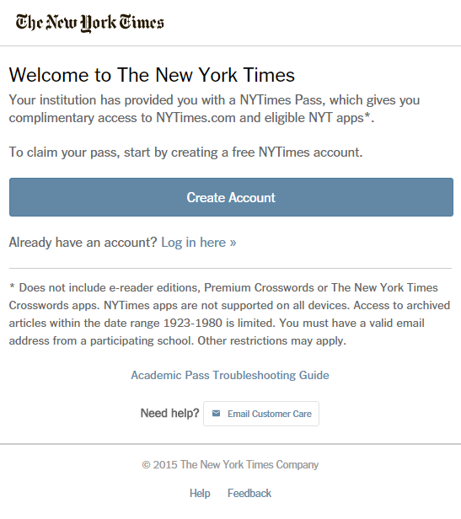
ACTIVATION: Step 1
NYTimes.com Pass via DOMAIN
www.NYTimes.com/Pass to get a pass connected to your PCCD College
Please note: a @peralta.edu email address is required to successfully claim a pass.
Please be sure to log out of NYTimes.com first if an existing subscriber.
Alternative Step 1:
Select
“Log in here”
if already having registered
at NYTimes.com before.
Enter same .edu username
and password log in as before.
Step 1:
Select
“Create Account”
Helpful
Troubleshooting Guide
located here.

Slide 2
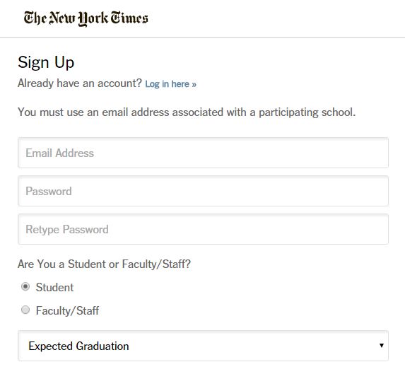
ACTIVATION: Step 2
All will see this page upon selecting “Create Account”.
Enter @college.edu
Email address
Create and confirm
your password
TIP!!
If existing NYTimes.com account
uses another email on account, please
go to NYTimes.com and change to the
@college.edu on My Account page.
Then log out of NYTimes.com.
And CLOSE WEB BROWSER.
Go to www.NYTimes.com/Pass,
Select “Log in here>>”
Use new .edu email and same pw.

Slide 3
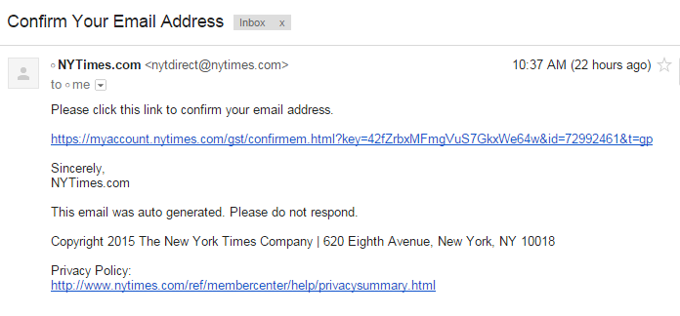
EMAIL VALIDATION
FOR ADMINISTRATORS: To verify that users are accessing Academic Passes with an authorized email domain, the New York Times sends users a verification email when they claim a pass for the first time. To avoid having our email blocked by resident spam software, we recommend that your IT department “whitelist” the nytimes.com domain or better yet, “whitelist” these IP addresses our emails come from: NYT Email IP Addresses 170.149.174.71 170.149.174.72 170.149.174.73 170.149.174.74 170.149.168.71 170.149.168.72 170.149.168.73 170.149.168.74
yourname@college.edu

Slide 4
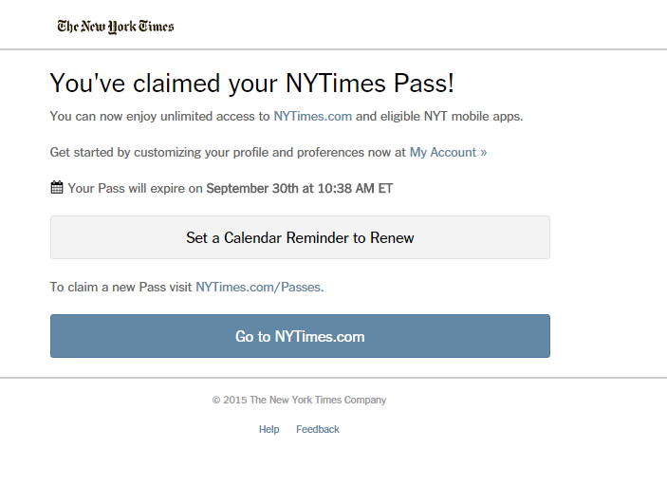
CONFIRMATION!!
Date and time indicates when the all digital access
will need to be activated for a subsequent year.
Click on “Go to NYTimes.com to start your pass.
Same activation process applies.
Go to NYTimes.com/Pass and select “Log in here,” to continue.

Slide 5
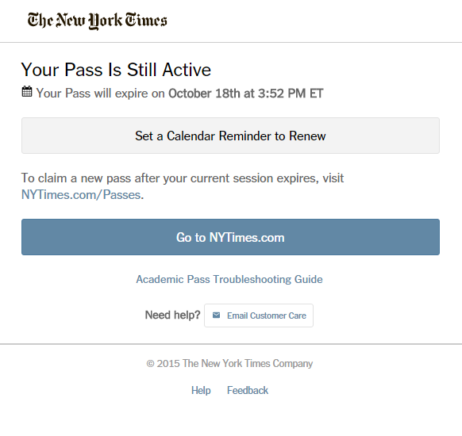
Check Time Stamp at NYTimes.com/Pass
Time stamp represents a year ahead.
Click to set an annual calendar reminder to log in to NYTimes.com/Pass for renewal.

Slide 6
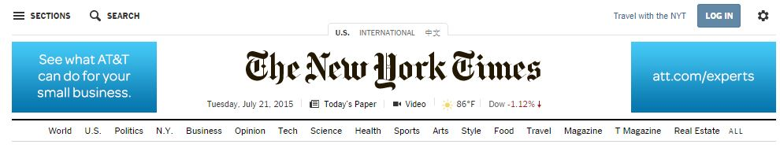
NYTimes.com – The masthead
Navigation structure: Horizontal and Vertical
Access to worldwide coverage: US, International and Chinese
Search: “Magnifying glass” icon found on all NYT pages
Today’s Paper: Read NYTimes.com just as it was printed in the daily print copy
Video: Watch the videos from many sectional-related “channels”
Log in: Necessary for saving articles, adding commentary or managing news alerts
Users can visit www.nytimes.com/forgot to reset their password directly to their username email which should be the campus email address.

Slide 7
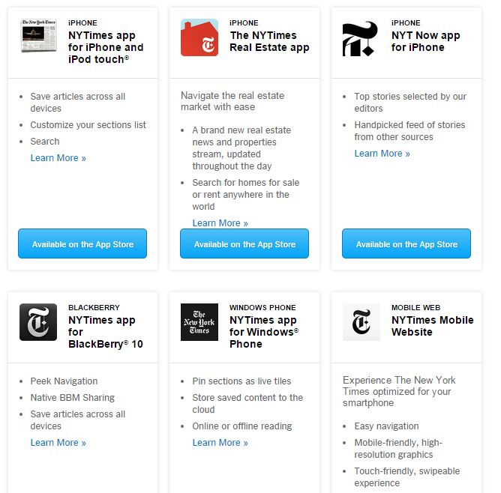
Download NYT smartphone app
Instructions:
Go to NYTimes.com/Mobile to view options.
When app is downloaded, go to “subscribe” and select “Log in”. Enter same credentials as for NYTimes.com and enjoy.

Slide 8
Email template for those reaching 1 YR anniversary with NYTimes.com
Marketing Resources
This email is to notify you that your complimentary digital subscription to The New York Times may have expired.
We hope you enjoyed your digital access to The New York Times.
To check the status and/or resume your complimentary access, please claim a new Pass by visiting nytimes.com/passes and logging in with your existing NYTimes.com ID and password.
If you’ve already claimed a new Pass, please disregard this message.
For any questions, please contact edu@nytimes.com.
The New York Times

Slide 9
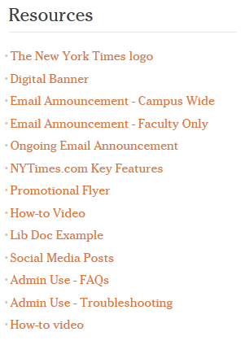
Marketing Resources
Marketing Resources
For marketing support for lib-guides, email blasts, social media posts and more:
www.nytimesineducation.com/annualpasses

Slide 10
THANK YOU!
The NYTimes.com + NYT smartphone app
Academic Site License
For any questions or needs, please contact either below who assisted in set up process:
Emily Ryan Tamra Gaines
Education Account Manager Education Account Manager
The New York Times The New York Times
emily.ryan@NYTimes.com tamra.gaines@NYTimes.com
The New York Times Education Manager for the West will coordinate on site training sessions and support curricular incorporation of our resources
Todd Halvorsen
Education Manager – West
The New York Times
todd.halvorsen@nytimes.com
917-699-1589

