Slide 1
ASSESSMENT COMMITTEE
Self-Evaluation Survey Results
Spring 2022

Slide 2
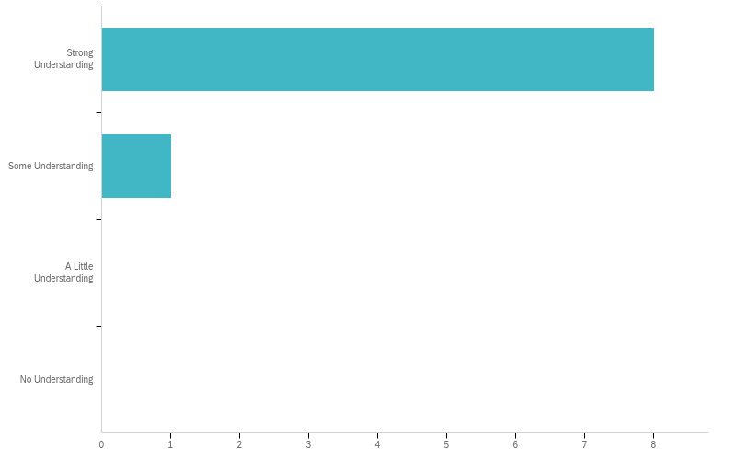
ASSESSMENT CHARGE
89% (n=8)
11% (n=1)

Slide 3
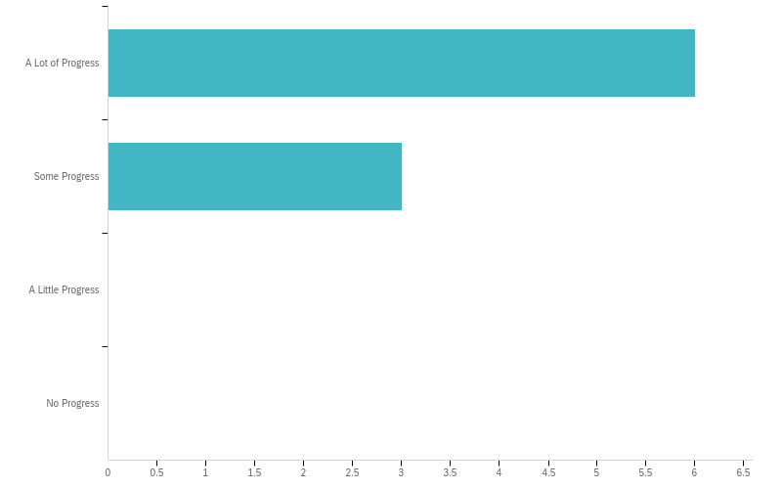
How much progress has the Assessment Committee made towards it charge and objectives this year?
67% (n=6)
33% (n=3)

Slide 4
COMMITTEE PERFORMANCE
Question | YES |  | NO |  | I DON'T KNOW |  | Total
Is the charge of this Committee current? | 100.00% | 9 | 0.00% | 0 | 0.00% | 0 | 9
Does the charge of this Committee need to be modified? | 11.11% | 1 | 66.67% | 6 | 22.22% | 2 | 9
Did the committee establish clearly stated goals for the academic year? | 77.78% | 7 | 11.11% | 1 | 11.11% | 1 | 9
Were Racial Equity, Student Success and Student Outcomes explicitly and regularly discussed? | 77.78% | 7 | 11.11% | 1 | 11.11% | 1 | 9
Did the Committee discuss topics and worked on tasks directly related to the charge? | 100.00% | 9 | 0.00% | 0 | 0.00% | 0 | 9
Did the committee review and discuss previous year’s survey results in order to make improvements for this year? | 55.56% | 5 | 22.22% | 2 | 22.22% | 2 | 9

Slide 5
Describe the Assessment Committee's strengths.
Under Adán's leadership, the committee is extremely well organized/efficient and mission driven.
Absolutely 100% professionally run. Adan is fantastic!
Great representation of college community, with clear stated goals and objective; structure and goal orientated meetings.
It's participants, patience, and help.
Well-organized and visible presence "on" campus. Tremendous outreach efforts and individualized support.
Up-to-date SLO/PLO Assessment status and calendar of Assessments for each department, all available from sharepoint/Google Doc. Supporting and working documents shared with members via Sharepoint. Well organized plans and tasks; nice followup on work from meeting to meeting.

Slide 6
Describe the Assessment Committee's opportunities for growth:
We have a couple of vacant positions in departments that also have low assessment completion rates. The Assessment Committee could use the support of Academic Senate? to follow up with full time faculty who are not complying with their assessment responsibilities, or the support of additional course release time. The Assessment Chair can only do so much with existing course release time. Someone needs to be meeting one-on-one with these faculty members.
Here's the deal: I came in in the middle of the year and don't feel competent to answer this question yet.
More support from admin with establish goals.
There are a lot of opportunities, and all Depts. should be represented as well.
The equity matter needs to be integrated.
We need to implement the disaggregation of SLO data.
Find a way to get all faculty at the college to assess their courses. Hold Curricunet Meta training sessions/workshops to show faculty how to submit assessments. Showcase departmental SLO assessment cycles that work well or work efficiently to help faculty understand or find a way to assess their courses.
stability for committee coordinator

