Slide 1
  EDUCATIONAL MASTER PLAN
  2024 - 2028
Enrollment Management: October 11, 2022
Dr. Phoumy Sayavong
Senior Research & Planning Analyst
Dr. Becky Gee
Chemistry Faculty, Researcher

Slide 2
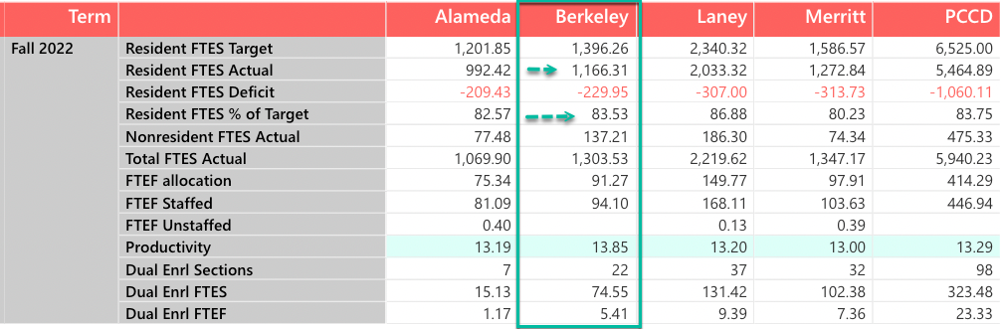
Fall 2022 Enrollment (as of October 10, 2022)
Headcount = 6,198
Class Enrollment = 10,947

Slide 3
Fall Enrollment Trend
-19%
-1%
-18%

Slide 4
Persistence at BCC
F18-S19
F19-S20
F20-S21
F21-S22
F18-F19
F19-F20
F20-F21
F21-F22

Slide 5
Fall ‘20 to Spring ‘21 Persistence: First Time Students
Ethnicity | Persistence Rate
American Indian | 33%
Asian | 50%
Black/African American | 43%
Latinx | 50%
Pacific Islander | 0%
Two or More | 54%
Unknown/NR | 48%
White | 57%
Overall First Time Students | 51%
Overall College | 48%
Notes:
Where do they go after in F21? How many of those who persist have BCC as there home school?

Slide 6
Service Area Feeder School Demographics
Students Enrolled in Community College
4,911
902
(18%)
4,809
879
(18%)
4,516
900
(20%)
4,566
817
(18%)
Alameda County
18%
Albany, Emeryville,
Berkeley, Oakland
2014-15
2015-16
2016-17
2017-18
* Most recent data provided by California Department of Education, Data Quest.
Notes:
We’ll add adult ed pipeline

Slide 7
Service Area Enrollment Pipeline
% Student Population Change Relative to Grade 12 from 2021-22
 | YR-2022 | YR-2023 | YR-2024 | YR-2025 | YR-2026 | YR-2027
Ethnicity | Grade 12 | Grade 11 | Grade 10 | Grade 9 | Grade 8 | Grade 7
African American | 1,000 | -13% | -11% | -18% | -11% | -15%
American Indian/Native Alaskan | 18 | -39% | -61% | -39% | -44% | -39%
Asian | 615 | -12% | 17% | -20% | -16% | -13%
Filipino | 52 | -23% | -29% | -31% | -37% | -37%
Latinx | 2,088 | -1% | -1% | 2% | -6% | -11%
Pacific Islander | 32 | -19% | 3% | 0% | 19% | 13%
White | 794 | -13% | -15% | -12% | -14% | -22%
Two or More | 293 | 1% | 11% | 10% | 3% | 16%
Not Reported | 94 | -4% | -3% | 19% | -32% | 7%
Total | 4,986 | -7% | -7% | -7% | -10% | -12%
Albany, Berkeley, Emeryville, and Oakland K-12 public school data suggests a potential increase in student populations shown in green. The percent changes are relative to Grade 12 from 2021-22.
29% of Albany, 18% of Berkeley, 30% of Emeryville, and 29% of Oakland public high school completers attend a community college.
CA Dept. of Ed.

Slide 8
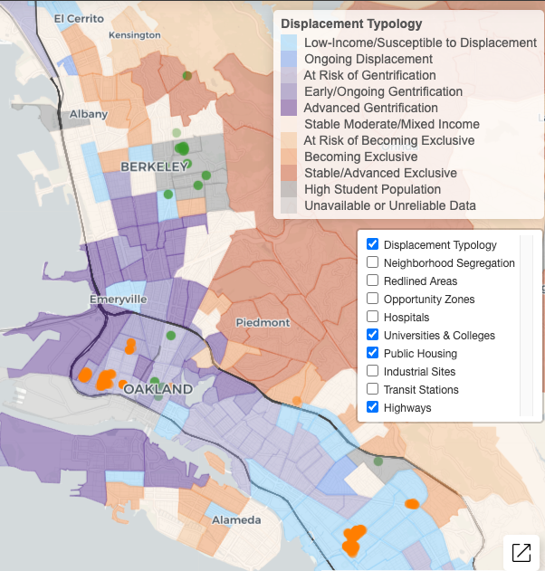

Gentrification
Albany HS
In 2018, over 10% or 161,343 low income households (living below 80% of the area’s median income) were at risk of or currently experiencing gentrification.
Nearly half of these households live in either Alameda or San Francisco counties.
Ongoing and advanced gentrification is most prevalent in San Francisco (18.5% of all tracts) and Alameda (11.1% of tracts) counties.
Berkeley HS
Emery HS
Oakland Tech HS
McClymonds HS
Street Academy HS
MetWest HS
Oakland HS
Fremont HS
Urban Displacement Project (UC Berkeley)
Notes:
Borders = census track
*ami - area median income

Slide 9
Student Success: Key Takeaways from Research
Non-academic obstacles might be key drivers of dropout rates for low-income students.
Survey of 6,000 community college students from 10 community colleges in California and 8 other states conducted by North Carolina State University revealed the top ten (10) challenges to student success.
Work (34%)
Paying expenses (34%)
Meeting demands of family and friends (30%)
Online classes, e.g. difficulty learning material on their own, lack of interaction with faculty (21%)
Parking on campus (21%)
Developmental courses, courses were too hard (17%)
Faculty (16%)
Health and disability (16%)
Doing college-level work (15%)
Registering for courses (14%)
*Percentages do not add to 100% as students could choose more than one option
RISC Report (Fall 2017 & Fall 2018; Published 2019)

