Slide 1
  ENROLLMENT OVERVIEW
Dr. Phoumy Sayavong
Senior Research & Planning Analyst

Slide 2
Are non-credit included?
BCC ENROLLMENT TREND
HEADCOUNT
10,976
+4%
11,427
-11%
10,137
FTES
3,697
-12%
3,263
-19%
2,628
% FT @ BCC
11%
8%
11%
GENDER

Slide 3
Demographics: Age Group

Slide 4
DUAL ENROLLMENT

Slide 5
Annual Demographics: Ethnicity
Latinx
White
Asian
Black/African American
Two+
Unknown
Pacific Islander
American Indian

Slide 6
Spring Census Trend
-2,238
-3,214
--3,124
-2,238
-322

Slide 7
Fall Enrollment Trend
-40%
-28%
-38%

Slide 8
Persistence at BCC

Slide 9
Fall ‘20 to Spring ‘21 Persistence: First Time Students
Ethnicity | Persistence Rate
American Indian | 33%
Asian | 50%
Black/African American | 43%
Latinx | 50%
Pacific Islander | 0%
Two or More | 54%
Unknown/NR | 48%
White | 57%
Overall | 51%
Notes:
Where do they go after in F21? How many of those who persist have BCC as there home school?

Slide 10
COURSE SUCCESS, RETENTION, WITHDRAWAL RATES
Retention: remained enrolled to receive a grade
Passing/Did Not Pass: Among retained students who received a passing or non-passing grade

Slide 11
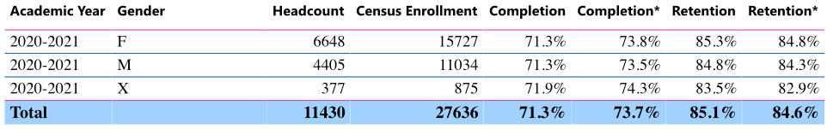
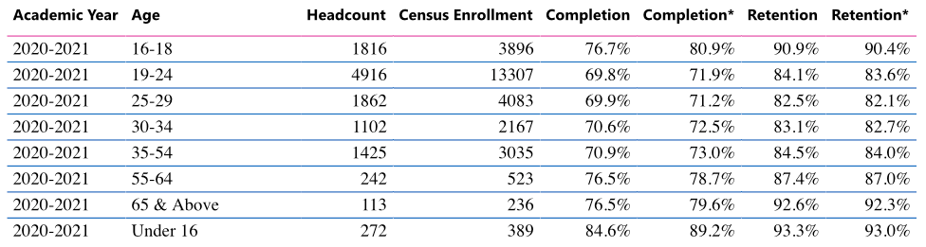
Course Success & Retention: 2020-21
Add variance from average column
*Excludes MW & EW Grades
Notes:
Dr. Garcia to spend 2 minutes on this slide

Slide 12
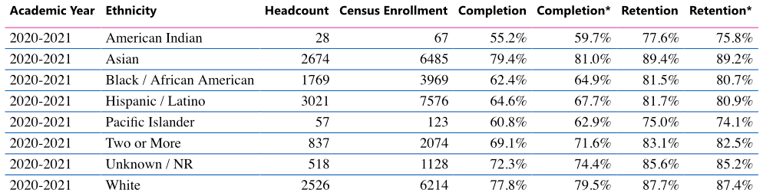
Course Success & Retention: 2020-21
*Excludes MW & EW Grades
Notes:
Dr. Garcia to spend 2 minutes on this slide

Slide 13
Spring 2021 Drops: Units Taken/Earned
Ethnicity | Units Taken | Unit Earned | Units Earned Rate | Diff from Term Average
American Indian | 61.5 | 24 | 39% | -34%
Asian | 8586 | 6898.5 | 80% | 7%
Black/African American | 4957.5 | 3301 | 67% | -6%
Latinx | 9581 | 6327.5 | 66% | -7%
Pacific Islander | 140 | 76 | 54% | -19%
Two or More | 2634.5 | 1840 | 70% | -3%
Unknown / NR | 1421.5 | 1061.5 | 75% | 2%
White | 8156.5 | 6397.5 | 78% | 5%
Grand Total | 35538.5 | 25926 | 73%

Slide 14
Transfer

Slide 15
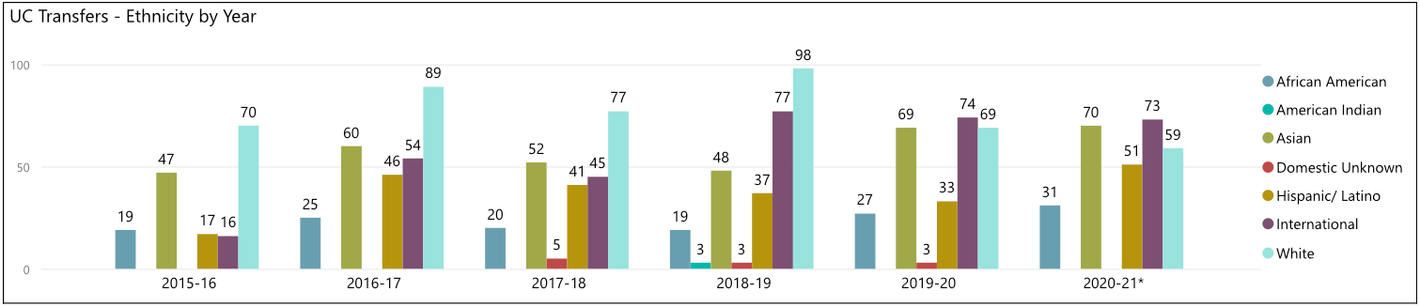
Transfer: UC
Total N = 169
Total N = 274
Total N = 240
Total N = 285
Total N = 275
Total N = 284
TOP F20 MAJORS
Social Sciences = 152
Mathematics and Statistics = 51
Multi/Interdisciplinary Studies = 51
Biological and Biomedical Sciences = 37
Psychology = 33
Visual and Performing Arts = 28
Natural Resources and Conservation = 26
Business, Management, Marketing, and Related Support Services = 26
Area, Ethnic, Cultural, Gender, and Group Studies = 25
Computer and Information Sciences and Support Services = 22

Slide 16
  EDUCATIONAL MASTER PLAN 2023 - 2027
  AN OVERVIEW

Slide 17
Overview of Research
Service Area Demographics (Albany, Berkeley, Emeryville, Oakland)
  Future Pipeline of Students from feeder schools
  Poverty & Living Wage scan
  Career & employment projections
Summary from Research Reports and Literature
  Barriers to student success
  Programs and initiatives that enabled student success focused on poverty, equity, and gentrification.

Slide 18
Preliminary Strategic Priorities for EMP
Student Completion
Teaching and Learning
Data-Informed Processes & Innovations
Community Partnerships
Human Capital Development
Fiscal Sustainability
Diversity, Equity, Inclusion & the Global Community
Advanced Technology & Facilities
BCC President’s Report

Slide 19
Student Success: Key Takeaways from Research
Non-academic obstacles might be key drivers of dropout rates for low-income students.
Survey of 6,000 community college students from 10 community colleges in California and 8 other states conducted by North Carolina State University revealed the top ten (10) challenges to student success.
Work (34%)
Paying expenses (34%)
Meeting demands of family and friends (30%)
Online classes, e.g. difficulty learning material on their own, lack of interaction with faculty (21%)
Parking on campus (21%)
Developmental courses, courses were too hard (17%)
Faculty (16%)
Health and disability (16%)
Doing college-level work (15%)
Registering for courses (14%)
*Percentages do not add to 100% as students could choose more than one option
RISC Report

Slide 20
Student Success: Key Takeaways from Research
An increase in a career technical education program’s flexibility is associated with increases in enrollment and completions, but not with changes in its completion rate.
Regarding online courses, UC Davis School of Education’s analysis of California Community College Data suggests
  On average, students have poorer outcomes in online courses in terms of the likelihood of course completion, course completion with a passing grade, and receiving an A or B.
  Students are more likely to repeat courses taken online, but are less likely to take new courses in the same subject following courses taken online.
  At BCC in 2021-22, completion rate for online classes was 70% vs. 71% in-person.
    Differences in completion rate was higher for female students: 70% online vs. 75% in-person;
    White students: 74% online vs. 80% in-person;
    Pacific Islander students: 55% online (44 students) vs. 100% in-person (6 students).
Online Course-taking and Student Outcomes in California Community Colleges. Education Finance and Policy

Slide 21
Service Area Feeder School Demographics
Total Alameda County Students Enroll in Community College
4,911
4,809
4,516
4,566
Albany, Emeryville, Berkeley, and Oakland
18%
18%
20%
18%
Include Adult Ed pipeline
* Most recent data provided by California Department of Education, Data Quest.

Slide 22
Percent of Socioeconomically Disadvantaged HS Students Attending CA Community College (Albany, Berkeley, Emeryville, and Oakland School Districts)
73% of Albany, Berkeley, Emeryville, and Oakland public school students who attend a California community college are socioeconomically disadvantaged (AY 2017-2018)
CA Dept. of Ed.

Slide 23
Service Area Enrollment Pipeline
% Student Population Change Relative to Grade 12 (2021-22)
1,000
18
615
52
2,088
32
293
94
4,986
Albany, Berkeley, Emeryville, and Oakland K-12 public school data suggests a potential increase in student populations shown in green and a decrease in student populations shown in black. The percent changes are relative to Grade 12 (2022).
CA Dept. of Ed.

Slide 24
Service Area Enrollment Pipeline
# of Students Attending Albany, Berkeley, Emeryville, and Oakland Public Schools in 2021-2022
29% of Albany, 18% of Berkeley, 30% of Emeryville, and 29% of Oakland public high school completers attend a community college.
CA Dept. of Ed.

Slide 25
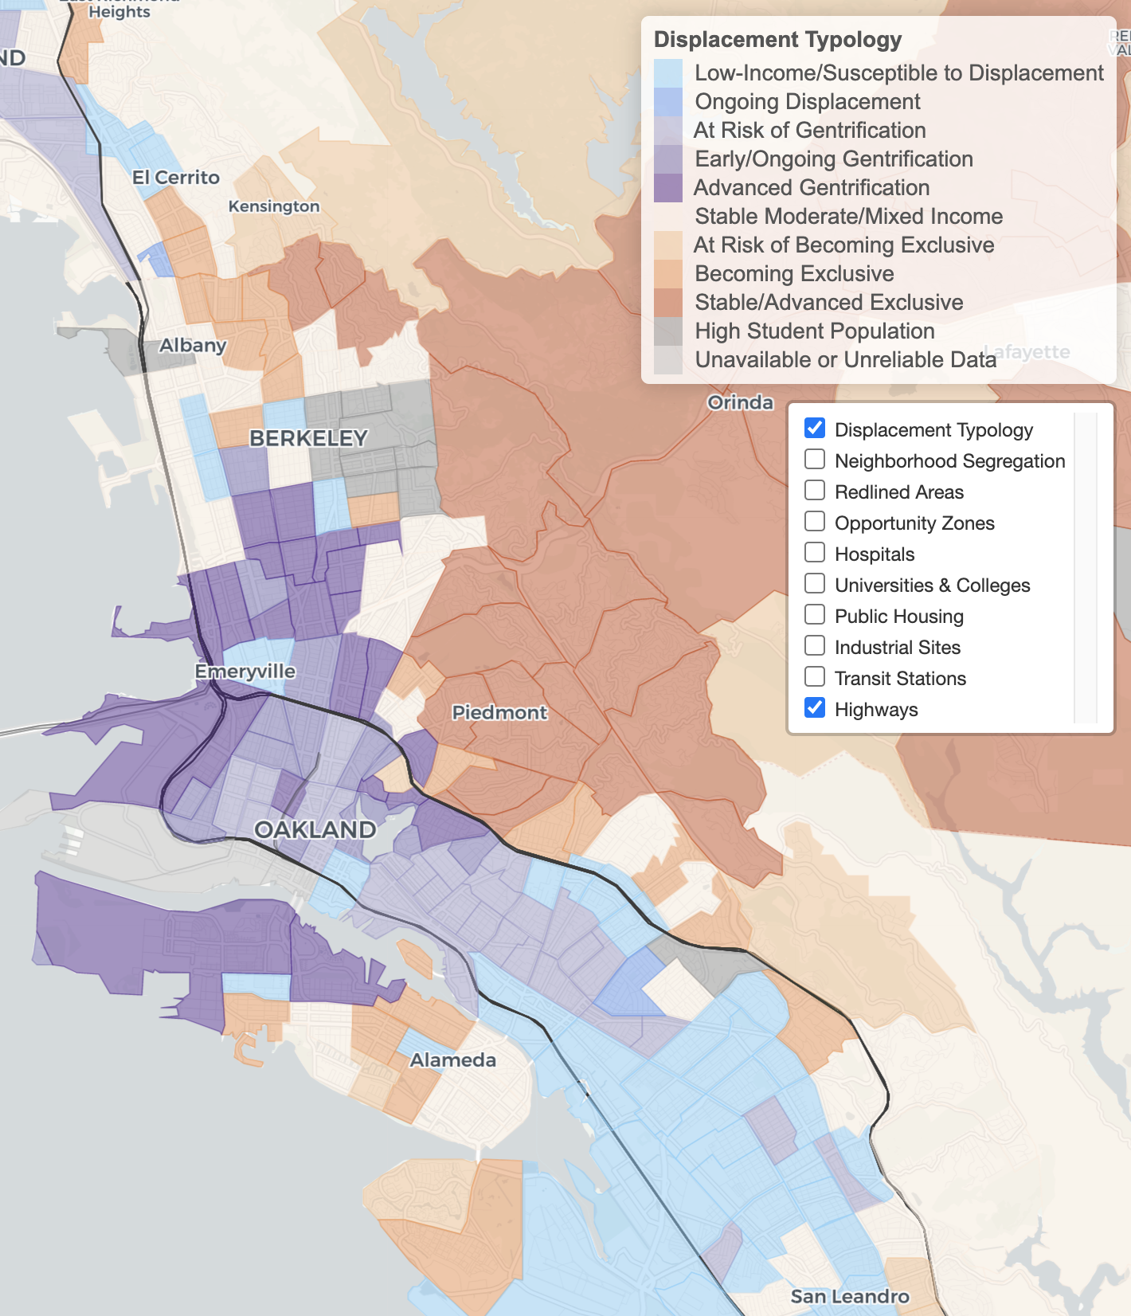
Diversity, Equity,
Inclusion & the Global Community
Urban Displacement Project(UC Berkeley)

Slide 26
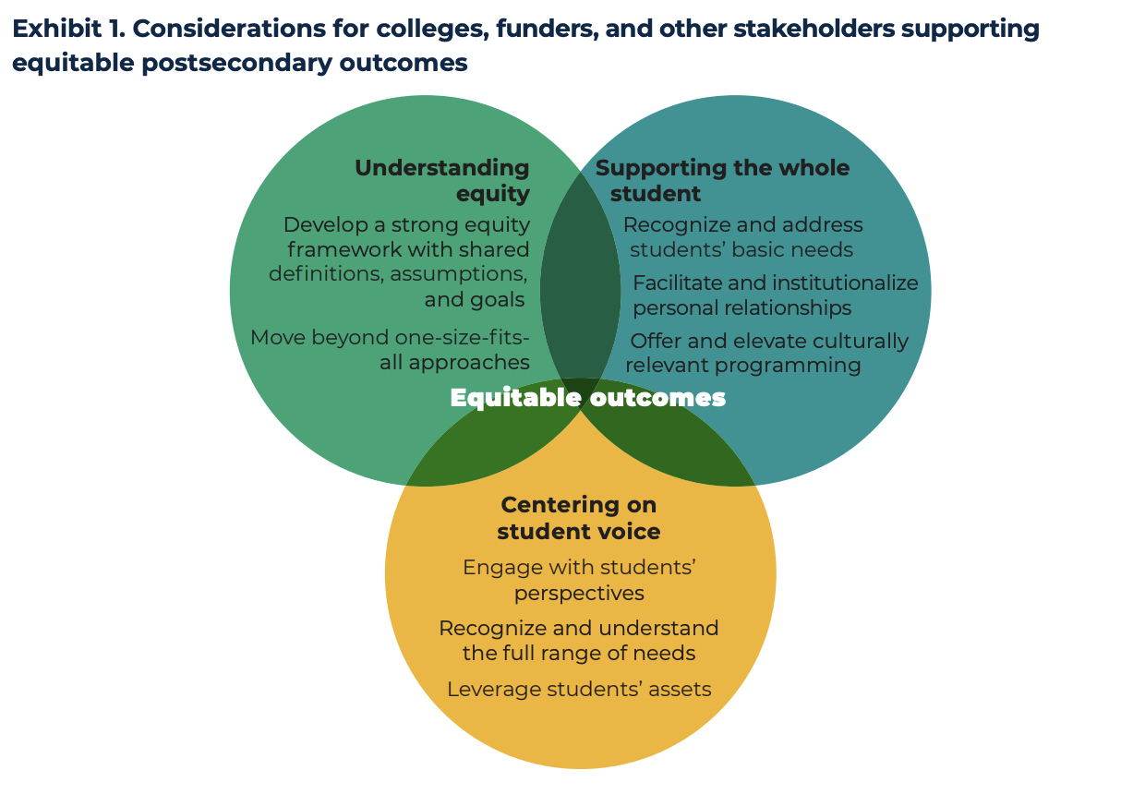
Diversity, Equity, Inclusion & the Global Community
BUILDING EQUITY BY SUPPORTING THE WHOLE STUDENT FINDINGS FROM CASE STUDIES OF TWO COLLEGES IN THE WORKING STUDENTS SUCCESS NETWORK. Annie E. Casey Foundation. Insight Center for Community Economic Development (Oakland) and Mathematica (October 2020)

Slide 27
Living Wage
Population by ethnicity living below poverty for Albany, Berkeley, Emeryville, and Oakland
Ethnicity | 2010 | 2020 | Change
White | 23,361 | 18,264 | -21.8%
Black or African American | 31,968 | 21,868 | -31.6%
American Indian or Alaska Native | 0 | 278 | INC
Asian | 22,624 | 20,482 | -9.5%
Native Hawaiian or Pacific Islander | 0 | 495 | INC
Some other race | 514 | 880 | 71.1%
Two or more races | 3,237 | 4,573 | 41.3%
Latinx | 30,615 | 25,269 | -17.5%
Total | 112,320 | 92,108 | -18.0%
US Census poverty threshold = $17,420/yr for a two person household
A living wage in Alameda County - per the MIT living wage calculator = $103,093/yr for one adult and one child before taxes.
Alameda County living wage: An adult plus one infant living require an annual wage of $96,986 after taxes. (The Insight Center for Community Economic Development Family Needs Calculator)
US Census Data

Slide 28
Median Wage
Median Earnings Data (US Census)
Earnings in the Past 12 Months (S2001)
Academic Attainment | Albany | Berkeley | Emeryville | Oakland
Less than high school graduate | $32,009 | $22,857 | $55,347 | $25,559
High school graduate | $39,931 | $32,972 | $34,700 | $31,493
Some college or associate's degrees | $41,458 | $36,165 | $55,568 | $38,498
Bachelor's degree | $65,823 | $56,541 | $86,485 | $68,369
Graduate or professional degree | $86,115 | $81,742 | $92,865 | $87,464
US Census Data

Slide 29
Career Salary & Projected Growth
Highest paying jobs for graduates with an associate’s degree and their projected growth through 2030. -US News analysis of Bureau of Labor Statistics (BLS)
Reference: US News
Career | 2020 Median Salary | Projected Growth Thru 2030
Geological and hydrologic technicians | $50,630 | 9%
Medical Equipment Repairers | $51,610 | 7%
Environmental engineering technologists and technicians | $51,630 | 8%
Life, physical, and social science technicians | $52,460 | 8%
Paralegals or legal assistants | $52,920 | 12%
Civil engineering technologists and technicians | $54,080 | 2%
Computer network support specialists | $55,510 | 9%
Radio, cellular and tower equipment installers and repairers | $57,720 | 4%
Drafters | $57,960 | -2%
Funeral Service Workers | $58,170 | 4%
Mechanical engineering technologists and technicians | $58,230 | 6%
Legal support workers | $59,540 | Flat
Electro-mechanical technicians (robotics) | $59,800 | -2%

Slide 30
Career Salary & Projected Growth
Career | 2020 Median Salary | Projected Growth Thru 2030
Occupational therapy assistants | $60,950 | 34%
Respiratory therapists | $62,810 | 23%
Radiologic and MRI technologists | $63,710 | 9%
Aircraft and avionics mechanics and technicians | $66,680 | 11%
Aerospace engineering and operations technologists and technicians | $68,570 | 9%
Diagnostic medical sonographers and cardiovascular technologists and technicians | $70,380 | 14%
Dental hygienists | $77,090 | 11%
Web developers and digital interface designers | $77,200 | 13%
Nuclear medicine technologists | $79,590 | 8%
Nuclear technicians | $84,190 | -12%
Radiation therapists | $86,850 | 9%
Air traffic controllers | $130,420 | 4%
Reference: US News

Slide 31
Awards & Wages
Top ten (10) paying jobs for an associate’s degree or certificate holders.
(Basis: Median wage 5 years after award. Award years 2010-2011 to 2014-2015.)
Data Mart Wage Tracker
Jobs | Award Category | Median Wage 5 Years After Award (2010-11 to 2014-15)
Electrical Systems and Power Transmission | Certificates Recipient | $159,160
Physicians Assistant | AA/AS Degree Recipient | $144,225
Physicians Assistant | Certificates Recipient | $141,727
Educational Technology | Locally Approved Certificates Recipient | $124,377
Electrical-095220 | Locally Approved Certificates Recipient | $119,918
*CCCCO Management Information Systems Data Mart Wage Tracker

Slide 32
Employment Wages: Career Education
Data Mart Wage Tracker
Jobs | Award Category | Median Wage 5 Years After Award (Award Years 2010-2011 to 2014-2015)
Paramedic | Chancellor's Office Approved Certificates Recipient | $112,609
Diagnostic Medical Sonography | Chancellor's Office Approved Certificates Recipient | $111,504
Fire Technology | Locally Approved Certificates Recipient | $106,303
Public Works | Chancellor's Office Approved Certificates Recipient | $102,898
Surveying | Chancellor's Office Approved Certificates Recipient | $100,629

Slide 33
Employment Wages: Career Education
Top three (3) paying jobs for an associate’s degree or certificate holders.
(Basis: Median wage 5 years after award. Award years 2010-2011 to 2014-2015.)
Job | Award Category | Median Wage 5 Years After Award (Award Years 2010-2011 to 2014-2015)
Electrical Systems and Power Transmission | Chancellor's Office Approved Certificates | $159,160
Educational Technology | Locally Approved Certificates | $124,377
Electrical | Locally Approved Certificates | $119,918
Data Mart Wage Tracker
Digital Media
$46k AA
$50k Chancellor's Approved Certificate
$21k Locally Approved Certificate
Multimedia
  $36k AA
  $39k Chancellor's Approved Certificate

Slide 34
Employment Wages: Arts/Humanities/Social Sciences
Top three (3) paying jobs for an associate’s degree or certificate holders.
(Basis: Median wage 5 years after award. Award years 2010-2011 to 2014-2015.)
Jobs | Award Category | Median Wage 5 Years After Award (2010-11 to 2014-15)
Geographic Information Systems | Chancellor's Office Approved Certificates Recipient ($74k), AA (~$58.8k) | $58,778 - $74,440
Economics | AA/AS Degree Recipient | $55,708
Speech Communication | Locally Approved Certificates Recipient | $54,865
Data Mart Wage Tracker

Slide 35
Employment Wages: STEM
Top three (3) paying jobs for an associate’s degree or certificate holders are given on the following slides. (Basis: Median wage 5 years after award. Award years 2010-2011 to 2014-2015.)
Jobs | Award Category | Median Wage 5 Years After Award (Award Years 2010-2011 to 2014-2015)
Physics, General | AA/AS Degree Recipient | $69,639
Biotechnology and Biomedical Technology | AA/AS Degree Recipient | $64,439
Mathematics, General | AA/AS Degree Recipient | $60,163
Data Mart Wage Tracker

Slide 36
Student Success: Key Takeaways from Research
Successful education and job skills training for low-income individuals with employment barriers focused on:
  curriculums targeting specific job sectors and occupations
  local employers' involvement in developing curriculums and providing work opportunities
  post-program job retention and career advancement services
Intensive case-management services for low-income community college students​ such as Stay the Course (STC) program (Fort Worth, Texas) significantly increased persistence and degree completion for women.​
  STC tripled associate's degree receipt by 31.5 percentage points.
Increasing Community College Completion Rates Among Low-Income Students:
Evidence from a Randomized Controlled Trial Evaluation of a Case-Management Intervention. Journal of Policy Analysis and Management
Exiting poverty: a systematic review of U.S. postsecondary education and job skills training programs in the post-welfare reform era.
International Journal of Sociology and Social Policy

