Slide 1
  EDUCATIONAL MASTER PLAN 2023 - 2027
  AN OVERVIEW
Integrated Planning Committee
September 8, 2022
Dr. Phoumy Sayavong
Senior Research & Planning Analyst

Slide 2
EMP Planning Background
Wednesday, June 22: Cabinet retreat
Reviewed initiatives and outcomes from 2021 – 2022
Completed a “Dream for BCC” exercise, in which participants suspended all rules and structures upon reflection on the following prompt:
  What would it look like for BCC to contribute to ending generational poverty in our local community?
  What would it look like for BCC to reverse the impact of gentrification and support for local community members to continue to live in the area for generations to come?”
Reviewed disaggregated data on BCC’s current progress towards equitable outcomes (enrollment, completion, transfer rates, and workforce opportunities), all centered around the lens of equity.
Sr. Researcher, Dr. Phoumy Sayavong, and Faculty Special Assignment Recipient, Dr. Becky Gee, were assigned by President Garcia, to conduct research on the preliminary EMP goals through the lens of equity and ending poverty and gentrification.
BCC President’s Report

Slide 3
Cabinet Retreat Preliminary Outcomes
Preliminary EMP Goals include: 1) Student Completion,2) Teaching & Learning, 3) Data-Informed Processes & Innovations, 4) Community Partnerships, 5) Human Capital Development, 6) Fiscal Sustainability, 7) Diversity, Equity, Inclusion & the Global Community, 8) Advanced Technology & Facilities.
The DREAMing session drew upon the very best of BCC, including a commitment to students, culturally and industry-relevant programs/services, collaborative community partnerships, and a focus on student access, success, and equitable outcomes.
Amidst the context of a post-pandemic society, topics included access to high wage, high skills job training, partnerships with local industries for impactful work experience for BCC students, student and employee health (physical, mental, fiscal), community partnerships to generate affordable housing opportunities, and developing a truly “free college for all”.
It is critical that Berkeley City College prioritize and pursue initiatives that lead to higher-wage jobs in the for students from historically marginalized and low-income backgrounds to achieve the goal of ending poverty and gentrification.
BCC President’s Report

Slide 4
Preliminary Strategic Priorities for EMP
Student Completion
Teaching and Learning
Data-Informed Processes & Innovations
Community Partnerships
Human Capital Development
Fiscal Sustainability
Diversity, Equity, Inclusion & the Global Community
Advanced Technology & Facilities
BCC President’s Report

Slide 5
Overview of Research
Service Area Demographics (Albany, Berkeley, Emeryville, Oakland)
  Future Pipeline of Students from feeder schools
  Poverty & Living Wage scan
  Career & employment projections

Slide 6
Service Area Feeder School Demographics
Total Alameda County Students Enroll in Community College
4,911
4,809
4,516
4,566
Albany, Emeryville, Berkeley, and Oakland
18%
18%
20%
18%
* Most recent data provided by California Department of Education, Data Quest.

Slide 7
Service Area Enrollment Pipeline
% Student Population Change Relative to Grade 12 (2021-22)
Albany, Berkeley, Emeryville, and Oakland K-12 public school data suggests a potential increase in student populations shown in green and a decrease in student populations shown in black. The percent changes are relative to Grade 12 (2022).
CA Dept. of Ed.

Slide 8
Living Wage
Population by ethnicity living below poverty for Albany, Berkeley, Emeryville, and Oakland
Ethnicity | 2010 | 2020 | Change
White | 23,361 | 18,264 | -21.8%
Black or African American | 31,968 | 21,868 | -31.6%
American Indian or Alaska Native | 0 | 278 | INC
Asian | 22,624 | 20,482 | -9.5%
Native Hawaiian or Pacific Islander | 0 | 495 | INC
Some other race | 514 | 880 | 71.1%
Two or more races | 3,237 | 4,573 | 41.3%
Latinx | 30,615 | 25,269 | -17.5%
Total | 112,320 | 92,108 | -18.0%
US Census poverty threshold = $17,420/yr for a two person household.
A living wage in Alameda County - per the MIT living wage calculator = $103,093/yr for one adult and one child before taxes.
Alameda County living wage: An adult plus one infant living require an annual wage of $96,986 after taxes. (The Insight Center for Community Economic Development Family Needs Calculator)
US Census Data

Slide 9
Median Wage
Earnings in the Past 12 Months
Academic Attainment | Albany | Berkeley | Emeryville | Oakland
Less than high school graduate | $32,009 | $22,857 | $55,347 | $25,559
High school graduate | $39,931 | $32,972 | $34,700 | $31,493
Some college or associate's degrees | $41,458 | $36,165 | $55,568 | $38,498
Bachelor's degree | $65,823 | $56,541 | $86,485 | $68,369
Graduate or professional degree | $86,115 | $81,742 | $92,865 | $87,464
Median Earnings Data (US Census)
US Census Data

Slide 10
Career Salary & Projected Growth
Highest paying jobs for graduates with an associate’s degree and their projected growth through 2030.
-US News analysis of Bureau of Labor Statistics (BLS)
Reference: US News
Career | 2020 Median Salary | Projected Growth Thru 2030
Geological and hydrologic technicians | $50,630 | 9%
Medical Equipment Repairers | $51,610 | 7%
Environmental engineering technologists and technicians | $51,630 | 8%
Life, physical, and social science technicians | $52,460 | 8%
Paralegals or legal assistants | $52,920 | 12%
Civil engineering technologists and technicians | $54,080 | 2%
Computer network support specialists | $55,510 | 9%
Radio, cellular and tower equipment installers and repairers | $57,720 | 4%
Drafters | $57,960 | -2%
Funeral Service Workers | $58,170 | 4%
Mechanical engineering technologists and technicians | $58,230 | 6%
Legal support workers | $59,540 | Flat
Electro-mechanical technicians (robotics) | $59,800 | -2%

Slide 11
Employment Wages: Career Education
Top three (3) paying jobs for an associate’s degree or certificate holders.
(Basis: Median wage 5 years after award. Award years 2010-2011 to 2014-2015.)
Job | Award Category | Median Wage 5 Years After Award (Award Years 2010-2011 to 2014-2015)
Electrical Systems and Power Transmission | Chancellor's Office Approved Certificates | $159,160
Educational Technology | Locally Approved Certificates | $124,377
Electrical | Locally Approved Certificates | $119,918
Data Mart Wage Tracker
Digital media
  $46k AA
  $50k Chancellor's Approved Certificate
  $21k Locally Approved Certificate
Multimedia
  $36k AA
  $39k Chancellor's Approved Certificate

Slide 12
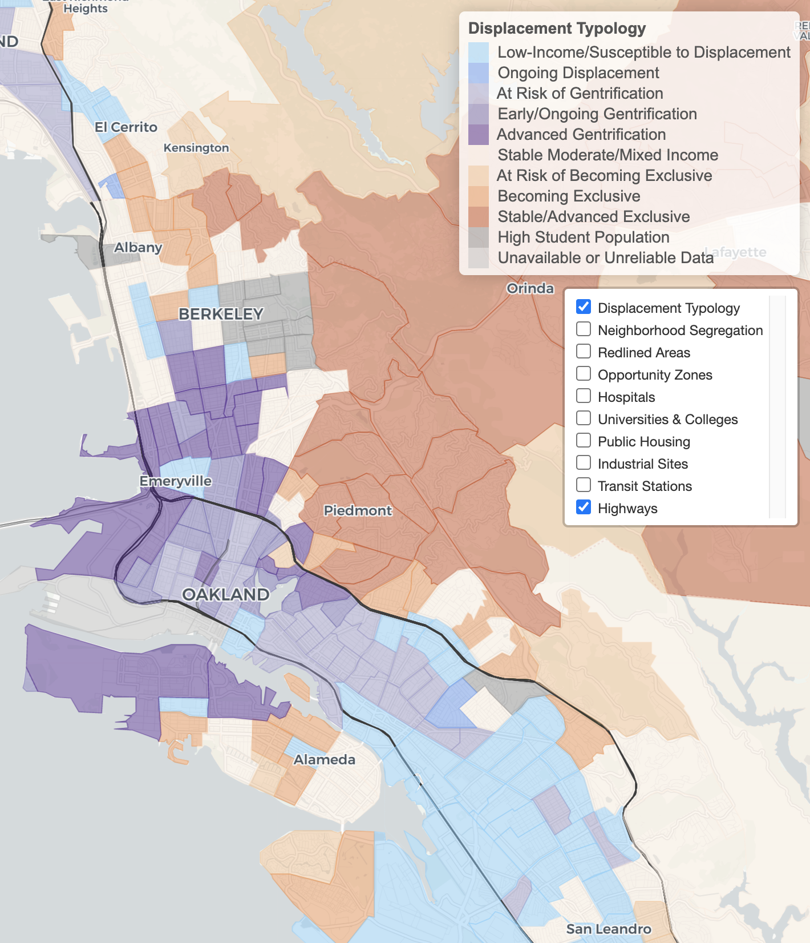
Diversity, Equity,
Inclusion & the Global Community
Urban Displacement Project(UC Berkeley)

Slide 13
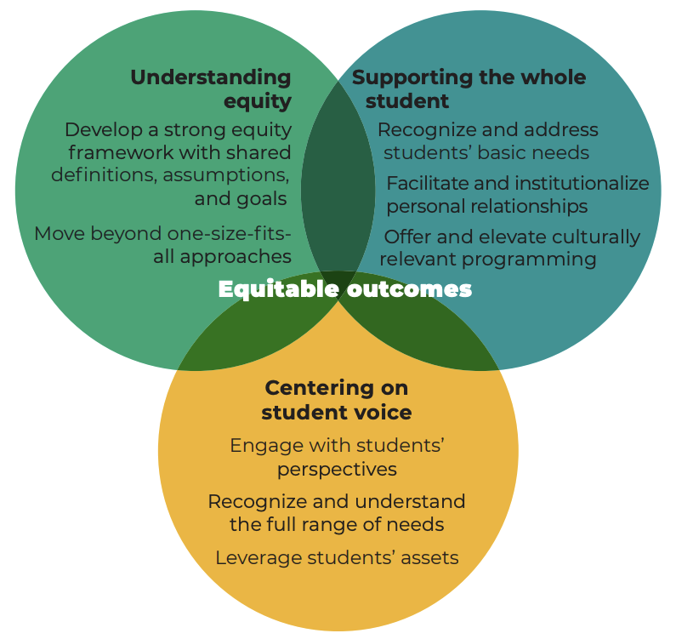
Diversity, Equity, Inclusion & the Global Community
BUILDING EQUITY BY SUPPORTING THE WHOLE STUDENT FINDINGS FROM CASE STUDIES OF TWO COLLEGES IN THE WORKING STUDENTS SUCCESS NETWORK. Annie E. Casey Foundation. Insight Center for Community Economic Development (Oakland) and Mathematica (October 2020)

Slide 14
Student Success: Key Takeaways from Research
WestEd Collaboration
Focus Groups
Campus Forum (in-person and Zoom)
RISC Report

Slide 15
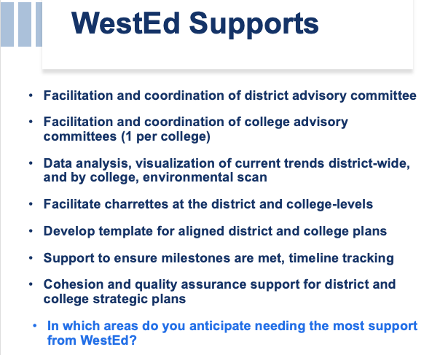
WestEd Support Outline

Slide 16
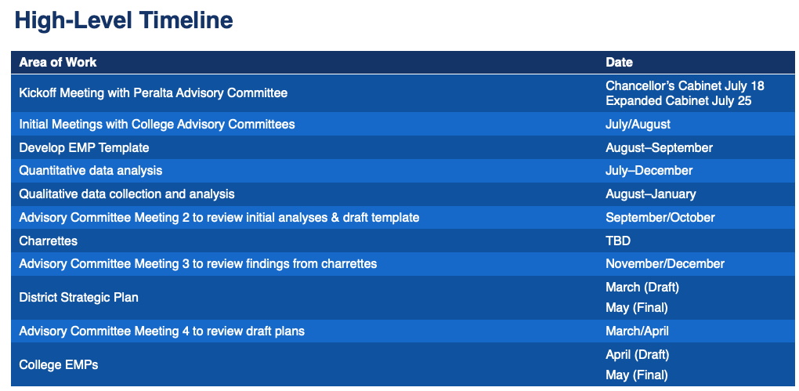
WestEd EMP Support Timeline

Slide 17
Questions?
Other research topics to consider?

