Slide 1
  EDUCATIONAL MASTER PLAN 2023 - 2027
  AN OVERVIEW
Roundtable: August 29, 2022
Dr. Phoumy Sayavong
Senior Research & Planning Analyst

Slide 2
EMP Planning Background
Wednesday, June 22: Cabinet retreat
Reviewed initiatives and outcomes from 2021 – 2022
Completed a “Dream for BCC” exercise, in which participants suspended all rules and structures upon reflection on the following prompt:
  What would it look like for BCC to contribute to ending generational poverty in our local community?
  What would it look like for BCC to reverse the impact of gentrification and support for local community members to continue to live in the area for generations to come?”
Reviewed disaggregated data on BCC’s current progress towards equitable outcomes (enrollment, completion, transfer rates, and workforce opportunities), all centered around the lens of equity.
Sr. Researcher, Dr. Phoumy Sayavong, and Faculty Special Assignment Recipient, Dr. Becky Gee, were assigned by President Garcia, to conduct research on the preliminary EMP goals through the lens of equity and ending poverty and gentrification.
BCC President’s Report

Slide 3
Cabinet Retreat Preliminary Outcomes
Preliminary EMP Goals include: 1) Student Completion,2) Teaching & Learning, 3) Data-Informed Processes & Innovations, 4) Community Partnerships, 5) Human Capital Development, 6) Fiscal Sustainability, 7) Diversity, Equity, Inclusion & the Global Community, 8) Advanced Technology & Facilities.
The DREAMing session drew upon the very best of BCC, including a commitment to students, culturally and industry-relevant programs/services, collaborative community partnerships, and a focus on student access, success, and equitable outcomes.
Amidst the context of a post-pandemic society, topics included access to high wage, high skills job training, partnerships with local industries for impactful work experience for BCC students, student and employee health (physical, mental, fiscal), community partnerships to generate affordable housing opportunities, and developing a truly “free college for all”.
It is critical that Berkeley City College prioritize and pursue initiatives that lead to higher-wage jobs in the for students from historically marginalized and low-income backgrounds to achieve the goal of ending poverty and gentrification.
BCC President’s Report

Slide 4
Preliminary Strategic Priorities for EMP
Student Completion
Teaching and Learning
Data-Informed Processes & Innovations
Community Partnerships
Human Capital Development
Fiscal Sustainability
Diversity, Equity, Inclusion & the Global Community
Advanced Technology & Facilities
BCC President’s Report

Slide 5
Overview of Research
Service Area Demographics (Albany, Berkeley, Emeryville, Oakland)
  Future Pipeline of Students from feeder schools
  Poverty & Living Wage scan
  Career & employment projections

Slide 6
Service Area Feeder School Demographics
Total Alameda County Students Enroll in Community College
4,911
4,809
4,516
4,566
Albany, Emeryville, Berkeley, and Oakland
18%
18%
20%
18%
* Most recent data provided by California Department of Education, Data Quest.

Slide 7
Percent of Socioeconomically Disadvantaged HS Students Attending CA Community College (Albany, Berkeley, Emeryville, and Oakland School Districts)
73% of Albany, Berkeley, Emeryville, and Oakland public school students who attend a California community college are socioeconomically disadvantaged (AY 2017-2018)
CA Dept. of Ed.

Slide 8
Service Area Enrollment Pipeline
% Student Population Change Relative to Grade 12 (2021-22)
Albany, Berkeley, Emeryville, and Oakland K-12 public school data suggests a potential increase in student populations shown in green and a decrease in student populations shown in black. The percent changes are relative to Grade 12 (2022).
CA Dept. of Ed.

Slide 9
Service Area Enrollment Pipeline
# of Students Attending Albany, Berkeley, Emeryville, and Oakland Public Schools in 2021-2022
29% of Albany, 18% of Berkeley, 30% of Emeryville, and 29% of Oakland public high school completers attend a community college.
CA Dept. of Ed.

Slide 10
Living Wage
Population by ethnicity living below poverty for Albany, Berkeley, Emeryville, and Oakland
Ethnicity | 2010 | 2020 | Change
White | 23,361 | 18,264 | -21.8%
Black or African American | 31,968 | 21,868 | -31.6%
American Indian or Alaska Native | 0 | 278 | INC
Asian | 22,624 | 20,482 | -9.5%
Native Hawaiian or Pacific Islander | 0 | 495 | INC
Some other race | 514 | 880 | 71.1%
Two or more races | 3,237 | 4,573 | 41.3%
Latinx | 30,615 | 25,269 | -17.5%
Total | 112,320 | 92,108 | -18.0%
US Census poverty threshold = $17,420/yr for a two person household.
A living wage in Alameda County - per the MIT living wage calculator = $103,093/yr for one adult and one child before taxes.
Alameda County living wage: An adult plus one infant living require an annual wage of $96,986 after taxes. (The Insight Center for Community Economic Development Family Needs Calculator)
US Census Data

Slide 11
Median Wage
Earnings in the Past 12 Months
Academic Attainment | Albany | Berkeley | Emeryville | Oakland
Less than high school graduate | $32,009 | $22,857 | $55,347 | $25,559
High school graduate | $39,931 | $32,972 | $34,700 | $31,493
Some college or associate's degrees | $41,458 | $36,165 | $55,568 | $38,498
Bachelor's degree | $65,823 | $56,541 | $86,485 | $68,369
Graduate or professional degree | $86,115 | $81,742 | $92,865 | $87,464
Median Earnings Data (US Census)
US Census Data

Slide 12
Career Salary & Projected Growth
Highest paying jobs for graduates with an associate’s degree and their projected growth through 2030.
-US News analysis of Bureau of Labor Statistics (BLS)
Reference: US News
Career | 2020 Median Salary | Projected Growth Thru 2030
Geological and hydrologic technicians | $50,630 | 9%
Medical Equipment Repairers | $51,610 | 7%
Environmental engineering technologists and technicians | $51,630 | 8%
Life, physical, and social science technicians | $52,460 | 8%
Paralegals or legal assistants | $52,920 | 12%
Civil engineering technologists and technicians | $54,080 | 2%
Computer network support specialists | $55,510 | 9%
Radio, cellular and tower equipment installers and repairers | $57,720 | 4%
Drafters | $57,960 | -2%
Funeral Service Workers | $58,170 | 4%
Mechanical engineering technologists and technicians | $58,230 | 6%
Legal support workers | $59,540 | Flat
Electro-mechanical technicians (robotics) | $59,800 | -2%

Slide 13
Career Salary & Projected Growth
Career | 2020 Median Salary | Projected Growth Thru 2030
Occupational therapy assistants | $60,950 | 34%
Respiratory therapists | $62,810 | 23%
Radiologic and MRI technologists | $63,710 | 9%
Aircraft and avionics mechanics and technicians | $66,680 | 11%
Aerospace engineering and operations technologists and technicians | $68,570 | 9%
Diagnostic medical sonographers and cardiovascular technologists and technicians | $70,380 | 14%
Dental hygienists | $77,090 | 11%
Web developers and digital interface designers | $77,200 | 13%
Nuclear medicine technologists | $79,590 | 8%
Nuclear technicians | $84,190 | -12%
Radiation therapists | $86,850 | 9%
Air traffic controllers | $130,420 | 4%
Reference: US News

Slide 14
Awards & Wages
Top ten (10) paying jobs for an associate’s degree or certificate holders.
(Basis: Median wage 5 years after award. Award years 2010-2011 to 2014-2015.)
Data Mart Wage Tracker
Jobs | Award Category | Median Wage 5 Years After Award (2010-11 to 2014-15)
Electrical Systems and Power Transmission | Certificates Recipient | $159,160
Physicians Assistant | AA/AS Degree Recipient | $144,225
Physicians Assistant | Certificates Recipient | $141,727
Educational Technology | Locally Approved Certificates Recipient | $124,377
Electrical-095220 | Locally Approved Certificates Recipient | $119,918
*CCCCO Management Information Systems Data Mart Wage Tracker

Slide 15
Employment Wages: Career Education
Data Mart Wage Tracker
Jobs | Award Category | Median Wage 5 Years After Award (Award Years 2010-2011 to 2014-2015)
Paramedic | Chancellor's Office Approved Certificates Recipient | $112,609
Diagnostic Medical Sonography | Chancellor's Office Approved Certificates Recipient | $111,504
Fire Technology | Locally Approved Certificates Recipient | $106,303
Public Works | Chancellor's Office Approved Certificates Recipient | $102,898
Surveying | Chancellor's Office Approved Certificates Recipient | $100,629

Slide 16
Employment Wages: Career Education
Top three (3) paying jobs for an associate’s degree or certificate holders.
(Basis: Median wage 5 years after award. Award years 2010-2011 to 2014-2015.)
Job | Award Category | Median Wage 5 Years After Award (Award Years 2010-2011 to 2014-2015)
Electrical Systems and Power Transmission | Chancellor's Office Approved Certificates | $159,160
Educational Technology | Locally Approved Certificates | $124,377
Electrical | Locally Approved Certificates | $119,918
Data Mart Wage Tracker
Digital media
  $46k AA
  $50k Chancellor's Approved Certificate
  $21k Locally Approved Certificate
Multimedia
  $36k AA
  $39k Chancellor's Approved Certificate

Slide 17
Employment Wages: Arts/Humanities/Social Sciences
Top three (3) paying jobs for an associate’s degree or certificate holders.
(Basis: Median wage 5 years after award. Award years 2010-2011 to 2014-2015.)
Jobs | Award Category | Median Wage 5 Years After Award (2010-11 to 2014-15)
Geographic Information Systems | Chancellor's Office Approved Certificates Recipient ($74k), AA (~$58.8k) | $58,778 - $74,440
Economics | AA/AS Degree Recipient | $55,708
Speech Communication | Locally Approved Certificates Recipient | $54,865
Data Mart Wage Tracker

Slide 18
Employment Wages: STEM
Top three (3) paying jobs for an associate’s degree or certificate holders. (Basis: Median wage 5 years after award. Award years 2010-2011 to 2014-2015.)
Jobs | Award Category | Median Wage 5 Years After Award (Award Years 2010-2011 to 2014-2015)
Physics, General | AA/AS Degree Recipient | $69,639
Biotechnology and Biomedical Technology | AA/AS Degree Recipient | $64,439
Mathematics, General | AA/AS Degree Recipient | $60,163
Data Mart Wage Tracker

Slide 19
Student Success: Key Takeaways from Research
Non-academic obstacles might be key drivers of dropout rates for low-income students.
Survey of 6,000 community college students from 10 community colleges in California and 8 other states conducted by North Carolina State University revealed the top ten (10) challenges to student success.
Work (34%)
Paying expenses (34%)
Meeting demands of family and friends (30%)
Online classes, e.g. difficulty learning material on their own, lack of interaction with faculty (21%)
Parking on campus (21%)
Developmental courses, courses were too hard (17%)
Faculty (16%)
Health and disability (16%)
Doing college-level work (15%)
Registering for courses (14%)
*Percentages do not add to 100% as students could choose more than one option
RISC Report

Slide 20
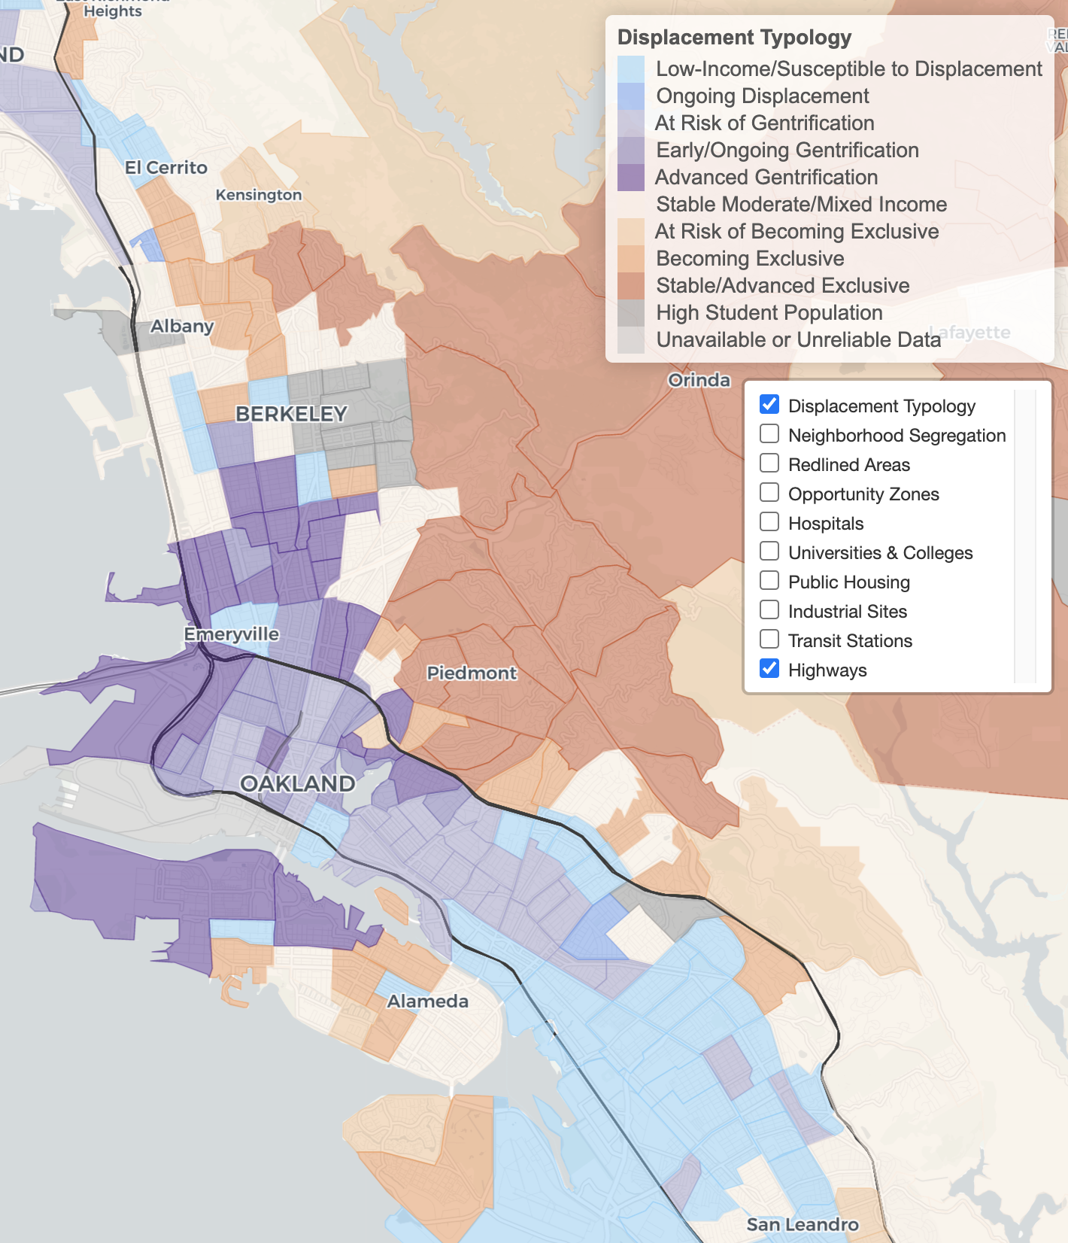
Diversity, Equity,
Inclusion & the Global Community
Urban Displacement Project(UC Berkeley)

Slide 21
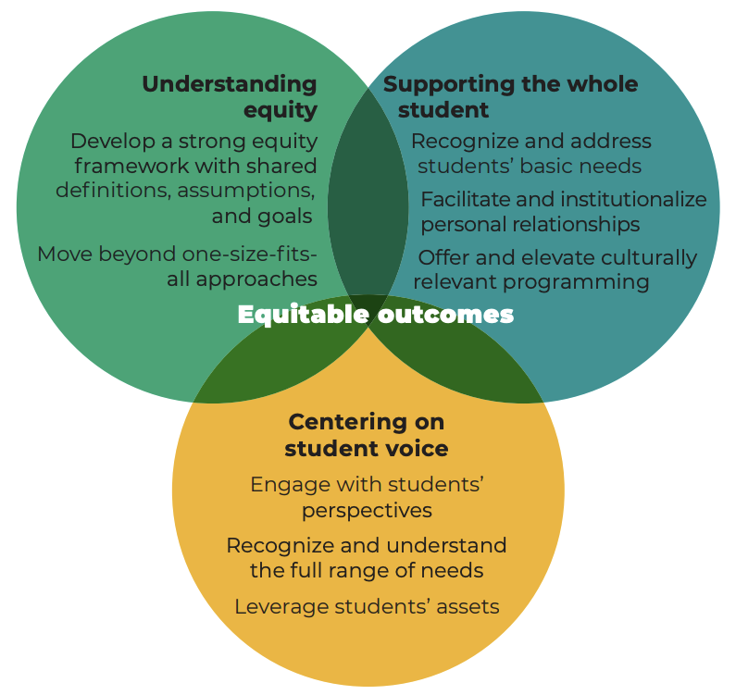
Diversity, Equity, Inclusion & the Global Community
BUILDING EQUITY BY SUPPORTING THE WHOLE STUDENT FINDINGS FROM CASE STUDIES OF TWO COLLEGES IN THE WORKING STUDENTS SUCCESS NETWORK. Annie E. Casey Foundation. Insight Center for Community Economic Development (Oakland) and Mathematica (October 2020)

Slide 22
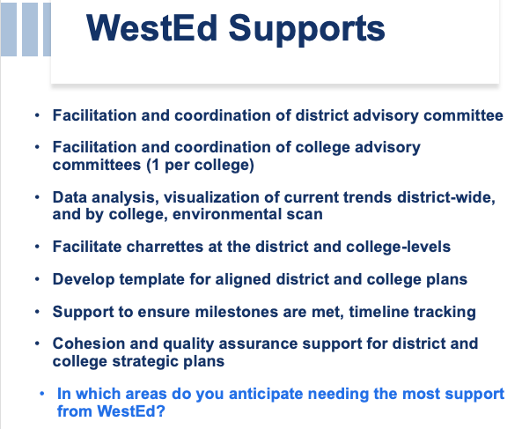
WestEd Support Outline

Slide 23
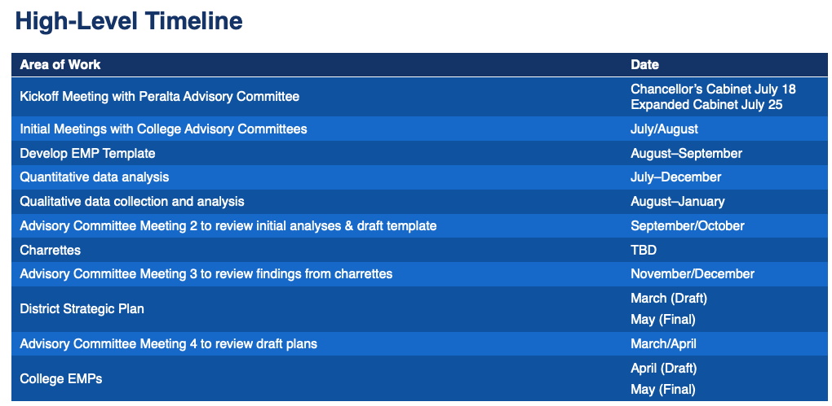
WestEd EMP Support Timeline

Slide 24
Questions?
Other research topics to consider?

