Slide 1
  EDUCATIONAL MASTER PLAN 2023 - 2028
  DREAMing Out Loud
Mid Semester Flex : October 19, 2022
Dr. Angélica Garcia & Dr. Phoumy Sayavong
President & Senior Research & Planning Analyst

Slide 2
Institutional Effectiveness at BCC
BCC College Strategic Plan
2023 - 2028
Goals & Objectives
Integrated Enrollment MGMT Plan
Comprehensive Program Review/ Annual Program Updates
Operational Plans
Responsive to local community
Focus on equitable student outcomes
Accreditation Standards: ISER
District Resource Allocation Model
Vision for Success
SCFF Metrics
Iterative process of assessment
2021-2026
Review Post-Pandemic Impact
Educational Master Plan
2023 - 2028
Technology
Distance Education
Student Equity Plan
Informs resource allocation
Equitable Student Outcomes
BCC President’s Report

Slide 3
EMP 2022 – 2023 Timeline
Spring 2022: IPC & College Roundtable Discussions on EMP process
June 2022: President's Cabinet review of college strategic plan goals
DREAMing for BCC Session June 2022
Research on gentrification and poverty on local community
College Day: Dr. Sayavong and Dr Gee data presentations August 2022
Presentation to College Roundtable August 2022
EMP Campus Forum September 2022
EMP Steering Committee Activated September 2022
PCCD Community Charette November 10, 2022
Finalize BCC EMP Priorities December 2022
Finalize & Route EMP through Governance AND Draft BCC College Strategic Plan Spring 2023
WestEd work launched July 2022

Slide 4
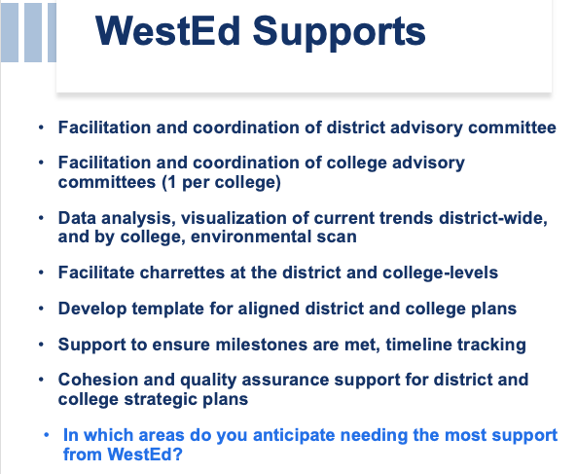
WestEd work with BCC & PCCD Colleges

Slide 5
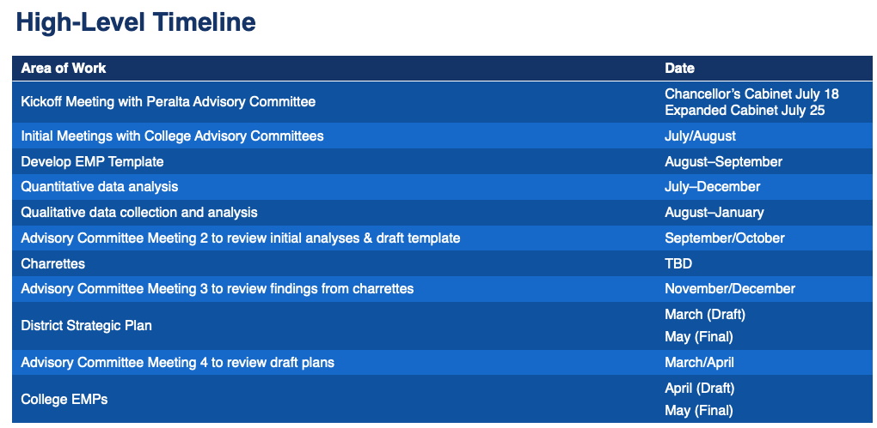
WestEd EMP Support Timeline

Slide 6
West Ed
Excerpt of Enviromental Scan Data Presentation to EMP Steering Committee 10-17-22
Presented by Dr. Phoumy Sayavong

Slide 7
Grounding Questions
  What would it look like for BCC to contribute to ending generational poverty in our local community?
  What would it look like for BCC to reverse the impact of gentrification and support for local community members to continue to live in the area for generations to come?”
BCC President’s Report

Slide 8
“The significant problems we face cannot be solved at the same level of thinking we were at when we created them.” —Albert Einstein

Slide 9
Appreciative Inquiry- Cooperrider (1980)
Discovery
Dream
Design
Destiny
Delivery
Discovery: What do we do well?
Dream: Imagine what might be
Design: Dialogue what should be
Destiny: Create what will be
Deliver: Action plan to fulfill our Destiny

Slide 10
Our Discovery: Preliminary Strategic Priorities for EMP
Student Completion
Teaching and Learning
Data-Informed Processes & Innovations
Community Partnerships
Human Capital Development
Fiscal Sustainability
Diversity, Equity, Inclusion & the Global Community
Advanced Technology & Facilities
BCC President’s Report

Slide 11
Community Engagement – 20 minutes
Breakout Rooms by Preliminary EMP Priorities
  Choose a breakout room
  Facilitator will guide you through addressing your priority and asking the following questions:
    What do we do well in this area?
    What is an impactful experience you have had that highlights how we do well in this area as a BCC community?
    What should be the ideal in terms of experience and outcomes?

Slide 12
Breakout Rooms by Preliminary EMP Priorities
  Facilitator will guide you through addressing your priority with guiding questions & capturing notes in a live document:
    What do we do well in this area?
    What is an impactful experience you have had that highlights how we do well in this area as a BCC community?
    What should be the ideal in terms of experience and outcomes?

Slide 13
Our Discovery: Community Engagement
Prelim EMP Strategic Priorities
Facilitator
Student Completion
Teaching and Learning
Data-Informed Processes & Innovations
Community Partnerships
Human Capital Development
Fiscal Sustainability
Diversity, Equity, Inclusion & the Global Community
Advanced Technology & Facilities
Dr. Phoumy Sayavong
Dr. Martín De Mucha Flores
John Nguyen
Tom Rizza & Djenilin Mallari
Chris Lewis
Dr. Stacey Shears
Lisa Cook
Sean Brooks
BCC President’s Report

Slide 14
Community Discovery
What did we learn when inquiring our work in these preliminary priorities?
How can we complement or strengthen our EMP Strategic Priorities?
What opportunities do you see?
Notes:
•What was surprising and what was known?
•What opportunities do you see?
•What are the implications for your College?

Slide 15
Next Points of Engagement
1. EMP Steering Committee
Kristiyan Klichev- Student Rep
Gail Pendleton – Classified Professional Rep
Fatima Shah – Faculty Rep
Kuni Hay – Administration Rep
Office of the President: Angélica Garcia, Phoumy Sayavong, Djenilin Mallari, Tom Rizza
2. EMP Data Circles
3. Discuss Preliminary Strategic Priorities in your department/division meetings
4. College Roundtable EMP Review in December 2022
5. EMP Writing Team

Slide 16


Slide 17
Questions?
THANK YOU!

