Slide 1
Expected outcomes of student-facing CCN (AB 1111)
Easily identifiable courses
Improved articulation
Increased transparency
Improved technology
Progress on the Vision for Success
  improved transfer student outcomes and the closing of equity

Slide 2
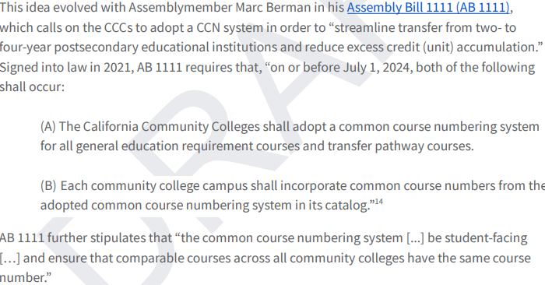

Slide 3
Recommended Implementation Plan – 12/7/2023
CCN Council, Steering Committee, Workgroups
CCN Descriptors – Minimum elements of a course for CCN
Course to course articulation - from one CCC to another CCC, a CSU, a UC, & independent colleges and universities
Common Course Number Workgroup
  find a numbering system that hasn’t been used yet
Technology & Processes Workgroup
Data Reconciliation / Data Structure
Linking Repository to Local Curriculum Software
Reduce Manual Inputting of information and data
Statewide Communication on work being done

Slide 4
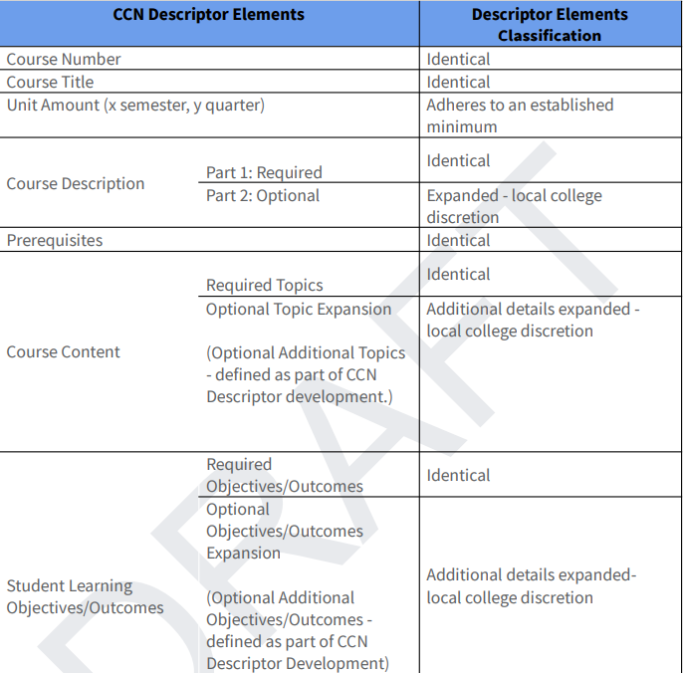

Slide 5


Slide 6
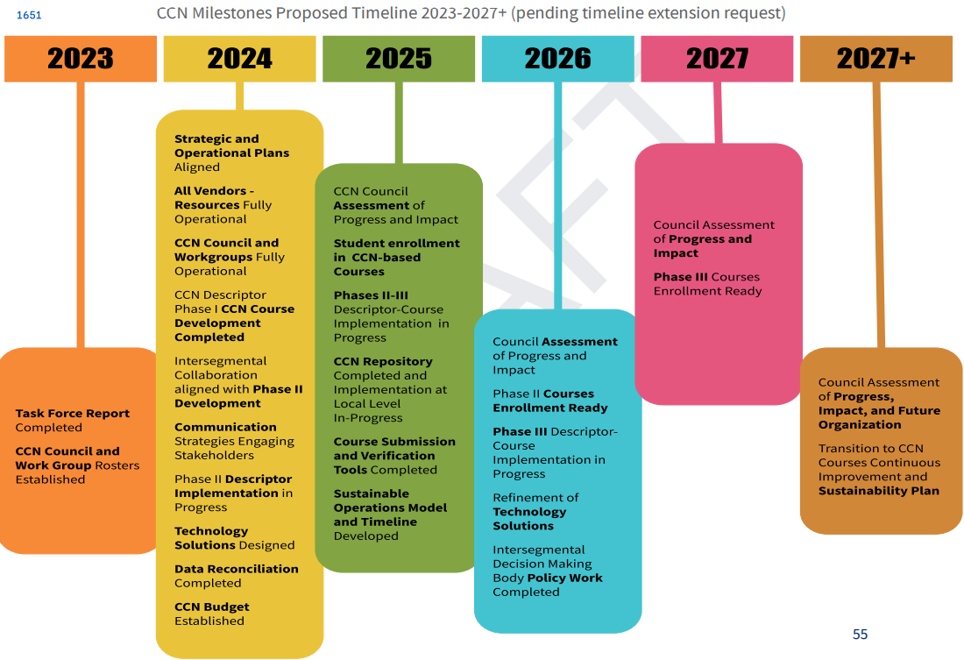

Slide 7


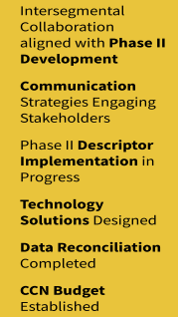


Slide 8
CCN implementation with integrity requires more than engaging 116 CCCs
in renumbering over 40,000 courses,
The CCN Task Force design of the CCN system recommended implementation plan illustrates the complexity and scale of this endeavor that necessitates additional time beyond July2024 to complete the work intended by the legislation.
It was therefore proposed that the CCN system implementation deadline be extended to fall 2027, with a comprehensive rolling implementation towards full scale beginning in January 2024.
What does all this mean for us?
First round of courses to be ready (aka updated, sent to state, and effective for Fall 2025)
We have to wait though
But, maybe not---
Districtwide process for expediting AB 1111 updates.

Slide 9
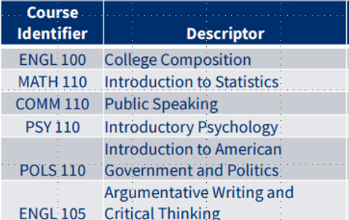
Other CCN Info:
Summer Supercharge sessions:
Gather content experts from the first 6 courses to review and decide on required template sections
2. Template to go to Steering Committee soon
3. Taxonomy of numbers process is beginning next Development Workgroup Meeting

