Slide 1
Cal-GETC
The 5 W’s
Who, what, when, where, and why

Slide 2
Cal-GETC
Who did this?
Assembly bill 928, Student Transfer Achievement Reform Act of 2021 (Berman, 2021)
Two parts
  Associate Degrees for Transfer (ADT)
    Establish ADT intersegmental Implementation Committee
    Requires CCC’s to place students on ADT Pathways
  Cal-GETC = Single general education pathway
Cal-GETC History

Slide 3
Cal-GETC
What is Cal-GETC?
Singular lower division general education (GE) pathway that meets the academic requirement necessary for transfer admission to the CSU and UC
Current GE patterns
  IGETC for UC and CSU
  GE Breadth for CSU only
    Area E: Lifelong Learning and Self-Develop will not be included in Cal-GETC
    Impact on BCC Counseling courses

Slide 4
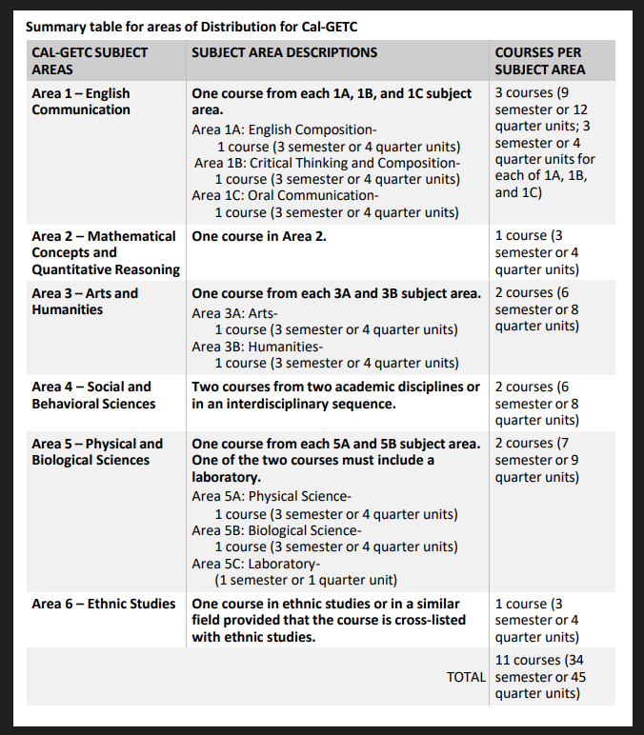
Cal-GETC
What continued

Slide 5
Cal-GETC
When?
Fall 2025

Slide 6
Cal-GETC
Where?
All California Community Colleges
  Legislated mandate

Slide 7
Cal-GETC
Why?
Create a singular pathway to both systems
Ensure reduction in the number of excess units at CCC
Eliminate repetition of courses at four-year universities taken by CCC students
Increase the number of CCC Students who transfer
Borrowed content from ASCCC AB 928 Webinar 9/27/23. Cheryl Aschenbach and Ginni May

Slide 8
Status
Consultation has been completed with our Communications faculty
  Established a timeline = Complete new Course Outline (COR) of Record to match the requirement for Area 1C.
    Comm 3, Comm 4, Comm 20, Comm 45
  COR will be completed at the end of spring 2024 for approval for the December 2024 Cal-GETC submission. Decisions are expected in May 2025.
STEM
  Waiting for ASCCC/Intersegmental Curriculum Workgroup/Transfer Alignment Project
To-Do
  Create a Cal-GETC certificate – Fall 2024
  Create a Cal-GETC worksheet for students and counselors – April 2025
  Update Program Pathway Maps - Summer of 2025

Slide 9
Wish List
Training for Counselors and Admission & Records staff
Monies for summer 2025 activities
Website counseling page explaining IGETC and CSU Breadth catalog rights

