Slide 1
Updates on AB 928: Singular Lower Division General Education Pathways for CSUs and UCs and
Updates on AB 1111: Common Corse Numbering
Connecting the dots…
Kuni Hay
Vice President of Instruction
Berkeley City College
October 5, 2023

Slide 2
Updates on AB 928 and Cal GETC
Let’s recap the essence of AB 928:
a) Student-centered transfer process to be developed
b) Intersegmental Implementation Committee to this work till July 1, 2025 = ICAS: Intersegmental Committee of the Academic Senate (of CCC, CSUs &UCs) and for it to
oversee the implementation.
c) Development of the Lower Division GE Transfer Pathways by May 31, 2023
d) Commencing 25-26 (as of Fall 2025), there will be the only LD GE Pathway used to determine eligibility & sufficient academic preparation to transfer to CSUs and UCs. * Development of the Cal – General Education Transfer
Curriculum (GETC)
e) “Auto ADT”
CCCs, On or before August 1, 2024 to place students who declare a goal of transfer on their mandatory SEP on the ADT pathway, if student has not opted out, as specified, if such a pathway exists for their intended major.
f) CCC to use funds for continued implementation of the Guided Pathways to accomplish this

Slide 3
Updates on AB 928 and Cal GETC
ICAS has accomplished :
  Established LD GE Transfer pathways for CSUs and UCs by May 31, 2023
  b) Cal GETC aligns UCs and CSUs transfer requirements without increasing the 34 units ceiling for GE course pattern as mandated by AB 928
  c) Students who begin CCC in Fall 2025 or later can fulfill LD breath and GE requirements by completion of Cal-GETC or fulfilling specific requirements of the college or school to which students apply

Slide 4
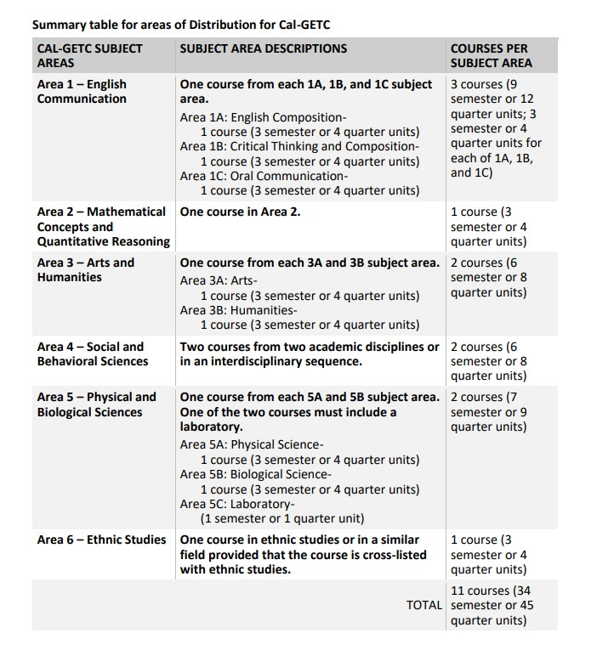
Updates on AB 928 and Cal GETC
Cal CETC:

Slide 5
BCC/PCCD Readiness? AB 928 and Cal GETC
Temperature check at BCC and PCCD:
Where are we with this process at BCC?
b) Are we ready to follow the Cal GETC for students ready to declare transfer on or after fall 2025?
c) Are we on course to establish a clearly delineated process to “auto ADT” students who declare a goal of transfer on their mandatory SEP?
d) What does each department need to be looking at now in terms of their courses and programs in relationship to AB 928 or Cal GETC implementation
Leverage the curriculum planning process for effective planning

Slide 6
Connecting the dots: AB 928 and AB 1111
What does the successful implementation of AB 928/Cal GETC look like at BCC?
AB 1111: common Course Numbering (CCN) system
It was signed into law in October 2021 and established Education code 66725.5. which requires implementation of a student-facing CCN system (including adoption into college course catalogs) for all GE requirements and transfer pathway courses across CCC on or before July 1, 2024.
Intention and Goal:
To streamline transfer from two-to four-year postsecondary educational institutions and reduce excess credit accumulation.

Slide 7
Connecting the dots: AB 928 and AB 1111 (CCN)
Updates on the work done on AB 1111 thus far
Facts:
AB 1111 Common Course Numbering Task Force was established and has been working hard to move this forward
It requires more than simply renumbering over 40,000 GE and transfer pathway courses within 115 CCCs.
It demands a student-centered approach that simplifies and streamlines how renumbered courses will count within CCCs and across CSUs, UCs, and Association of Independent California College and Universities (AICCU).

Slide 8
Connecting the dots: AB 928 and AB 1111 (CCN)
Updates on the work done on AB 1111 thus far
The CCN Task Force has comprehensive and specific recommendations as follows (Report shared separately):
1. Forming a statewide intersegmental CCN steering and operational structure for ongoing CCN course assessment and alignment process (considerate of local curriculum and catalog processes).
2. Establishing which course elements must be identical, and/or equivalent for a course to be numbered the same.
3. Assessing technology needs and solutions that will increase data-informed decisions, expedite operational processes, and create a streamlined CCN repository.
4. Identifying and addressing where CCN changes to CCC courses will potentially disrupt existing course articulation/transferability with CSU, UC, and AICCU institutions, while simultaneously working across segments to ensure maximum articulation of commonly numbered courses (recognizing CSU, UC, and AICCU are not currently mandated to participate).

Slide 9
Connecting the dots: Next steps on AB 1111
AB 1111 next steps:
The CCN Task Force will finalize the implementation planning recommendations in two remaining public meetings: October and December 2023
CCCCO has proposed the deadline of completion be extended to Fall 2027, with a rolling implementation commencing 2024 (formally through the CCCCO’s annual budget & legislative request process before the Board of Governors in September 2023).
Such an extension will enable for continuous progress to be achieved by applying the new CCN system to groups of courses in a scheduled cycle, while continuing to build toward sustainable CCN infrastructure with CSU, UC, and AICCU.

Slide 10
Connecting the dots: Next steps on AB 1111 at BCC and PCCD
Leverage the BCC curriculum planning process to assess and determine GE course revisions and other activities (AB 928 and Cal GETC)
Review of the “shared” GE courses within the district (CIPD):
Are there courses that are shared among colleges but not agreed?
3. Critically important roles of a) Curriculum Chair, b) Curriculum Specialist, c) Articulation officer, and d) Academic senate to be well informed about the progresses both on AB 928 and AB 1111
4. Also critically important roles in the Student Services: Counselors, A&R, and Technology support (PCCD and BCC) for the development of local infrastructure

Slide 11
Q&A?

