Slide 1

Information Technology
District-Wide Network Infrastructure Upgrade
April, 2023-2024

Slide 2


BCC Campus Infrastructure Refresh
We were invited by the Peralta IT Team to provide pricing on several of the initiatives surrounding network infrastructure upgrades.
One of the goals of the IT team was to align PCCD with current Higher Educational IT standards, which includes infrastructure that supports the needs of the staff and students today and moving forward.
The IT team had several amazing ideas, and there was a significant number of meetings, white board design sessions, site surveys, and documentation that went back and forth and the outcome was the following-

Slide 3

BCC Campus Infrastructure Implementation
Physical Layer
  NetXperts installed new fiber & cat6A between all the network closets (IDF) and server room (MDF). This new infrastructure will provide high performance and faster access and required for today’s advanced applications. The previous fiber & copper infrastructure did not provide optimal performance in all of the IDFs.
Network Infrastructure
  Switches are the backbone of the network which is critical toward allow users and devices to connect. New switches was installed as the existing switches were 10+ years old and did not have capacity for growth. These new Cisco switches - POE+ available on all ports with Scalability and designed to grow with Peralta’s needs for years to come
Undisturbed Power Supply (UPS)
  The new APC UPS(s) have a back up running time of 30 minutes on full load. All rack mounted, all with network cards, all with at least (8) receptacle
Wireless Access Point (WAP)
  The WAP is a networking device that allows wireless-capable devices to connect to a wired network. Your new wireless IT infrastructure was installed to support next-generation technologies. These WAPs meet the new Wi-Fi 6 (802.11ax) standard, that will help you build a reliable, scalable, and secure wireless network to handle the rapidly growing number of Internet of Things (IoT) devices
  By migrating to Cisco access points allows BCC to be on the same wireless platform as Merritt, Laney, COA College, and the DO.

Slide 4

BCC Campus Infrastructure Upgrades
The following was completed without any major outage to the school:
Work was completed after School hours
Incredible teamwork
Over 5,000 feet of new single-mode fiber 10GIG & Cat6A pulled to the main campus of BCC
13 Cisco switches installed
18 APC UPS(s) installed
Over 110 Cisco Wireless Access Points installed
This work would not have been possible without the teamwork between the SLBE (Net Electric), BCC Administrators, the District Administrators, the BCC IT team, and the District Office IT team, and NetXperts.

Slide 5
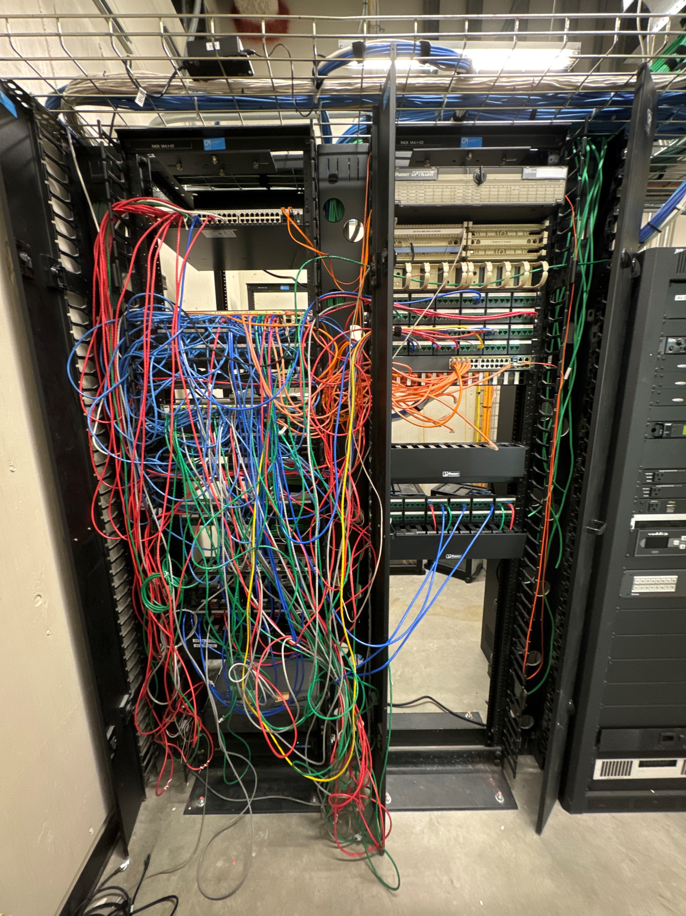
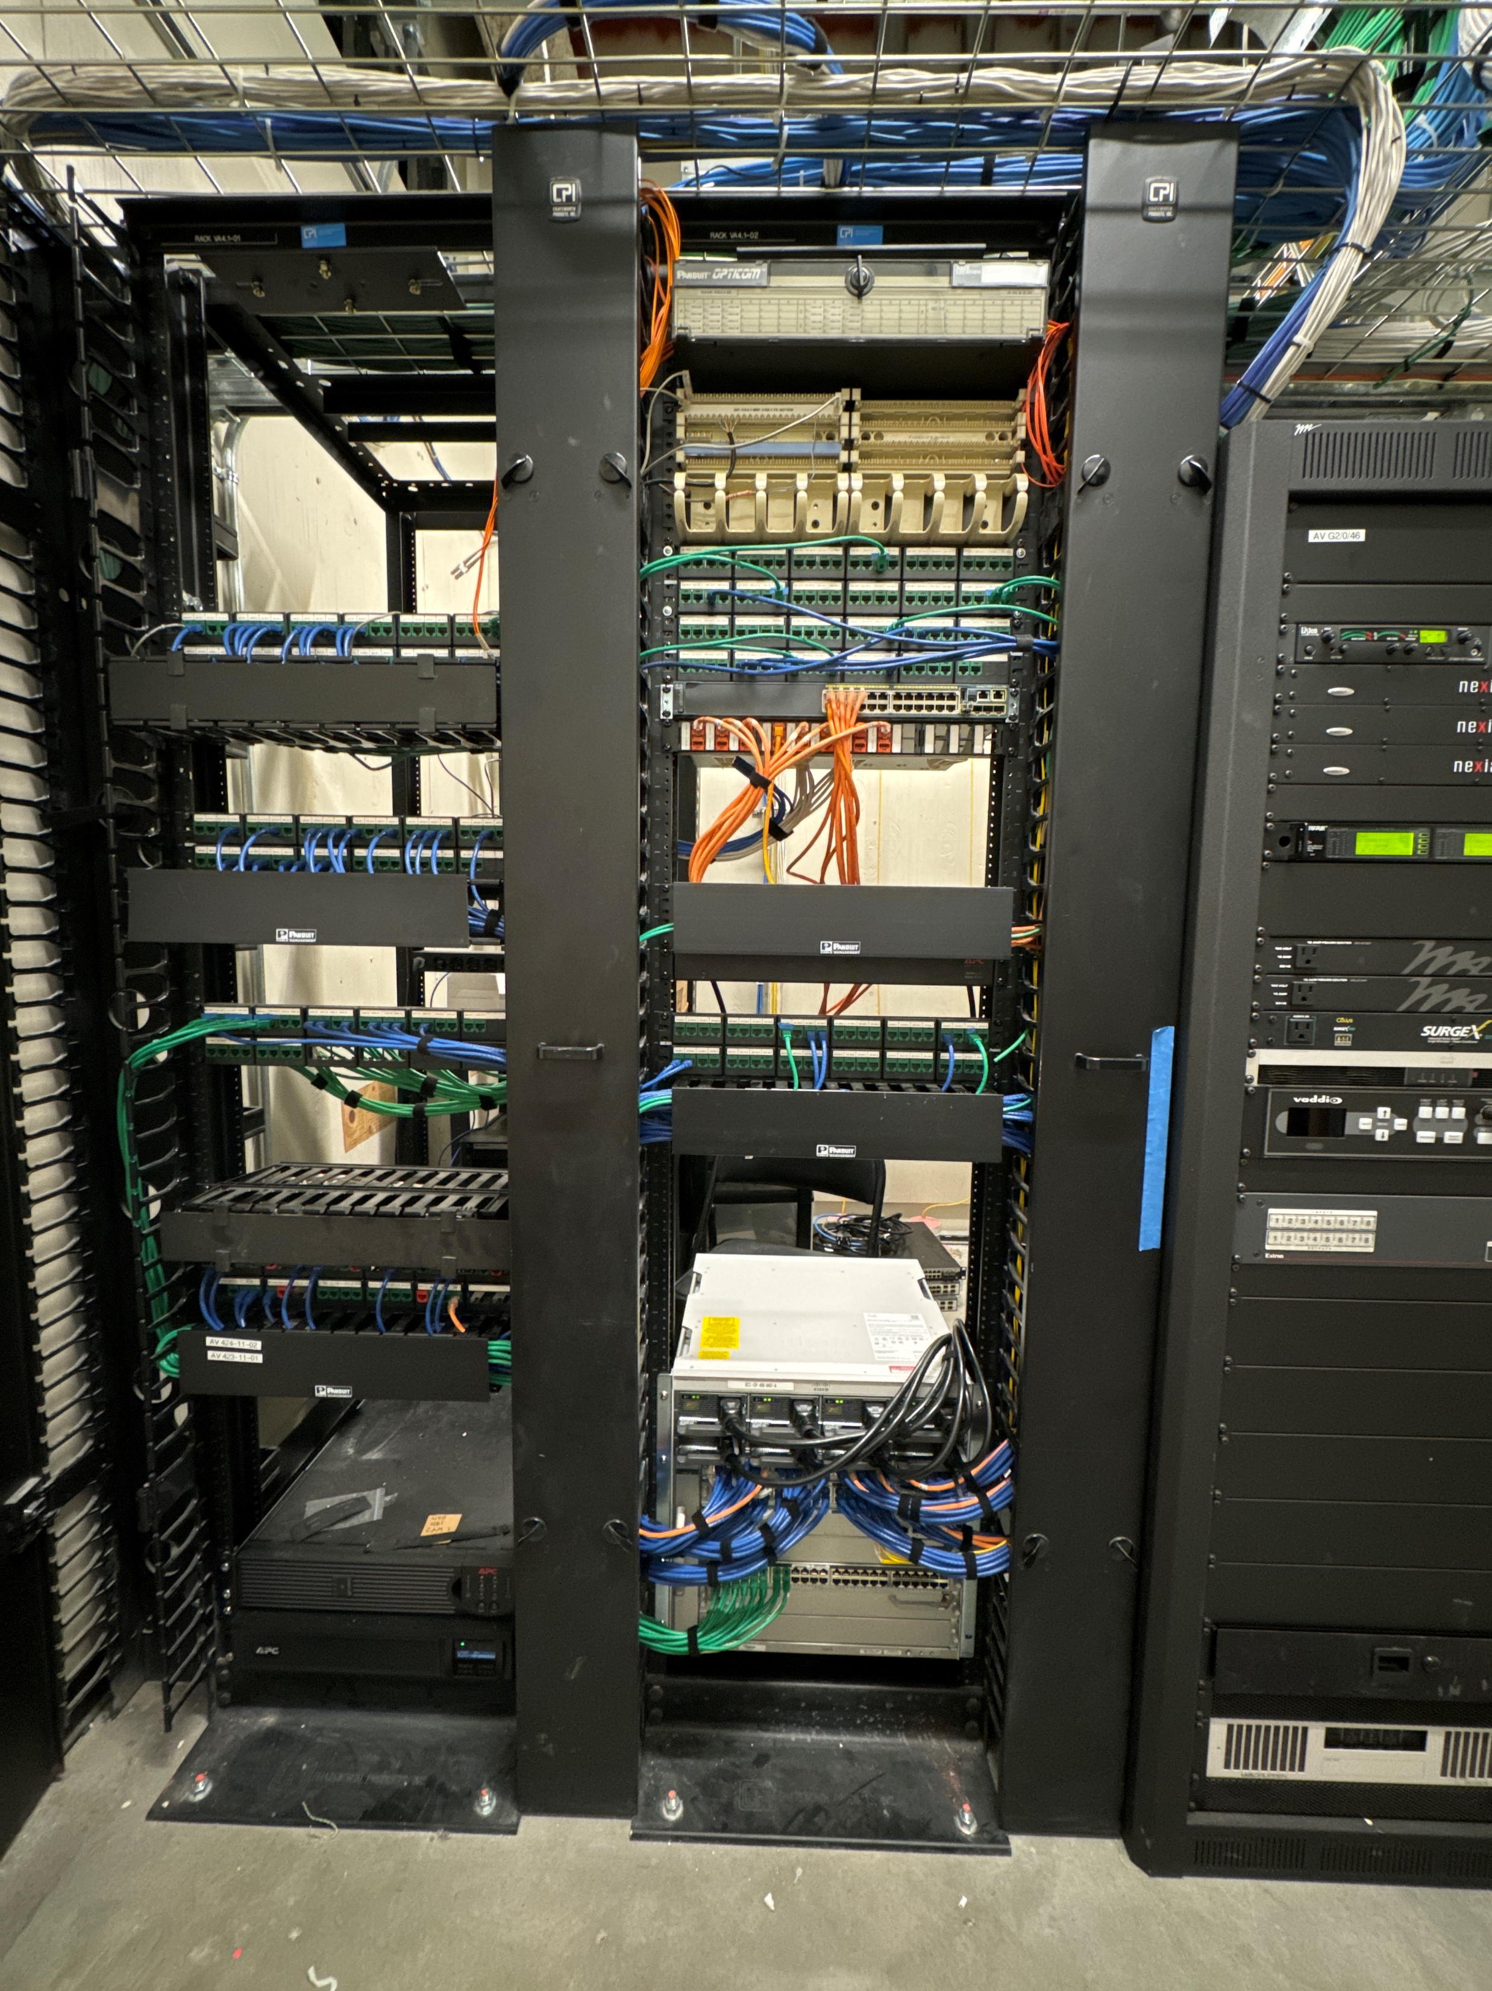
BCC Campus Infrastructure Cut-Over
BEFORE
AFTER
IDF-406

Slide 6

District-Wide Network Infrastructure Upgrade
  Laney College –
    New Network Switches
    New campus wide Wireless Access Points (Wi-Fi)
    New Power Backup System, new Fiber and CAT6A Cabling, new racks and cabinets
  Berkeley City College –
    New Network Switches campus wide
    New campus wide Wireless Access Points (Wi-Fi)
    New Power Backup System, new Fiber and CAT6A Cabling, new racks and cabinets
  Merritt College & “S” Building -
    New Network Switches, and WiFi for select buildings and areas
    Cellular Phone Coverage extension for select buildings
    New Power Backup System, new Fiber and CAT6A Cabling, new racks and cabinets
  Alameda College
    Firewall Refresh and new CAT6A Cabling
  District Office
    New Network Switches WiFi
    District Wide Security and Firewall upgrades
    District wide Voice, Voicemail Upgrades

Slide 7

What does the project consist of:
The total cost ($8,015,090.83) of the solution is broken down into these categories by percentage:
Networking Hardware, Software, and Service Contracts (Cisco, Panduit, Leviton, Etc.) = Approximately 61.5%
SLBE’s (Small, Local Business Enterprise) Portion = Approximately 25%
FCCC Contract Fee *Foundation for Community Colleges)= Approximately 2%
NetXperts Engineering, and Project Management = Approximately 11.5%

