Slide 1
Institutional Self-Evaluation Report (ISER)
Training
A Workshop for Berkeley City College
Dr. Stephanie Droker, Senior Vice President, ACCJC
September 26, 2019

Slide 2

Welcome and Introductions
Welcome!
Introductions
Resources/ACCJC Website
Notes:
Steph

Slide 3
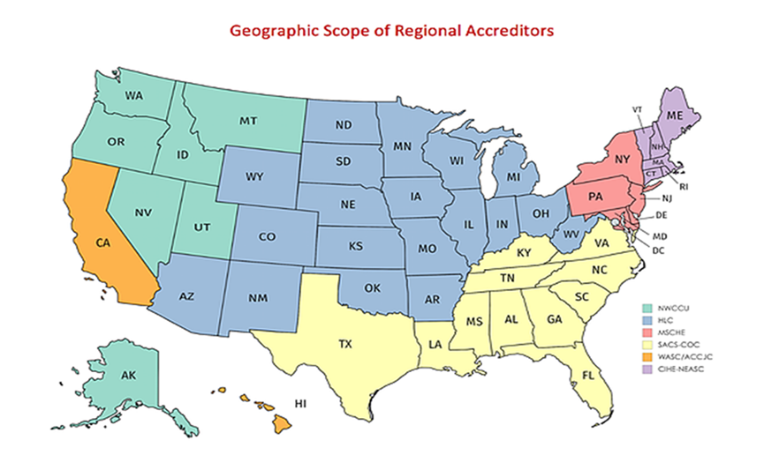
Accreditation 101
Regional Accreditor
  6 Regions, 7 Accreditors

Slide 4
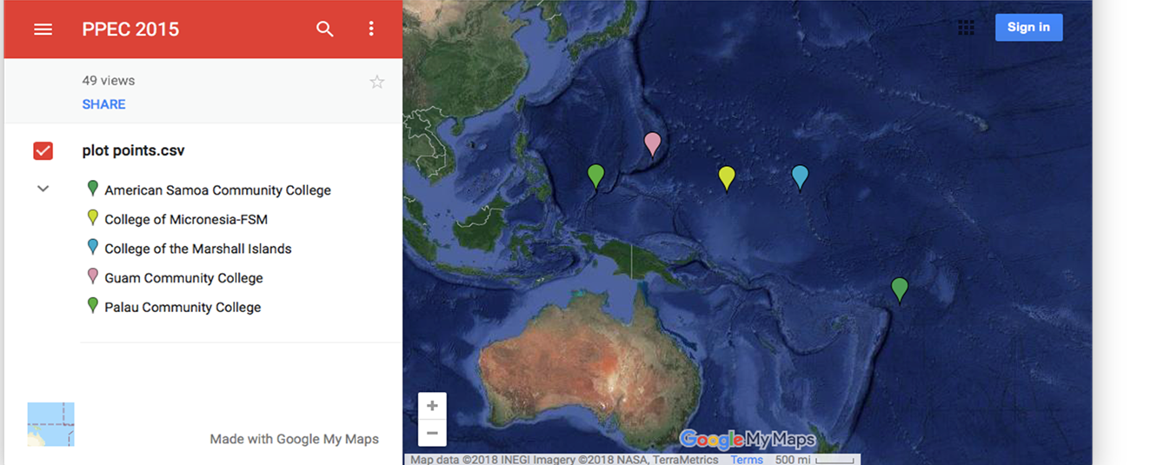

Slide 5


What is the Purpose of Accreditation?
Why Go Through This????
  Gatekeepers of federal financial aid
  Assure quality to the public and students
  Ensure institutions can meet their missions
    Student Outcomes
U.S. Higher Education – Commitment to Peer Review
  Unique to U.S.
  Uses academic inquiry to inform effective practices for improvement
  Criticisms
    “Fox guarding the henhouse”
    “Watchdog without any bite”

Slide 6

ACCJC Philosophy on Peer Review
ACCJC’s Philosophy on Peer Review
  Meeting/not meeting Standards vs. alignment with Standards
  Peer reviewer vs. peer evaluator
  Support and celebrate the College
  Balanced approach to compliance and improvement
Notes:
Steph

Slide 7
How Does One Interpret a Standard?
Standard II.A.2: Faculty, including full time, part time, and adjunct faculty,
regularly engage in ensuring that the content and methods of instruction meet
generally accepted academic and professional standards and expectations.
In exercising collective ownership over the design and improvement of the
learning experience, faculty conduct systematic and inclusive program review,
using student achievement data, in order to continuously improve instructional
courses and programs, thereby ensuring program currency, improving teaching
and learning strategies, and promoting student success.
Notes:
Steph

Slide 8

Interpreting the Standards - Continued
  Read the Standard that has been assigned to you.
  Interpret the Standard and determine possible sources of evidence.
Notes:
Kevin

Slide 9
Activity 3: Let’s Discuss
  I.B.6 (Assuring Academic Quality and Institutional Effectiveness/Institutional Effectiveness): The institution disaggregates and analyzes learning outcomes and achievement for subpopulations of students. When the institution identifies performance gaps, it implements strategies, which may include allocation or reallocation of human, fiscal and other resources, to mitigate those gaps and evaluates the efficacy of those strategies.
  I.C.8 (Institutional Integrity): The institution establishes and publishes clear policies and procedures that promote honesty, responsibility and academic integrity. These policies apply to all constituencies and include specifics relative to each, including student behavior, academic honesty and the consequences for dishonesty.

Slide 10
Activity 3: Let’s Discuss
  II.A.3 (Instructional Programs): The institution identifies and regularly assesses learning outcomes for courses, programs, certificates and degrees using established institutional procedures. The institution has officially approved and current course outlines that include student learning outcomes. In every class section students receive a course syllabus that includes learning outcomes from the institution’s officially approved course outline.
  II.C.2 (Student Support Services): The institution identifies and assesses learning support outcomes for its student population and provides appropriate student support services and programs to achieve those outcomes. The institution uses assessment data to continuously improve student support programs and services.

Slide 11

Challenging Standards
What Standards do you have questions about?
Notes:
Steph

Slide 12
Improvement Plans and the QFE
Self-Identified Improvement plans (a.k.a. planning agenda)
vs. quality focus projects
Quality Focus Essay (QFE)
  Should be long term plans to improve student learning and/or achievement
  Should identify outcomes, which are measurable and achievable
  Should identify responsible parties/groups
  Should have a timeline
Teams will provide feedback in the team report

Slide 13

Questions and Comments
Have we addressed your questions and concerns?
Any new questions or concerns?

