Slide 1
BCC
Budget Advisory Committee
Tuesday, December 9th, 2025

Slide 2
Hiring Updates
Shelsea Reyes, A & R Clerk – Temporary
Susana Abdurahman – EOPS Coordinator, 12/22/25
Dr. Ajani Byrd – VPSS 1/5/25-6/30/26
Lissette Flores – Dean of Enrollment 1/5/25 – 6/30/25
Hoda Jirde – SAS Staff Assistant – 12/22/25
Evan Storey – SAS Staff Assistant/Recruitment Sub
Director of Student Activities and Campus Life Update
Positions going to Board – 12/9/25
  VP of Student Learning and Success
  Director of Business Services

Slide 3
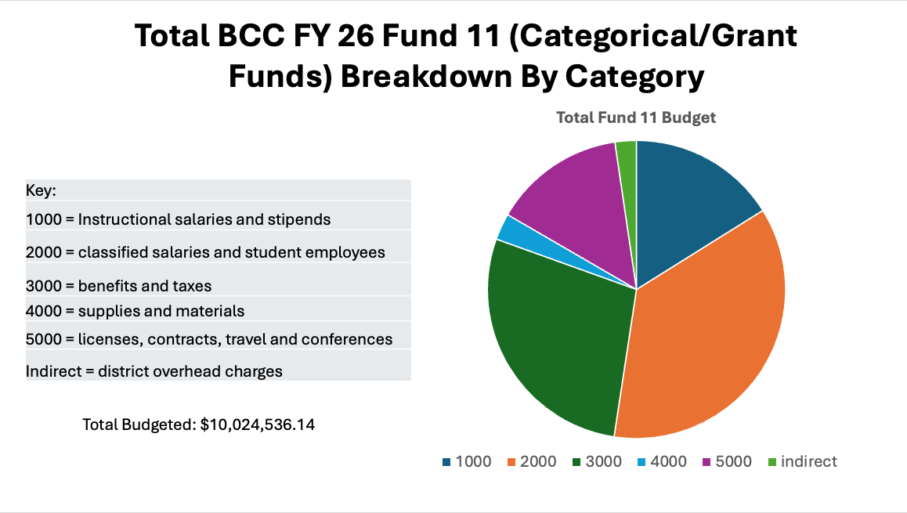

Slide 4
Coming Soon
How to look for grants
Districtwide Subscriptions (untapped Resources)
Salary Savings: Department Chair Release Time

Slide 5
Phoumy Sayavong APU Presentation

Slide 6
Announcements
VPI Lewis Retirement Party tomorrow 12/10/2025

