Slide 1
SUMMARY of CVC-OEI CONSORTIUM AGREEMENT

Slide 2
What is CVC-OEI?
"The Consortium is comprised of colleges that are committed to participate as teaching and home colleges in the initial implementation of the Online Education Initiative." - Consortium Charter
General Requirements
"The Consortium colleges shall . . . actively promote and deliver online education within the Online Education Initiative." - Consortium Charter
"The Consortium colleges will leverage their existing online course activity and provide resources to assist faculty and colleges in expanding and/or enhancing their existing online course offerings." - Consortium Charter

Slide 3
APPENDIX A: Consortium Participation Requirements
1- General Provisions
1- Use of Canvas Course Management System (CMS)
2- Participate in the CVC Student Exchange
3- Financial Aid Agreement
4- Giving access to the database/IdP set-up and proxy integration (IT department-Antoine)

Slide 4
APPENDIX A: Consortium Participation Requirements
Meet the CVC-OEI Benchmarks for High Quality Inclusive Learning
2- Course Review & Alignment
1- Establish a local POCR process to align courses with the CVC-OEI Rubric
2- Increase the quality of online courses by June 2023
Foundational Benchmarks
Growth Benchmarks
College provides faculty preparation prior to online teaching through Introduction to Teaching with Canvas and Introduction to Online Teaching & Learning courses
Annual growth with a 10% target in the number of online instructors who have earned a badge in one or more of the Online Teaching & Design competencies.
3- Provide Training for Faculty in a Local POCR Process
4- Accessibility: Courses utilize technology and materials that comply with Section 508
College formally adopts the OEI Course Design Rubric.
20% of college’s online courses or sections are aligned to the CVC-OEI Course Design Rubric within two years of establishing a local POCR process.
College establishes a Local Peer Online Course Review (POCR) program that is certified by the CVC-OEI.
Annual growth with a 10% target in the number of college’s online instructors who have earned a badge in Humanizing Online Learning and Equity & Culturally Responsive Online Teaching

Slide 5
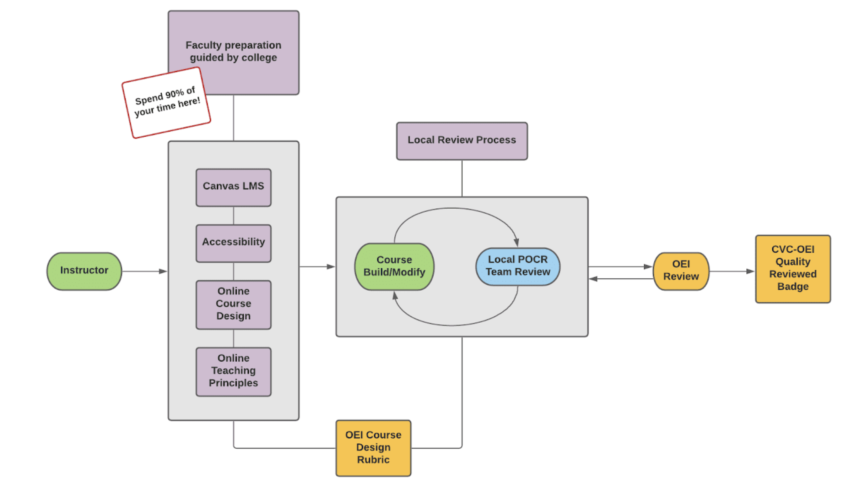
Local POCR Resource Center
Preparation for Local Review Road Map

Slide 6
APPENDIX A: Consortium Participation Requirements
3- Course Offerings
For example; creating classes that helps students have an online pathway to good paying jobs.
1- Incorporate CVC-OEI support services
2- Develop additional online courses that fill the critical gaps outlined by CVC-OEI
Bonnie Peters
CVC_OEI
Head of Student Services
Project Lead/Point of contact can coordinate it with CVC-OEI.

Slide 7
APPENDIX A: Consortium Participation Requirements
4- Consortium Activities & College Consortium Teams
1-Establish a College Consortium Team
a) administrators, faculty, staff
b) Project Lead (for communication between the college and CVC-OEI)
2- Actively participate in CVC-OEI Consortium activities and respond to communications in a timely manner

Slide 8
APPENDIX A: Consortium Participation Requirements
5- Cessation
2- Upon cessation of participation in the CVC-OEI Consortium, College is no longer eligible to receive CVC-OEI funded resources.
1-Failure to meet any provisions stated in Sections 1-4 may result in termination of this agreement.

Slide 9
Benefits as a Participating (Home and Teaching) College
Increase student enrollment
Students are eligible to take up two courses from a participating college
Flexibility for course offerings allows for creativity in scheduling
6 or 8 week rolling courses
Access to Subsidized Technologies and Services
Negotiated Rates for Non-Subsidized Technologies and Services
Participation in statewide Research Projects
Trainings and resources to support Local POCR

Slide 10
Distance Education Infrastructure
CVC consortium
2 year benchmarks
Goals
Connected to the Strategic Plan and DE Plan
POCR
(Peer Online Course Review)
Accessibility
Assessment
Professional Development
Instructional Designer
Trainings for AP 4105
LTI Trainings
Student DE support/ embedded tutors
Teaching and Learning Center
Curriculum

