Slide 1
Lecture-1
By the end of this lecture, students will be able to:
  Describe the scientific method, and differentiate fact/observations, hypotheses, theories and laws;
  Classify matter into element, compound, homogeneous and heterogeneous mixtures;
  Describe physical and chemical properties and changes;
  Identify units in the metric system and the SI units;
  Define random and systematic errors, accuracy and precision;
  Write numbers in the decimal form and in scientific notation;

Slide 2
Lecture-2
By the end of this lecture, students will be able to:
  Distinguish exact and uncertain numbers;
  Correctly represent uncertainty in quantities using significant figures;
  Apply proper rounding rules in computation;
  Use conversion factors in dimensional analysis;
  Perform conversion of temperature units between Celsius, Fahrenheit and Kelvin;
  Perform calculations involving mass, volume and density

Slide 3
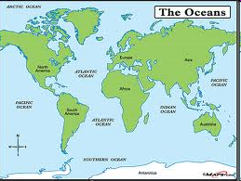
Water, Water Everywhere

Slide 4
The Three States of Water
Macroscopic and Microscopic Views

Slide 5
Where does Chemistry fit in?
Chemistry provides the links between the macroscopic world and the microscopic particles of atoms and molecules.
It is relevant to all form of scientific studies.

Slide 6
Roles of Chemistry

Slide 7
The Central Science
Chemistry is the study of the properties of matter and changes they undergo.
It is central in all scientific studies.
It is essential in the understanding of nature;

Slide 8
What is Matter?
The materials of the universe
− anything that has mass and occupies space

Slide 9
Classification of Matter

Slide 10
Classification of Matter
Mixture: has variable composition
Homogeneous mixture:
  One that has uniform appearance and composition throughout;
Heterogeneous mixture:
  One that has neither uniform appearance nor composition – the composition in one part of the mixture may differ from those of other parts;
Pure Substance: has a fixed composition

Slide 11
Pure Substance
Element:
  Composed of only one type of atoms – it cannot be further reduced to simpler forms.
Compound:
  Composed of atoms of at least two different elements combined chemically in a fixed ratio; it may be reduced into simpler forms or into its elements.

Slide 12
Some Examples
Elements: carbon, oxygen, iron, copper, argon, etc.
Compounds: pure water, carbon dioxide, sugar, salt (sodium chloride), etc.
Homogeneous mixtures: air, gasoline, oil tap water, mineral water, soda drinks, etc.
Heterogeneous mixtures: sand, soil, coffee beans, jelly beans, chunky peanut butter; muddy water, etc.

Slide 13
What Type of Changes Matter Undergoes?
Physical or Chemical?
Physical Change:
  A process that alters only the states of substances, but not their fundamental compositions.
Chemical Change:
  A process that alters the fundamental compositions of the substance and their identity.

Slide 14
Physical Changes
  Examples:
  Melting: solid becomes liquid;
  Freezing: liquid becomes solid;
  Evaporation: liquid becomes vapor;
  Condensation: vapor becomes liquid;
  Sublimation: solid becomes vapor;
  Dissolution: solute dissolves.

Slide 15
Chemical Changes
Examples:
Combustion (burning),
Decomposition,
Rotting,
Fermentation,
Rancidity,
Corrosion/rusting,
Any type of chemical reactions

Slide 16
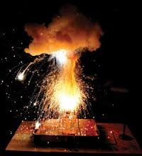
Chemical Reaction

Slide 17
Study of Matter & Changes
In chemistry you will study:
The physical and chemical properties of matter at macroscopic and microscopic levels;
the different states of matter;
factors that determine their physical and chemical properties, as well as their stability.

Slide 18
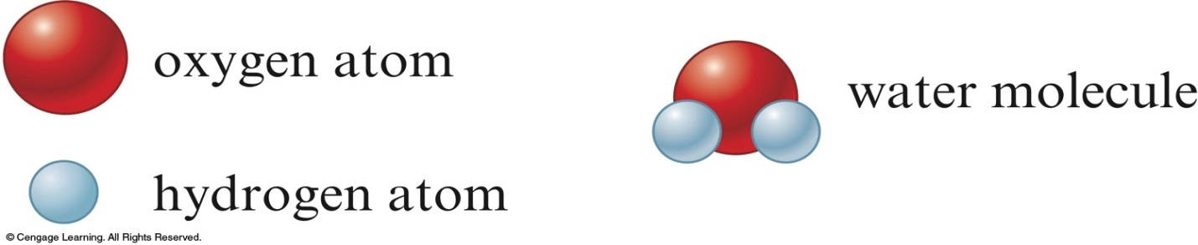
Atoms vs. Molecules
Matter is composed of tiny particles called atoms.
Atoms are smallest part of elements that retain the chemical properties of the elements.
Molecules units of substances, each contains two or more atoms bound (bonded) together and acts as a unit.
Molecules of an element contains identical atoms; molecules of a compound contains atoms of different elements.

Slide 19
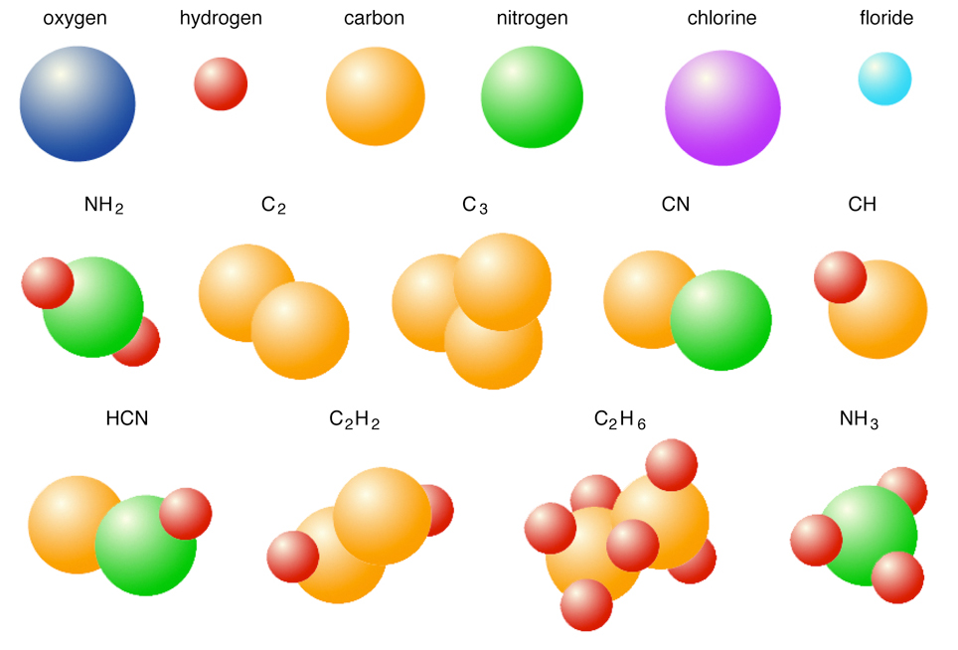
Don’t Believe Atoms
They make up everything!

Slide 20
Simple and Complex Molecules

Slide 21
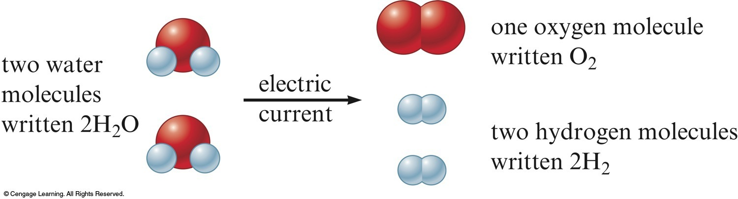
Chemical Reaction
A process that alters the fundamental composition and identity of the substance;
Electrolysis converts water into hydrogen and oxygen gas;
Burning candle changes wax into H₂O and CO₂;

Slide 22
Electrolysis is a Chemical Process

Slide 23
Roles of Scientists
Scientists continuously challenge our current beliefs about nature, and always:
  asking questions about what we have already known;
  testing our current knowledge about everything, either to confirm what already know or to gain new insight.

Slide 24
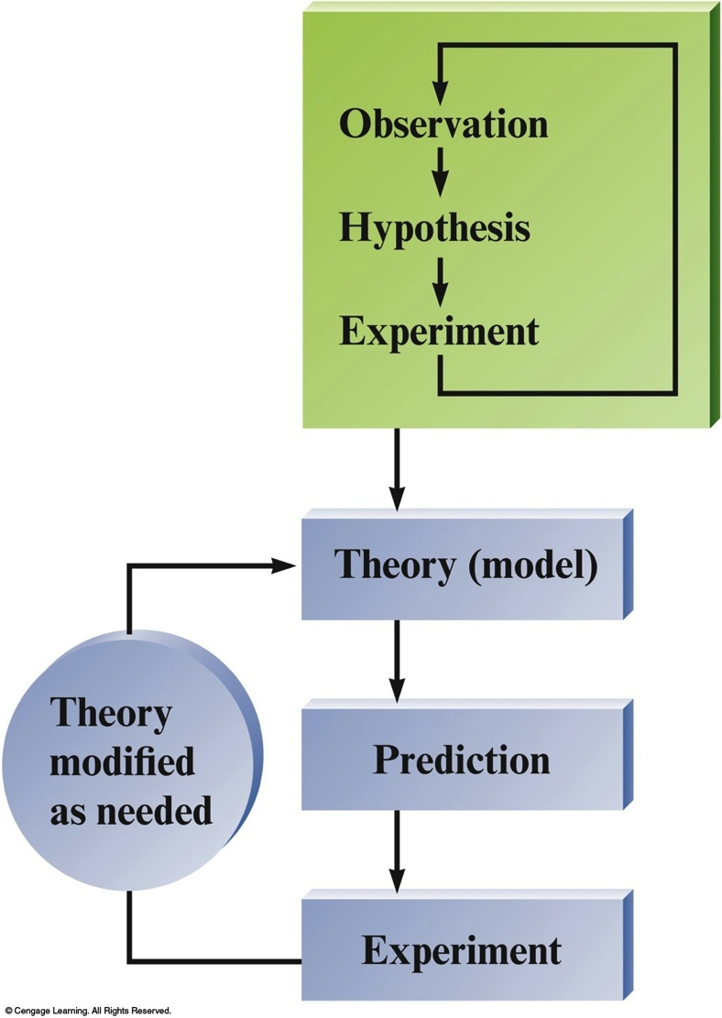
The Process:
The Scientific Method

Slide 25
Fundamental Steps in Scientific Method
Make an observations and collect data;
Develop a hypothesis based on available data;
Test the hypothesis
  (Make prediction & perform experiments)
Collect and analyze more data to support hypothesis
Summarizing the results:
    Tested hypotheses become Theory.
    Observation of natural behavior of nature becomes Scientific Law;

Slide 26
The Scientific Method

Slide 27
Terms in the Scientific Method
Hypothesis:
  a tentative explanation for an observation.
Theory:
  a set of (tested) hypotheses that gives an overall explanation of some natural behavior.
Scientific Law:
  a concise statement (or a mathematical formula) that summarizes repeatable observed or measurable behavior of nature.

Slide 28
Measurements and Units
  Measurement
Quantitative observations consist of:
  Number & Units
  (without unit, values become meaningless)
Examples:
  65 kg (kilogram; unit that implies mass)
  4800 km (kilometer; unit implies distance)
  3.00 x 10⁸ m/s
  (meter per second; unit implies speed)

Slide 29
Measurements
The Number System
Decimal form:
  384,400
  0.08206
Scientific Notation:
  3.844 x 10⁵ (NOT 384.4 x 10³)
  8.206 x 10⁻²

Slide 30
Meaning of 10^{n} and 10^{-n}
The exponent 10^{n} :
  if n = 0, 10⁰ = 1;
  if n > 0, 10^{n} > 1;
  Examples: 10¹ = 10; 10² = 100; 10³ = 1,000;
The exponent 10^{-n} :
  if n > 1, 10^{-n} < 1;
  Examples: 10⁻¹ = 0.1; 10⁻² = 0.01; 10⁻³ = 0.001

Slide 31
Units
Units give meaning to numerical values.
  Without Unit With Units
  384,400 ? 384,400 km (implies very far)
  384,400 cm (not very far)
  144 ? 144 eggs (implies quantity)
  0.08206 ? 0.08206 ^{L.atm}/_{(K.mol)}
  (No meaning)

Slide 32
English Units
  Mass: ounce (oz.), pound (lb.), ton;
  Length: inches (in), feet (ft), yd, mi., etc;
  Volume: pt, qt, gall., in³, ft³, etc.;
  Area: in², ft², yd², mi², acre, hectare.

Slide 33
Metric Units
  Mass: gram (g): kg, mg, μg, ng;
  Length: meter (m): cm, mm, km, μm, nm, pm;
  Area: cm², m², km²
  Volume: L, mL, μL, dL, cm³, m³;
  (1 cm³ = 1 mL; 1 m³ = 10³ L)

Slide 34
Fundamental SI Units
Physical Quantity Name of Unit Abbreviation
  Mass kilogram kg
  Length meter m
  Time second s
  Temperature Kelvin K
  Amount of substance mole mol
  Energy Joule J
  Electrical charge Coulomb C
  Electric current ampere A

Slide 35
Prefixes in the Metric System
Prefix Symbol 10^{n} Decimal Forms
Giga G 10⁹ 1,000,000,000
Mega M 10⁶ 1,000,000
kilo k 10³ 1,000
deci d 10⁻¹ 0.1
centi c 10⁻² 0.01
milli m 10⁻³ 0.001
micro μ 10⁻⁶ 0.000,001
nano n 10⁻⁹ 0.000,000,001
pico p 10⁻¹² 0.000,000,000,001
—————————————————————

Slide 36
Mass and Weight
Mass is a measure of quantity of substance;
Mass does not vary with condition or location.
Weight is a measure of the gravitational force of attraction exerted on an object;
Weight varies with location if the gravitational force changes.
(Earth gravitational constant is 9.8 m/s² ; moon gravitational constant is 1.625 m/s².

Slide 37
Types of Errors in Measurements
Random errors
  values have equal chances of being high or low;
  magnitude of error varies from one measurement to another;
  error may be minimize by taking the average of several measurements of the same kind.

Slide 38
Errors in Measurements
Systematic errors
  Errors due to faulty instruments;
  reading is either higher or lower than the correct values;
  the magnitude of error is the same, regardless of quantity measured;
  For balances, systematic errors can be eliminated by weighing by difference.

Slide 39
Accuracy and Precision in Measurements
Accuracy
  Agreement of an experimental value with the “true” or accepted value;
Precision
  Degree of agreement among values of same measurements; reproducibility of experimental results;

Slide 40
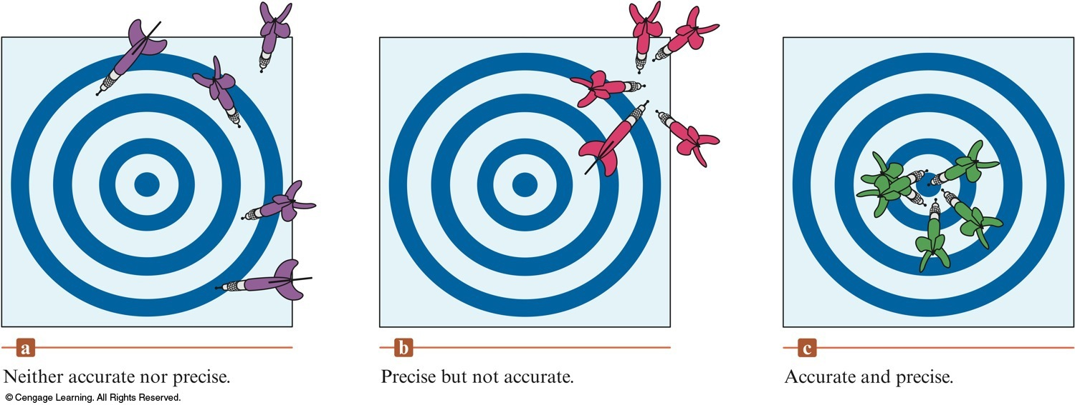
Accuracy and Precision

Slide 41
Accuracy and Precision
In a given set of measurement, accuracy and precision are defined by the type of instrument used.

Slide 42
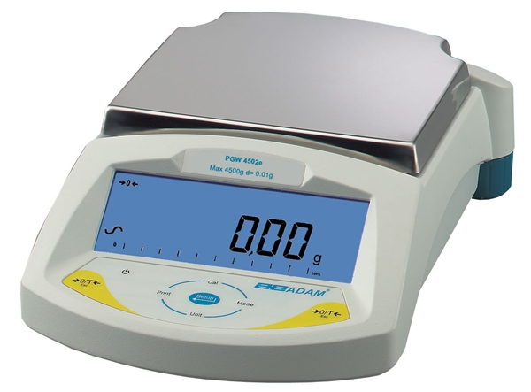
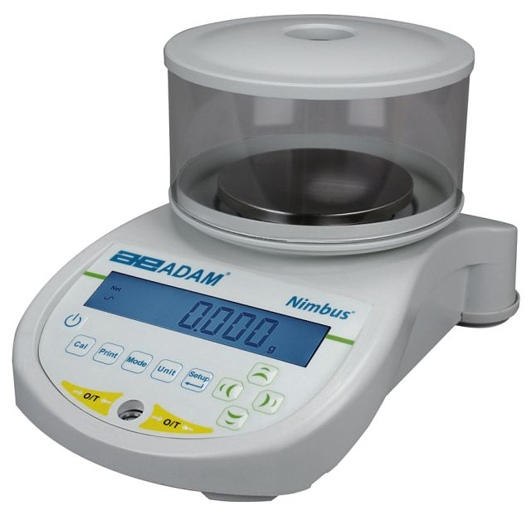
Balances with Different Precisions
Centigram Balance
(precision: ± 0.01 g)
Milligram Balance
(precision: ± 0.001 g)

Slide 43
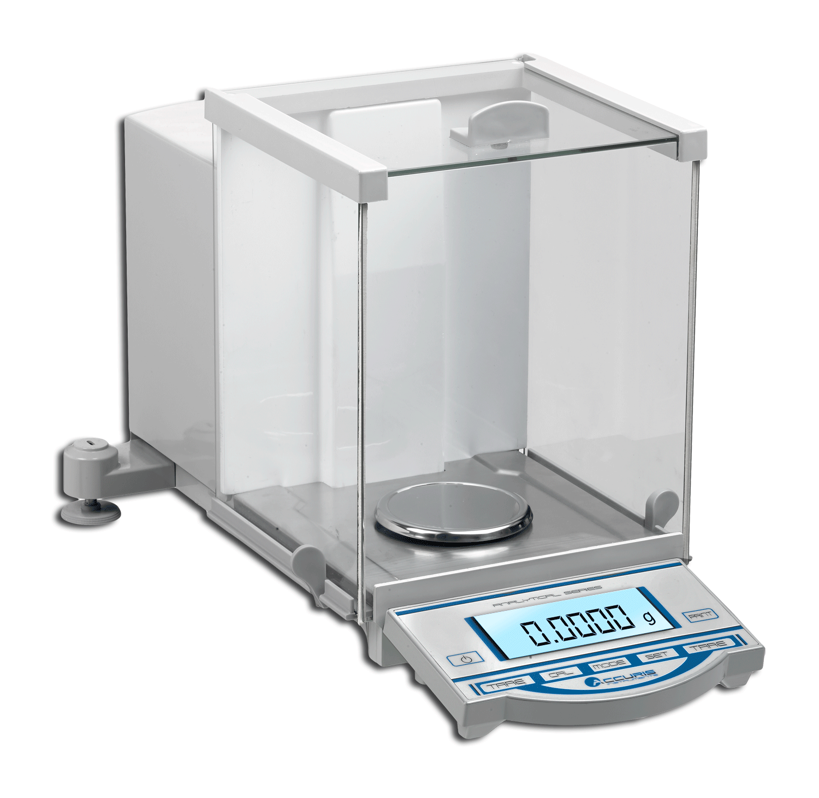
Analytical Balance
(precision: ± 0.0001 g)

Slide 44
Significant Figures
Expressing measured values with degree of certainty;
For examples:
    Mass of a penny on a centigram balance = 2.51 g;
    (Absolute error on measurement = 0.4%)
    Mass of same penny on analytical balance = 2.5089 g;
  (Absolute error on measurement = 0.004%)
  Analytical balance gives the mass of penny with 5 significant figures, implying a higher precision; the centigram balance yields the mass of the same penny with 3 significant figures, implying a lower precision.

Slide 45
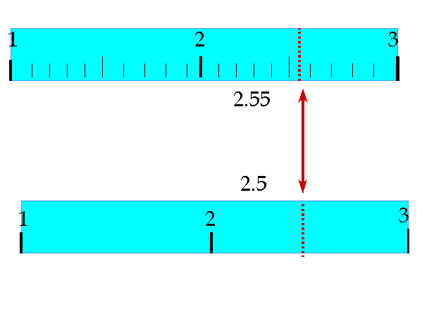
How many significant figures are shown in the following measurements?

Slide 46
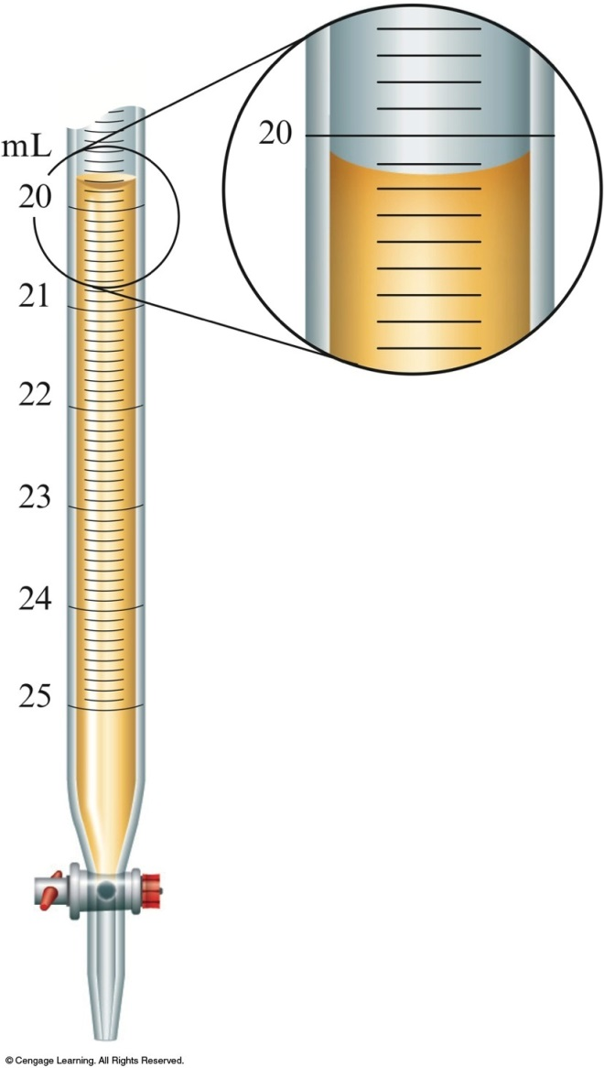
What is the buret reading shown in the diagram?
Reading liquid volume in a buret;
Read at the bottom of meniscus;
Suppose meniscus is read as 20.15 mL:
  Certain digits: 20.15
  Uncertain digit: 20.15
Buret readings must be recorded with 2 decimal digits, as shown above.

Slide 47
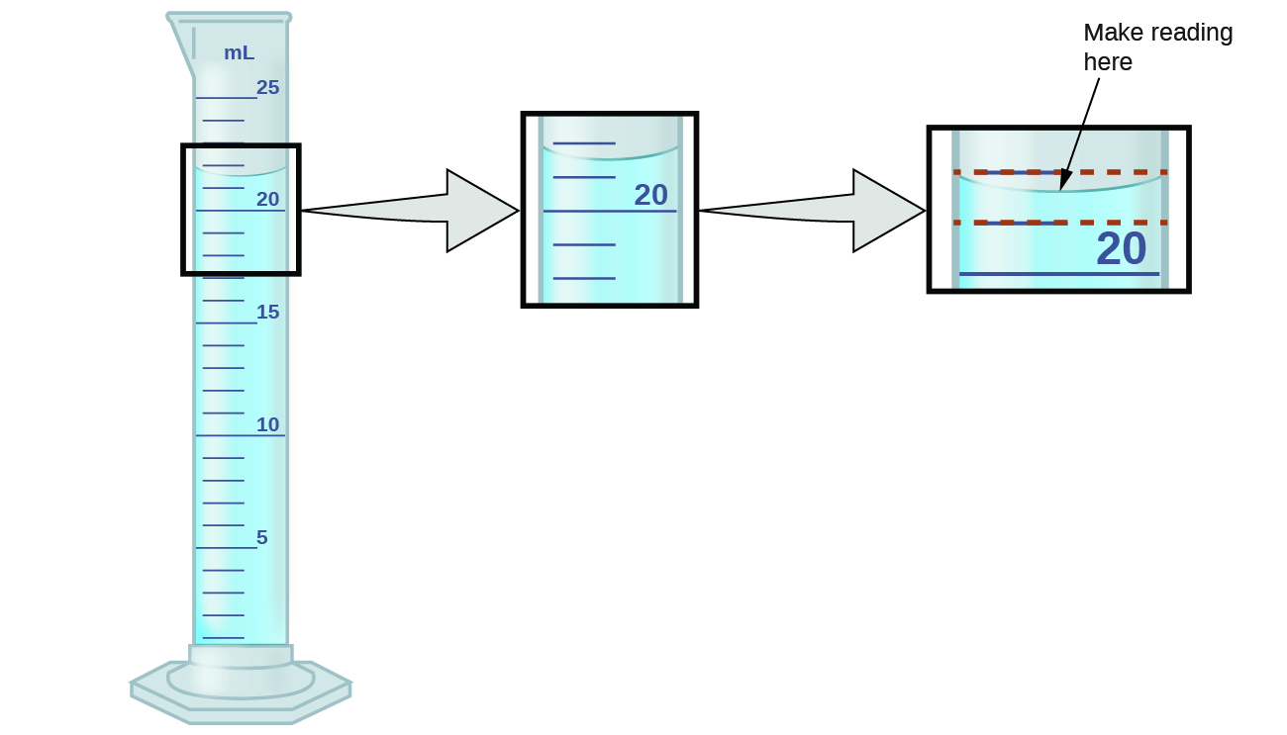
What is the volume of liquid in the graduated cylinder?

Slide 48
Rules for Counting Significant Figures
All nonzero integers are significant figures;
  Examples:
  453.6 has four significant figures;
  4.48 x 10⁵ has three significant figures;
  0.00055 has two significant figures.

Slide 49
Rules for Counting Significant Figures
2. Captive zeroes – (zeroes between nonzero digits)
are significant figures.
  Examples:
  1.079 has four significant figures;
  1.0079 has five significant figures;
  0.08206 has four significant figures.

Slide 50
Rules for Counting Significant Figures
Leading zeroes – (zeroes preceding nonzero digits)
are NOT counted as significant figures.
  Examples:
  0.00055 has two significant figures;
  0.082059 has five significant figures;

Slide 51
Rules for Counting Significant Figures
4. Trailing zeroes – (zeroes at the right end of a value) are significant in all values with decimal points, but not in those values without decimal points.
  Examples:
  208.0 has four significant figures;
  2080. also has four significant figures, but
  2,080 has three significant figures, and
  2,000 has only one significant figure.

Slide 52
Rules for Counting Significant Figures
5. Exact numbers – numbers given by definition, or those obtained by counting.
They have infinite number of significant figures; meaning the value has no error.
Examples:
1 yard = 36 inches; 1 inch = 2.54 cm (exactly);
there are 24 eggs in the basket;
this class has 60 students enrolled;
(There are 35,600 spectators watching the A’s game at the Coliseum is not an exact number, because it is an estimate.)

Slide 53
Exercise-#1: How many significant figures?
0.00239
0.082060
1.050 x 10⁻³
100.40
168,000
1 mile = 1760 yards
1 yard = 0.9144 m
That basket contains 24 apples;
14,850 people watched 2017 Wimbledon final between Roger Federer and Martin Cilic.

Slide 54
Rounding off Values in Calculations
In Multiplications and/or Divisions
  Round off the final answer so that it has the same number of significant figures as the value with the least significant figures.
  Examples:
  (a) 9.546 x 3.12 = 29.8 (round off from 29.78352)
  (b) 9.546/2.5 = 3.8 (round off from 3.8184)
  (c) (9.546 x 3.12)/2.5 = 12 (round off from 11.913408)

Slide 55
Rounding off Calculated values
In Additions and/or Subtractions
  Round off the final answer so that it has the same number of digits after the decimal point as the data value with the least number of such digits.
  Examples:
  (a) 53.6 + 7.265 = 60.9 (round off from 60.865)
  (b) 53.6 – 7.265 = 46.3 (round off from 46.335)
  (c) 41 + 7.265 – 5.5 = 43 (round off from 42.765)

Slide 56
Exercise-#2: Rounding off Values
Round off the following values to the number of significant figures indicated in parenthesis.
(a) 0.037421 (to 3 sig. fig.) = ________________
(b) 1.5587 (to 2 sig. fig.) = __________________
(c) 29,979 (to 3 sig. fig.) = __________________
(d) 201,035 (to 4 sig. fig.) = _________________

Slide 57
Exercise-#3: Values consistent with Precision
Express the following quantities using the significant figures that are consistent with the precision (that would imply the state error).
(a) 2.3 ± 0.001 = _______________
(b) 22,500 ± 10 = _______________
(c) 21.45 ± 0.02 = ________________
(d) 0.00549 ± 0.0001 = _____________
(Answer: (a) 2.300; (b) 2.250 x 10⁴; (c) 21.45; (d) 0.0055)

Slide 58
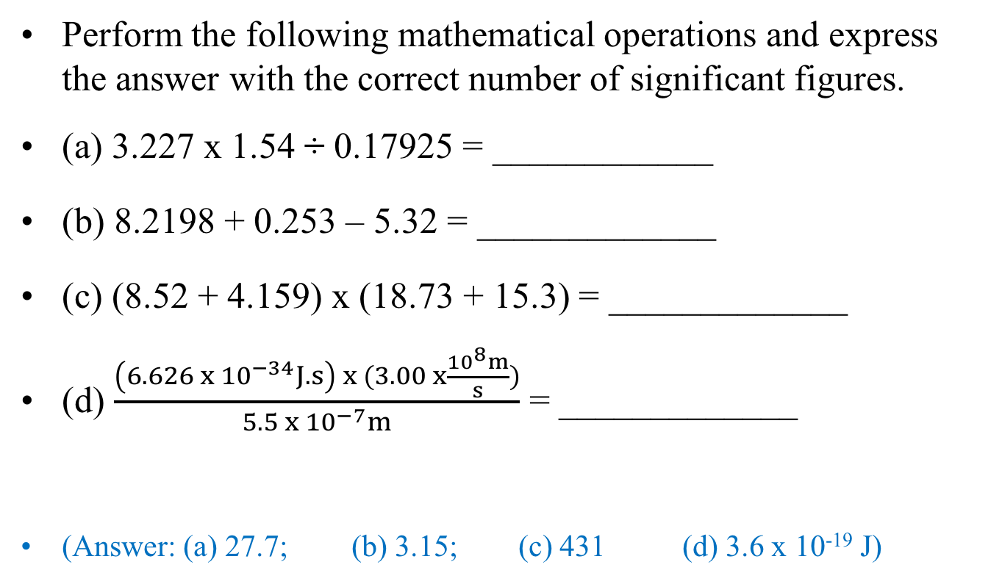
Exercise-#4: Significant Figures
Perform the following mathematical operations and express the answer with the correct number of significant figures.
(a) 3.227 x 1.54 ÷ 0.17925 = ____________
(b) 8.2198 + 0.253 – 5.32 = _____________
(c) (8.52 + 4.159) x (18.73 + 15.3) = _____________
(d) $\frac{\left(6.626 x {10}^{−34}J.s\right) x (3.00 x\frac{{10}^{8}m}{s})}{5.5 x {10}^{−7}m}$ = _____________
(Answer: (a) 27.7; (b) 3.15; (c) 431 (d) 3.6 x 10⁻¹⁹ J)

Slide 59
Mean, Median & Standard Deviation
Mean = average
  Example:
    Consider the following temperature values:
    20.4ºC, 20.6ºC, 20.3ºC, 20.5ºC, 20.4ºC, and 20.2ºC;
    (Is there any outlying value that we can throw away?)
    No outlying value, the mean temperature is:
    (20.4 + 20.6 + 20.3 + 20.5 + 20.4 + 20.2) ÷ 6 = 122.4/6
    = 20.40ºC

Slide 60
Mean, Median & Standard Deviation
Median:
  the middle value (for odd number samples) or
  average of two middle values (for even number)
  when values are arranged in ascending or descending order.
  Arranging the temperatures from lowest to highest:
  20.2ºC, 20.3ºC, 20.4ºC, 20.4ºC, 20.5ºC, and 20.6ºC,
  the median = (20.4ºC + 20.4ºC)/2 = 20.4ºC

Slide 61
Mean, Median & Standard Deviation
Standard Deviation: S = ; (for n < 10)
    (n = sample size; X_{i} = measured value; = mean value)
    [Note: calculated value for std. deviation should have one significant figure only.]
  For above temperatures, S = 0.1; mean = 20.4 ± 0.1 ºC

Slide 62
Calculating Mean Value
Consider the following masses of pennies (in grams):
  2.48, 2.50, 2.52, 2.49, 2.50, 3.02, 2.49, and 2.51;
Is there an outlyer?
  Yes; 3.02 does not belong in the group – can be discarded
Outlying values should not be included when calculating the mean, median, or standard deviation.
Average or mean mass of pennies:
  (2.48 + 2.50 + 2.52 + 2.49 + 2.50 + 2.49 + 2.51) ÷ 7 = 2.50 g;

Slide 63
Calculating Standard Deviation
  _________________________
  -0.02 0.0004
  -0.00 0.0000
  0.02 0.0004
  -0.01 0.0001
  0.00 0.0000
  -0.01 0.0001
  0.01 0.0001___
  Sum: 0.0011
  ------------------------------------------

Slide 64
Mean and Standard Deviation
The correct mean value that is consistent with the precision is expressed as follows:
2.50 ± 0.01

Slide 65
What if outlying values are not obvious?
Perform Q-test on questionable values as follows:
Q_{calc} =
Compare Q_{calc} with Q_{tab} in Table-2 at the chosen confidence level for the matching sample size;
If Q_{calc} < Q_{tab}, the questionable value is retained;
If Q_{calc} > Q_{tab}, the questionable value is can rejected.
(Questionable values: highest and lowest values in a set of data)

Slide 66
Rejection Quotient
Rejection quotient, Q_{tab}, at 90% confidence level
———————————————————
Sample size Q_{tab} ___
4 0.76
5 0.64
6 0.56
7 0.51
8 0.47
9 0.44
10 0.41
——————————

Slide 67
Determining Outlyers using Q-test
Consider the following set of data:
  0.5230, 0.5325, 0.5560, 0.5250, 0.5180, and 0.5270;
Two questionable values are: 0.5180 & 0.5560 (the lowest and highest values in the group)
Perform Q-test at 90% confidence level on 0.5180:
Q_{calc.} = 0.13 < 0.56
(limit at 90% confidence level for sample size of 6)
We keep 0.5180.

Slide 68
Performing Q-test on questionable value
Q_{calc} for 0.5560:
=
Q_{calc.} = 0.618 > 0.56
(Q_{tab} = 0.56 for n = 6 at 90% confidence level)
We reject 0.5560.

Slide 69
Calculate the mean using acceptable values

Slide 70
Calculating Standard Deviation
⎯⎯⎯⎯⎯⎯⎯⎯⎯⎯⎯⎯⎯⎯⎯
0.5230 -0.0028 7.8 x 10⁻⁶
0.5325 0.0067 4.5 x 10⁻⁵
0.5250 -0.0008 6.4 x 10⁻⁷
0.5180 -0.0078 6.1 x 10⁻⁵
0.7270 0.0012 1.4 x 10⁻⁶
Σ = 1.16 x 10⁻⁴

Slide 71
Writing the Mean with Precision
Standard deviation provides the precision of calculated mean; it indicates where uncertainty occurs;
The calculated mean is 0.52580, but standard deviation is ± 0.005; not consistent.
Uncertainty occurs on third decimal placing;
The mean must be rounded off to be consistent with the precision, such as:
    Mean = 0.526 ± 0.005

Slide 72
Mean value must be consistent with the precision
Standard deviation:
  should be rounded off to one significant digit;
  indicates the placing in the mean value where uncertainty begins to appear;
  The mean should be rounded off to include this uncertainty.

Slide 73
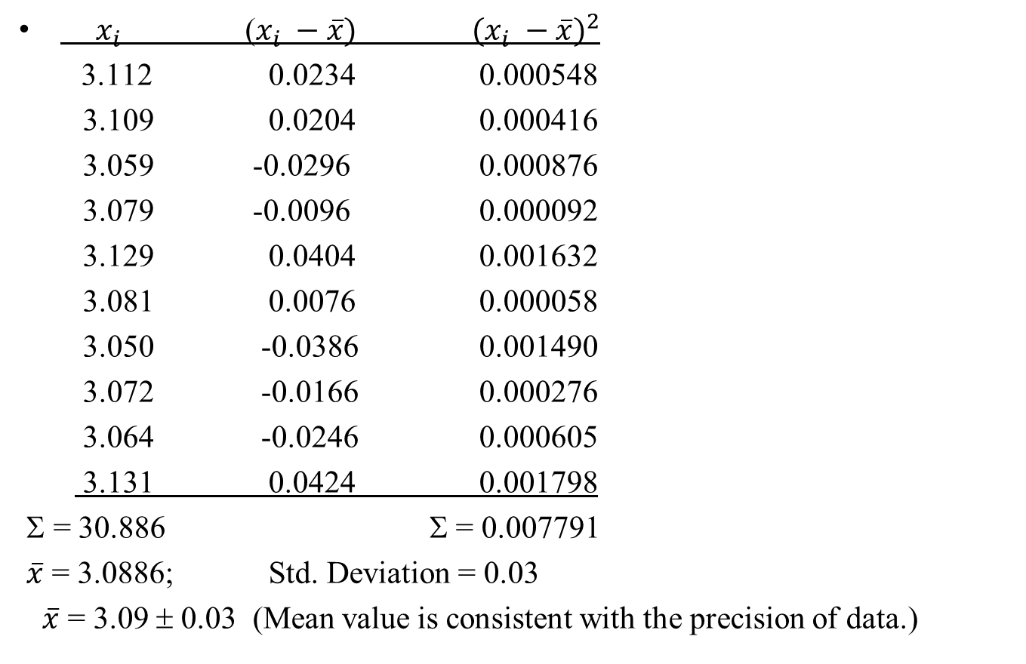
Data Table for Standard Deviation
$x_{i}$ ($x_{i} −\overline{x})$ ${(x_{i} −\overline{x})}^{2}$
  3.112 0.0234 0.000548
  3.109 0.0204 0.000416
  3.059 -0.0296 0.000876
  3.079 -0.0096 0.000092
  3.129 0.0404 0.001632
  3.081 0.0076 0.000058
  3.050 -0.0386 0.001490
  3.072 -0.0166 0.000276
  3.064 -0.0246 0.000605
  3.131 0.0424 0.001798
Σ = 30.886 Σ = 0.007791
$\overline{x}$ = 3.0886; Std. Deviation = 0.03
$\overline{x}$ = 3.09 ± 0.03 (Mean value is consistent with the precision of data.)

Slide 74
Problem Solving by Dimensional Analysis
Value sought = value given x conversion factor(s)
Example:
What is 26 miles in kilometers? (1 mi. = 1.609 km)
Value sought: ? km; value given = 26 miles;
conversion factor: 1 mi. = 1.609 km
? km = 26 mi. x (1.609 km/1 mi.) = 41.834 km
Final answer = 42 km (rounded off to 2 sig. fig.)

Slide 75
Exercise-#5: Unit Conversion
1. Express 26 miles per gallon (mpg) to kilometers per liter (kmpL).
  (1 mile = 1.609 km and 1 gallon = 3.7854 L)
2. The speed of light is 3.00 x 10⁸ m/s; what is the speed in miles per hour (mph)?
  (1 km = 1000 m; 1 hour = 3600 s)
(Answer: (1) 11 kmpL; (2) 6.71 x 10⁸ mph)

Slide 76
Exercise-#6: Mean and Standard Deviation
A student weighed 12 pennies on a balance and recorded the following masses:
  3.112 g 3.109 g 3.059 g 2.518 g 3.079 g 3.129 g
  3.081 g 2.504 g 3.050 g 3.072 g 3.064 g 3.131 g;
  Are there outliers among the masses of pennies?
  Calculate the mean mass of pennies and the standard deviation excluding the outliers. Write the mean mass with precision.
(Answer: (a) 2.518 g and 2.504 g are outliers;
  (b) mean with precision = 3.09 ± 0.03 g; std. deviation = 0.03 g)

Slide 77
Density
  (Mass = volume x density; Volume = mass/density)
Units: g/mL or g/cm³ (for liquids or solids)
g/L (for gases)
SI unit: kg/m³

Slide 78
Determining Volumes
Rectangular objects: V = length x width x thickness;
Cylindrical objects: V = πr²l (or πr²h);
Spherical objects: V = (⁴/₃)πr³
Liquid displacement method:
  the volume of object submerged in a liquid is equal to the volume of liquid displaced by the object.

Slide 79
Volume by Displacement Method

Slide 80
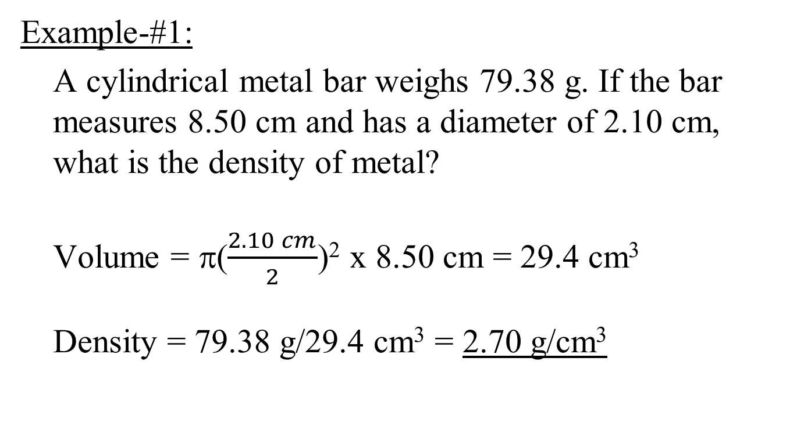
Density Determination
Example-#1:
A cylindrical metal bar weighs 79.38 g. If the bar measures 8.50 cm and has a diameter of 2.10 cm, what is the density of metal?
Volume = π($\frac{2.10 cm}{2}$)² x 8.50 cm = 29.4 cm³
Density = 79.38 g/29.4 cm³ = 2.70 g/cm³

Slide 81
Density Determination
Example-#2:
A 100-mL graduated cylinder is filled with 35.0 mL of water. When a 45.0-g sample of zinc pellets is poured into the graduate, the water level rises to 41.3 mL. Calculate the density of zinc.
Volume of zinc pellets = 41.3 mL – 35.0 mL = 6.3 mL
Density of zinc = 45.0 g/6.3 mL = 7.1 g/mL (7.1 g/cm³)

Slide 82
Exercise-#7: Density Calculation #1
The mass of an empty flask was 64.25 g. When filled with water at 20 ºC, the combined mass of flask and water was 91.75 g. When the water in the flask was replaced with the same volume of an alcohol, the combined mass of flask and alcohol was 85.90 g. (a) If we assume that the density of water is 0.998 g/mL, what was the volume of water in the flask? (b) What is the density of alcohol? (c) Express density in SI unit.
(Answer: (a) 27.6 mL; (b) 0.786 g/mL; (c) 786 kg/m³)

Slide 83
Exercise-#8: Density Calculation #2
A 50-mL graduated cylinder weighs 41.30 g when empty. When filled with 30.0 mL of water, the combined mass is 71.25 g. A piece of metal is dropped into the water in cylinder, which causes the water level to increase to 36.9 mL. The combined mass of cylinder, water and metal is 132.65 g. Calculate the densities of water and metal, respectively.
(Answer: 0.998 g/mL and 8.9 g/mL, respectively)

Slide 84
Temperature
Temperature scales:
  Celsius (ºC)
  Fahrenheit (ºF)
  Kelvin (K)
  Reference temperatures: freezing and boiling point of water:
  T_{f} = 0 ºC = 32 ºF = 273.15 K
  T_{b} = 100 ºC = 212 ºF = 373.15 K

Slide 85
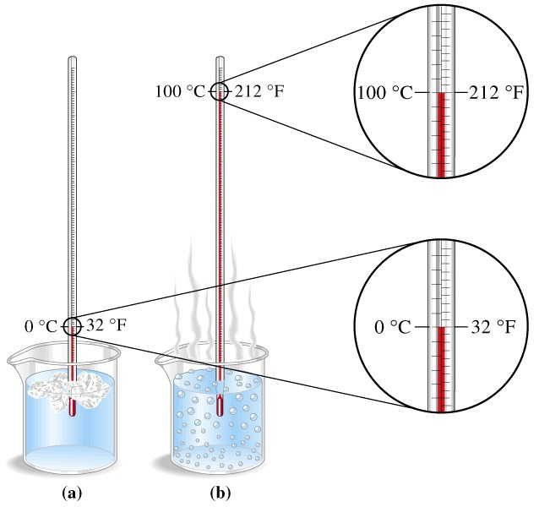
Temperature Conversion

Slide 86
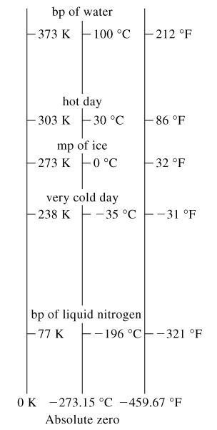
Relative Temperature Scales

Slide 87
Temperature Conversion
Fahrenheit to Celsius:
  Example: convert 98.6ºF to ºC;

Slide 88
Temperature Conversion
Celsius to Fahrenheit:
  Example: convert 25.0ºC to ºF;

Slide 89
Temperature Conversion
Celsius to Kelvin: T ºC + 273.15 = T K
Kelvin to Celsius: T K – 273.15 = T ºC
Examples: convert:
  25.0 ºC to Kelvin = 25.0 + 273.15 = 298.2 K
  310. K to ºC = 310. – 273.15 = 37 ºC

Slide 90
Exercise-#9: Temperature Conversion #1
What is the temperature of 65.0 ºF expressed in degree Celsius and in Kelvin?
The boiling point of liquid nitrogen at 1 atm is 77 K. What is the boiling point of nitrogen in degrees Celsius and Fahrenheit, respectively?
(Answers: (1) 18.3 ºC; 291.5 K;
(2) -196 ºC; -321 ºF)

Slide 91
Exercise-#10: Temperature Conversion #2
Suppose that a new thermometer uses a T-scale that ranges from -50 ºT to 300 ºT. On this thermometer, the freezing point of water is -20 ºT and its boiling point 230 ºT. (a) If this thermometer records a temperature value of 92.5 ºT, what is the temperature in degrees Celsius?
(b) Derive a formula that would enable you to convert a T-scale temperature to degrees Celsius.
Answer: (a) 45.0 ºC
(b)

Slide 92
