Slide 1
Electronic Structures & Period Properties
Electromagnetic Waves and Radiation Energy
Photoelectric Effect
Atomic Spectra of Hydrogen gas and other elements
The Bohr’s Model of H-atom
Quantum Mechanic Model for Electrons in Atoms
Atomic Orbitals and Quantum Numbers
Electron Spin and Pauli Exclusion Principle
Electron Configurations for Multi-electron Atoms
Periodic Trends in Atomic Properties

Slide 2
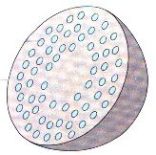
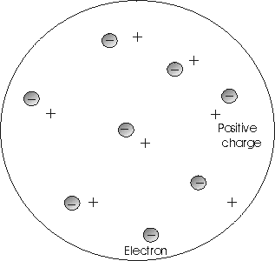
Various Depictions of the Plum Pudding Model (but not so correct)
Notes:
There are many popular depictions of what has come to be known as the “Plum Pudding Model”; a Google images search resulted in many representations like these here, none of them true to Thomson’s actual proposed atomic model.

Slide 3
Atomic Modeling in the Early 20th Century: 1904-1913
Charles Baily
University of Colorado, Boulder
Oct 12, 2008

Slide 4
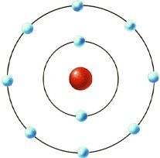
Thomson’s Atomic Model* (1904)
sphere of uniform
positive charge
negatively charged
“corpuscle”
Equal angular intervals
d ~ “atomic dimensions”
* Joseph J. Thomson, “On the Structure of the Atom”
Philosophical Magazine and Journal of Science, Series 6, Vol. 7, No. 39, pp. 237-265
Notes:
In Thomson’s model, atom is composed of a sphere of massless positive charge, within which rings of electrons circulate, with the electrons spaced at equal angular intervals about the ring. The positive charge is such so as to make the atom electrically neutral. Thomson was foremost concerned with the conditions for stability for such an atom. After finding the conditions for dynamic equilibrium, he went on to consider the motions of the electrons about their equilibrium positions due to small disturbances.

Slide 5
Electromagnetic Spectrum

Slide 6
Characteristic of Wave Properties
One-dimensional sinusoidal waves show the relationship between wavelength, frequency, and speed. The wave with the shortest wavelength has the highest frequency. Amplitude is one-half the height of the wave from peak to trough.

Slide 7
Spectrum produced by diffraction of White Light
Notes:
A beam of white light is dispersed into a spectrum of seven visible colors after it passes through a prism. Such dispersion is due to the different lights, depending on their wavelengths and frequencies, are diffracted differently by the prism. Not that the color spectrum is continuous.

Slide 8
What is Electromagnetic Radiation?
Light is a form of Electromagnetic Radiation;
Radiation: energy that propagates through space or vacuum in the form of wave;
The speed of light is constant in a given medium; speed of light in vacuum is approximately, c = 3.00 x 10⁸ m/s;
Speed: c = λν (where λ = wavelength, ν = frequency);
Light with longer wavelength has lower frequency, and one with higher frequency has shorter wavelength.
According to Quantum Theory: Radiation Energy depends only on frequency: E_{ν} = hν
where the Planck constant h = 6.626 x 10⁻³⁴ J.s

Slide 9
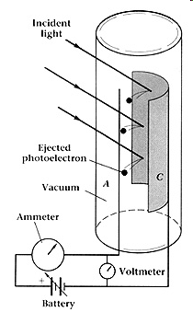
Photoelectric Effect
Photoelectric current

Slide 10
What is Photoelectric Effect?
When light with sufficient energy strikes a metal plate, electrons are ejected;
This creates a potential gradient that causes electrons to flow in a closed circuit, producing a photoelectric current.
Different metals have different work function – threshold or minimum energy value to produce photoelectric effect.
Light with energy values lower than the its work function will not produce photoelectric current.
This work function or threshold energy value is related to the binding energy of electrons on that metal.

Slide 11
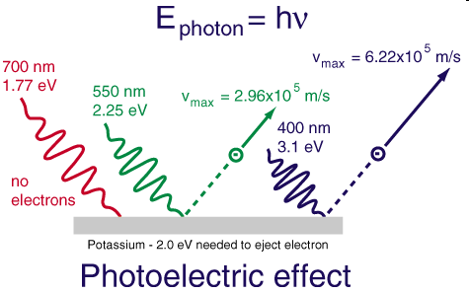
Frequency Dependence of Photoelectric Effect
Light with minimum frequency needed to eject electrons

Slide 12
Photoelectric Voltage & Current
The kinetic energy of ejected electron increases with light frequency:
K.E_{e} = E_{i} – E_{o} (E_{o} = minimum energy)
= hν_{i} – hν_{o} (ν_{o} = minimum frequency)
= hc/λ_{i} – hc/λ_{o} (λ_{o} = longest wavelength)
Velocity of ejected electron: v_{e} = $\sqrt{\text{(2}\text{E}\text{e}\text{/}\text{m}\text{e}\text{)}}$
The photoelectric voltage is directly dependent on the frequency of incident light.
The photoelectric current (the amperes or amps) depends on the intensity of incident light; light with a higher intensity will produce more current (higher amps) as long as its energy is greater than the work function for the metal.

Slide 13
Einstein explanation of the Photoelectric Effect
Light is composed of energy particles called photon;
Photon energy depends only on the light frequency:
E_{p} = hν; (aka “a quantum of energy”)
Total energy per pulse of light, such as laser light = Nhν,
where N = number of photon per pulse;
Energy is quantized: it increases in multiple of whole number;
When light shines on metal surface, its energy is absorbed on one photon (one quantum) per electron basis.
Electrons will be ejected if the photon has energy greater than the metal binding energy. The excess energy becomes the kinetic energy of the ejected electron that translates into electrical voltage.

Slide 14
Continuous and Line Spectra
Compare the two types of emission spectra: continuous spectrum of white light (top) and the line spectra of the light from excited sodium, hydrogen, calcium, and mercury atoms.

Slide 15
Identifying Elements in Crab Nebula
The Crab Nebula consists of remnants of a supernova (the explosion of a star). NASA’s Hubble Space Telescope produced this composite image. Measurements of the emitted light wavelengths enabled astronomers to identify the elements in the nebula, showing that it contains specific ions including S⁺ (green filaments) and O²⁺ (red filaments). (credit: modification of work by NASA and ESA)

Slide 16
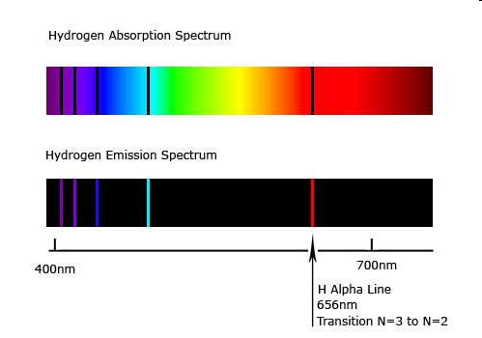
Line or Atomic Spectrum for Hydrogen
Spectrum produced by hydrogen gas contains discrete lines:

Slide 17
Hydrogen Spectrum
Johann Balmer derived the following equation to describe hydrogen spectrum in the visible region:
$\frac{1}{\text{l}}$ = R_{H}(¹/2² – ¹/n²); (R_{H} = 1.097 x 10⁷ m⁻¹ and n > 2)
If n = 3: $\frac{1}{\text{l}}$ = R_{H} (¹/2² – ¹/3²) = 1.524 x 10⁶ m⁻¹ ;
λ = 6.563 x 10⁻⁷ m = 656.3 nm;
If n = 4: $\frac{1}{\text{l}}$ = R_{H} (¹/2² – ¹/4²) = 2.057 x 10⁶ m⁻¹ ;
λ = 4.862 x 10⁻⁷ m = 486.2 nm

Slide 18
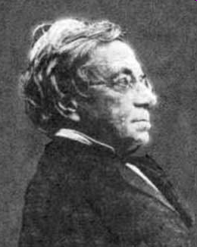
Balmer’s Equation: $\frac{1}{\text{l}}$ = R_{H}($\frac{1}{2^{2}}$ – $\frac{1}{n^{2}}$) (R_{H} = 1.097 x 10⁷ m⁻¹; n = 3, 4, 5,…)
Portrait of Johann Balmer:

Slide 19
General Equations for Hydrogen Spectrum
(1) $\frac{1}{\text{l}}$ = R_{H} ($\frac{1}{m^{2}}$ – $\frac{1}{n^{2}}$); (m > 0; n > m);
Equation (1) yields wavelength (λ) when R_{H} = 1.097 x 10⁷ m⁻¹
(2) ν = R_{H} ($\frac{1}{m^{2}}$ – $\frac{1}{n^{2}}$); (m > 0; n > m);
Equation (2) yields frequency (ν) when R_{H} = 3.289 x 10¹⁵ Hz
For example, if m = 2 and n = 3,
ν = 3.289 x 10¹⁵ Hz ($\frac{1}{2^{2}}$ – $\frac{1}{3^{2}}$) = 4.568 x 10¹⁴ Hz

Slide 20
Spectral Series of Hydrogen Spectrum
Recurring patterns of line spectra for hydrogen also observed in other spectral regions, such as ultraviolet and infrared regions.
Lyman series: spectral lines in ultraviolet region, which are due to electronic transitions from higher energy levels n to level n = 1;
Balmer series: spectral lines observed in the visible region due to electronic transitions from higher energy levels n to level n = 2;
Paschen series: spectral lines in infrared region, due to electronic transitions from higher energy levels n to level n = 3.

Slide 21
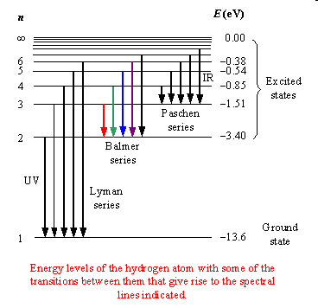
Electronic Transitions in Hydrogen
Electronic transitions that produce different sets of line spectra

Slide 22
Bohr’s Model for Hydrogen
Electron travels around the nucleus in a fixed set of orbits;
Each orbit must satisfies the angular momentum: mvr = n($\frac{h}{\text{2}\text{p}}$);
(n = quantum number: 1, 2, 3, … m = mass of electron; v = speed of electron; r = radius of orbit)
Each orbit represents a stationary state: electron does not gains or lose energy if it stays in the same orbit.
Electronic energy in a given orbit is given by the expression:
E_{n} = -2.18 x 10⁻¹⁸ J($\frac{1}{ \text{n}\text{2}}$ ) (n = 1, 2, 3,…. Z = atomic number)
Electron gains energy when it jumps from an inner to outer orbits, and loses energy when it jumps from an outer to inner orbits;
ΔE = -2.18 x 10⁻¹⁸ J(¹/n_{f}² - ¹/n_{i}²); (n = 1, 2, 3, …)

Slide 23
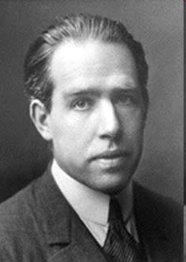
Bohr’s energy levels in hydrogen is defined by: E_{n} = -B($\frac{1}{n^{2}}$); (B = 2.179 x 10⁻¹⁸ J)
Portrait of Niels Bohr:

Slide 24
Quantized energy level in hydrogen atom
Quantum numbers and energy levels in a hydrogen atom. The more negative the calculated value, the lower the energy.

Slide 25
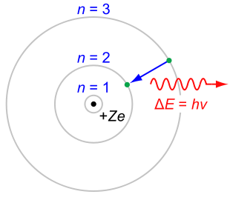
Bohr’s Model for Hydrogen Atom
Electrons occupy discrete orbits of constant energy.
Orbits are described using the mechanic model for particle’s angular motion;
However, the energy change when an electron jumps between different orbitals or stationary states is treated using the quantum concept.
A single photon is emitted or absorbed for each electron transition between orbits

Slide 26
Applying Bohr’s Model to Hydrogen Spectrum
Consider an electron jumping from orbits n = 3 to n = 2:
E₂ = -2.178 x 10⁻¹⁸ J ∙ ($\frac{1}{2^{2}}$) = -5.445 x 10⁻¹⁹ J;
E₃ = -2.178 x 10⁻¹⁸ J ∙ ($\frac{1}{3^{2}}$) = -2.420 x 10⁻¹⁹ J;
ΔE = E₂ – E₃ = -2.178 x 10⁻¹⁸ J($\frac{1}{2^{2}}$ - $\frac{1}{3^{2}}$) = -3.025 x x 10⁻¹⁹ J
Energy lost by an electron is emitted as a single photon with energy, E_{p} = $\frac{hc}{\text{l} }$ = 3.025 x x 10⁻¹⁹ J
λ = $\frac{hc}{E}$ = $\frac{(6.626 x {10}^{−34}J.s)(2.998 x {10}^{8}\frac{m}{s})}{3.025 x {10}^{−19} m)}$ = 6.567 x 10⁻⁷ m = 656.7 nm

Slide 27
Applying Bohr’s Model to Hydrogen Spectrum
Calculated wavelength agrees with observed value of alpha line (red) in the hydrogen spectrum.
When electron jumps from orbit-4 to orbit-2 (n = 4 to n = 2), the calculated wavelength (λ = 486.4 nm) agrees with the beta (blue) line in observed hydrogen spectrum.

Slide 28
Limitation of the Bohr’s Model
Bohr’s model works only for hydrogen atom and other one-electron (hydrogen-like) ionic species, such as He⁺, Li²⁺, etc.
For H-atom, Bohr’s energy is given by:
E_{n} = -2.179 x 10⁻¹⁸ J ∙ ($\frac{1}{n^{2}}$); (n = 1, 2, 3, …)
For other one-electron particle, energy is given by:
E_{n} = -2.179 x 10⁻¹⁸ J ∙ ($\frac{Z^{2}}{n^{2}}$) (Z = atomic number)
Bohr’s model cannot explain atomic spectra of atoms or ions with more than one electron; (equation does not take into consideration the effect electron-electron repulsion.)

Slide 29
Traveling and Standing Waves
Light waves are traveling waves – have infinite values of wavelength and frequency;
Waves on a plucked guitar strings, which depicts vibrating particles, are standing waves – the wave motions limited within the boundary between the two points the string is fixed;
Traveling waves can acquire infinite values of wavelengths – not restricted;
Values of wavelengths for standing waves, such as a vibrating guitar string, are limited by the equation:
λ= ( $\frac{2}{n}$ )L
(L is the length of the part of string that is freely vibrating, or the distance traveled by wave, and n is an integer: 1, 2, 3, …)
The wavelength of a standing wave is quantized – only certain values are possible.

Slide 30
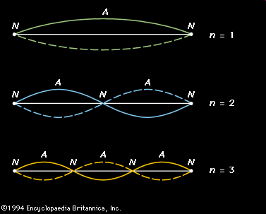
Defined Wavelength for Standing Waves

Slide 31
Applying Standing Wave Concept the Electron Orbit in Bohr’s Atomic Model
If an electron is viewed as a wave circling around the nucleus, an integer number of wavelengths must fit into the orbit for this standing wave behavior to be possible.

Slide 32
Particle-Wave Duality
Louis de Broglie proposed that a traveling particle such as a electron can acquire both particulate and wave-like properties.
de Broglie proposed that a particle with mass m traveling at a speed v will exhibit a wave property with wavelength:
λ = $\frac{h}{mv}$ (h is Planck constant)
For example, an electron (with mass, m_{e} = 9.11 x 10⁻³¹ kg) traveling at 1% the speed of light (i.e. v = 3.00 x 10⁷ m/s) will have a wave character with the following wavelength:
λ = $\frac{(6.626 x {10}^{−34}J.s)}{(9.11 x {10}^{−31}kg)(3.00 x\frac{{10}^{6}m}{s})}$ = 2.42 x 10⁻¹⁰ m = 0.242 nm;
Electron is not orbiting the nucleus in a straight circular path, but it is orbiting the nucleus in wave-like path)

Slide 33
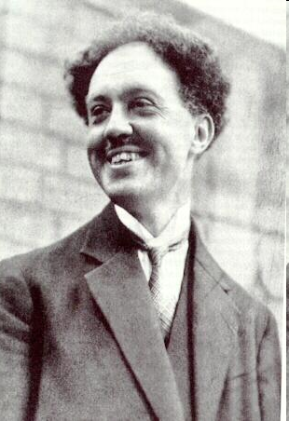
De Broglie’s Equation for wave-particle dual property: λ = $\frac{h}{mv}$; (h = Planck’s constant)
Portrait of Louis de Broglie:

Slide 34
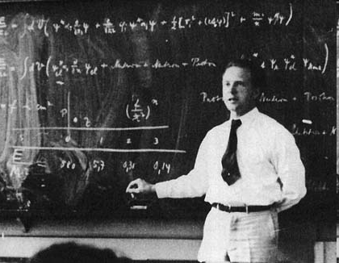
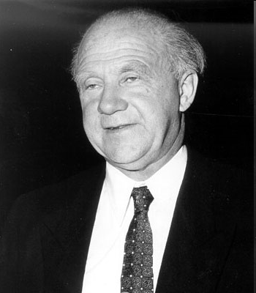
Heisenberg Uncertainty: Δx·Δp ≥ $\frac{h}{4\text{p}}$; (Δx = uncertainty of location; Δp = uncertainty of momentum)
Portrait of Werner Heisenberg:

Slide 35
Heisenberg Uncertainty Principle
It is not possible to determine both the exact location and the energy of an electron in an atom.
According to Heisenberg, if the energy or momentum of a moving electron is accurately determined, the knowledge of its location becomes less precise. This is called the Heisenberg Uncertainty Principle, which is given by the expression:
Δx · (mΔv) ≥ $\frac{h}{\text{4}\text{p}}$
(Δx represents the uncertainty in determining the location and Δv represents the uncertainty in measuring the speed)
According to Heisenberg Uncertainty principle, it is not possible to determine the exact part of an electron orbiting the nucleus as depicted by the Bohr’s model.

Slide 36
Quantum Mechanical Model
Also called wave mechanic model – a concept that treats all motions of particles are wave-like;
Require a new mathematical expression that would satisfy in explaining both the particle and wave properties.
Erwin Schrödinger took the concept of wave-particle duality and Heisenberg uncertainty principle to derived a mathematical formula called wave function, ψ(x,y,z), that describes the energy of electron in atom, but only provides the a probability where the electron might be found, rather than the exact location or path of the electron.
His wave function generates the probability space called orbital.

Slide 37
Schrödinger’s Wave Function, ψ(x,y,z)
Schrödinger’s equation:
($\frac{h^{2}}{8{\text{p}}^{2}m}$)[$\frac{δ^{2}\text{ψ}}{δx^{2}}$ + $\frac{δ^{2}\text{ψ}}{δy^{2}}$ + $\frac{δ^{2}\text{ψ}}{δz^{2}}$] – (Zq₁q₂/r)ψ = Eψ;
This equation has no physical meaning, but the square of the function defines the probability about where an electron with certain energy value might be found.
{ψ(x,y,z)}² = Probability
The sum of the squares of the wave functions yields the probability space called orbital.
Σ{ψ(x,y,z)}² = Orbital

Slide 38
Orbitals
An orbital is a probability space inside atom where we might find an electron with a certain energy value.
An orbital encloses a space where the probability of finding an electron is about 90%;
Each orbital is described by a set of three quantum numbers: n, l, and m_{l} ;
Each quantum number is given a fixed set of values.

Slide 39
Quantum Numbers
A set of three quantum numbers are required to describe an orbital;
The principal quantum number, n, defines an electronic shell; values for n are restricted to positive integers: 1, 2, 3,..∞;
The angular momentum quantum number, l , defines the shape of orbitals; allowed values for l are: 0, 1, 2,…, up to (n – 1);
Each value of l is also assigned a letter symbol as follows:
Values of l: 0 1 2 3 4
Letter symbols: s p d f g
The magnetic quantum number, m_{l}, describes the orientation of orbitals (within a sub-shell) in the Cartesian coordinates (x, y, z); allowed values for m_{l} in a given sub-shell are:
-l, -(l – 1),..-2, -1, 0, 1, 2,...(l – 1), +l;

Slide 40
Other Meanings of Quantum Numbers
The principal quantum numbers (n) also describes the quantum energy levels in an atom;
The angular momentum quantum numbers (l) also describes sub-shells;
The number of sub-shells in a given shell is n:
Shell n = 1 has one subshell = 1s-subshell;
Shell n = 2 has two subshells = 2s- and 2p- subshells;
Shell n = 3, has three subshells = 3s-, 3p-, and 3d- subshells, and so on;
The number of orbitals in a given subshell is determined by the possible values for m_{l}, which is (2l + 1):
Subshell l = 0 has m_{l} = 0; there is one orbital only in subshell l = 0;
Subshell l = 1 has m_{l} = -1, 0, 1; there are 3 orbitals in subshell l = 1;
Subshell l = 2 has m_{l} = -2, -1, 0, 1, 2; ➔ 5 orbitals in subshell l = 1, and so on…
How many orbitals in subshells l = 3 and l = 4?

Slide 41
Quantum Numbers and Orbital Designations
The combination of quantum numbers: n, l, and m_{l}, describes a particular orbital in an atom.
n = 1, l = 0, and m_{l} = 0, ➔ orbital 1s;
n = 2, l = 0, and m_{l} = 0, ➔ orbital 2s;
n = 3, l = 0, and m_{l} = 0, ➔ orbital 3s;
n = 2, l = 1, and m_{l} = -1, ➔ orbital 2p;
n = 2, l = 1, and m_{l} = 0, ➔ orbital 2p;
n = 2, l = 1, and m_{l} = 1, ➔ orbital 2p;
Orbitals with l = 0 have spherical shape, but size increases with higher values of n;
Each orbital-p has two lobes, like a dumb-bell shape, with a nodal plane;
A node is a region of zero probability;

Slide 42
Radial Probability Distribution for 1s in Hydrogen

Slide 43
Probability Diagram for finding electron
The graphs show the probability (y axis) of finding an electron for the 1s, 2s, 3s orbitals as a function of distance from the nucleus.

Slide 44
Radial Probability Distributions for 1s, 2s & 2p in Hydrogen

Slide 45
Radial Probability Distributions of 1s, 2s, 3s, 2p and 3p

Slide 46
Radial Probability Distributions of 3d and 4s

Slide 47
The Shapes of s, p, d, and f Orbitals

Slide 48
Experiment by Stern & Gerlac Led to The Concept of Electron Spins

Slide 49
Electronic Spins in Atom
Electrons with spin values ±1/2 in an external magnetic field.

Slide 50
Quantum Numbers for Orbitals and Electrons
A set of three quantum numbers: n, l, and m_{l}, are required to describe an orbital;
A set of four quantum numbers: n, l, m_{l}, and m_{s}, are required to describe an electron;
The spin quantum number (m_{s}) is assigned value of +½ or -½; this value denotes electron spin direction as either in clockwise or counter-clockwise spin.

Slide 51
Pauli Exclusion Principle
Pauli Exclusion Principle set a limit to the number of electrons in a given orbital;
It states that no two electrons in a given atom should have the same set of the four quantum numbers;
As a consequence of this principle, one orbital can accommodate only two electrons with opposite spins. (Since two electrons occupying the same orbital share the same first three quantum numbers: n, l, m_{l}, their spin quantum number (m_{s}) must be different.)

Slide 52
Relative Energy of Orbitals in Hydrogen and in Multi-electron Atoms
In hydrogen atom the energy of orbitals are defined only by the principal quantum number n.
(Example: 2s and 2p have the same energy; 3s, 3p, and 3d have the same energy.)
While in multi-electron atoms, the energy of orbitals are defined mainly by the principal quantum number n and, to a smaller extent, by the angular momentum quantum number l.
Relative energy of orbitals in multi-electron atoms:
1s < 2s < 2p < 3s < 3p < 4s < 3d < 4p < 5s < 4d < 5p < 6s < 4f < 5d < 6p < 7s < 5f < 6d < 7p.

Slide 53
Relative Energy Levels of Orbitals in Hydrogen

Slide 54
Relative Energy Levels of Orbitals in Multi-electron Atoms
The chart shows the energies of electron orbitals in a multi-electron atom.

Slide 55
Total Number of Electrons in Subshells
The chart indicates the maximum number of electrons each subshell can accommodate: 2 for ns, 6 for np, 10 for nd, and 14 for nf.

Slide 56
Aufbau process for building electron configurations
The arrow leads through each subshell in the appropriate filling order for electron configurations.
This chart is easy to construct and is useful. Simply make a column for all the s orbitals with each n shell on a separate row. Repeat for p, d, and f. Be sure to only include orbitals allowed by the quantum numbers (no 1p or 2d, and so forth). Finally, draw diagonal lines from top to bottom as shown.

Slide 57
The Ground (most stable) State Electron Configurations for Multi-electron Atoms
The Aufbau method suggests that, when building the electron configurations of atoms having more than one electron, orbitals with the lowest energy must be filled first, then the next one;
The maximum number of electrons in an orbital or a subshell must be consistent with the Pauli Exclusion Principle;
Hund’s Rule is followed when assigning electrons to orbitals in the same subshell, such as those in 2p, 3d, or 4f.
That is, when assigning electron to degenerate orbitals (orbitals having the same energy levels), electrons are assigned to each orbital singly with the same spin direction, before the second electron is added.

Slide 58
Electron Configurations for Multi-Electron Atoms
H (Z = 1): 1s¹
He (Z = 2): 1s²
Li (Z = 3): 1s² 2s¹
Be (Z = 4): 1s² 2s²
B (Z = 5): 1s² 2s² 2p¹
C (Z = 6): 1s² 2s² 2p²
N (Z = 7): 1s² 2s² 2p³
O (Z = 8): 1s² 2s² 2p⁴
F (Z = 9): 1s² 2s² 2p⁵
Ne (Z = 10): 1s² 2s² 2p⁶

Slide 59
Electron Configuration for Sodium (long and short-hand forms)
In the short-hand (or abbreviated) form, a noble gas symbol is used to represent the core-electron configuration (right).

Slide 60
Electron Configurations for 3rd Period Elements (using the noble gas abbreviated form)
Na (Z = 11): 1s² 2s² 2p⁶ 3s¹ = [Ne] 3s¹
Mg (Z = 12): [Ne] 3s²
Al (Z = 13): [Ne] 3s² 3p¹
Si (Z = 14): [Ne] 3s² 3p²
P (Z = 15): [Ne] 3s² 3p³
S (Z = 16): [Ne] 3s² 3p⁴
Cl (Z = 17): [Ne] 3s² 3p⁵
Ar (Z = 18): [Ne] 3s² 3p⁶

Slide 61
Orbital Diagrams for 2nd Period Elements
Atoms Orbital Diagram (shows electrons in individual orbitals)
Li: [He] ↑
Be: [He] ↑↓
B: [He] ↑↓ ↑
C: [He] ↑↓ ↑ ↑
N: [He] ↑↓ ↑ ↑ ↑
O: [He] ↑↓ ↑↓ ↑ ↑
F: [He] ↑↓ ↑↓ ↑↓ ↑
Ne: [He] ↑↓ ↑↓ ↑↓ ↑↓
2s -----2p-----

Slide 62
Electron Configurations for Transition Metals using a noble gas symbol for inner shell.
Sc (Z = 21): [Ar] 4s² 3d¹ ([Ar] = 1s² 2s² 2p⁶ 3s² 3p⁶)
Ti (Z = 22): [Ar] 4s² 3d²
V (Z = 23): [Ar] 4s² 3d³
*Cr (Z = 24): [Ar] 4s¹ 3d⁵ (Note: one electron in 4s)
Mn (Z = 25): [Ar] 4s² 3d⁵
Fe (Z = 26): [Ar] 4s² 3d⁶
Co (Z = 27): [Ar] 4s² 3d⁷
Ni (Z = 28): [Ar] 4s² 3d⁸
*Cu (Z = 29): [Ar] 4s¹ 3d¹⁰ (Note: one electron in 4s)
Zn (Z = 30): [Ar] 4s² 3d¹⁰

Slide 63
Orbital Diagrams for The Transition Metals
Sc: [Ar] ↑↓ ↑
Ti: [Ar] ↑↓ ↑ ↑
V: [Ar] ↑↓ ↑ ↑ ↑
Cr: [Ar] ↑ ↑ ↑ ↑ ↑ ↑
Mn: [Ar] ↑↓ ↑ ↑ ↑ ↑ ↑
Fe: [Ar] ↑↓ ↑↓ ↑ ↑ ↑ ↑
Co: [Ar] ↑↓ ↑↓ ↑↓ ↑ ↑ ↑
Ni: [Ar] ↑↓ ↑↓ ↑↓ ↑↓ ↑ ↑
Cu: [Ar] ↑ ↑↓ ↑↓ ↑↓ ↑↓ ↑↓
Zn: [Ar] ↑↓ ↑↓ ↑↓ ↑↓ ↑↓ ↑↓
4s -----------3d------------

Slide 64
Periodic Table

Slide 65
The spdf Blocks of Periodic Table

Slide 66
Main Group Elements

Slide 67
Electron Configurations for Valence-Shells
Elements in the same group have the same valence-shell electron configurations – thus explains the similarity in their properties.
Groups: Electron Configurations
of valence-shell
1A ns¹
2A ns²
3A ns² np¹
4A ns² np²
5A ns² np³
6A ns² np⁴
7A ns² np⁵
8A ns² np⁶

Slide 68
Periodic Trend of Atomic Sizes

Slide 69
Ionization Energy
Energy needed to remove an electron from a gaseous atom:
M(g) + IE → M⁺(g) + e⁻;
(IE = ionization energy)

Slide 70
What is Ionization Energy?

Slide 71
The Periodic Trend of Ionization Energy

Slide 72
First Ionization Energies of Elements
This version of the periodic table shows the first ionization energy of (IE₁), in kJ/mol, of selected elements.

Slide 73
Successive Ionization Energies for Magnesium
Mg(g) → Mg⁺(g) + e⁻; IE₁ = 736 kJ/mol
Mg⁺(g) → Mg²⁺(g) + e⁻; IE₂ = 1445 kJ/mol
Mg²⁺(g) → Mg³⁺(g) + e⁻; IE₃ = 7730 kJ/mol
Notice the large jump in ionization energy between the second (IE₂) and third (IE₃), which is about 9 times the difference between the first (IE₁) and second (IE₂). Can you explain the much larger increase in IE₃ ?

Slide 74
Successive Ionization Energies for 3rd Period Elements
Notice the very large jump in ionization energies at certain points in the ionization process of each element, which represents the trend for that group.

Slide 75
Electron Affinity
It is the energy released when an electron is added to an atom in the gaseous state:
X(g) + e⁻ → X⁻(g) + Energy (EA)

Slide 76
Electron Affinity = Energy released when an electron is added to a gaseous atom
+ Energy

Slide 77
Electron Affinity

Slide 78
Electron Affinity
Electron affinities for the halogen family
EA (kJ/mol)
F(g) + e⁻ → F⁻(g); -328 kJ/mol
Cl(g) + e⁻ → Cl⁻(g); -349 kJ/mol
Br(g) + e⁻ → Br⁻(g); -325 kJ/mol
I(g) + e⁻ → I⁻(g); -295 kJ/mol

Slide 79
Electron Affinity
Electron affinities of oxygen:
O(g) + e⁻ → O⁻(g); ΔHº = EA₁ = -141 kJ/mol
O⁻(g) + e⁻ → O²⁻(g); ΔHº = EA₂ = 878 kJ/mol
⎯⎯⎯⎯⎯⎯⎯⎯⎯⎯⎯⎯⎯⎯⎯⎯⎯⎯⎯⎯
O(g) + 2e⁻ → O²⁻(g); ΔHº = EA = 737 kJ/mol
EA₂ has a positive value, implying that energy is needed to overcome the repulsion force between O⁻ and e⁻ (both are negatively charged).

Slide 80
Electronegativity
The relative ability of bonded atoms to draw (pull) shared electrons closer to its center.

Slide 81
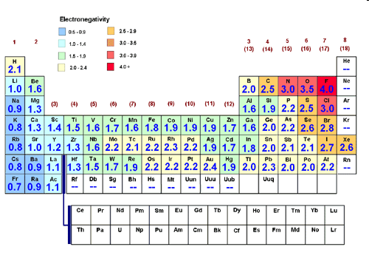
Trend in Electronegativity

Slide 82
Trends of Atomic Properties

Slide 83
Trends in Metallic, Ionic, and Covalent Characters

Slide 84
Exercise-#1: Trends in Atomic Properties
Rank the following element in order of increasing (smallest to largest) atomic radii:
C, N, Mg, Al, and Si;
Li, Na, K, Rb, and Cs;
Si, P, S, Cl, and Ar;

Slide 85
Exercise-#2: Trend in Atomic Properties
Rank the following atoms in order of increasing ionization energy.
Al, Si, P, S, Cl;
Li, Na, K, Rb, Cs;
Al, C, Ca, Mg, N;

Slide 86
Exercise-#3: Trend in Atomic Properties
The energy level for the valence electron in atom A is lower than the corresponding energy level for a valence electron in atom B. Which atom has the higher first ionization energy? Explain.
First ionization energies among main group elements generally increase from left to right across a period. However, boron has first ionization energy that is lower than beryllium (that is, 800 kJ/mol in boron versus 900 kJ/mol in beryllium). Explain this discrepancy.

Slide 87
Exercise-#4: Trends in Atomic Properties
The first ionization energy for a given atom in Group 2 is x. A good estimate for the second ionization energy of this atom is:
Less than x. It is easier to remove the second electron since this will result in an ion that achieves a stable noble gas electron configuration.
About 2x. The second electron is harder to remove than the first electron, because after the first electron is ionized, the size of the resulting ion becomes smaller than the original atom, and this leads to a higher value for the second ionization energy.
(See next slide)

Slide 88
Exercise-#4: Trends in Atomic Properties
(contd)
About “x.” Since the electrons are taken from the same energy level, the ionization energies are about the same.
About “-x.” The ionization energy is exothermic since the Group 2 atoms want to lose two electrons to achieve a noble gas electron configuration.
About “-2x.” The ionization energy is very exothermic since the Group 2 atoms want to lose two electrons to achieve a noble gas electron configuration.

Slide 89
Exercise-#5: Trends in Atomic Properties
Which of the following processes requires the most energy? Explain your choice.
Na(g) → Na⁺(g) + e⁻;
Na⁺(g) → Na²⁺(g) + e⁻;
Mg(g) → Mg⁺(g) + e⁻;
4. Mg⁺(g) → Mg²⁺(g) + e⁻;

Slide 90
Exercise-#6: Trends in Atomic Properties
Refering to the chart on electron affinities, while electron affinity generally increases from left to right across periods in the periodic table, Group 5A(15) elements have lower electron affinities than those in either Group 4A (14) or Group 6A (16). Provide a plausible (logical) explanation.
The electron affinity for main group elements generally decreases from top to bottom going down a group in the periodic table. Yet, chlorine has electron affinity (EA = -349 kJ/mol), which is slightly higher than fluorine (EA = 328 kJ/mol). Explain this discrepancy.

Slide 91
Exercise-#7: Trends in Atomic Properties
Which of the following reactions is expected to release the most energy, and which one is expected to release the lease energy?
O(g) + e⁻ → O⁻(g)
F(g) + e⁻ → F⁻(g)
P(g) + e⁻ → P⁻(g)
Cl(g) + e⁻ → Cl⁻(g)

Slide 92
Exercise-#8: Relative Size of Orbitals
Which is larger, the hydrogen 1s orbital or the Li 1s orbital? Explain.
Which is lower in energy, the hydrogen 1s orbital or the Li 1s orbital? Explain.

Slide 93
Exercise-#9: Trends in Atomic Properties
Going across a row of the periodic table, protons and electrons are added, but atomic size decreases;
For example, in the second period, lithium has the largest atomic radius and fluorine has the smallest.
In going down a group of the periodic table, protons and electrons are also being added, but the atomic size increases;
For example, in Group 1A (the alkali metals), lithium has the smallest atomic radius and francium has the largest.
Explain why such trends are observed.

