Slide 1
Solution Properties
Solution Composition
The Energies of Solution Formation
Factors Affecting Solubility
The Vapor Pressures of Solutions
Boiling-Point Elevation and Freezing-Point Depression
Osmotic Pressure
Colligative Properties of Electrolyte Solutions
Colloids

Slide 2
Various Types of Solutions
Example | State of Solution | State of Solute | State of Solvent
Air, natural gas | Gas | Gas | Gas
Vodka, antifreeze | Liquid | Liquid | Liquid
Brass | Solid | Solid | Solid
Carbonated water (soda) | Liquid | Gas | Liquid
Seawater, sugar solution | Liquid | Solid | Liquid
Hydrogen in platinum | Solid | Gas | Solid

Slide 3
Solubility
The maximum amount of solute that dissolves in a given quantity of solvent to yield a saturated solution at a given temperature.

Slide 4
Saturated Solution
Solution that contains the maximum amount of dissolved solute at a particular temperature.

Slide 5
Supersaturated Solution
One that contains more dissolved solute than the maximum amount it normally has in the saturated solution.

Slide 6
Types of Solute-Solvent Interactions
Ion-dipole Interactions (relative strong)
(Ionic compounds dissolved in water)
Dipole-dipole (relatively strong)
(Polar solutes in polar solvents
Hydrogen bonding (strong)
Example: NH3 in water; HF in CH3OH
London dispersion forces (relatively strong)
Nonpolar solutes in nonpolar solvent – example: oil in gasoline; Br2 in CCl4

Slide 7
Other Types of Solute-Solvent Interactions
Ion-induced dipole (very weak)
Ionic compounds in nonpolar solvent – example: NaCl in gasoline
Dipole-induced dipole (very weak)
Nonpolar solute in polar solvent – example: iodine in water or alcohol
Polar solute in nonpolar solvent – example: sugar in gasoline or hexane.

Slide 8
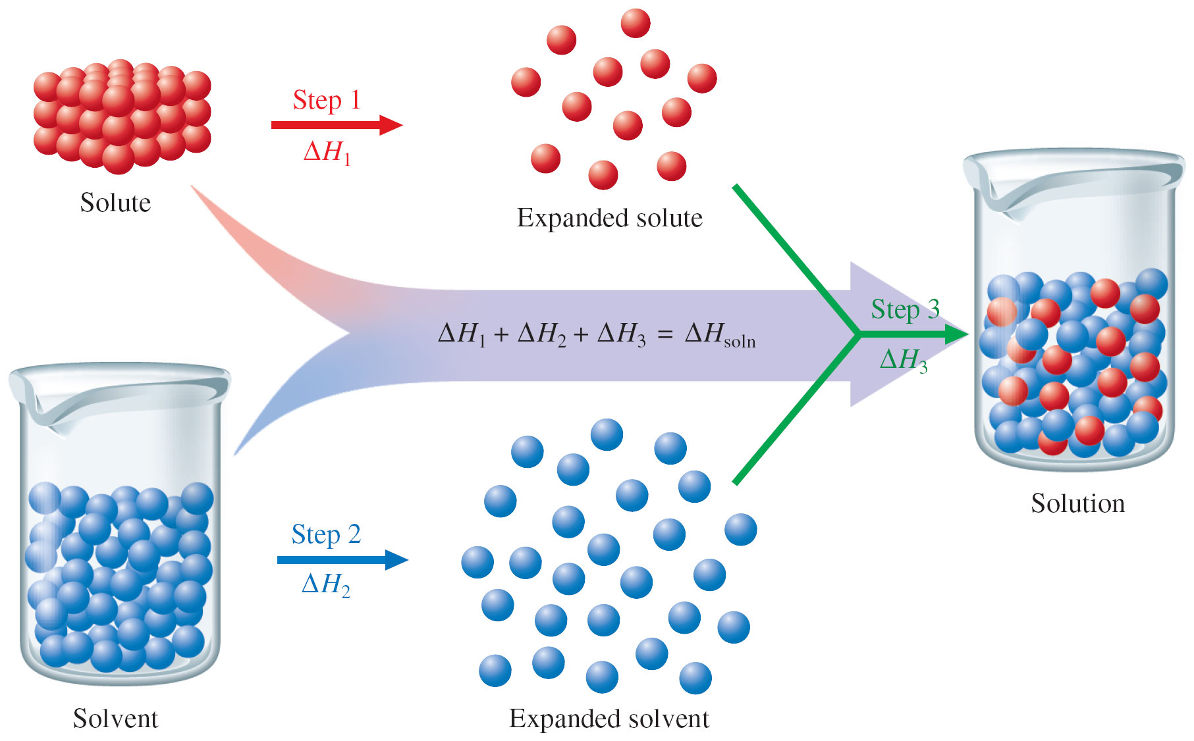
Steps in the Formation of Solutions

Slide 9
Formation of a Liquid Solution
Steps involved:
Separation of solute particles
- an endothermic process (ΔH₁ > 0)
Separation of solvent molecules
- an endothermic process (ΔH₂ > 0)
Mixing of solute and solvent to form the solution
- an exothermic process (ΔH₃ < 0).

Slide 10
Steps in the Dissolving Process
Steps 1 and 2 require energy – energy needed to separate solute and solvent particles.
Intermolecular forces that hold solute and solvent particles.
Step 3 releases energy – interactions between solute and solvent molecules results in energy being released.

Slide 11
Enthalpy of Solution
Enthalpy change associated with the formation of a solution is the sum of ΔH of each steps:
ΔH_{soln} = ΔH₁ + ΔH₂ + ΔH₃
= ΔH_{solute} + ΔH_{solvent} + ΔH_{mixture}
ΔH_{soln} may have a positive sign or a negative sign depends on magnitudes of individual ΔH.

Slide 12
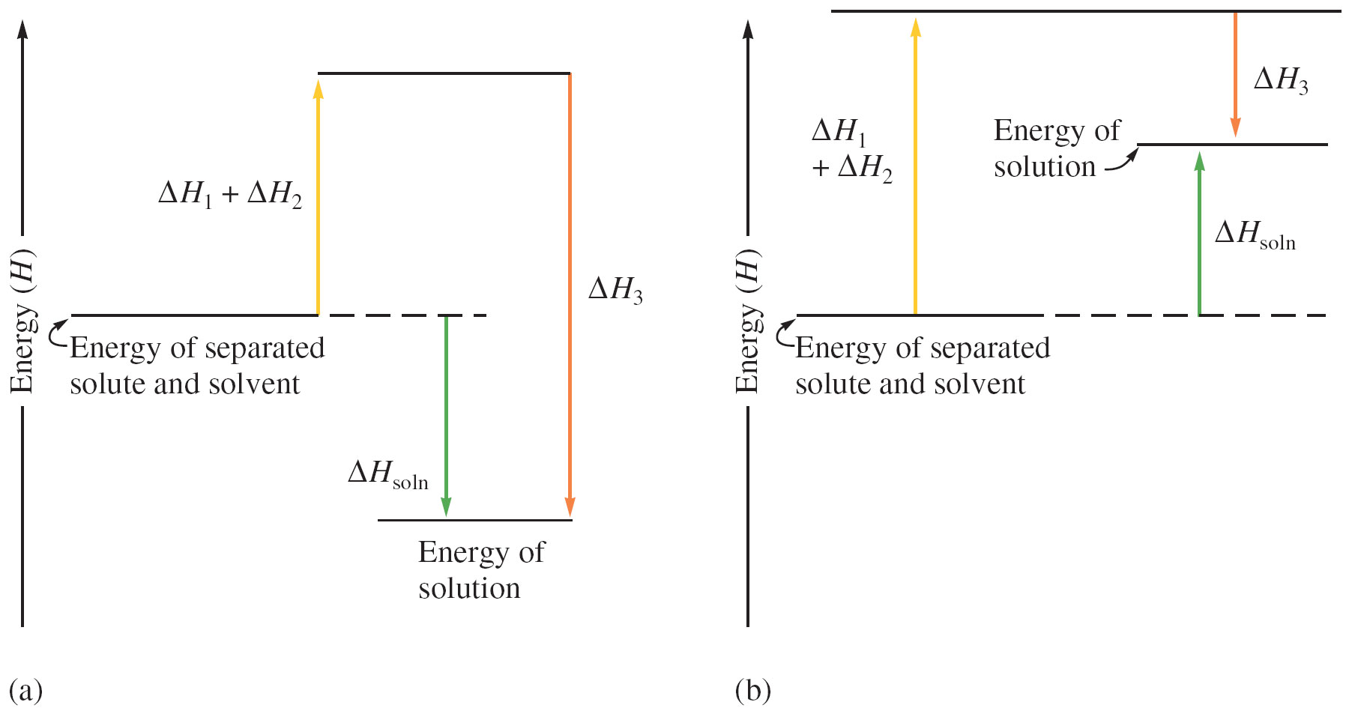
Enthalpy (Heat) of Solution

Slide 13
Concept Check-#1
Explain why water and oil (a long chain hydrocarbon) do not mix. In your explanation, be sure to address how ΔH plays a role.
Notes:
Oil is a mixture of nonpolar molecules that interact through London dispersion forces, which depend on molecule size. ΔH₁ will be relatively large for the large oil molecules. The term ΔH₃ will be small, since interactions between the nonpolar solute molecules and the polar water molecules will be negligible. However, ΔH₂ will be large and positive because it takes considerable energy to overcome the hydrogen bonding forces among the water molecules to expand the solvent. Thus ΔH_{soln} will be large and positive because of the ΔH₁ and ΔH₂ terms. Since a large amount of energy would have to be expended to form an oil-water solution, this process does not occur to any appreciable extent.

Slide 14
Enthalpy of Hydration
ΔH_{hydration} = ΔH_{solvent} + ΔH_{mixing}
ΔH_{solution} = ΔH_{solute} + ΔH_{hydration}
ΔH_{hydration}: M^{n+}(g) + H₂O → M^{n+}(aq)
X^{n-}(g) + H₂O → X^{n-}(aq)
ΔH_{solution} = ΔH_{lattice} + Σ(ΔH_{hydration} )

Slide 15
Enthalpy of Hydration of Some Ions
Ions Ionic R(pm) ΔH_{hydration}(kJ/mol)
Li⁺ 76 -510
Na⁺ 102 -410
Mg²⁺ 72 -1903
Ca²⁺ 100 -1591
Cl- 181 -313

Slide 16
Lattice Energy
LiCl 853 kJ/mol
NaCl 787 kJ/mol
KCl 682 kJ/mol
NaF 923 kJ/mol
NaBr 747 kJ/mol
NaI 704 kJ/mol
MgCl₂ 2524 kJ/mol
MgO 3790 kJ/mol

Slide 17
Factors Affecting Solubility
Molecular Structures:
Polarity – “like dissolves like”
Temperature:
Influence solubility in aqueous solutions
Pressure:
Influence the solubility of gases - Henry’s law

Slide 18
Temperature Effects
Solubility of most solids in water increases with temperature; very few exception.
Solubility of a gas in solvent typically decreases with increasing temperature.
Predicting the temperature dependence of solubility is very difficult.

Slide 19
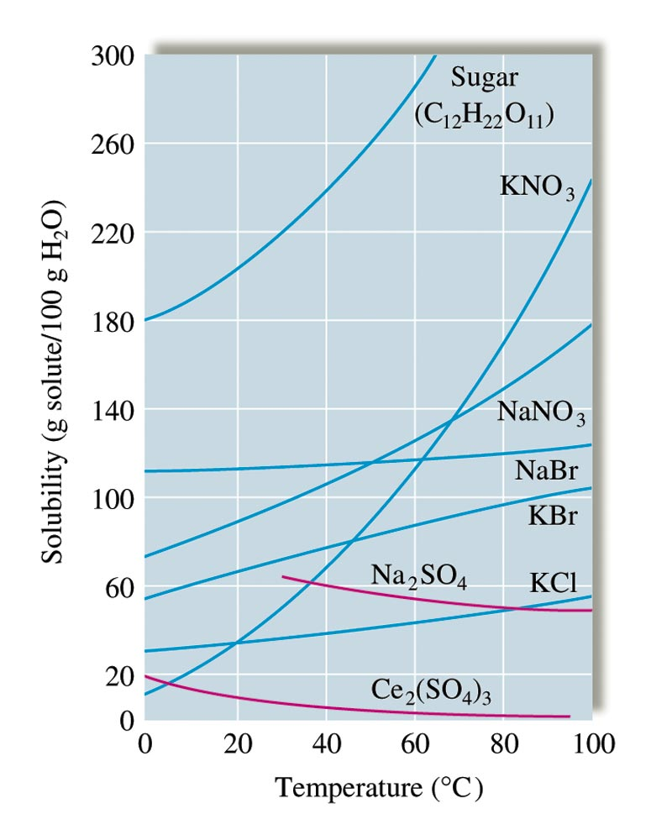
The Solubilities of Several Solids as a Function of Temperature

Slide 20
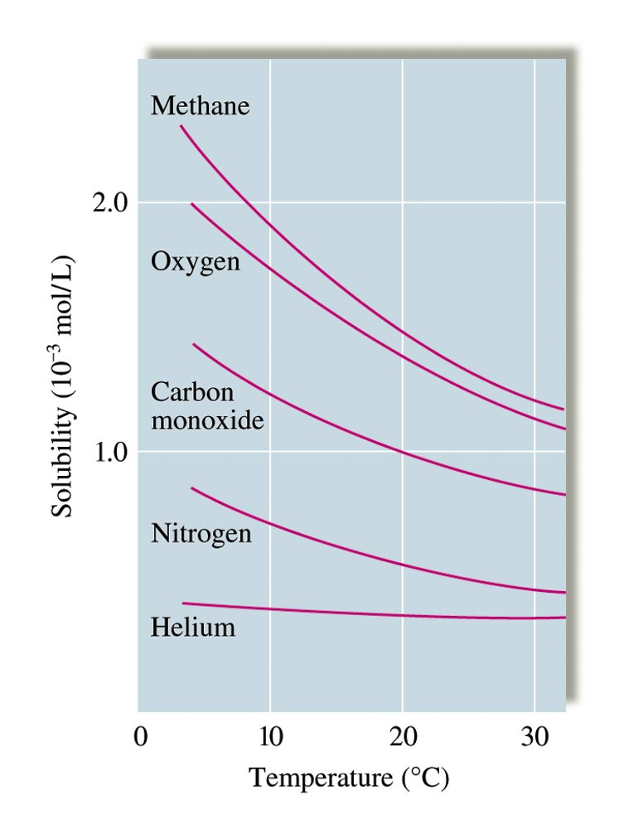
The Solubility of Gases in Water

Slide 21
Effect of Pressure on Solubility
Henry’s law: c = kP
c = concentration of dissolved gas
k = constant
P = partial pressure of gas solute above the solution
Amount of gas dissolved in a solution is directly proportional to the partial pressure of gas above the solution.

Slide 22
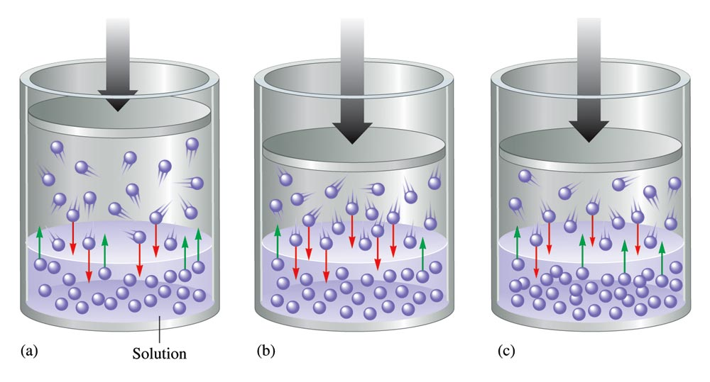
Effect of Pressure of Solubility of Gas

Slide 23
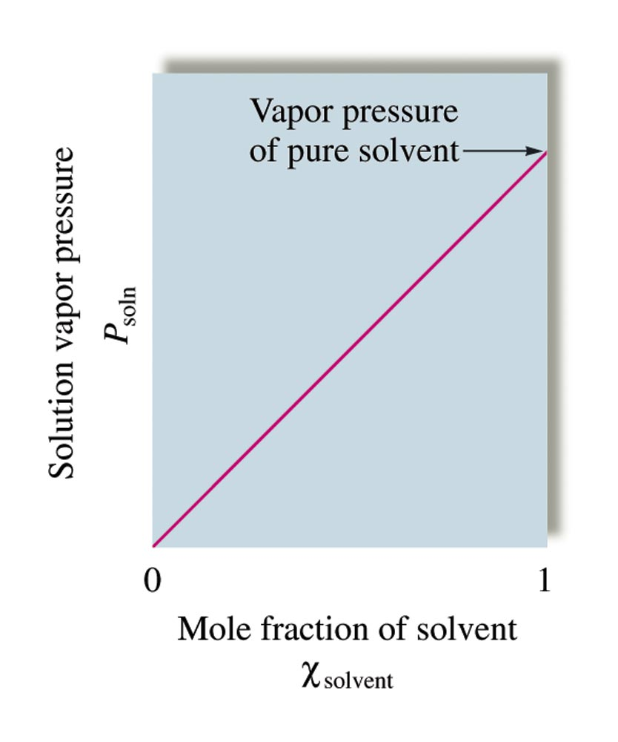
Ideal Solution: One that obeys Raoult’s Law

Slide 24
Solution Composition

Slide 25
Molarity

Slide 26
Exercise-#1
You have 1.00 mol of sugar in 125.0 mL of solution. Calculate the concentration in units of molarity.
8.00 M
Notes:
1.00 mol / (125.0 / 1000) = 8.00 M

Slide 27
Exercise-#2
You have a 10.0 M sugar solution. What volume of this solution do you need to have 2.00 mol of sugar?
0.200 L
Notes:
2.00 mol / 10.0 M = 0.200 L

Slide 28
Mass Percent

Slide 29
Exercise-#3
What is the percent-by-mass concentration of glucose in a solution made my dissolving 5.5 g of glucose in 78.2 g of water?
6.6%
Notes:
[5.5 g / (5.5 g + 78.2 g)] × 100 = 6.6%

Slide 30
Mole Fraction

Slide 31
Exercise-#4
A solution of phosphoric acid was made by dissolving 8.00 g of H₃PO₄ in 100.0 mL of water. Calculate the mole fraction of H₃PO₄. (Assume water has a density of 1.00 g/mL.)
0.0145
Notes:
8.00 g H₃PO₄ × (1 mol / 97.994 g H₃PO₄) = 0.0816 mol H₃PO₄
100.0 mL H₂O × (1.00 g H₂O / mL) × (1 mol / 18.016 g H₂O) = 5.55 mol H₂O
Mole Fraction (H₃PO₄) = 0.0816 mol H₃PO₄ / [0.0816 mol H₃PO₄ + 5.55 mol H₂O] = 0.0145

Slide 32
Molality

Slide 33
Exercise-#5
A solution of phosphoric acid was made by dissolving 8.00 g of H₃PO₄ in 100.0 mL of water. Calculate the molality of the solution. (Assume water has a density of 1.00 g/mL.)
0.816 m
Notes:
8.00 g H₃PO₄ × (1 mol / 97.994 g H₃PO₄) = 0.0816 mol H₃PO₄
100.0 mL H₂O × (1.00 g H₂O / mL) × (1 kg / 1000 g) = 0.1000 kg H₂O
Molality = 0.0816 mol H₃PO₄ / 0.1000 kg H₂O] = 0.816 m

Slide 34
Solutions containing Nonvolatile Solutes
Nonvolatile solute lowers the vapor pressure of solvent.
Raoult’s Law:
P_{soln} = vapor pressure of solution
_{solv} = mole fraction of solvent
= vapor pressure of pure solvent

Slide 35
Colligative Properties
Lowering of solvent vapor pressure
Freezing-point depression
Boiling-point elevation
Osmotic pressure
Colligative properties depend only on the number, not on the identity, of the solute particles in an ideal solution.

Slide 36
The Lowering of Solvent Vapor Pressure
The presence of nonvolatile solute particles lowers the number of solvent molecules in the vapor that is in equilibrium with the solution.
The solvent vapor pressure is lowered;
For ideal solutions, the lowering of vapor pressure is proportional to the mole fraction of solute:
ΔP = X_{solute}.Pº_{solvent} (for non-electrolytes)
= iX_{solute}.Pº_{solvent} (for electrolytes)
(i is the van’t Hoff’s factor, which approximately relates to the number of ions per formula unit of the compound)

Slide 37
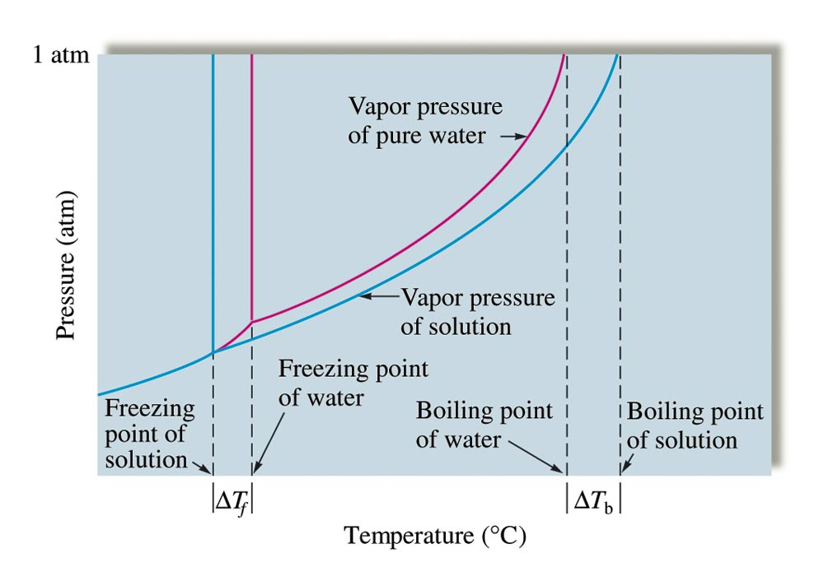
Changes in Boiling Point and Freezing Point of Water

Slide 38
Freezing-Point Depression
When a solute is dissolved in a solvent, the freezing point of the solution is lower than that of the pure solvent.
ΔT_{f} = K_{f}m (for nonelectrolytes)
= iK_{f}m (for electrolytes)
i = van’t Hoff factor
ΔT_{f} = freezing-point depression
K_{f} = freezing-point depression constant
m = molality of solution

Slide 39
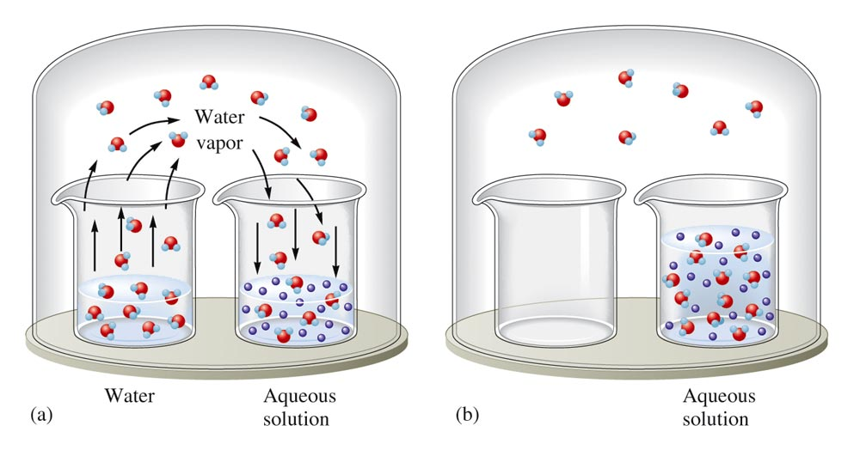
An Aqueous Solution and Pure Water in a Closed Environment

Slide 40
Liquid-Vapor Equilibrium in Pure Solvent

Slide 41
Lowering of Vapor Pressure by Solute Particles

Slide 42
Solute Particles Lower Solvent Vapor Pressure and Its Freezing Point

Slide 43
Boiling-Point Elevation
Nonvolatile solute elevates the boiling point of the solvent.
ΔT_{b} = K_{b}m (for nonelectrolytes)
= iK_{b}m (for electrolytes)
i = van’t Hoff factor
ΔT_{b} = boiling-point elevation
K_{b} = boiling-point elevation constant
m = molality of solution

Slide 44
Liquid-Vapor Equilibrium at Boiling Point of Pure Solvent

Slide 45
Solute Particles Lower Solvent Vapor Pressure and Raise Its Boiling Point

Slide 46
Exercise-#6
What mass of ethylene glycol (C₂H₆O₂), in grams, must be added to 1.50 kg of water to produce a solution that boils at 105ºC?
(Boiling point elevation constant for water is K_{b} = 0.512ºC/m)
At what temperature will the solution freeze?
(Freezing point depression constant for water is K_{f} = 1.86ºC/m)

Slide 47
Exercise-#7
A solution was prepared by dissolving 25.00 g glucose in 200.0 g water. The molar mass of glucose is 180.16 g/mol. What is the boiling point of the resulting solution (in °C)? Glucose is a molecular solid that is present as individual molecules in solution.
100.35 °C
Notes:
The change in temperature is ΔT = K_{b}m_{solute}. K_{b} is 0.51 °C·kg/mol. To solve form_{solute}, use the equation m = moles of solute/kg of solvent.
Moles of solute = (25.00 g glucose)(1 mol / 180.16 g glucose) = 0.1388 mol glucose
Kg of solvent = (200.0 g)(1 kg / 1000 g) = 0.2000 kg water
m_{solute} = (0.1388 mol glucose) / (0.2000 kg water) = 0.6938 mol/kg
ΔT = (0.51 °C·kg/mol)(0.6938 mol/kg) = 0.35 °C.
The boiling point of the resulting solution is 100.00 °C + 0.35 °C = 100.35 °C.
Note: Use the red box animation to assist in explaining how to solve the problem.

Slide 48
Exercise-#8
Suppose you dissolve a 20.0-g mixture containing sucrose (C₁₂H₂₂O₁₁) and NaCl in 1.0 kg of water. The solution is found to freeze at -0.426°C.
(a) Assuming ideal behavior, calculate the mass percent of sucrose and NaCl, respectively, in the mixture. (b) Calculate the mole fraction of sucrose in the mixture.
(a) Mass %: sucrose = 72.8%; NaCl = 27.2%;
(b) Mole fraction of sucrose = 0.313
Notes:
The solution is 72.8% sucrose and 27.2% sodium chloride. The mole fraction of the sucrose is 0.313. To solve this problem, the students must assume that i = 2 for NaCl.
Note: Use the red box animation to assist in explaining how to solve the problem.

Slide 49
Osmotic Pressure
Osmosis – flow of solvent into the solution through a semi permeable membrane.
= MRT (for nonelectrolytes)
= iMRT (for electrolytes)
= osmotic pressure (atm)
M = molarity of the solution
R = gas law constant
T = temperature (Kelvin)

Slide 50
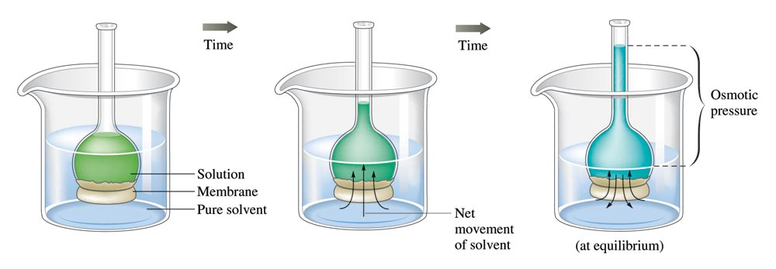

Slide 51
Osmosis

Slide 52
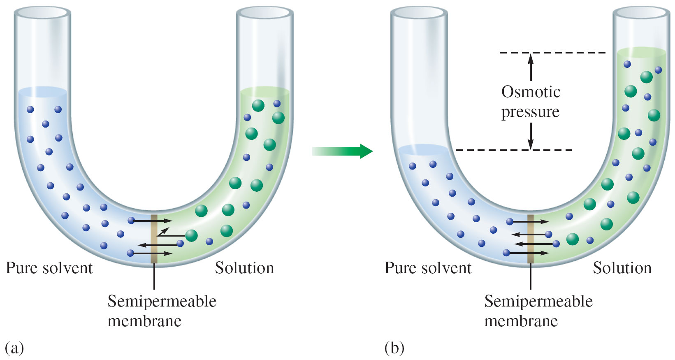

Slide 53
Exercise-#9
A plant cell has a natural electrolyte concentration of 0.25 m. If you immerse the cell in an aqueous solution that freezes at -0.246°C, will there be a net flow of water into the cell of out of the cell, or neither? (Kf = 1.86°C/m)
Notes:
The cell will explode (or at least expand). The concentration of the solution is 0.186 m. Thus, the cell has a higher concentration, and water will enter the cell.
Note: Use the red box animation to assist in explaining how to solve the problem.

Slide 54
Exercise-#10
When a 33.4-mg sample of a compound is dissolved in 20.0 mL of water at 25°C, the solution has an osmotic pressure of 58.0 torr. Calculate the molar mass of this compound. (Assume the compound is nonelectrolyte.)
535 g/mol
Notes:
The molar mass is 111 g/mol.
Note: Use the red box animation to assist in explaining how to solve the problem.

Slide 55
van’t Hoff Factor, i
The expected value for i of an ionic compound is the number of ions per formula unit (assuming ions dissociate completely and that ion pairing does not occur).
Examples:
NaCl i = 2
Ca(NO₃)₂ i = 3
Na₃PO₄ i = 4

Slide 56
van’t Hoff Factor, i
In reality, i < number of ions per formula;
This is because ions do not completely ionize or ion-paring occurs, esp. when solution is not very dilute;
i = $\frac{moles of particles in solution}{moles of solute dissolved}$
The value of i for an ionic compound varies with concentrations, and can be determined by calculating
The ratio: $\frac{Measured ∆T or measured π}{Calculated ∆T (or π) by assuming no dissociation}$

Slide 57
Exercise-#11
The measured osmotic pressure of 0.050 M NaCl solution at 25°C is 2.3 atm. What is the van’t Hoff’s factor i for NaCl at this concentration?
Answer: i = 1.9

Slide 58
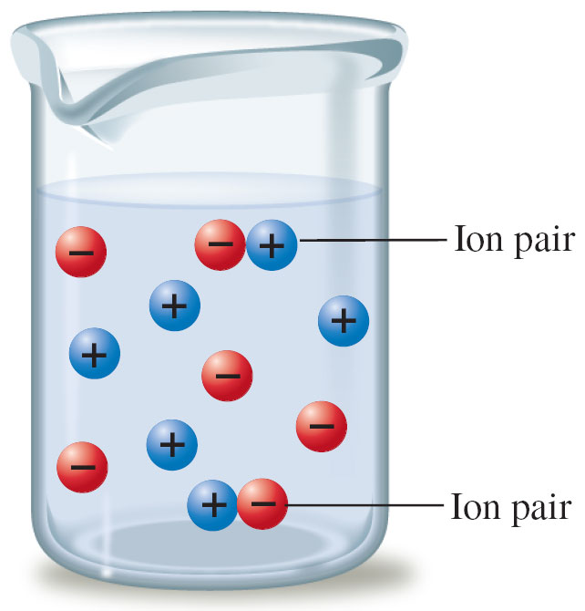
Ion Pairing
At a given instant a small percentage of the sodium and chloride ions are paired and thus count as a single particle.

Slide 59
Ion Pairing
Ion-pairing occurs to some extent in all electrolyte solutions.
They are more significant in concentrated solutions.
Ion-pairings are also significant in solutions containing highly charged ions.
Ion-parings are less significant in very dilute solutions.

Slide 60
Solutions Composed of Two Liquids
Two Liquids form Ideal Solution if:
they are structurally very similar, and
interactions between non-identical molecules were relatively similar to identical molecules.
The vapor of each liquid obeys Raoult’s Law:
P_{A} = X_{A}Pº_{A}; P_{B} = X_{B}Pº_{B}
P_{T} = P_{A} + P_{B} = X_{A}Pº_{A} + X_{B}Pº_{B}
(X : mole fraction; Pº : vapor pressure of pure liquid)

Slide 61
A Summary of the Behavior of Various Types of Solutions Composed of Two Volatile Liquids
Interactive Forces Between Solute (A) and Solvent (B) Particles | ΔH_{soln} | ΔT for Solution Formation | Deviation from Raoult’s Law | Example
A ↔ A, B ↔ B ≡ A ↔ B | Zero | Zero | None (ideal solution) | Benzene-toluene
A ↔ A, B ↔ B < A ↔ B | Negative (exothermic) | Positive | Negative | Acetone-water
A ↔ A, B ↔ B > A ↔ B | Positive (endothermic) | Negative | Positive | Ethanol-hexane

Slide 62
Vapor Pressure for a Solution of Two Volatile Liquids

Slide 63
Laboratory Fractional Distillation Apparatus

Slide 64
Fractional Distillation Towers in Oil Refinaries

Slide 65
Refined Crude Oil Mixtures

Slide 66
Concept Check-#12
For each of the following solutions, would you expect it to be relatively ideal (with respect to Raoult’s Law), show a positive deviation, or show a negative deviation?
Hexane (C₆H₁₄) and chloroform (CHCl₃)
Ethyl alcohol (C₂H₅OH) and water
Hexane (C₆H₁₄) and octane (C₈H₁₈)
Notes:
a) Positive deviation; Hexane is non-polar, chloroform is polar.
b) Negative deviation; Both are polar, and the ethyl alcohol molecules can form stronger hydrogen bonding with the water molecules than it can with other alcohol molecules.
c) Ideal; Both are non-polar with similar molar masses.

Slide 67
Exercise-#13
A solution of benzene (C₆H₆) and toluene (C₇H₈) contains 50.0% benzene by mass. The vapor pressures of pure benzene and pure toluene at 25ºC are 95.1 torr and 28.4 torr, respectively. Assuming ideal behavior, calculate the following:
(a) The mole fractions of benzene and toluene;
(b) The total vapor pressure above the solution;
(c) The mole percent of each component in the vapor.

Slide 68
Exercise-#14
A solution made up of 24.3 g acetone (CH₃COCH₃) and 39.5 g of carbon disulfide (CS₂) has a vapor pressure of 645 torr at 35ºC. The vapor pressures of pure acetone and pure carbon disulfide at 35ºC are 332 torr and 515 torr, respectively.
(a) Is the solution ideal or non-ideal?
(b) If non-ideal, does it deviate positively or negatively from Raoult’s law?
(c) What can you say about the relative strength of carbon disulfide-acetone interactions compared to the acetone-acetone and carbon disulfide-carbon disulfide interactions?

Slide 69
Colloidal Mixtures
A suspension of tiny particles in some medium.
Tyndall effect – scattering of light by particles.
Suspended particles are single large molecules or aggregates of molecules or ions ranging in size from 1 to 1000 nm.

Slide 70
Scattering of Light by Colloid Particles

Slide 71
Tyndall Effect of Colloidal Mixture

Slide 72
Tyndall Effect of Morning Mist

Slide 73
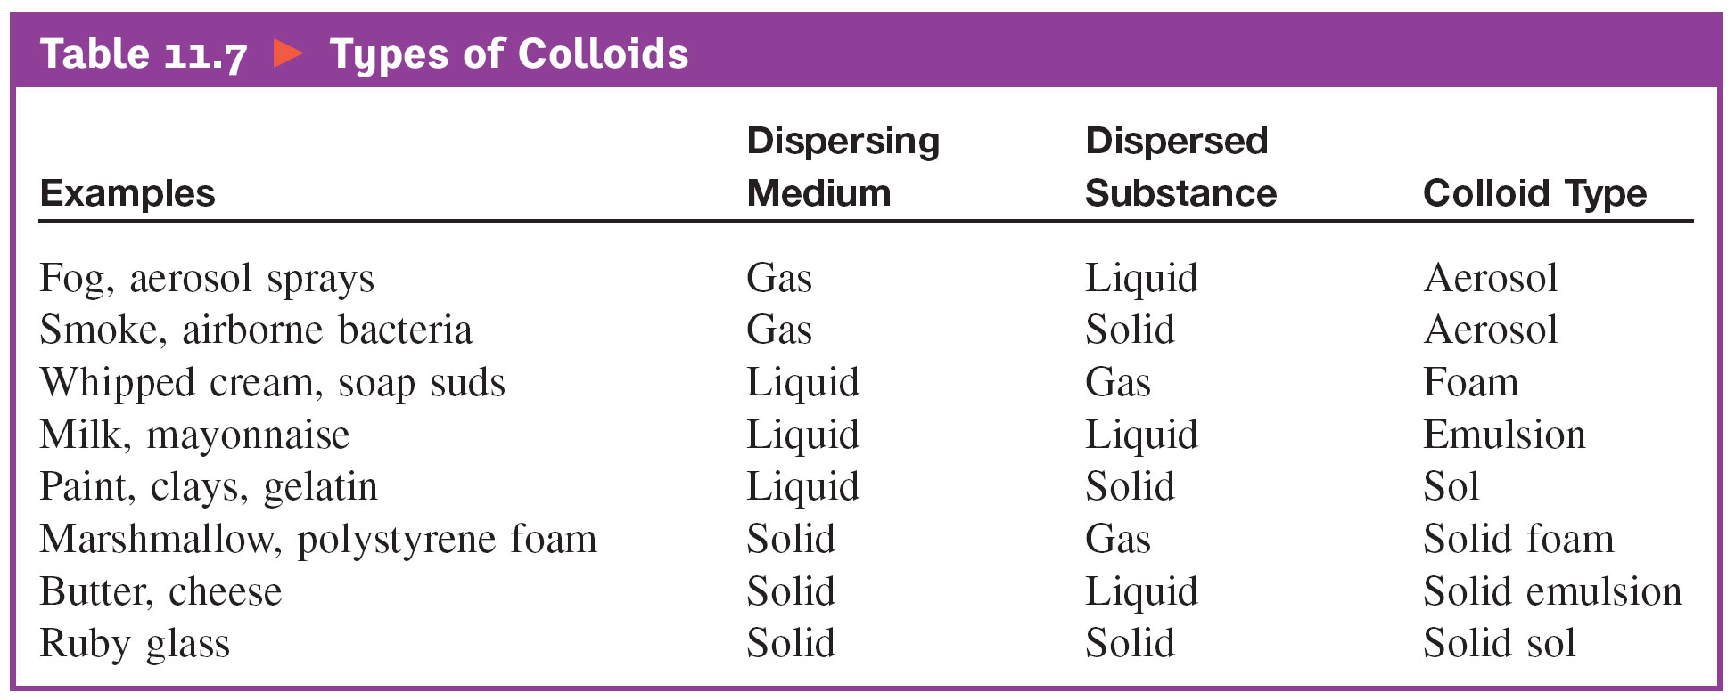
Types of Colloids

Slide 74
Micelle – A Colloidal Suspension

Slide 75
Micelle in Soap Bubbles

Slide 76
Coagulation
Destruction of a colloid.
Usually accomplished either by heating or by adding an electrolyte.

