Slide 1
Gases – Topic Outlines
Gas Pressure
Gas Laws & Ideal Gas Equation
Density of Gases
Stoichiometry involving gas reactions
Kinetic Molecular Theory of Gases
Root-mean-square speed
Rates of Gas Diffusion and Effusion
Deviation of Real Gases
Atmospheric Chemistry

Slide 2
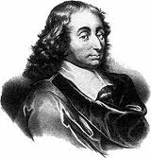
Pressure
SI units = Newton/meter² = 1 Pascal (Pa)
1 standard atmosphere = 1 atm
1 atm = 760 mm Hg = 760 torr = 101,325 Pa

Slide 3
Gas and Liquid Pressure
Both are due to force exerted by molecules colliding with the surface of container walls.
Liquid Pressure = g·d·h
  (g= gravitational constant; d = liquid density; h = height of liquid column)
Gas pressure = nRT/V
  (n = mol of gas; R = gas constant; T = temperature in K, and V = volume in L)

Slide 4
Barometer
A device used to measure atmospheric pressure.
Mercury barometer uses Hg(l);
Pressure exerted by Hg(l) column (PHg) is equalized by air pressure;
Since PHg ∝ hHg; atm pressure ∝ hHg , and atm pressure is expressed in term of height of Hg column:
1 atm = 760.0 mmHg (760 torr)

Slide 5
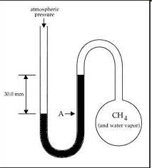
Opened-end Manometer

Slide 6
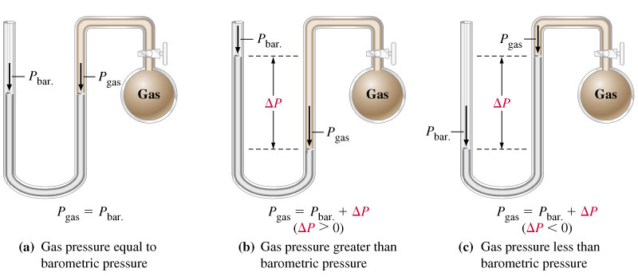
Opened-end Mercury Manometers
Notes:
Difficult to place a barometer inside a gas to be measured.
Manometers compare gas pressure and barometric pressure.

Slide 7
Manometer or Pressure Gauge
Device used for measuring the pressure of a gas in a container.

Slide 8
Pressure Conversions: An Example
The pressure of a gas is measured as 2.5 atm. Represent this pressure in both torr and pascals.

Slide 9
Boyle’s Law
  For a given quantity of gas at constant temperature, volume is inversely proportional to pressure;
  V = b/P (b is a proportionality constant); P₁V₁ = P₂V₂

Slide 10

Boyle’s Law

Slide 11
Charles’s Law
  For a given quantity of gas at constant pressure, volume is directly proportional to the temperature in Kelvin;
  V = cT (c is a proportionality constant; T is temperature in Kelvin)
  V₁/T₁ = V₂/T₂

Slide 12
Charles’s Law
Volume and Temperature (in Kelvin) are directly related (constant P and n).
V=cT (c is the proportionality constant)
K = °C + 273
0 K is called absolute zero.

Slide 13

Charles’s Law

Slide 14
Avogadro’s Law
  At fixed temperature and pressure, volume is directly proportional to the moles of gas;
  V = an (a is a proportionality constant);
  V₁/n₁ = V₂/n₂

Slide 15
Avogadro’s Law
Volume and number of moles are directly related (constant T and P).
V = an (a is a proportionality constant)

Slide 16
Ideal Gas Law
We can combine these laws into one comprehensive law:
        V = bT (constant P and n)
        V = an (constant T and P)
        V = k/P (constant T and n)
        PV = nRT
        (where R = 0.08206 L·atm/mol·K, the universal gas constant)

Slide 17
Molar Volume of an Ideal Gas
For 1 mole of an ideal gas at 0°C and 1 atm, the volume of the gas is 22.41 L.
STP = standard temperature and pressure
  0°C and 1 atm
  Therefore, the molar volume is 22.41 L at STP.

Slide 18
Standard Temperature and Pressure
STP = Standard Temperature and Pressure
  Standard Temperature = 0ºC = 273.15 K
  Standard Pressure = 1.000 atm (760.0 torr)
At STP, molar volume of ideal gas = 22.4 L/mol
Ideal gas constant, R = 0.08206 ^{L.atm}/_{K.mol}
In another units, R = 62.36 ^{L.torr}/_{K.mol}
= 6.236 x 10⁴ ^{mL.torr}/_{K.mol};

Slide 19
Dalton’s Law of Partial Pressure
In a mixture of gases, the total pressure is equal to the sum of the partial pressures of individual gases.
If the partial pressures of gases A, B, C,…are P_{A}, P_{B}, P_{C},.., then the total pressure is
P_{Total} = P_{A} + P_{B} + P_{C} + …
Since P_{A} = n_{A}RT/V; P_{B} = n_{B}RT/V, and P_{C} = n_{C}RT/V,
P_{T} = (n_{A}RT/V) + (n_{B}RT/V) + (n_{C}RT/V)
= (n_{A} + n_{B} + n_{C} + …)(RT/V) = (n_{total})RT/V

Slide 20

Exercise-1
27.4 L of oxygen gas at 25.0°C and 1.30 atm, and 8.50 L of helium gas at 25.0°C and 2.00 atm were pumped into a 5.81-liter tank at 25°C.
Calculate the new partial pressure of oxygen.
6.13 atm
Calculate the new partial pressure of helium.
2.93 atm
Calculate the new total pressure of both gases.
9.06 atm
Notes:
For oxygen:
P₁V₁=P₂V₂
(1.30 atm)(27.4 L) = (P₂)(5.81 L)
P₂ = 6.13 atm
For helium:
P₁V₁=P₂V₂
(2.00 atm)(8.50 L) = (P₂)(5.81 L)
P₂ = 2.93 atm
The total pressure is therefore 6.13 + 2.93 = 9.06 atm.

Slide 21
Density and Molar Mass of Gases
Density = Mass/Volume = grams/L
Mass (in grams) = mole x molar mass = nM

Slide 22
Molar Mass of a Gas
        d = density of gas
        T = temperature in Kelvin
        P = pressure of gas
        R = universal gas constant

Slide 23
Model/Theory to explain Gas Behavior
So far we have considered “what happens,” but not “why.”
In science, “what” always comes before “why.”
Kinetic Molecular Theory (KMT) is introduced.

Slide 24
Postulates in Kinetic Molecular Theory
Gas contains particles/molecules that have mass but negligible size/volume; Molecular volume is negligible compared to the volume occupied by gas sample;

Slide 25
Postulates of the Kinetic Molecular Theory
2) The particles are in constant motion and continuous molecular collisions. The force exerted by the collisions of gas molecules with the container walls results in gas pressure.

Slide 26
Postulates of the Kinetic Molecular Theory
The particles are separated by distance much greater than their size; attraction or repulsion between molecules are assumed to not exist.

Slide 27
Postulates of the Kinetic Molecular Theory
The average molecular kinetic energy of a gas is assumed to be directly proportional to the Kelvin temperature of the gas.

Slide 28
Kinetic Molecular Theory
Gas is composed of tiny particles with finite masses but negligible molecular volume;
Gas particles are in constant random motion, and colliding with the with the container walls;
Molecular collisions are completely elastic – energy is conserved during collisions;
Intermolecular attractions between gas particles are nonexistent;
The average molecular kinetic energy for gas depends only on its temperature in Kelvin.

Slide 29
Kinetic Molecular Theory
  Two gases at the same temperature have the same average molecular kinetic energy;
  At the same temperature, the lighter gaseous molecules have greater average velocity;

Slide 30
KMT Explanation of Boyle’s Law
Pressure-Volume Relationship
At constant temperature, gaseous particles travel with the same average speed.
If volume is compressed, the average distance traveled by particles decreases;
This leads to a higher frequency of molecular collisions with walls, which leads to higher gas pressure.

Slide 31
KMT Explanation of Charles’s Law
Volume–Temperature Relationship
The volume of a gas will increase proportionally as the temperature increases at constant pressure.
Increasing the temperature causes:
  molecules to travel faster;
  rate of molecular collision with container walls increases.
To maintain a constant pressure when temperature increases:
  the volume of the gas must increase to reduce the frequency of collisions.

Slide 32
KMT Explanation of Charles’s Law
Pressure-Temperature Relationship
Gas pressure will increase proportionally as the temperature is increased at constant volume.
As the temperature increases, average molecular speed increases;
This causes frequency of collisions to increase, which leads to an increase in pressure.

Slide 33
KMT Explanation of Avogadro’s Law
Volume – Mole Relationship
At constant temperature, increasing the number of gas molecules leads to higher rates of collisions and higher pressure;
To maintain a constant pressure, volume of gas must expand.
Avogadro’s law: at constant temperature and pressure, gas volume increases proportionally with the number of moles.

Slide 34
Root Mean Square Velocity
R = 8.3145 J/K·mol
(J = joule = kg·m²/s²)
T = temperature of gas (in K)
M = mass of a mole of gas in kg
Final units are in m/s.

Slide 35
Diffusion and Effusion
Diffusion – the mixing of gases.
Effusion – describes the passage of a gas through a tiny orifice into an evacuated chamber.
Rate of effusion measures the speed at which the gas escapes from the chamber.

Slide 36
Graham’s Law of Effusion
M₁ and M₂ represent the molar masses of the gases.

Slide 37
Molar Mass Determination using Relative Rate of Effusion
The rate of effusion of an unknown gas at a certain temperature and pressure is 25.0 mL per minute. Under the same conditions, the effusion rate of N₂ gas is 57.1 mL/minute. What is the molar mass of the unknown gaseous compound? If the gaseous compound is composed of 21.95% sulfur and 78.05 % fluorine, by mass, what is the formula of the compound?
Molar mass = 146; Formula SF₆

Slide 38
Real Gases
Deviate from ideal behavior at:
  High pressure
  Low temperature
Under these conditions:
  Molecular volume is finite
  Attractive forces become important.

Slide 39
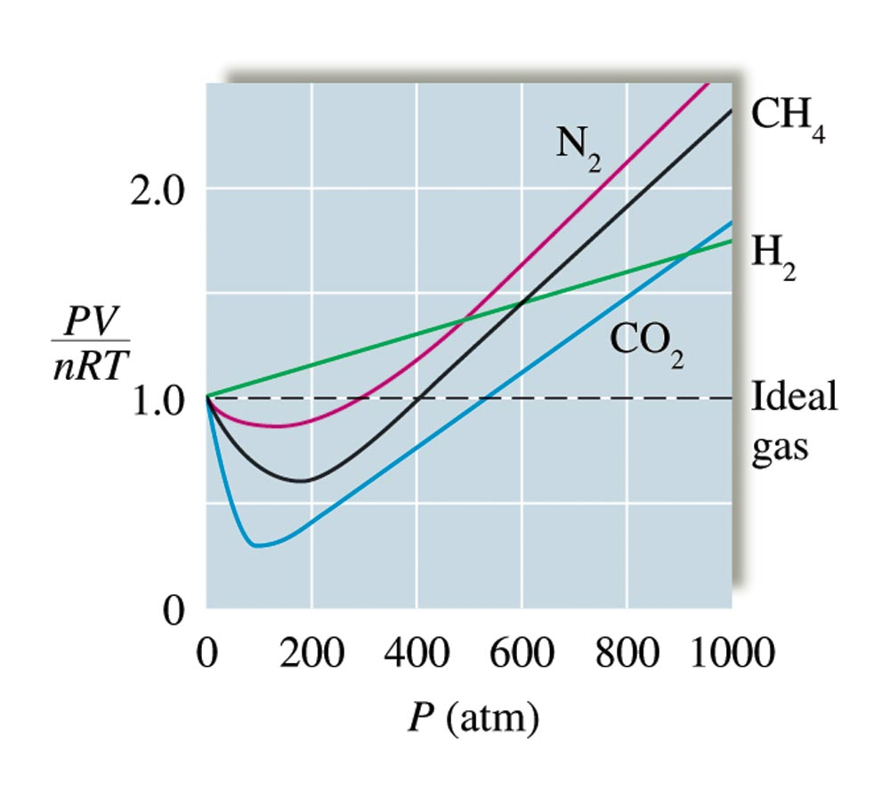
Plots of PV/nRT Versus P for Several Gases (200 K)

Slide 40
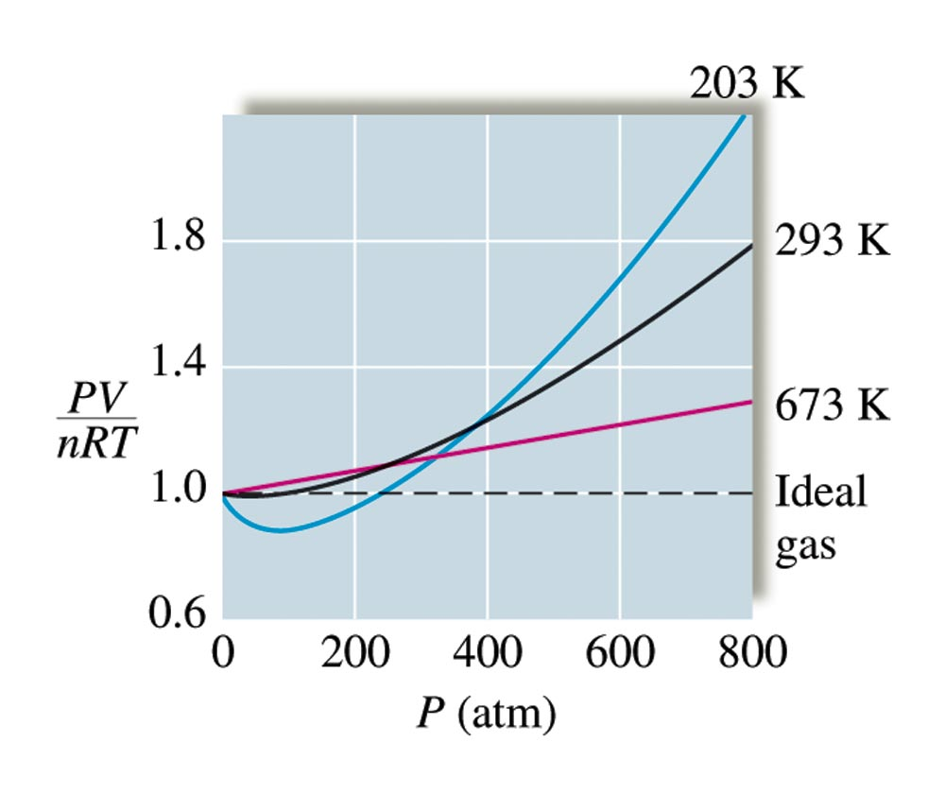
Plots of PV/nRT Versus P for Nitrogen Gas at Three Temperatures

Slide 41
Real Gases
Approach ideal behavior at:
  High temperature
  Low pressure
Under these conditions:
  Molecular volume and intermolecular forces are insignificant – molecules are very far apart and any intermolecular attraction is negligible.

Slide 42
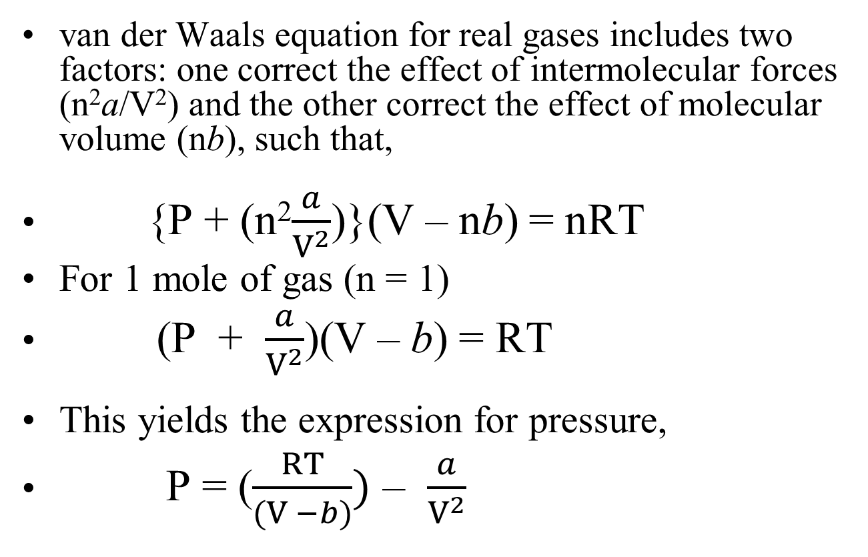
Correction for Real Gases
van der Waals equation for real gases includes two factors: one correct the effect of intermolecular forces (n²a/V²) and the other correct the effect of molecular volume (nb), such that,
{P + (n²$\frac{a}{V^{2}}$)}(V – nb) = nRT
For 1 mole of gas (n = 1)
(P + $\frac{a}{V^{2}}$)(V – b) = RT
This yields the expression for pressure,
P = ($\frac{RT}{(V −b)})$ – $\frac{a}{V^{2}}$

Slide 43
Real Gases (van der Waals Equation)
↑
↑
corrected pressure
corrected volume
P_{ideal}
V_{ideal}

Slide 44
Values of the van der Waals Constants for Some Gases
The value of a reflects how much of a correction must be made to adjust the observed pressure up to the expected ideal pressure.
A low value for a reflects weak intermolecular forces among the gas molecules.

Slide 45
Characteristics Real Gases
The actual pressure for a real gas is lower than that expected for an ideal gas.
The existence of intermolecular (attractive) forces lowers the observed pressure in real gases.

Slide 46
Pressure of Real Gases
Use the van der Waals equation to estimate the pressure of 1.00 mol of N₂ and Cl₂, respectively, in a 22.4-L gas flask, at 0.0ºC?
(For N₂: a = 1.39 L²-atm/mol²; b = 0.0391 L/mol;
for Cl₂: a = 6.49 L²-atm/mol²; b = 0.0562 L/mol)
For N₂, P = 1.00 atm;
For Cl₂, P = 0.990 atm.

Slide 47

Concept Check
Sketch a graph of:
  Pressure versus volume at constant temperature and moles.

Slide 48
Concept Check
Sketch a graph of:
  Volume vs. moles at constant temperature and pressure.

Slide 49
Concept Check
Sketch a graph of:
  Volume vs. temperature (°C) at constant pressure and moles.

Slide 50
Concept Check
Sketch a graph of:
  Volume vs. temperature (K) at constant pressure and moles.

Slide 51
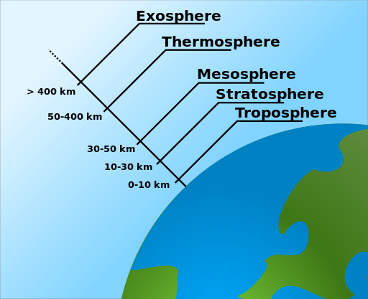
The Atmosphere

Slide 52
Atmospheric Chemistry
Earth atmosphere is divided into 5 regions:
  Troposphere (ca. 0 – 10 km) – climate changes occur
  Stratosphere (ca. 10 – 30 km) – where ozone layer is
  Mesosphere (ca. 30 – 50 km,
  Thermosphere (ca. 50 – 400 km, and
  Exosphere (ca. > 400 km)
Principal components of atmosphere:
  N₂, O₂, Ar, H₂O, and CO₂
  H₂O and CO₂ make the Earth warm and livable

Slide 53
Troposphere
Lowest part of the atmosphere;
Contains most of our weather phenomena – clouds, rain, snow;
Contains about 75% of all the air;
Temperature decreases with altitude by about 6.5ºC per km;
Pressure also decreases with height;

Slide 54
Stratosphere
Contains much of the ozone in the atmosphere;
Temperature increases with height due to absorption of UV radiation by ozone;
Absorption of dangerous UV radiation by ozone protect us from skin cancer.
Uses of CFC compounds in refrigeration and air-conditioning systems caused the reduction of ozone layer in Stratosphere.

Slide 55
The Ozone Layer
The formation of ozone in the Stratosphere:
  Photo-dissociation of O₂: O₂ → 2O;
Reaction of O with O₂ to form ozone molecule:
    O₂ + O → O₃
Absorption of uv radiation by ozone molecule:
    O₃ + uv → O₂ + O

Slide 56
Destruction of Ozone Layer
Photo-dissociation of CFC compounds produce free-radical chlorine atom (Cl). For example,
    CCl₂F₂ + uv → CClF₂ + Cl
Reaction of Cl with O₃:
    Cl + O₃ → ClO + O₂
Reaction of ClO with O and re-generation of Cl:
    ClO + O → O₂ + Cl
Overall reaction: O₃ + O → 2O₂

Slide 57
Air Pollution
Two main sources:
  Transportation
  Production of electricity
Combustion of petroleum produces CO, CO₂, NO, and NO₂, along with unburned molecules (hydrocarbons) from gasoline.

Slide 58
Atmospheric Pollutants
Formation of nitric oxide, NO, in internal combustion engines and its subsequent oxidation to NO₂:
    N₂ + O₂ → 2NO (inside the engine)
    2NO + O₂ → 2NO₂ (occurs in air)
Photo-dissociation of NO₂:
    NO₂ + uv → NO + O*

Slide 59
Atmospheric Pollutants
Reaction of reactive O* atom with O₂ to form O₃
    O₂ + O* → O₃
Reaction of O* with H₂O to produce excited hydroxyl radical OH:
    H₂O + O* → 2OH*
Reaction of OH radical with NO₂ forms HNO₃:
    OH* + NO₂ → HNO₃
HNO₃ causes acid rain.

Slide 60
The Formation of Acid Rain, HNO₃
The formation of NO, NO₂, and HNO₃:
  N₂ + O₂ → 2NO
  2NO + O₂ → 2NO₂
  2NO₂ + H₂O → HNO₃ + HNO₂
  NO₂ + OH* → HNO₃;
Action of HNO₃ on marble structures:
  CaCO₃(s) + 2HNO₃ → Ca(NO₃)₂ + H₂O + CO₂

Slide 61
Sulfur Oxides
(from Burning Coal for Electricity)
Sulfur burns to form toxic SO₂ gas.
SO₂ is oxidized to SO₃, which combines with rain water to form corrosive sulfuric acid, H₂SO₄.

Slide 62
The Formation of Acid Rain, H₂SO₄
Combustion of sulfur-containing coal produces SO₂ gas, which is further oxidized to SO₃:
  S + O₂ → SO₂
  2SO₂ + O₂ → 2SO₃
Reaction of SO₃ with rain water produces H₂SO₄:
  SO₃ + H₂O → H₂SO₄(aq)
Reaction of H₂SO₄ with marble structures:
  CaCO₃(s) + H₂SO₄(aq) → CaSO₄(aq) + H₂O(l) + CO₂(g)

Slide 63
Removal of SO₂ From Flu-Gas
Decomposition of CaCO₃ to produce quicklime:
  CaCO₃(s) → CaO(s) + CO₂(g)
Reaction of CaO with SO₂ to form CaSO₃:
  CaO(s) + SO₂(g) → CaSO₃(s)
  (CaSO₃ is disposed in landfills)

Slide 64
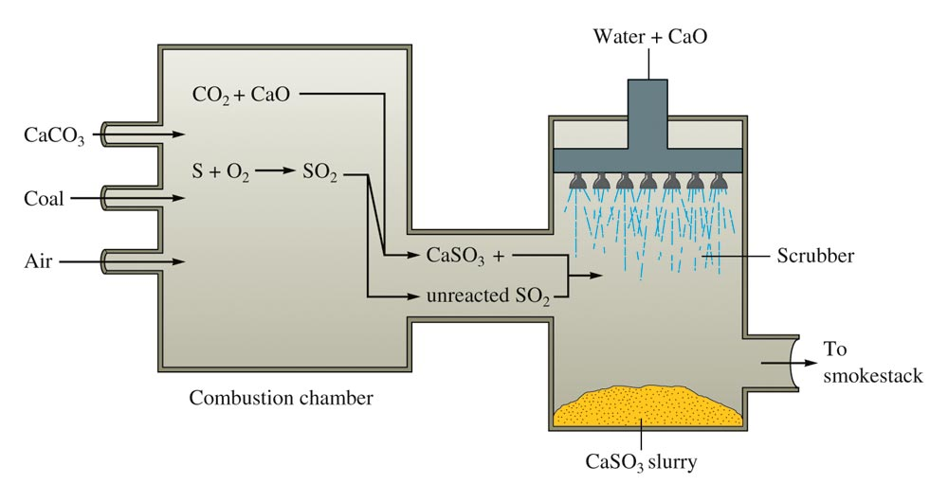
A Schematic Diagram of a Scrubber

Slide 65
Explain the following:
The destruction of ozone by chlorofluorocarbon (CFC) compounds;
The formation of HNO₃ and H₂SO₄, respectively, in the atmosphere;
The destruction of marble structures by acid rains.
The use of quick lime (CaO) to remove toxic gas such as SO₂ from industrial flu-gas.

Slide 66
Concept Check
Which best explains the final result that occurs once the gas sample has cooled?
  The pressure of gas increases.
  The volume of gas increases.
  The pressure of gas decreases.
  The volume of gas decreases.
  Both volume and pressure change.
Notes:
d) is correct.

Slide 67
Concept Check
The gas sample is then cooled to a temperature of 15°C. Find the new gas volume. (Hint: A moveable piston keeps the pressure constant overall, so what condition will change?)
5.43 L
Notes:
The new volume is 5.43 L (use Charles’s law to solve for the new volume).
(6.00 L) / (45+273) = (V₂) / (15+273)

Slide 68
Concept Check
V_{Ne} = 2V_{Ar}
Ne
Which of the following best represents the mass ratio of Ne:Ar in the balloons?
  1:1
  1:2
  2:1
  1:3
  3:1
Ar
Notes:
1:1

Slide 69
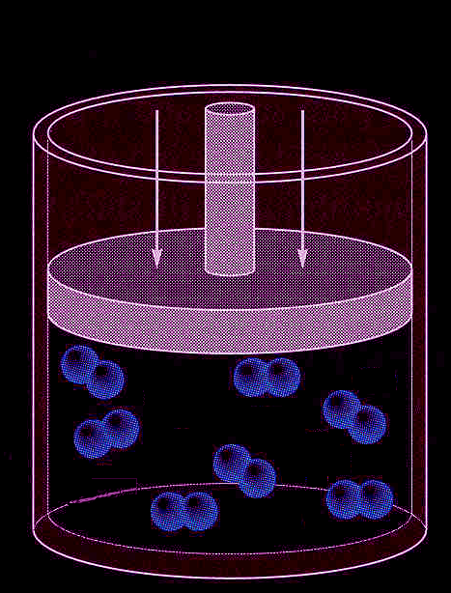
Concept Check
You have a sample of nitrogen gas (N₂) in a container fitted with a piston that maintains a pressure of 6.00 atm. Initially, the gas is at 45°C in a volume of 6.00 L.
You then cool the gas sample.

Slide 70

Exercise-2
Consider the following apparatus containing helium in both sides at 45°C. Initially the valve is closed.
  After the valve is opened, what is the pressure of the helium gas?
2.00 atm
9.00 L
3.00 atm
3.00 L
Notes:
The pressure is 2.25 atm. There are two ways to solve the problem:
1) Find the new pressure of the gas on the left side after the valve is opened (P₁V₁=P₂V₂). The pressure becomes 1.50 atm.
(2.00 atm)(9.00 L) = (P₂)(9.00 L + 3.00 L)
P₂ = 1.50 atm
Find the new pressure of the gas on the right side after the valve is opened (P₁V₁=P₂V₂). The pressure becomes 0.75 atm.
(3.00 atm)(3.00 L) = (P₂)(9.00 L + 3.00 L)
P₂ = 0.75 atm
The total pressure is therefore 1.50 + 0.75 = 2.25 atm.
2) Find the number of moles in each chamber separately (using PV = nRT), add the number of moles and volumes on each side, then use PV = nRT to solve for the new pressure.

Slide 71
Exercise-3
A sample of helium gas occupies 12.4 L at 23°C and 0.956 atm. What volume will it occupy at 1.20 atm assuming that the temperature stays constant?
9.88 L
Notes:
(0.956 atm)(12.4 L) = (1.20 atm)(V₂)
The new volume is 9.88 L.

Slide 72
Exercise-4
Suppose a balloon containing 1.30 L of air at 24.7°C is placed into a beaker containing liquid nitrogen at –78.5°C. What will the volume of the sample of air become (at constant pressure)?
0.849 L
Notes:
The new volume will become 0.849 L. Remember to convert the temperatures to Kelvin.
(1.30 L) / (24.7+273) = V₂ / (-78.5 + 273)

Slide 73
Exercise-5
If 2.45 mol of argon gas occupies a volume of 89.0 L, what volume will 2.10 mol of argon occupy under the same conditions of temperature and pressure?
76.3 L
Notes:
The new volume is 76.3 L.
(2.45 mol) / (89.0 L) = (2.10 mol) / (V₂)

Slide 74
Exercise-6
An automobile tire at 23°C with an internal volume of 25.0 L is filled with air to a total pressure of 3.18 atm. Determine the number of moles of air in the tire.
3.27 mol
Notes:
The number of moles of air is 3.27 mol.
(3.18 atm)(25.0 L) = n(0.08206)(23+273)

Slide 75
Exercise-7
What is the pressure in a 304.0 L tank that contains 5.670 kg of helium at 25°C?
114 atm
Notes:
The pressure is 114 atm. Remember to convert kg of helium into moles of helium before using the ideal gas law.
(P)(304.0) = ([5.670×1000]/4.003)(0.0821)(25+273)

Slide 76
Exercise-9
At what temperature (in °C) does 121 mL of CO₂ at 27°C and 1.05 atm occupy a volume of 293 mL at a pressure of 1.40 atm?
696°C
Notes:
The new temperature is 696°C.
(1.05 atm)(121 mL) / (27+273) = (1.40 atm)(293 mL) / (T₂ + 273)

Slide 77
Exercise-10
A sample of oxygen gas has a volume of 2.50 L at STP. How many grams of O₂ are present?
3.57 g
Notes:
3.57 g of O₂ are present.
(1.00 atm)(2.50 L) = n(0.08206)(273)
n = 0.112 mol O₂ × 32.00 g/mol = 3.57 g O₂

Slide 78
Exercise-11
What is the density of F₂ at STP (in g/L)?
1.70 g/L
Notes:
d = (MM)(P) / (R)(T)
d = (19.00g/mol × 2)(1.00 atm) / (0.08206)(273 K)
d = 1.70 g/L

