Slide 1
BCC ESL Program
US Culture Contest
Part 1

Slide 2
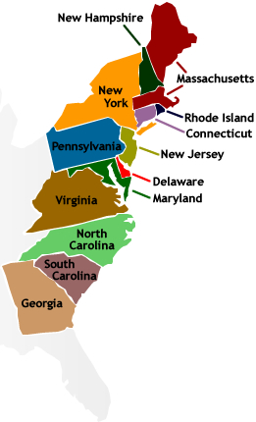
How many English colonies were there in North America in the 17th century?
13

Slide 3
When did the colonial leaders sign the Declaration of Independence?
July 4, 1776

Slide 4
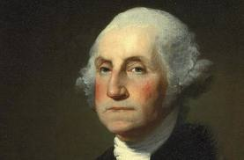
Who was the first president of the United States?
George Washington

Slide 5
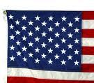
How many stars are there on the American flag today?
50

Slide 6
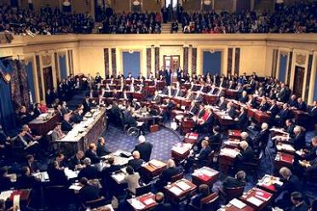
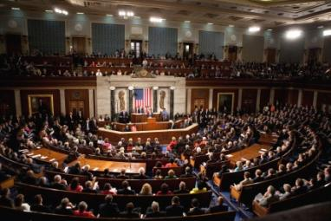
What are the names of the two houses of Congress?
The Senate and the House of Representatives

Slide 7
Can the president of the United States pass laws?
No

Slide 8
Which amendment guarantees citizens the freedom of speech?
The 1st amendment

Slide 9
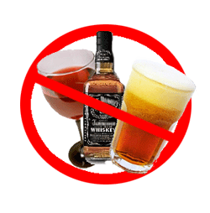
The 18th amendment was called Prohibition. What did this amendment do?
It prohibited the sale of alcoholic beverages.

Slide 10
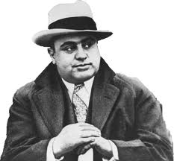
During Prohibition a lot of alcohol was sold illegally. What gangster became rich during this time?
Al Capone

Slide 11
What is the maximum number of years that someone can be president of the United States?
8 years (two four-year terms)

Slide 12
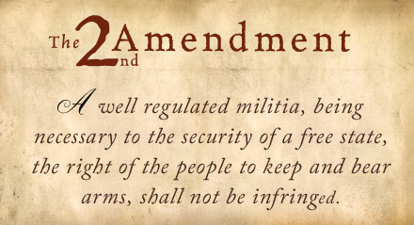
Which amendment allows citizens the right to own a gun?
The 2nd amendment

Slide 13
What disease did the Europeans who arrived in the New World in the 17th century bring with them that killed many Native Americans?
smallpox

Slide 14
Africans were brought to the United States as slaves. In which part of the United States was slavery common?
the Southern states

Slide 15
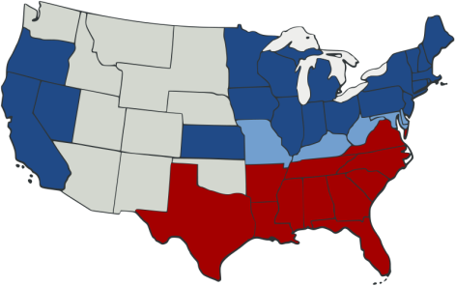
Which war ended slavery in the United States?
The Civil War

Slide 16
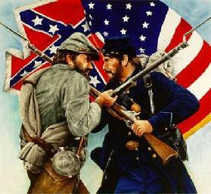
When did the Civil War begin? When did it end?
It began in 1861 and ended in 1865.

Slide 17
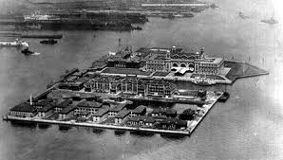
Many immigrants came from Europe to the United States in the 19th century by ship. Where did they land?
at Ellis Island

Slide 18
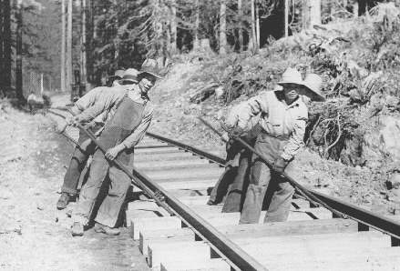
Many Chinese came to California during the 19th century. What kinds of jobs did they do?
Mining and building the railroad

Slide 19
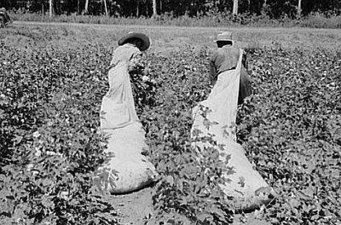
What kind of work did many of the slaves do in the South before the Civil War?
They worked in the fields picking cotton

Slide 20
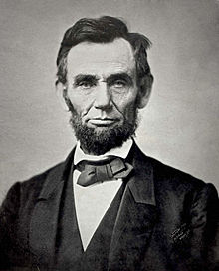
What president was assassinated at the end of the Civil War?
Abraham Lincoln

Slide 21
Who killed President Lincoln?
John Wilkes Booth

Slide 22
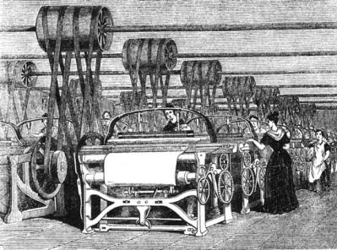
During the 19th century, which section of the country had more manufacturing, the North or the South?
The North

Slide 23
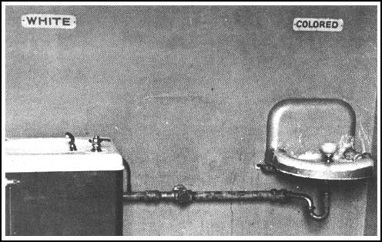
What was the name of the laws passed after the Civil War that created a system of segregation between blacks and whites in the South?
Jim Crow Laws

Slide 24
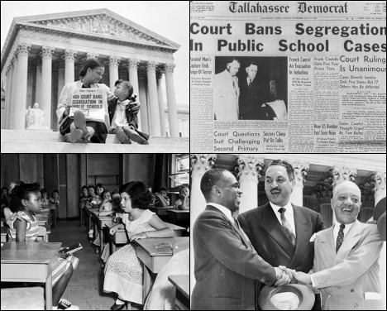
In the 1950s a famous Supreme Court case ended segregation. What was the name of this case?
Brown versus Board of Education

Slide 25
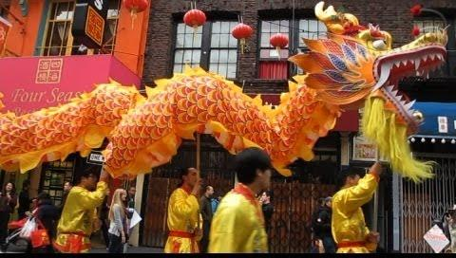
Which neighborhood in the US has the largest new Year Parade outside of Asia?
San Francisco Chinatown

Slide 26
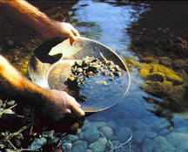
When was gold discovered in California?
1848

Slide 27
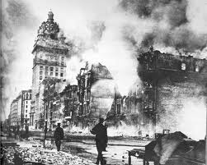
What happened in San Francisco in 1906?
The Great Earthquake and fire

Slide 28
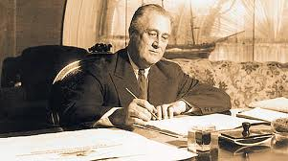
Who was president during the Great Depression in the 1930s?
Franklin Roosevelt

Slide 29
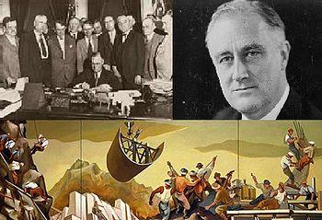
What was the name of the program President Roosevelt introduced during the Great Depression to build infrastructure and the economy?
The New Deal

Slide 30
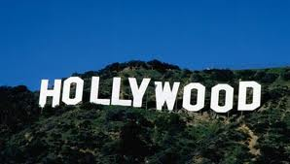
What American city is associated with the movie industry?
(Los Angeles)

Slide 31
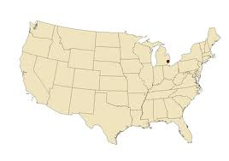
What American city is famous for the automobile industry?
Detroit

Slide 32
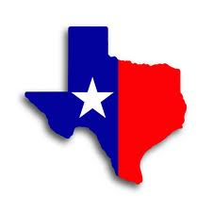
Which is the largest state in the continental United States?
Texas

Slide 33
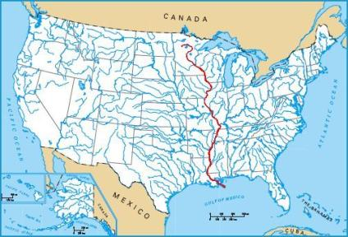
What is the longest river in the United States?
The Mississippi River

Slide 34
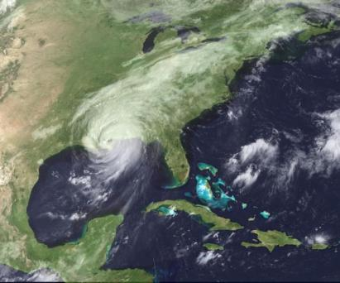
Which city in the United States was devastated by Hurricane Katrina?
New Orleans

Slide 35
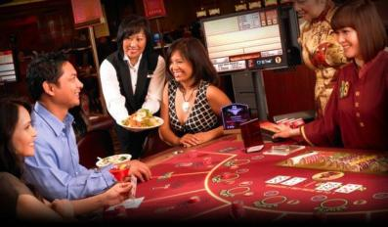
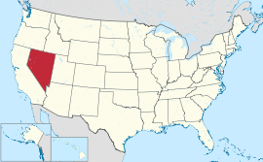
In which state is gambling legal?
Nevada

Slide 36
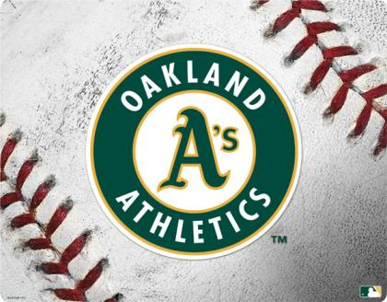
What is the name of Oakland’s professional baseball team?
the Oakland A’s

Slide 37
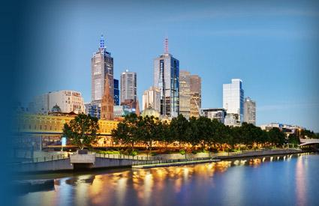
What is the capital of California?
Sacramento

Slide 38
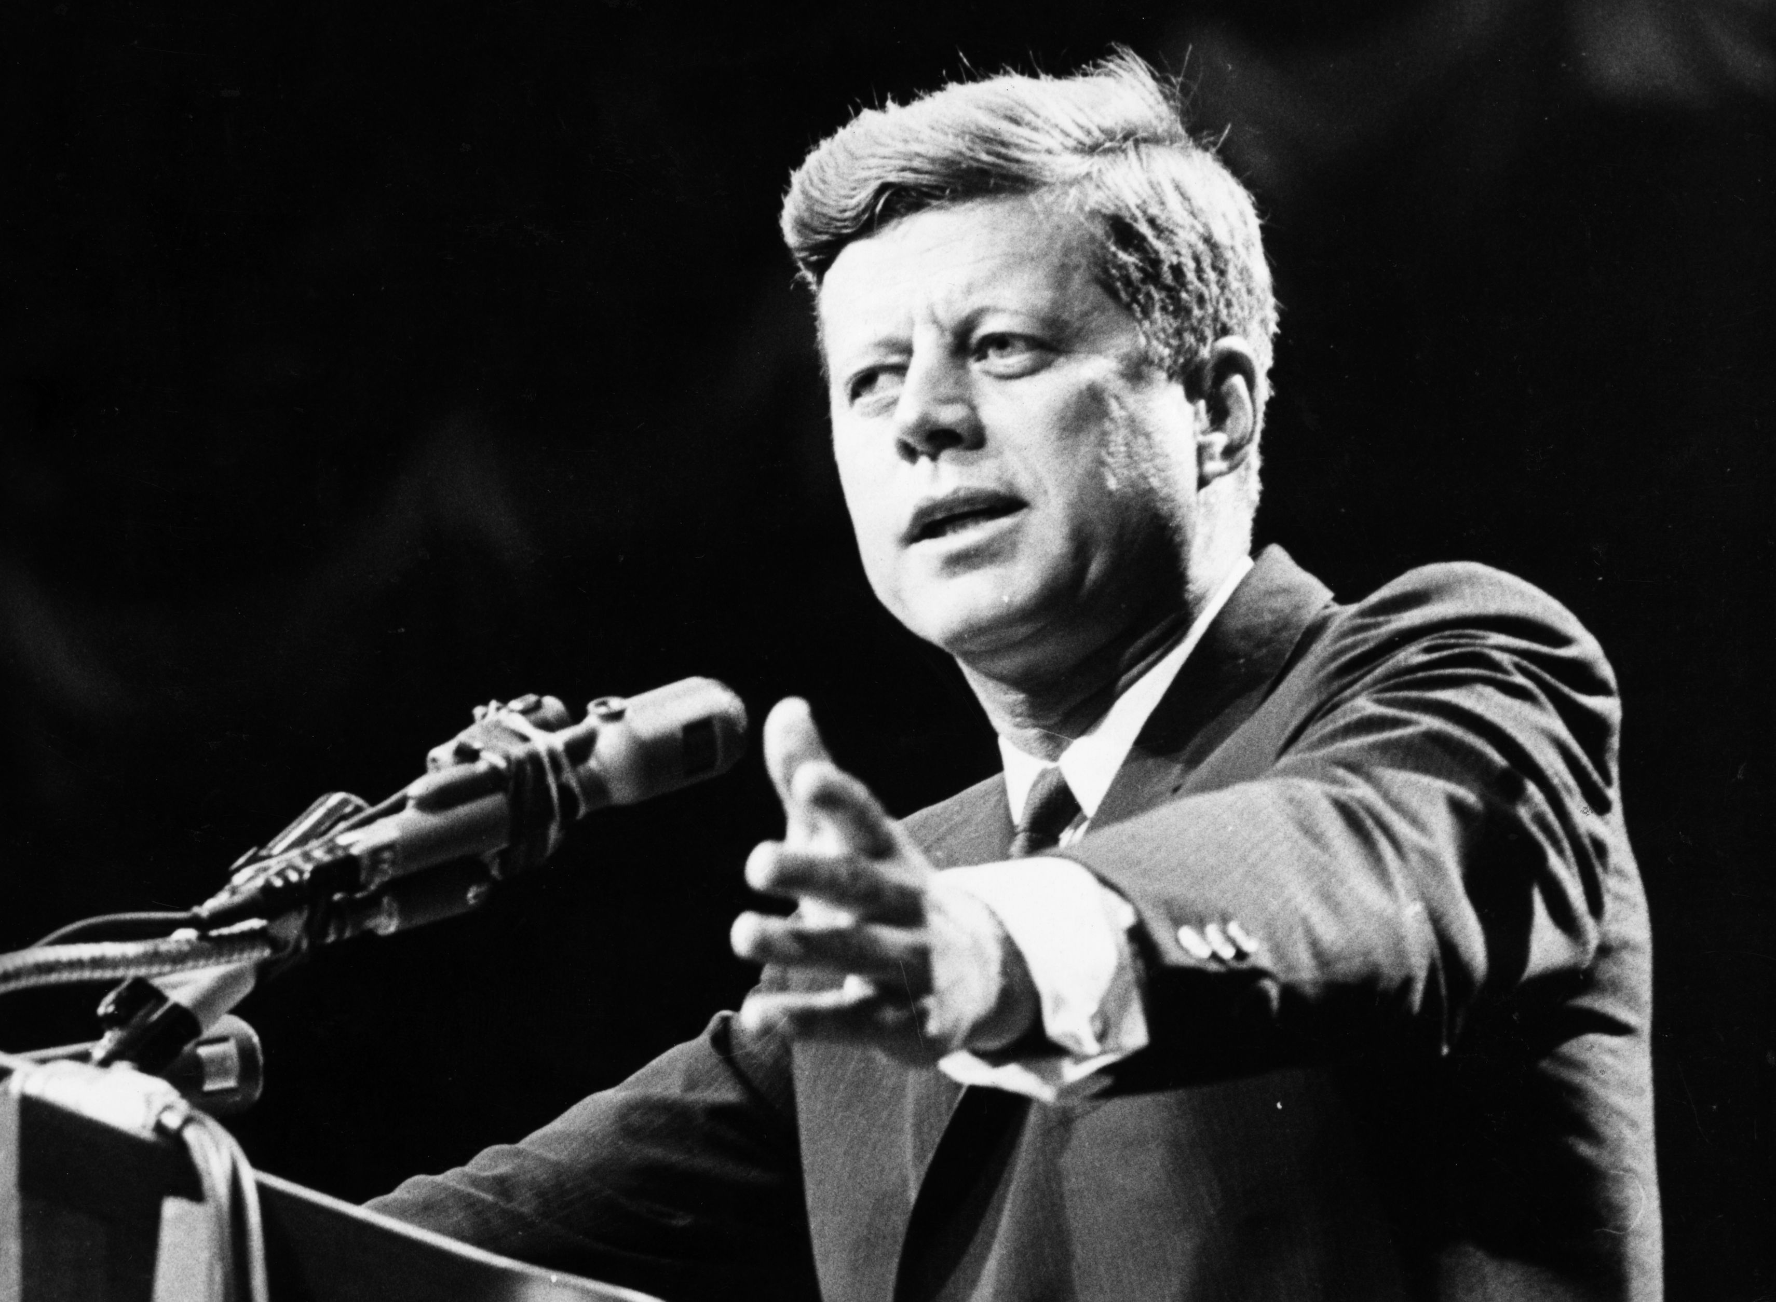
What American President was assassinated in 1963?
John F. Kennedy

Slide 39
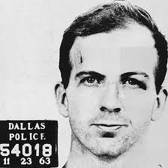
Who killed John F Kennedy?
Lee Harvey Oswald

Slide 40
How did Martin Luther King Jr. die?
He was assassinated in 1968

Slide 41
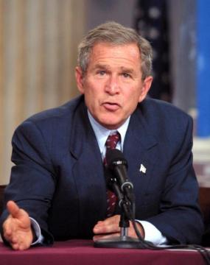
Who was president of the United States before Obama?
George W. Bush

Slide 42
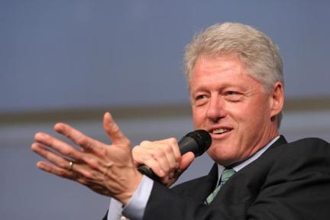
Who was president of the United States before George W. Bush?
Bill Clinton

Slide 43
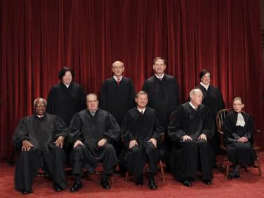
How many Supreme Court justices are there?
9

Slide 44
How long can a Supreme Court justice keep his/her job?
for life

Slide 45
Are immigrants eligible to run for president of the United States?
No. To be president you have to be born here.

Slide 46
Are judges to the Supreme Court elected or appointed?
They are appointed by the president.

Slide 47
Are immigrants eligible to run for governor or other offices?
Yes. (In fact the former governor of California was Arnold Schwarzenegger.)

Slide 48
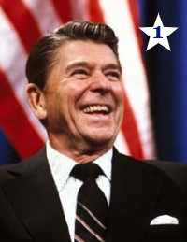
What former movie actor became president of the United States?
Ronald Reagan

Slide 49
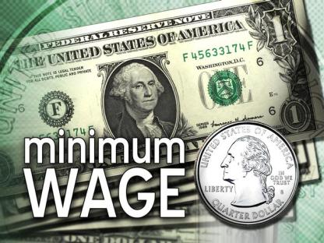
What do we call the lowest hourly rate of pay allowed by law?

Slide 50
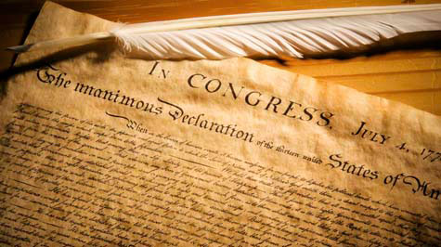
Who wrote the Declaration of Independence?
Thomas Jefferson

Slide 51
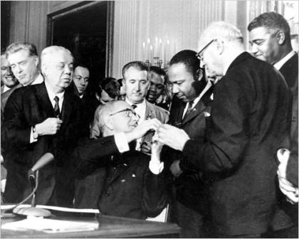
Which act in 1964 prohibited segregation in schools and public places and prohibited discrimination by employers?
The Civil Rights Act

Slide 52
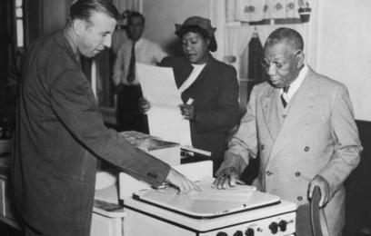
Which act in 1965 gave the federal government the power to make sure that African-Americans were allowed to vote in elections?
The Voting Rights Act

Slide 53
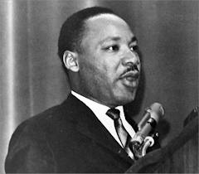
Who said the words, “… I have a dream my four little children will one day live in a nation where they will not be judged by the color of their skin but by the content of their character?”
Dr. Martin Luther King, Jr.

Slide 54
Which organization was established in 1961 to fight for equal rights for women?

Slide 55
What is the term used to describe policies and actions that help to reverse the effects of current and past discrimination?
Affirmative Action

Slide 56
What law passed in 1990 supports the rights of disabled people?

Slide 57
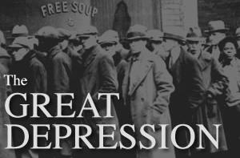
What is the name of the period in history (1929-1940) when economic activity slowed dramatically, prices fell, and people lost their jobs?

Slide 58
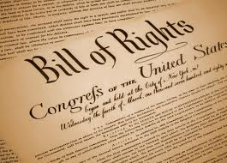
What do we call the first ten amendments to the constitution?
The Bill of Rights

Slide 59
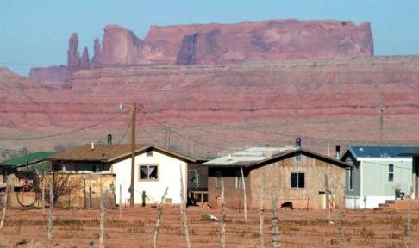
What is the name for the lands Native Americans were forced onto?
reservations

Slide 60
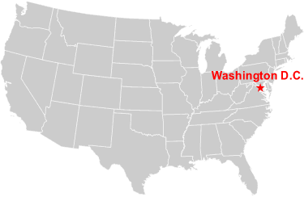
What is the capital of the United States?

Slide 61
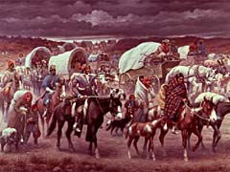
What was the name of the death march that killed 4,000 Cherokees in 1837?
The Trail of Tears

Slide 62
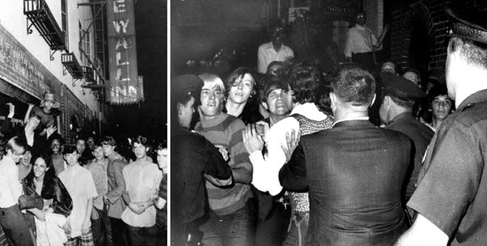
What was the name of the event that took place in New York in 1969 where gay people fought back against raiding police, inspiring the Gay Liberation Movement?
The Stonewall Riots

Slide 63
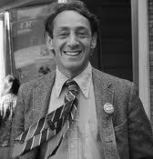
Who was the openly gay San Francisco City Supervisor who was murdered by Dan White in 1978?
Harvey Milk

Slide 64
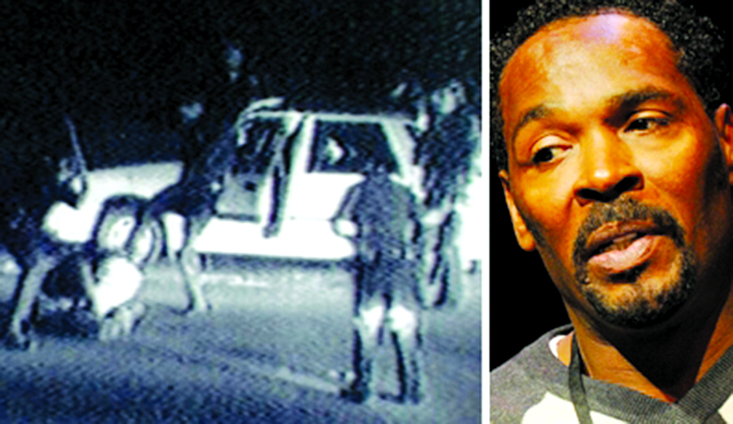
Who is the man whose videotaped beating by the Los Angeles Police Department during a traffic stop led to the LA Riots in 1991?
Rodney King

Slide 65
What famous student uprising began in the 1960s at UC Berkeley?
Free Speech Movement

Slide 66
What famous Oakland group, started at Merritt College, was important in the Black Power movement in the 1960s?
The Black Panther Party

Slide 67
Who was the first African American to play on a major league baseball team?
Jackie Robinson

Slide 68
Who was Leadbelly (1885-1949)?
A famous American blues singer

Slide 69
Who was Billie Holiday (1915-1959)?
A famous American jazz singer

Slide 70
What is the voting age for American citizens?
18

Slide 71
What is the legal drinking age for Americans?
21

Slide 72
When were the first fast-food restaurants opened in the US?
The 1940’s

Slide 73
What is the nickname of California?
The Golden State

Slide 74
What is the nickname of the state of New York?
The Empire State

Slide 75
What is the name of the American National Anthem?
The Star Spangled Banner

Slide 76
What is the motto of California?
Eureka (I have found it)

Slide 77
Name 3 Native American (Indian) tribes
(any 3) Sioux, Cherokee, Navajo, Ohlone, Apache, Blackfeet, Iroquois, Seminole

Slide 78
How many states are there in the United States?
50

Slide 79
How many senators are there in the United States?
100

Slide 80
What date is the birthday of the United States?
July 4, 1776

Slide 81
What was the name of the document that ended slavery?
The Emancipation Proclamation

Slide 82
What do the 13 stripes on the US flag represent?
The first 13 colonies (now states)

Slide 83
Name the ship on which The Pilgrims traveled to America.
The Mayflower

Slide 84
What is the youngest age the President of the United States can be?
35

Slide 85
In what month do American citizens vote for the President?
November

