Slide 1
Curriculum Review: planning ahead
Main Contributors
Curriculum Chair, Amy Bohorquez, Laney College
Curriculum Chair, Dylan Eret, Berkeley City College
Curriculum Chair, Robert Brem, College of Alameda
Curriculum Chair, Alexis Alexander, Merritt College
Peralta Colleges Curriculum Process

Slide 2
Where does all begin?

Slide 3
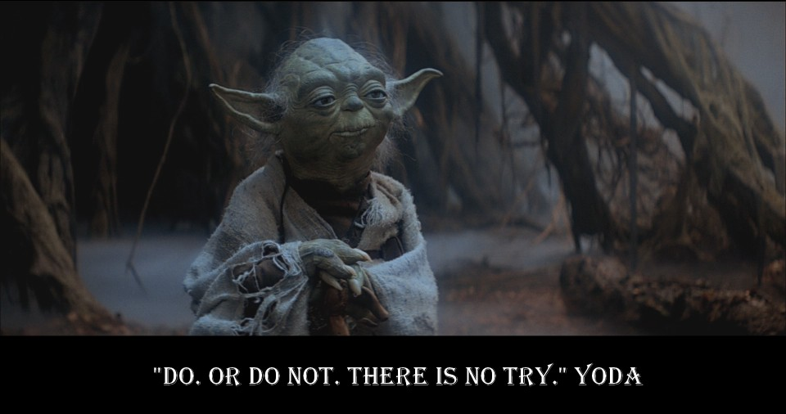
Your Department Chair

Slide 4
Who are your guides along the way?

Slide 5
Your Curriculum Chair (or Curricunet Superuser, Dylan Eret)

Slide 6
Your Articulation Officer (Joseph Bielanski)

Slide 7
Your Assessment Coordinator (Jenny Lowood)

Slide 8
Your Librarian (Joshua Boatright)

Slide 9
Your Faculty Colleagues (Locally and District-Wide)

Slide 10
Where does all this work end up?

Slide 11
Our Local Curriculum Committee

Slide 12
Council on Instruction, Planning, and Development (CIPD): Meets once a month

Slide 13
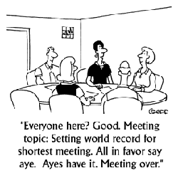
The Peralta Board of Trustees

Slide 14
The State Chancellor’s Office

Slide 15
BCC Curriculum Committee Schedule: Spring 2013 (subject to change)
BCC Curriculum Committee meetings will be held
in the TLC on the third floor from 10:00am – 12:00pm.
Deadlines to submit courses and programs within CurricUNET | BCC Curriculum Committee Meeting Times | CIPD MEETING DATE
Thursday, January 10, 2013 Thursday, January 24, 2013 | Thursday, January 24, 2013 Thursday, February 7, 2013 | February 4, 2013 March 4, 2013 (last meeting for new programs effective Summer/Fall 2013 to be approved)
Thursday, February 7, 2013 Thursday, February 21, 2013 | Thursday, February 21, 2013 Thursday, March 7, 2013 | April 1, 2013 (last meeting for items for 2013-2015 Catalog including changes/adjustments to programs to be presented)
Thursday, March 7, 2013 Thursday, March 21, 2013 Thursday, April 4, 2013 | Thursday, March 21, 2013 Thursday, April 4, 2013 Thursday, April 18, 2013 | April 22, 2013 May 6, 2013 (GE Subcommittee report due)
Thursday, April 18, 2013 | Thursday, May 2, 2013 | September 9, 2013
*Any curriculum reviewed must have been entered in the CurricUNET system several weeks prior to the meeting date and must have received the appropriate approvals within the system’s work flow. In other words, it should have reached the Curriculum Committee Chair step (after Tech Review).

Slide 16
CIPD Schedule 2012-2013
MEETING DATE | AGENDA MATERIALS DUE | AGENDA MATERIALS SENT
February 4, 2013 | January 22, 2013 | January 28, 2013
March 4, 2013 (last meeting for new programs effective Summer/Fall 2013 to be approved) | February 19, 2013 | February 25, 2013
April 1, 2013 (last meeting for items for 2013-2015 Catalog including changes/adjustments to programs to be presented) April 22, 2013 | March 18, 2013 April 9, 2013 | March 22, 2013 April 15, 2013
May 6, 2013 (GE Subcommittee report due) | April 22, 2013 | April 29, 2013
All meetings will be held in the District Office Board Room from 1:15 – 3:15 p.m.

Slide 17
Overview of Workshop
Curriculum Approval Process
Steps in Process
College Differences
Transfer Degrees
What? Why?
Course Outline of Record (COR)
Why Update?
Using CurricuNet, ASSIST and C-ID Websites
Contact Information

Slide 18
Curriculum Approval Process
Planning, Procedures, Process

Slide 19
Process for Approval
Local College Approval
Varies by campus
Council on Instruction, Planning and Development
New courses and programs
Changes to existing courses and programs
Board of Trustees
All courses & programs to go to CIPD
State Chancellor’s Office
Course – gets a code
Programs – gets final approval

Slide 20
Ex: Berkeley City College (Workflow)
Joshua Boatright

Slide 21
Ex: Berkeley City College (Workflow)
Jenny Lowood
Joseph Bielanski

Slide 22
Ex: Berkeley City College (Workflow)
Dylan Eret
Jenny Lowood
Johnny Dong

Slide 23
Ex: Berkeley City College (Workflow)
Dylan Eret
Sheryl Queen

Slide 24
What is CIPD?
Role of CIPD
Voting Members (by college)
To advise the district in academic areas and related planning
To provide a leadership role in program development
To review college curriculum additions, deletions, or modifications
submit them to the Chancellor and subsequently to the Board of Trustees for approval.
College Curriculum Committee Chair
Articulation Officer
Faculty Senate appointees

Slide 25
What Goes to CIPD?
CIPD - YES
CIPD - NO
Anything that changes the catalog!
Department name and/or abbreviation
Course number
Course title
Course description
Pre/co-requisite, including recommended preparation
Hours for lecture and/or laboratory
Grading basis
DE Addendum
Info only
Needs to be added to schedule
Only needs college curriculum committee approval if:
Fee Based Courses
Doesn’t change catalog
Textbook Updates
Modifying lecture/lab content
Updating objectives
Adding SLOs

Slide 26
Uniform Course Numbering System
UCN | Explanation
001-199 | Credit, transfer, degree applicable liberal arts and vocational courses including Selected Topics for liberal arts and vocational disciplines (48s) (degree credit courses in approved programs)
200-249 | Credit, non-transfer, degree applicable courses including Selected Topics for liberal arts and vocational disciplines (248s)
250-299 | Credit, non-transfer, non-degree applicable courses (non-degree credit courses that require either state approval or approval under delegated approval authority)
300-301 | Credit, non-transfer, non-degree applicable Selected Topics laboratory courses
302-399 | Credit, non-transfer, non-degree applicable Selected Topics courses (non-degree credit courses)

Slide 27
Uniform Course Numbering System
UCN | Explanation
400-499 | Credit Apprenticeship and Cooperative Education/Work Experience Education courses
500-599 | Non-credit, general, apprenticeship and older adult courses
600-699 | Non-credit, courses specific for the disabled (non-credit courses that require state approval)
700-799 | Not-for-credit (fee based) courses for contracted education
800-899 | Community Services (fee-based) courses
1000-9999 | Professional Development (PRDEV) courses for faculty and staff (0 unit, non-FTES courses)

Slide 28
Consultation is required if…
Offering a new course, making a substantive change to an existing course, or course reinstatement when it is similar to any course offered at another college.
Substantive change to existing UCN course
New single course which overlaps courses offered as part of an approved program at another college
New programs (certificates or degrees) or substantive changes to programs which are similar to any other program or contains similar courses offered at other colleges (whether or not these programs are in the same discipline)
Borrowing a course

Slide 29
Consultation Procedures
Consultation among colleges regarding curriculum issues is necessary to ensure:
program integrity
appropriate use of district resources
program delivery to students in convenient locations
adequate enrollment in all programs at all colleges

Slide 30
Good Faith Effort
College representatives must contact by email (or by phone with a follow up email) the appropriate dean and department chair at all affected colleges.
Curriculum committee chair should be copied on this email as well.
If a regular district wide discipline meeting is part of the ongoing curriculum process in this discipline, the membership of that group will also be consulted.
All consultations should be completed within 2 weeks of the initial email.
If there are unresolved disputes related to the valid curricular reasons outlined in the introductory paragraph to these procedures, the issues will be discussed and resolved at CIPD.

Slide 31
Planning Ahead
Plan a year in advance
Program Review Year is a good time to look ahead
Ensure you have enough time for your goal
If your goal is Fall 2013, it should be in submitted for approval now
Check CIPD website for dates
Or college website if available
Make sure you are leaving enough time for approval process

Slide 32
Transfer Degrees – SB1440
What are they?
Why are we doing them?

Slide 33
SB1440 – Bill Language
SB 1440 establishes the Student Transfer Achievement Reform (STAR) Act. SB 1440 requires a community college district to grant an associate degree for transfer to a student in that student’s field of study once a student has met degree and transfer requirements for a particular major.

Slide 34
SB1440 – Bill Language
Upon completion of the transfer associate degree, the student is eligible for transfer with junior standing into the California State University (CSU) system.

Slide 35
SB1440 – Bill Language
Students will be given priority consideration when applying to a particular program that is similar to the student’s community college area of emphasis.

Slide 36
SB1440 – Bill Language
The bill prohibits a community college district or campus from adding local course requirements in addition to requirements of the STAR Act, and prohibits the CSU from requiring a transferring student to repeat courses similar to those taken at the community college that counted toward their associate degree for transfer.

Slide 37
AA-Ts & AS-Ts - Why create them?
Increase students’ ability to transfer to a local CSU
Increase students’ ability to finish a 4-year degree in 4 years
Helps ensure our students have the background they need to be successful
Both CSUs and UCs will consider these degrees as part of their admission decision

Slide 38
What Disciplines Are Eligible?
Finalized TMCs
Administration of Justice
Art History
Business Administration
Communication Studies
Early Childhood Education (ECE)
Elementary Education
English
Geography
Geology
History
Journalism
Kinesiology
Mathematics
Music
Psychology
Physics
Political Science
Sociology
Studio Arts
Theatre

Slide 39
New Transfer Degrees Completed at BCC
Finalized TMCs
English
Mathematics
Psychology
Sociology

Slide 40
New Transfer Degrees in Process at BCC (Goal: Fall 2012 CIPD)
Finalized TMCs
Art History
Studio Arts
Business Administration
Elementary Education
History
Political Science

Slide 41
Degrees that are almost ready…
Vetting Closed
In the queue
Anthropology
Chemistry
Computer Science
Biology
Philosophy
Spanish
Radio/TV/Film
Social Work

Slide 42
Making Sure We are Ready!
Transfer Degrees:
AA-T
AS-T
Make sure your CORs are updated
Updated within 3-5 years
Check with C-ID website for matching description, content
Current textbooks
Need to ensure this process is Faculty DRIVEN!

Slide 43
Course Outline of Record (COR)
Why update?
How often?
What tools will help?

Slide 44
Course Outline of Record (COR)
Legal document of what we are teaching
Has to be available to public
Students can ask for a copy
Needs to be current for Articulation to CSU/UC
Available to Everyone via CurricuNet

Slide 45
What does the COR have to include?
Basics for Catalog
Title, Course Number, Date, Hours, Grading Policy
Description, Pre-req/Co-reqs if any
Transfer Status
Textbooks
Can list more than one (choices)
Need to be current unless historical (literature)
Course Objectives
Course Content that relates to objectives
Need percentage of time spent on topics
Need detail for Articulation
Student Learning Outcomes
Required for all courses and programs

Slide 46
Using ASSIST.org
When faculty choose to propose a course that is for CSU-GE Breadth, IGETC or major requirements or want to update their outlines, they can search other CA community colleges to locate outlines.

Slide 47
Using ASSIST.org
Where do you find this information?
Use Firefox, Internet Explorer, or Google Chrome
as your web browser.
Safari does not show menus
Start with Web site: http://www2.assist.org/maint/login.jsp
Type Username: berkeleyfac
Type Password: tumbleweed

Slide 48
Using ASSIST. org
How to do you search for a course?
On left menu bar click on Course Search
Under “institutions” select and click on
All Community College Campuses
Enter your course in the box that says,
“Search in the course title” (e.g., type “Shakespeare”)

Slide 49
Using ASSIST. org
How do you search for a course?
Optional to type minimum and maximum units
Scroll down, click on Continue
To view outline, click on .pdf document.
Remember to “Log Off” when finished.

Slide 50
Using ASSIST. org
How do you search for a course?
Some outlines have not been submitted electronically;
Your Articulation Officer can request them from a particular community college, or even a CurricUNET participant.
To view General Education Areas for IGETC and CSU-GE, click on the appropriate bubbles during the search process.

Slide 51
C-ID Courses – c-id.net
The California Community College (CCC) courses on this list have been approved by the C-ID program and given a C-ID designation:
Courses with this C-ID designation will articulate with any other CCC course with the same designation for course content credit.
Any separate General Education (GE) designation a course may have is not connected to the C-ID designation and should not be assumed.
C-ID designation cannot be used as justification for GE certification.
A course with a C-ID course designation will articulate to four-year universities that have approved articulation with that C-ID designation.

Slide 52
C-ID Courses
CCC C-ID designations adopted by private institutions may not be used as justification for credit from private institutions to 2 or 4 year institutions participating in the C-ID process.

Slide 53
CurricuNet
Why it’s helpful
How to use it
How to get there – www.curricunet.com/pccd

Slide 54
CurricuNet can…
Help you track where your course is in the process
Don’t have to email us to ask
Compare with outlines from other colleges in district
Look at changes if consultation is needed
Store previous versions of outlines
Only one/group person can work an outline at a time
Store deactivated courses
in case you want to reactivate

Slide 55
Examples
Practice with CurricuNet

Slide 56
Contact Information
Curriculum Chairs
Articulation Officers
Department Chairs*
Deans*
*Consult your local campus or curriculum chairs.

Slide 57
Curriculum Chairs
Robert Brem, College of Alameda, rbrem@peralta.edu
Dylan Eret, Berkeley City College, deret@peralta,edu
Amy Bohorquez, Laney College, abohorquez@peralta.edu
Alexis Alexander, Merritt College, aalexander@peralta.edu

Slide 58
Articulation Officers
Sheila Lau, College of Alameda, slau@peralta.edu
Joseph Bielanski, Berkeley City College, jbielanski@peralta,edu
Laura Bollentino, Laney College, lbollentino@peralta.edu
Steven Pantell, Merritt College, spantell@peralta.edu

Slide 59
Key Resources
Program and Course Approval Handbook (New 2012 Edition!)
Downloadable via State Chancellor’s website
Helps provide general guidelines and instructions for the submission of curriculum for approval
http://extranet.cccco.edu/Portals/1/AA/ProgramCourseApproval/PCAH_Final_July2012.pdf
The Course Outline of Record: A Curriculum Reference Guide
Helps you create a thorough course outline according to state standards
http://asccc.org/sites/default/files/Curriculum-paper.pdf
ASSIST.org
Helps you look up other course outlines across different college campuses
http://www2.assist.org/maint/login.jsp
username: berkeleyfac, password: tumbleweed
C-ID Website
Helps you build new transfer degree programs (AA-T and AS-T)
http://c-id.net
CurricUNET
Helps you create a specific course outline at your local campus
http://curricunet.com/pccd

